Slide 1

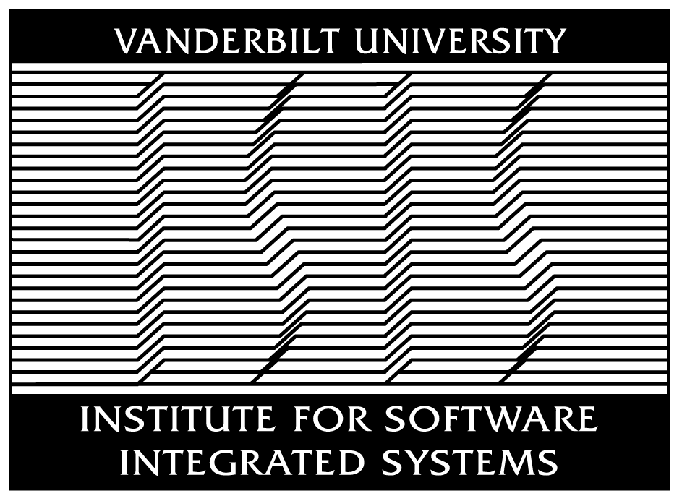

Patterns, Frameworks, & Middleware:
Their Synergistic Relationships
Douglas C. Schmidt
d.schmidt@vanderbilt.edu
Professor of EECS
Vanderbilt University
Nashville, Tennessee

Slide 2
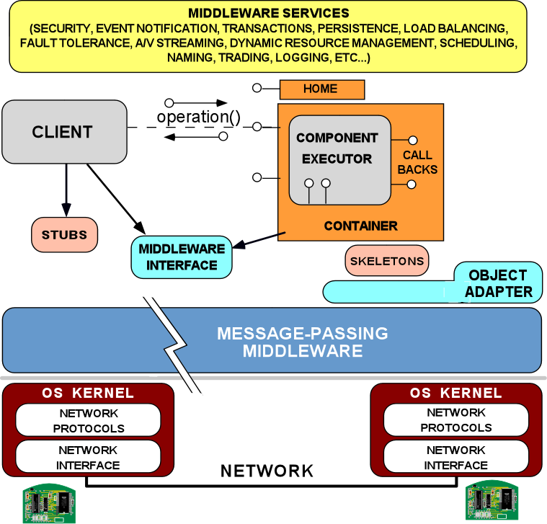


Technology Trends (1/3)
Information technology is being commoditized
  i.e., hardware & software are getting cheaper, faster, & (generally) better at a fairly predictable rate
These advances stem largely from standard hardware & software APIs & protocols, e.g.:
  Intel x86 & Power PC chipsets
  TCP/IP, GSM, Link16
  POSIX, Windows, & VMs
  Middleware & component models
  Quality of service (QoS) aspects

Slide 3
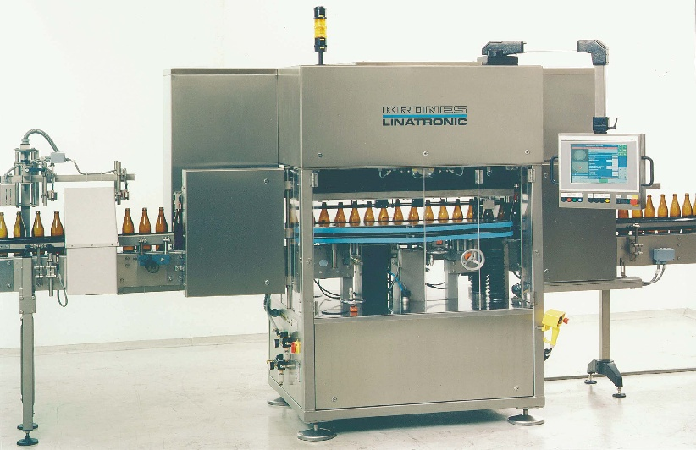
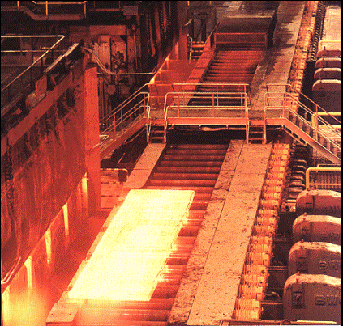
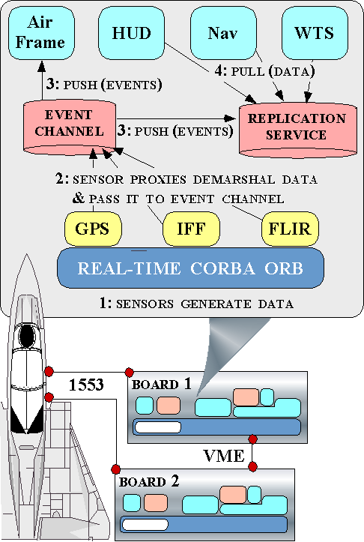
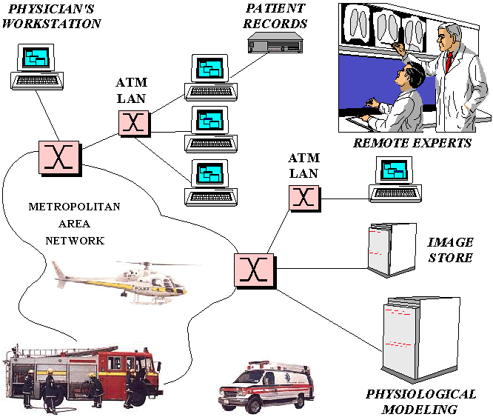
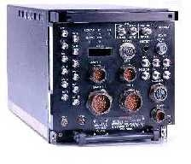
Technology Trends (2/3)
Growing acceptance of a network-centric component paradigm
  i.e., distributed applications with a range of QoS needs are constructed by integrating components & frameworks via various communication mechanisms
Avionics Mission Computing
Process Automation Quality Control
Hot Rolling Mills
Electronic Medical Imaging
Software Defined Radio
Modalities
e.g., MRI, CT, CR, Ultrasound, etc.

Slide 4
Technology Trends (3/3)
Component middleware is maturing & becoming pervasive
…
Components encapsulate application “business” logic
Components interact via ports
  Provided interfaces, e.g.,facets
  Required connection points, e.g., receptacles
  Event sinks & sources
  Attributes
Containers provide execution environment for components with common operating requirements
Components/containers can also
  Communicate via a middleware bus and
  Reuse common middleware services
…
…
…
Container
Container
Middleware Bus
Replication
Security
Persistence
Notification
A/V Streaming
Scheduling
Load Balancing

Slide 5
The Evolution of Middleware
Historically, mission-critical apps were built directly atop hardware
Applications
& OS
Domain-Specific
Services
Tedious, error-prone, & costly over lifecycles
Common
Middleware Services
There are layers of middleware, just like there are layers of networking protocols
Distribution
Middleware
Standards-based COTS middleware helps:
  Control end-to-end resources & QoS
  Leverage hardware & software technology advances
  Evolve to new environments & requirements
  Provide a wide array of reuseable, off-the-shelf developer-oriented services
Host Infrastructure
Middleware
Operating Systems
& Protocols
Hardware
There are multiple COTS middleware layers & research/business opportunities
Notes:
Definitions of the Middleware Layers
Infrastructure middleware. This layer encapsulates core OS communication and concurrency services to eliminate many tedious, error-prone, and non-portable aspects of developing and maintaining distributed applications using low-level network programming mechanisms, such as sockets. Widely-used examples of infrastructure middleware include the Java Virtual Machine (JVM) and the ADAPTIVE Communication Environment (ACE).
Distribution middleware. This layer builds upon the lower-level infrastructure middleware to automate common network programming tasks, such as parameter marshaling/demarshaling, socket and request demultiplexing, and fault detection/recovery. Common examples of distribution middleware include the Object Management Group's (OMG's) Common Object Request Broker Architecture (CORBA), Microsoft's Distributed COM (DCOM), and JavaSoft's Remote Method Invocation (RMI).
Common middleware services. This layer augments the distribution middleware by defining domain-independent services, such as event notifications, logging, multimedia streaming, persistence, security, transactions, fault tolerance, and distributed concurrency control. Applications can reuse these services to perform common distribution tasks that would otherwise be implemented manually.
Domain-specific Services. This layer is tailored to the requirements of particular domains, such as telecommunications, e-commerce, health-care, or process automation. Unlike the other three OO middleware layers, domain-specific services are not as generally reusable, and thus are the least mature of the middleware layers today. Since they embody domain-specific knowledge, however, they have the most potential to increase system quality and decrease the cycle-time and effort required to develop particular types of networked applications.

Slide 6







Operating System & Protocols
Operating systems & protocols provide mechanisms to manage endsystem resources, e.g.,
  CPU scheduling & dispatching
  Virtual memory management
  Secondary storage, persistence, & file systems
  Local & remove interprocess communication (IPC)
OS examples
  UNIX/Linux, Windows, VxWorks, QNX, etc.
Protocol examples
  TCP, UDP, IP, SCTP, RTP, etc.
INTERNETWORKING ARCH
MIDDLEWARE ARCH
RTP
TFTP
FTP
HTTP
Middleware
Applications
DNS
TELNET
Middleware
Services
UDP
TCP
IP
Middleware
Fibre Channel
Solaris
VxWorks
Ethernet
ATM
FDDI
Win2K
Linux
LynxOS
20th Century
21st Century

Slide 7
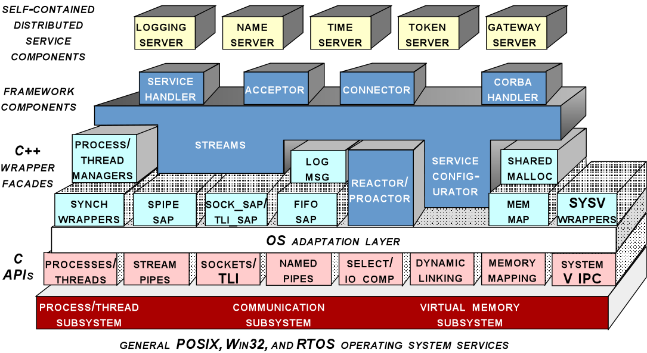
Host Infrastructure Middleware
Host infrastructure middleware encapsulates & enhances native OS mechanisms to create reusable network programming components
  These components abstract away many tedious & error-prone aspects of low-level OS APIs
Domain-Specific
Services
Common
Middleware Services
Distribution
Middleware
Examples
  Java Virtual Machine (JVM), Common Language Runtime (CLR), ADAPTIVE Communication Environment (ACE)
Host Infrastructure
Middleware
Asynchronous
Event Handling
Asynchronous
Transfer of
Control
Physical
Memory
Access
Synchronization
Memory
Management
Scheduling
www.rtj.org
www.cs.wustl.edu/~schmidt/ACE.html

Slide 8
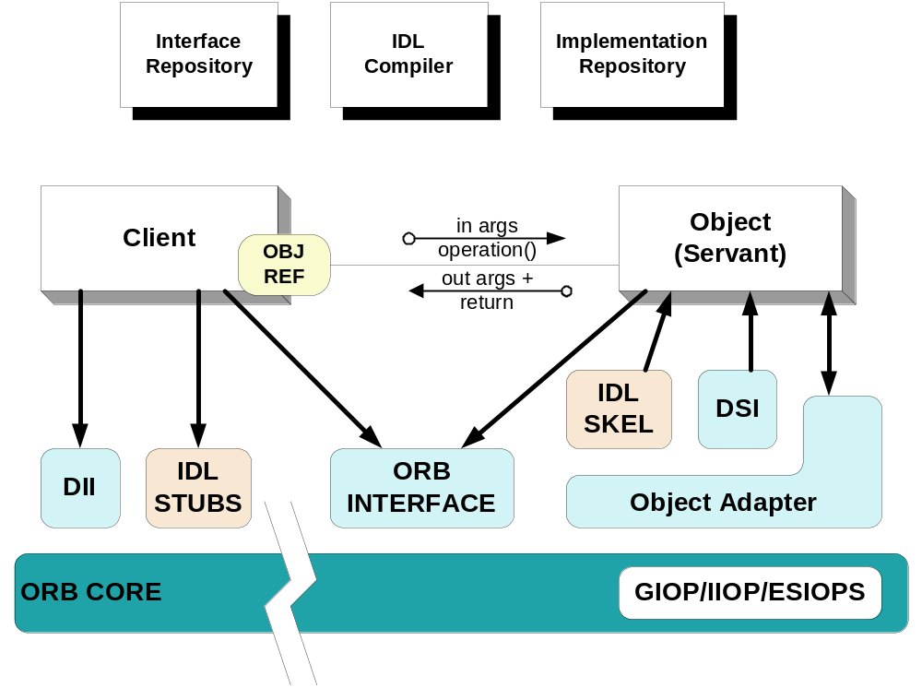
Distribution Middleware
Distribution middleware defines higher-level distributed programming models whose reusable APIs & components automate & extend native OS capabilities
Domain-Specific
Services
Common
Middleware Services
Examples
  OMG CORBA, Sun’s Remote Method Invocation (RMI), Microsoft’s Distributed Component Object Model (DCOM)
Distribution
Middleware
Host Infrastructure
Middleware
Distribution middleware avoids hard-coding client & server application dependencies on object location, language, OS, protocols, & hardware

Slide 9
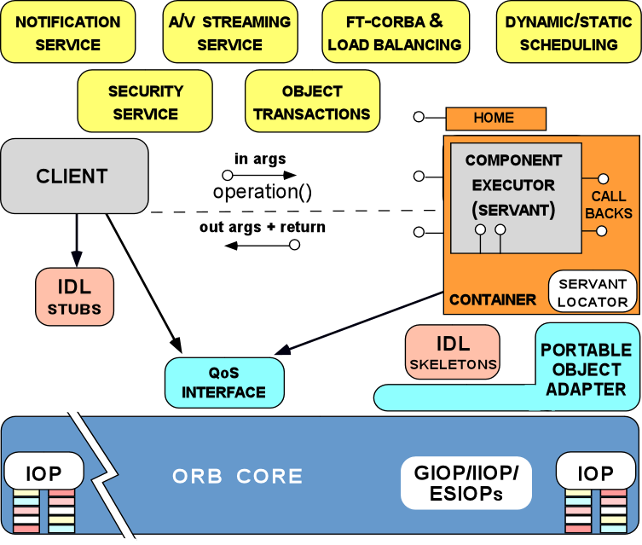
Common Middleware Services
Common middleware services augment distribution middleware by defining higher-level domain-independent services that focus on programming “business logic”
Domain-Specific
Services
Common
Middleware Services
Examples
  CORBA Component Model & Object Services, Sun’s J2EE, Microsoft’s .NET
Distribution
Middleware
Host Infrastructure
Middleware
Common middleware services support many recurring distributed system capabilities, e.g.,
  Transactional behavior
  Authentication & authorization,
  Database connection pooling & concurrency control
  Active replication
  Dynamic resource management

Slide 10
Domain-Specific Middleware
Domain-specific middleware services are tailored to the requirements of particular domains, such as telecom, e-commerce, health care, process automation, or aerospace
Domain-Specific
Services
Common
Middleware Services
Examples
Distribution
Middleware
Siemens MED Syngo
Common software platform for distributed electronic medical systems
Used by all ~13 Siemens MED business units worldwide
Host Infrastructure
Middleware
Boeing Bold Stroke
  Common software platform for Boeing avionics mission computing systems
Modalities
e.g., MRI, CT, CR, Ultrasound, etc.

Slide 11
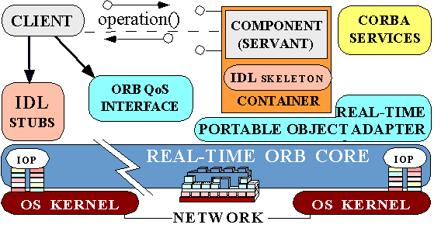
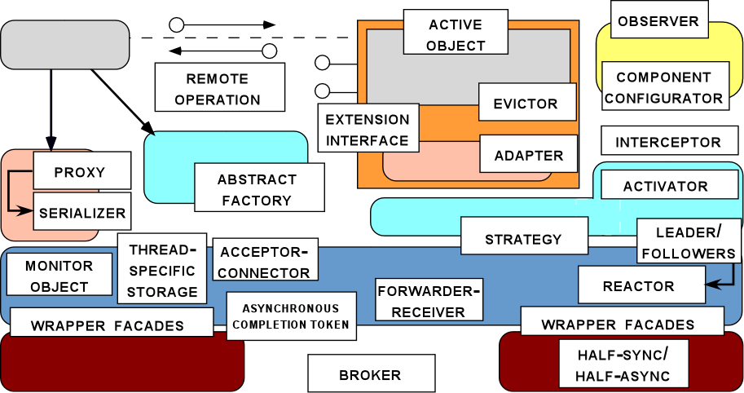
Why We are Succeeding
The past decade has yielded significant progress in QoS-enabled middleware, stemming in large part from the following trends:
  Years of iteration, refinement, & successful use
  The maturation of middleware standards
  The maturation of component middleware frameworks & patterns
Real-time CCM
Web Services
Applications
CORBA Component
Model (CCM)
Domain-Specific
Services
Common
Services
Component
Models (EJB)
Distribution
Middleware
Real-time
CORBA
Host Infrastructure
Middleware
CORBA & DCOM
Operating Systems
& Protocols
DCE
Hardware
Micro-kernels
RPC
NET, J2EE, CCM
Real-time CORBA
Real-time Java
SOAP & Web Services
ARPAnet
1970
Year
2005

Slide 12

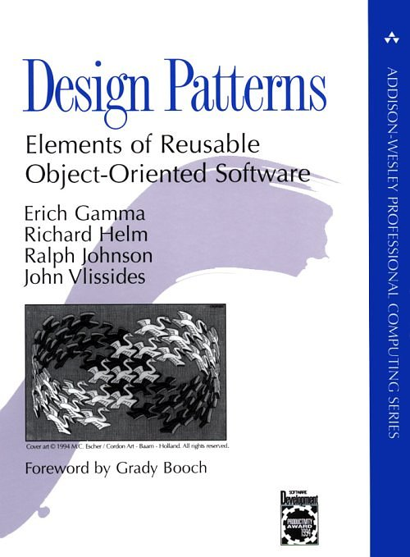
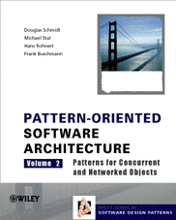
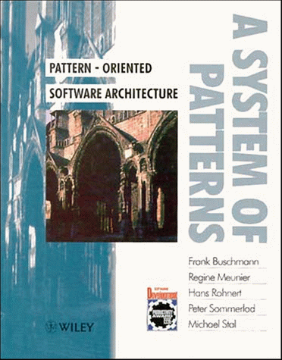
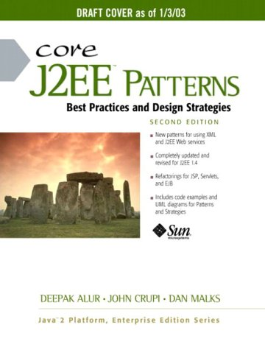
Overview of Patterns
Present solutions to common software problems arising within a certain context
Help resolve key software design forces
  Flexibility
  Extensibility
  Dependability
  Predictability
  Scalability
  Efficiency
Capture recurring structures & dynamics among software participants to facilitate reuse of successful designs
Generally codify expert knowledge of design strategies, constraints & “best practices”
AbstractService
service
Client
Proxy
Service
service
1
1
service
The Proxy Pattern

Slide 13
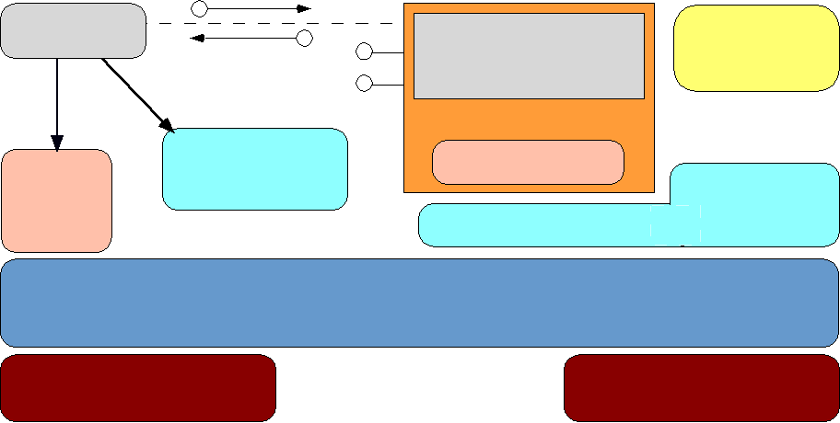
Overview of Pattern Languages
Motivation
Individual patterns & pattern catalogs are insufficient
Software modeling methods & tools largely just illustrate how – not why – systems are designed
Benefits of Pattern Languages
Define a vocabulary for talking about software development problems
Provide a process for the orderly resolution of these problems
Help to generate & reuse software architectures

Slide 14
Taxonomy of Patterns & Idioms
Type | Description | Examples
Idioms | Restricted to a particular language, system, or tool | Scoped locking
Design patterns | Capture the static & dynamic roles & relationships in solutions that occur repeatedly | Active Object, Bridge, Proxy, Wrapper Façade, & Visitor
Architectural patterns | Express a fundamental structural organization for software systems that provide a set of predefined subsystems, specify their relationships, & include the rules and guidelines for organizing the relationships between them | Half-Sync/Half-Async, Layers, Proactor, Publisher-Subscriber, & Reactor
Optimization principle patterns | Document rules for avoiding common design & implementation mistakes that degrade performance | Optimize for common case, pass information between layers

Slide 15
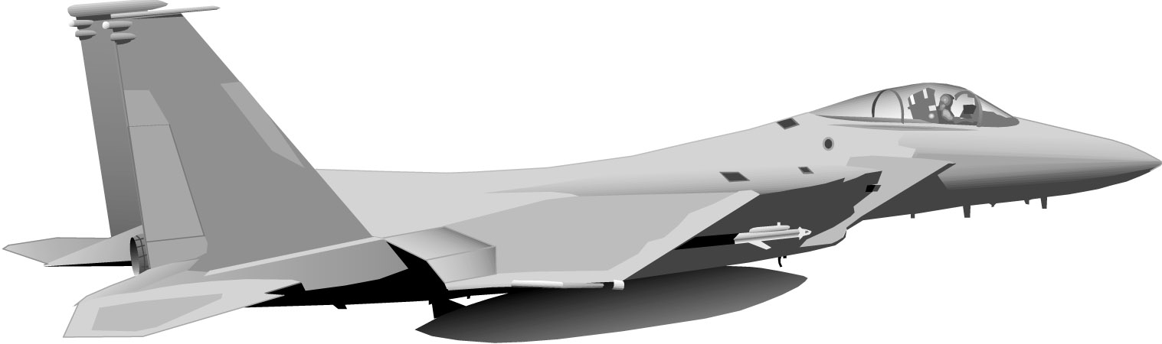
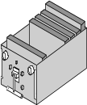
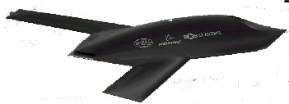
Example: Boeing Bold Stroke
Nav Sensors
Vehicle
Mgmt
Mission
Computer
Data Links
Weapon
Management
Radar
Weapons
Bold
Stroke Architecture
Mission Computing Services
Middleware Infrastructure
Operating System
Networking Interfaces
Hardware (CPU, Memory, I/O)
Avionics mission computing product-line architecture for Boeing military aircraft, e.g., F-18 E/F, 15E, Harrier, UCAV
DRE system with 100+ developers, 3,000+ software components, 3-5 million lines of C++ code
Based on COTS hardware, networks, operating systems, & middleware
Used as Open Experimention Platform (OEP) for DARPA IXO PCES, MoBIES, SEC, MICA programs

Slide 16
Example: Boeing Bold Stroke
Mission Computing Services
Middleware Infrastructure
Operating System
Networking Interfaces
Hardware (CPU, Memory, I/O)
COTS & Standards-based Middleware Infrastructure, OS, Network, & Hardware Platform
  Real-time CORBA middleware services
  VxWorks operating system
  VME, 1553, & Link16
  PowerPC

Slide 17
Example: Boeing Bold Stroke
Reusable Object-Oriented Application Domain-specific Middleware Framework
  Configurable to variable infrastructure configurations
  Supports systematic reuse of mission computing functionality
Mission Computing Services
Middleware Infrastructure
Operating System
Networking Interfaces
Hardware (CPU, Memory, I/O)

Slide 18
Example: Boeing Bold Stroke
Product Line Component Model
Configurable for product-specific functionality & execution environment
Single component development policies
Standard component packaging mechanisms
Mission Computing Services
Middleware Infrastructure
Operating System
Networking Interfaces
Hardware (CPU, Memory, I/O)

Slide 19
Example: Boeing Bold Stroke
Mission Computing Services
Middleware Infrastructure
Operating System
Networking Interfaces
Hardware (CPU, Memory, I/O)
Operator
Component Integration Model
  Configurable for product-specific component assembly & deployment environments
  Model-based component integration policies
Push Control Flow
Real World Model
Pull Data Flow
Avionics Interfaces
Infrastructure Services

Slide 20
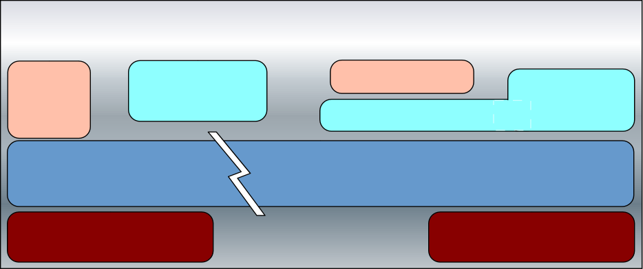
Legacy Avionics Architectures
Key System Characteristics
  Hard & soft real-time deadlines
    ~20-40 Hz
  Low latency & jitter between boards
    ~100 usecs
  Periodic & aperiodic processing
  Complex dependencies
  Continuous platform upgrades
4: Mission
functions
perform
avionics
operations
Avionics Mission Computing Functions
  Weapons targeting systems (WTS)
  Airframe & navigation (Nav)
  Sensor control (GPS, IFF, FLIR)
  Heads-up display (HUD)
  Auto-pilot (AP)
3: Sensor
proxies
process data
& pass to
missions
functions
2: I/O via
interrupts
1: Sensors
generate
data
Board 1
1553
VME
Board 2

Slide 21

Legacy Avionics Architectures
Key System Characteristics
  Hard & soft real-time deadlines
    ~20-40 Hz
  Low latency & jitter between boards
    ~100 usecs
  Periodic & aperiodic processing
  Complex dependencies
  Continuous platform upgrades
4: Mission
functions
perform
avionics
operations
Air
Frame
Nav
WTS
AP
FLIR
GPS
IFF
3: Sensor
proxies
process data
& pass to
missions
functions
Limitations with Legacy Avionics Architectures
  Stovepiped
  Proprietary
  Expensive
  Vulnerable
  Tightly coupled
  Hard to schedule
  Brittle & non-adaptive
Cyclic
Exec
2: I/O via
interrupts
1: Sensors
generate
data
Board 1
1553
VME
Board 2

Slide 22
Decoupling Avionics Components
Context | Problems | Solution
I/O driven DRE application Complex dependencies Real-time constraints | Tightly coupled components Hard to schedule Expensive to evolve | Apply the Publisher-Subscriber architectural pattern to distribute periodic, I/O-driven data from a single point of source to a collection of consumers
Structure
Dynamics
Publisher
Event Channel
Subscriber
: Publisher
: Event Channel
: Subscriber
attachPublisher
detachPublisher
attachSubscriber
detachSubscriber
pushEvent
attachSubscriber
produce
consume
produce
: Event
pushEvent
event
pushEvent
creates
receives
event
*
consume
Event
Filter
filterEvent
detachSubscriber

Slide 23
Applying the Publisher-Subscriber Pattern to Bold Stroke
Bold Stroke uses the Publisher-Subscriber pattern to decouple sensor processing from mission computing operations
  Anonymous publisher & subscriber relationships
  Group communication
  Asynchrony
5: Subscribers
perform
avionics
operations
Subscribers
HUD
WTS
Air Frame
Nav
push(event)
4: Event Channel
pushes events
to
subscribers(s)
Event Channel
push(event)
3: Sensor
publishers
push events
to event
channel
Considerations for implementing the Publisher-Subscriber pattern for mission computing applications include:
  Event notification model
    Push control vs. pull data interactions
  Scheduling & synchronization strategies
    e.g., priority-based dispatching & preemption
  Event dependency management
    e.g.,filtering & correlation mechanisms
GPS
IFF
FLIR
Publishers
2: I/O via interrupts
Board 1
1: Sensors
generate
data
1553
VME
Board 2

Slide 24
Ensuring Platform-neutral & Network-transparent Communication
Context | Problems | Solution
Mission computing requires remote IPC Stringent DRE requirements | Applications need capabilities to: Support remote communication Provide location transparency Handle faults Manage end-to-end QoS Encapsulate low-level system details | Apply the Broker architectural pattern to provide platform-neutral communication between mission computing boards
Client Proxy
Server Proxy
marshal
unmarhal
receive_result
service_p
Structure
marshal
unmarshal
dispatch
receive_request
*
1
Broker
1
*
calls
message exchange
main_loop
srv_registration
srv_lookup
xmit_message
manage_QoS
message exchange
*
calls
*
1
1
Server
Client
start_up
main_loop
service_i
call_service_p
start_task

Slide 25
Ensuring Platform-neutral & Network-transparent Communication
Context | Problems | Solution
Mission computing requires remote IPC Stringent DRE requirements | Applications need capabilities to: Support remote communication Provide location transparency Handle faults Manage end-to-end QoS Encapsulate low-level system details | Apply the Broker architectural pattern to provide platform-neutral communication between mission computing boards
: Client
: Client Proxy
: Broker
: Server Proxy
: Server
operation (params)
register_service
start_up
connect
assigned port
marshal
Dynamics
send_request
unmarshal
dispatch
operation (params)
result
receive_reply
marshal
unmarshal
result

Slide 26
Applying the Broker Pattern to Bold Stroke
Bold Stroke uses the Broker pattern to shield distributed applications from environment heterogeneity, e.g.,
  Programming languages
  Operating systems
  Networking protocols
  Hardware
6: Subscribers
perform
avionics
operations
Subscribers
HUD
Nav
WTS
Air Frame
push(event)
5: Event Channel
pushes events
to
subscribers(s)
Event Channel
4: Sensor
publishers
push events
to event
channel
push(event)
A key consideration for implementing the Broker pattern for mission computing applications is QoS support
    e.g., latency, jitter, priority preservation, dependability, security, etc.
GPS
IFF
FLIR
Publishers
3: Broker
handles I/O
via upcalls
Broker
2: I/O via interrupts
Board 1
1: Sensors
generate
data
Caveat
These patterns are very useful, but having to implement them from scratch is tedious & error-prone!!!
1553
VME
Board 2

Slide 27
Overview of Frameworks
Framework Characteristics
Frameworks exhibit “inversion of control” at runtime via callbacks
Frameworks provide integrated domain-specific structures & functionality
Frameworks are “semi-complete” applications
Application-specific functionality
Scientific
Visualization
Mission Computing
E-commerce
GUI
Networking
Database

Slide 28
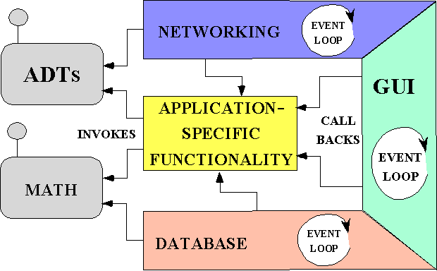
Comparing Class Libraries,
Frameworks, & Components
Class Library Architecture
Component Architecture
APPLICATION-
SPECIFIC
FUNCTIONALITY
LOCAL
INVOCATIONS
Math
Naming
ADTs
Events
Files
Strings
GUI
Logging
Locking
EVENT
LOOP
GLUE
CODE
Locks
IPC
Middleware Bus
A class is a unit of abstraction & implementation in an OO programming language
A component is an encapsulation unit with one or more interfaces that provide clients with access to its services
Framework Architecture
Class
Libraries
Frameworks
Components
ADTs
Reactor
NETWORKING
Strings
APPLICATION-SPECIFIC FUNCTIONALITY
Micro-level
Meso-level
Macro-level
INVOKES
CALLBACKS
GUI
Stand-alone language entities
“Semi-complete” applications
Stand-alone composition entities
Files
Locks
DATABASE
Domain-independent
Domain-specific
Domain-specific or Domain-independent
A framework is an integrated set of classes that collaborate to produce a reusable architecture for a family of applications
Borrow caller’s thread
Inversion of control
Borrow caller’s thread

Slide 29
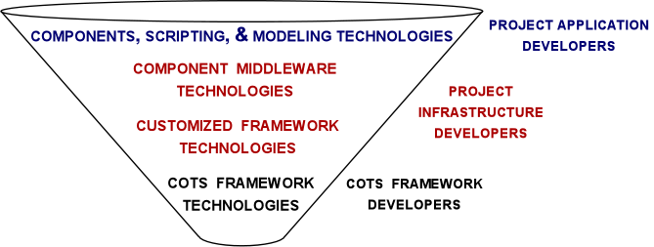
Using Frameworks Effectively
Observations
Frameworks are powerful, but hard to develop & use effectively by application developers
  It’s often better to use & customize COTS frameworks than to develop in-house frameworks
Components are easier for application developers to use, but aren’t as powerful or flexible as frameworks
Successful projects are therefore often organized using the “funnel” model

Slide 30
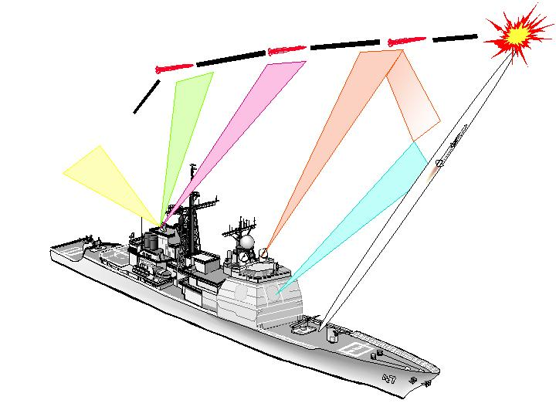

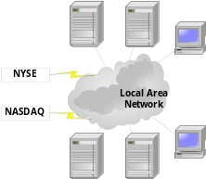
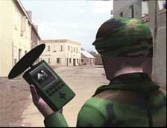

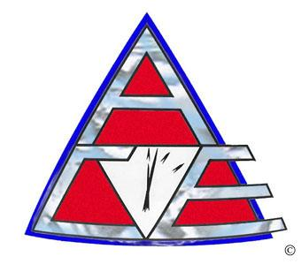
Overview of the ACE Frameworks
Features
Open-source
6+ integrated frameworks
250,000+ lines of C++
40+ person-years of effort
Ported to Windows, UNIX, & real-time operating systems
  e.g., VxWorks, pSoS, LynxOS, Chorus, QNX
Large user community
Application-
specific
functionality
Acceptor Connector
Stream
Component
Configurator
Task
Reactor
Proactor
  www.cs.wustl.edu/~schmidt/ACE.html

Slide 31
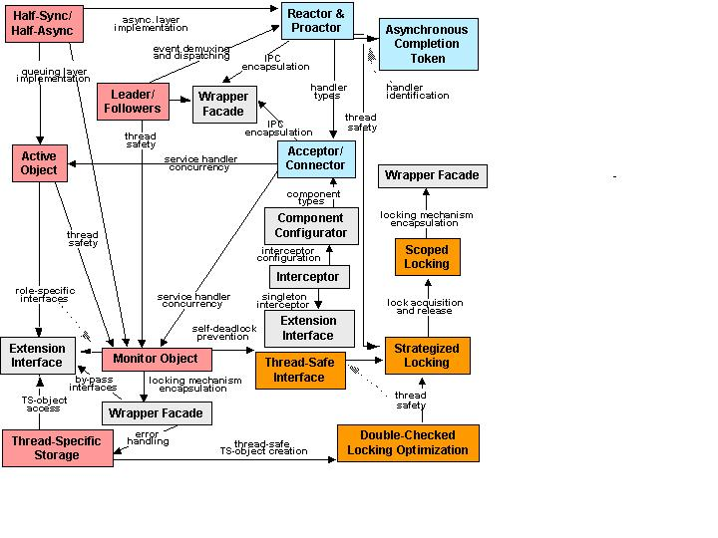
The POSA2 Pattern Language
Pattern Benefits
  Preserve crucial design information used by applications & middleware frameworks & components
  Facilitate reuse of proven software designs & architectures
  Guide design choices for application developers

Slide 32
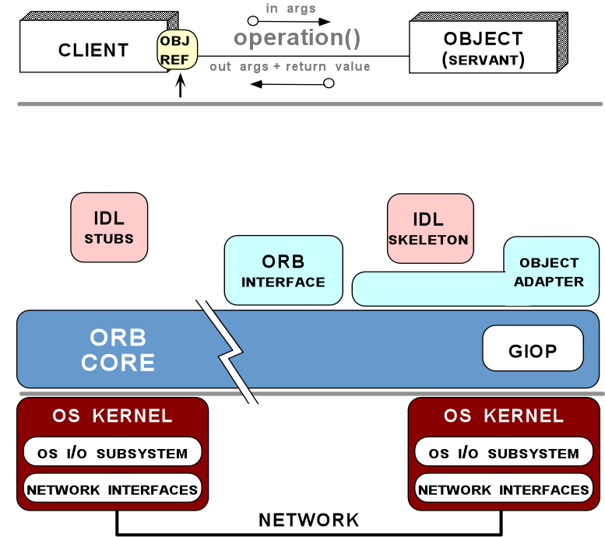
Implementing the Broker Pattern for Bold Stroke Avionics
Client Propagation & Server Declared Priority Models
CORBA is a distribution middleware standard
Real-time CORBA adds QoS to classic CORBA to control:
Static Scheduling
Service
Standard
Synchonizers
  1. Processor Resources
Request
Buffering
2. Communication
Resources
Explicit Binding
Thread Pools
  3. Memory Resources
Portable Priorities
These capabilities address some (but by no means all) important DRE application development & QoS-enforcement challenges
Protocol
Properties
www.omg.org
Notes:
Key themes of this slide
Our initial R&D goal in achieving the ARMS vision focused on developing the TAO Real-time CORBA foundation
TAO is a stellar example of DRE middleware that’s widely used both in research and in industry.

Slide 33

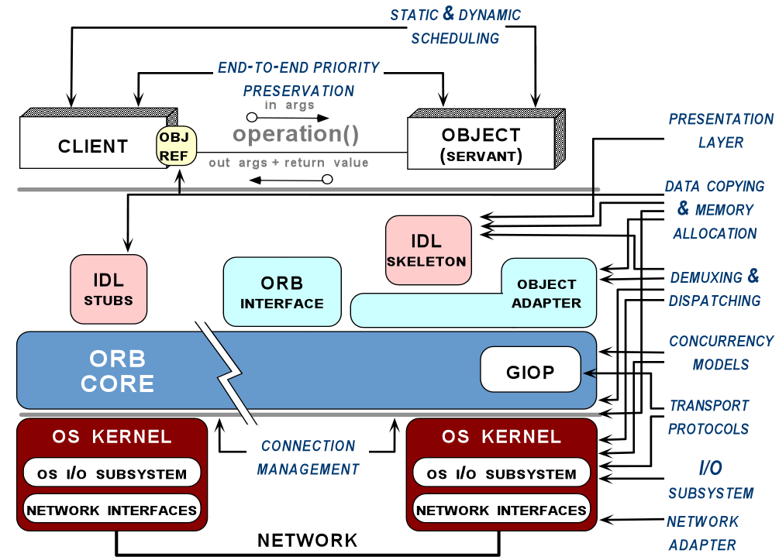
Applying Patterns & Framworks to Middleware:
The ACE ORB (TAO)
TAO is an open-source version of Real-time CORBA
TAO Synopsis
  > 1,000,000 SLOC
  80+ person years of effort
Pioneered R&D on DRE middleware design, patterns, frameworks, & optimizations
TAO is basis for many middleware R&D efforts
Example of good synergy between researchers & practitioners
www.cs.wustl.edu/~schmidt/TAO.html
Notes:
Key themes of this slide
Our initial R&D goal in achieving the ARMS vision focused on developing the TAO Real-time CORBA foundation
TAO is a stellar example of DRE middleware that’s widely used both in research and in industry.

Slide 34
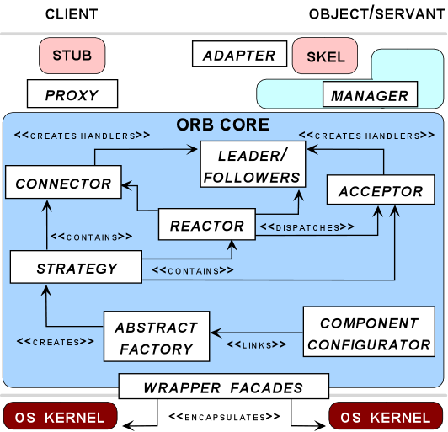
Key Patterns Used in TAO
www.cs.wustl.edu/~schmidt/PDF/ORB-patterns.pdf
Wrapper facades enhance portability
Proxies & adapters simplify client & server applications, respectively
Component Configurator dynamically configures Factories
Factories produce Strategies
Strategies implement interchangeable policies
Concurrency strategies use Reactor & Leader/Followers
Acceptor-Connector decouples connection management from request processing
Managers optimize request demultiplexing

Slide 35
Enhancing ORB Flexibility w/the Strategy Pattern
Context | Problem | Solution
Multi-domain resuable middleware framework | Flexible ORBs must support multiple event & request demuxing, scheduling, (de)marshaling, connection mgmt, request transfer, & concurrency policies | Apply the Strategy pattern to factory out similarity amongst alternative ORB algorithms & policies
Hook for marshaling strategy
Hook for the request demuxing strategy
Hook for the event demuxing strategy
Hook for the connection management strategy
Hook for the concurrency strategy
Hook for the underlying transport strategy

Slide 36
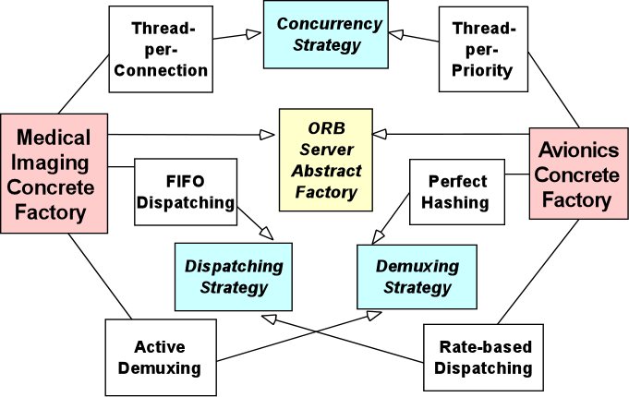
Consolidating Strategies with the Abstract Factory Pattern
Context | Problem | Solution
A heavily strategized framework or application | Aggressive use of Strategy pattern creates a configuration nightmare Managing many individual strategies is hard It’s hard to ensure that groups of semantically compatible strategies are configured | Apply the Abstract Factory pattern to consolidate multiple ORB strategies into semantically compatible configurations
Concrete factories create groups of strategies

Slide 37
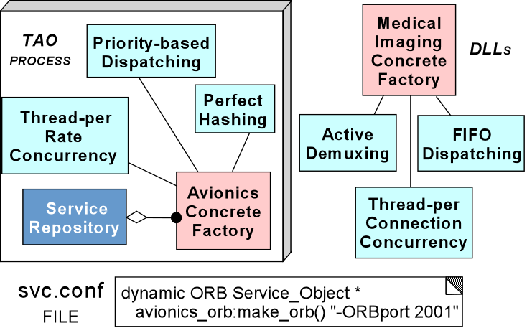
Dynamically Configuring Factories w/the Component Configurator Pattern
Context | Problem | Solution
Resource constrained & highly dynamic environments | Prematurely commiting to a particular ORB configuration is inflexible & inefficient Certain decisions can’t be made until runtime Forcing users to pay for components that don’t use is undesirable | Apply the Component Configurator pattern to assemble the desired ORB factories (& thus strategies) dynamically
ORB strategies are decoupled from when the strategy implementations are configured into an ORB
This pattern can reduce the memory footprint of an ORB

Slide 38
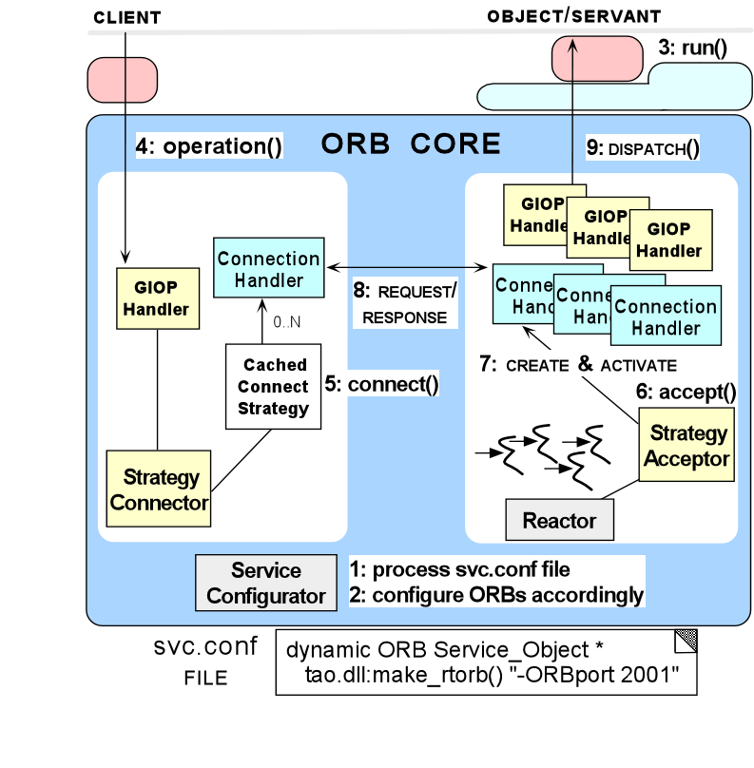
ACE Frameworks Used in TAO
Reactor drives the ORB event loop
  Implements the Reactor & Leader/Followers patterns
Acceptor-Connector decouples passive/active connection roles from GIOP request processing
  Implements the Acceptor-Connector & Strategy patterns
Service Configurator dynamically configures ORB strategies
  Implements the Component Configurator & Abstract Factory patterns

Slide 39
Summary of Pattern, Framework,
& Middleware Synergies
The technologies codify expertise of experienced researchers & developers
Frameworks codify expertise in the form of reusable algorithms, component implementations, & extensible architectures
Patterns codify expertise in the form of reusable architecture design themes & styles, which can be reused event when algorithms, components implementations, or frameworks cannot
Middleware codifies expertise in the form of standard interfaces & components that provide applications with a simpler façade to access the powerful (& complex) capabilities of frameworks
Application-specific functionality
Acceptor Connector
Stream
Component
Configurator
Reactor
Task
Proactor
There are now powerful feedback loops advancing these technologies

Slide 40
The Road Ahead (1/2)
Key Challenges
There is a limit to how much application functionality can be factored into broadly reusable standard COTS middleware
Middleware has become extremely complicated to use, configure, & provision statically & dynamically
There are now (& will always be) multiple middleware technologies to choose from
DRE Applications
CORBA
Apps
J2EE
Apps
.NET
Apps
Middleware
Services
CORBA
Services
J2EE
Services
.NET
Services
Middleware
Load Balancer
FT CORBA
CORBA
J2EE
.NET
Workload &
Replicas
RT/DP CORBA + DRTSJ
Connections &
priority bands
Operating Sys
& Protocols
RTOS + RT Java
CPU & memory
IntServ + Diffserv
Network latency
& bandwidth
Hardware &
Networks

Slide 41
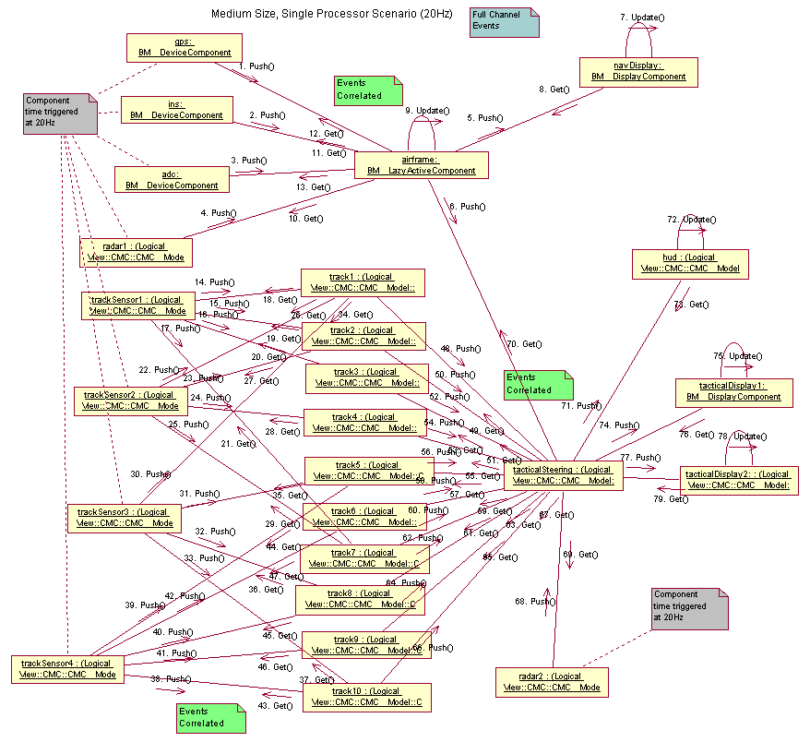
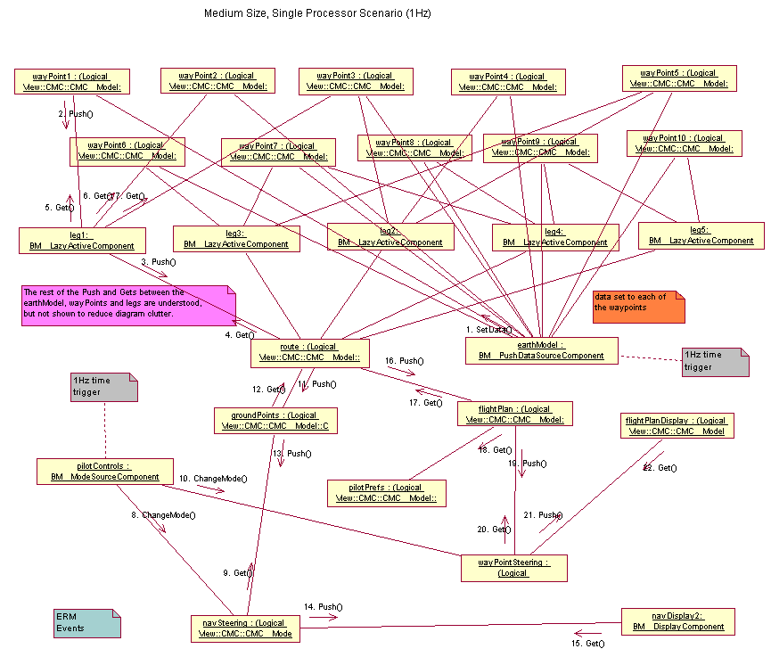
The Road Ahead (2/2)
Solution approach: Integrate model-based software technologies with QoS-enabled component middleware
e.g., standard technologies are emerging that can:
  Model
  Analyze
  Synthesize &
  Provision
multiple layers of QoS-enabled middleware
These technologies are guided by patterns & implemented by component frameworks
…
…
Container
QoS-enabled Middleware Bus
<CONFIGURATION_PASS>
<HOME> <…>
<COMPONENT>
<ID> <…></ID>
<EVENT_SUPPLIER>
<…events this component supplies…>
</EVENT_SUPPLIER>
</COMPONENT>
</HOME>
</CONFIGURATION_PASS>
…
…
Container
Distributed
system

Slide 42
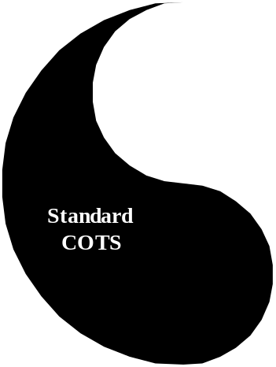
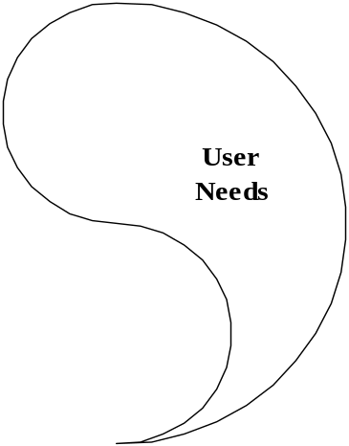


Concluding Remarks
R&D Synergies
Researchers & developers of distributed systems face common challenges, e.g.:
connection management
service initialization
error handling
flow & congestion control
event demultiplexing
distribution
concurrency & synchronization
fault tolerance
scheduling &
persistence
Pattern languages, frameworks, & component middleware work together to help resolve these challenges
Key open R&D challenges include:
Prior R&D efforts have address some, but by no means all, of the challenging DOC middleware research topics
Layered QoS specification & enforcement
Separating policies & mechanisms across layers
Time/space optimizations for middleware & apps
Multi-level global resource mgmt. & optimization
High confidence
Stable & robust adaptive systems

Slide 43
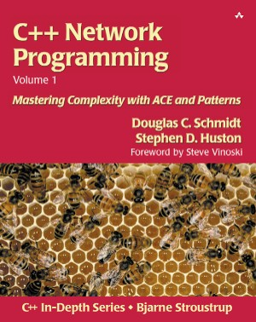
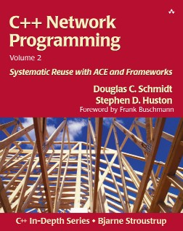
Additional Information
Patterns & frameworks for concurrent & networked objects
  www.cs.wustl.edu/~schmidt/POSA/
  www.cs.wustl.edu/~schmidt/ACE/
ACE & TAO open-source middleware
  www.cs.wustl.edu/~schmidt/ACE.html
  www.cs.wustl.edu/~schmidt/TAO.html
Research papers
  www.cs.wustl.edu/~schmidt/research.html
Tutorial on patterns, frameworks, & middleware
  UCLA extension, July 9-11, 2003
  www.cs.wustl.edu/~schmidt/UCLA.html
Conferences on patterns, frameworks, & middleware
  DOA, ECOOP, ICDCS, ICSE, Middleware, OOPSLA, PLoP(s), RTAS,
Notes:
[Guys, can you think of some other URLs to add here?!]

