Slide 1

Software Architecture
SSE USTC Qing Ding
dingqing@ustc.edu.cn
http://staff.ustc.edu.cn/~dingqing

Slide 2

Architecture and Architect

Slide 3
Learning Objectives
Define software architecture and its elements
Distinguish between accidental and essential difficulties in software and enumerate them
Compare and contrast software architecture to building architecture and understand the role of the architect
Identify essential elements of the architecture of the WWW and the UNIX pipes and filters paradigm
Understand software product lines and the role of reuse in software design

Slide 4
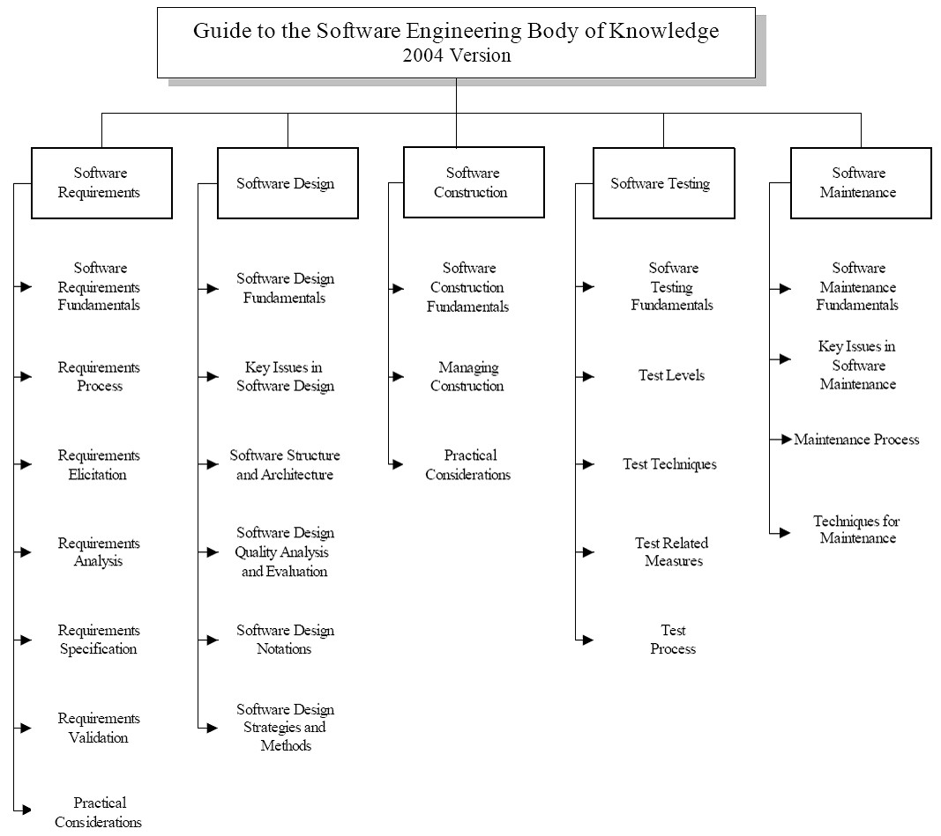
SWEBOK
Guide to the Software Engineering Body of Knowledge
– A project of the IEEE Computer Society Professional Practices Committee

Slide 5
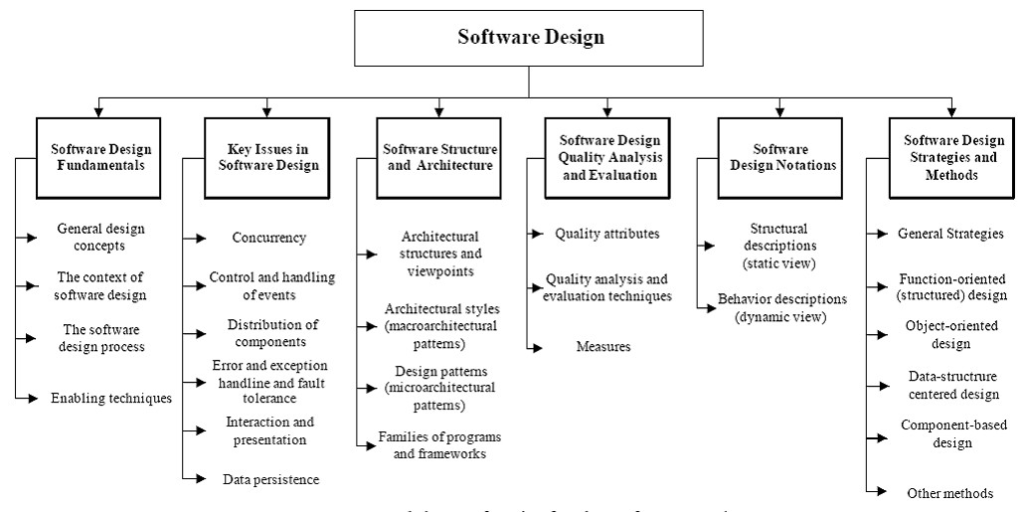
SWEBOK
REliable, INtelligent & Scalable Systems
Guide to the Software Engineering Body of Knowledge
– A project of the IEEE Computer Society Professional Practices Committee

Slide 6
Architecture
What is architecture?

Slide 7
What is Software Architecture?
It’s all about software design
  Architecture is software design, but not all design is software architecture
    part of the design process
[Gorton] Architecture focuses on ‘issues that will be difficult/impossible to change once the system is built’
  E.g., quality attributes like security, performance
  E.g., non-functional requirements like cost, deployment hardware

Slide 8
Definitions – Taylor et al.
[Software architecture is] the set of principal design decisions governing a system

Slide 9
Definitions - ANSI/IEEE Std 1471-2000
“Architecture is the fundamental organization of a system, embodied in its components, their relationships to each other and the environment, and the principles governing its design and evolution.”

Slide 10
Definitions - SEI
“The software architecture of a program or computing system is the structure or structures of the system, which comprise software elements, the externally visible properties of those elements, and the relationships among them.”

Slide 11
What is Software Architecture?
There are two common elements:
  One is the highest-level breakdown of a system into its parts;
  the other, decisions that are hard to change.
It's also increasingly realized that there isn't just one way to state a system's architecture;
  rather, there are multiple architectures in a system, and the view of what is architecturally significant is one that can change over a system's lifetime.

Slide 12
Main point: Architecture Defines Structure
Decomposition of system into components/modules/subsystems
Architecture defines:
  Component interfaces
    What a component can do
  Component communications and dependencies
    How components communicate
  Component responsibilities
    Precisely what a component will do

Slide 13
Typical System Architecture
Enterprise/Product Architecture
Business Architecture
Application Architecture
Technical Architecture
Product Architecture

Slide 14
What is Software Architecture
Software Architecture
  transforms Business Architecture into an set of designs and guidelines to realize business process in an information systems
Software Architecture
  relies on Technical Architecture to provide an efficient/scalable/secure environment

Slide 15
Software Engineering Difficulties
Software engineers deal with unique set of problems
  Young field with tremendous expectations
  Building of vastly complex, but intangible systems
  Often software is not useful on its own
    (e.g., unlike a car)
    thus it must conform to changes in other engineering areas
Some problems can be eliminated
  “accidental difficulties”
Other problems can be lessened, but not eliminated
  “essential difficulties”

Slide 16
Accidental Difficulties
Solutions exist
  Possibly waiting to be discovered
Past productivity increases were the result of overcoming
  Inadequate programming constructs & abstractions
    Remedied by high-level programming languages
    Increased productivity by factor of five
    Complexity was never inherent in program at all

Slide 17
Accidental Difficulties (cont’d)
Past productivity increases were the result of overcoming (cont’d)
  Inadequate tools:
    E.g., Viewing results of programming decisions took long time
      Remedied by time–sharing
      Turnaround time approaching limit of human perception
  Difficulty of using heterogeneous programs
    Addressed by integrated software development environments
    Support task that was conceptually always possible

Slide 18
Essential Difficulties
Only partial solutions exist for them, if any
Cannot be abstracted away
  Complexity
  Conformity
  Changeability
  Intangibility

Slide 19
Complexity
No two software parts are alike
  If they are, they are abstracted away into one
Complexity grows super-linearly with size
  E.g., it is impossible to enumerate all states of program
    Except perhaps “toy” programs

Slide 20
Conformity
Software is required to conform to its
  Operating environment
  Hardware
Often “last kid on block”
Perceived as most conformable

Slide 21
Changeability
Software is viewed as infinitely malleable
Change originates with
  New applications, users, machines, standards, laws
  Hardware problems

Slide 22
Intangibility
Software is not embedded in space
  Often no constraining physical laws
No obvious representation
  E.g., familiar geometric shapes

Slide 23
Promising Attacks On Complexity
Buy vs. Build
Requirements refinement & rapid prototyping
  Hardest part is deciding what to build (or buy?)
  Must show product to customer to get complete spec.
  Need for iterative feedback

Slide 24
Promising Attacks On Complexity (cont’d)
Incremental/Evolutionary/Spiral Development
  Grow systems, don’t build them
  Good for morale
  Easy backtracking
  Early prototypes
Great designers
  Good design can be taught; great design cannot
  Nurture great designers

Slide 25
Primacy of Design
Software engineers collect requirements, code, test, integrate, configure, etc.
An architecture-centric approach to software engineering places an emphasis on design
  Design pervades the engineering activity from the very beginning
But how do we go about the task of architectural design?

Slide 26
Analogy: Architecture of Buildings
We all live in them
(We think) We know how they are built
  Requirements
  Design (blueprints)
  Construction
  Use
This is similar (though not identical) to how we build software

Slide 27
Some Obvious Parallels
Satisfaction of customers’ needs
Specialization of labor
Multiple perspectives of the final product
Intermediate points where plans and progress are reviewed

Slide 28
Deeper Parallels
Architecture is different from, but linked with the product/structure
Properties of structures are induced by the design of the architecture
The architect has a distinctive role

Slide 29
Deeper Parallels (cont’d)
Process is not as important as architecture
  Design and resulting qualities are at the forefront
  Process is a means, not an end
Architecture has matured over time into a discipline
  Architectural styles as sets of constraints
  Styles also as wide range of solutions, techniques and palettes of compatible materials, colors, and sizes

Slide 30
More about the Architect
A distinctive role in a project
Very broad training
Amasses and leverages extensive experience
A keen sense of aesthetics
Deep understanding of the domain
  Properties of structures, materials, and environments
  Needs of customers

Slide 31
More about the Architect (cont’d)
Even first-rate programming skills are insufficient for the creation of complex software applications
  But are they even necessary?

Slide 32
Limitations of the Analogy…
We know a lot about buildings, much less about software
The nature of software is different from that of building architecture
Software is much more malleable than physical materials
The two “construction industries” are very different
Software deployment has no counterpart in building architecture
Software is a machine; a building is not

Slide 33
…But Still Very Real Power of Architecture
Giving preeminence to architecture offers the potential for
  Intellectual control
  Conceptual integrity
  Effective basis for knowledge reuse
  Realizing experience, designs, and code
  Effective project communication
  Management of a set of variant systems
Limited-term focus on architecture will not yield significant benefits!

Slide 34
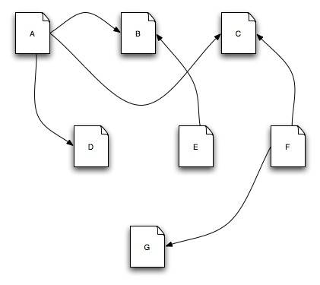
Architecture in Action: WWW
This is the Web

Slide 35
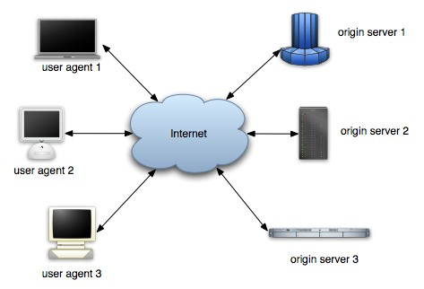
Architecture in Action: WWW
So is this

Slide 36
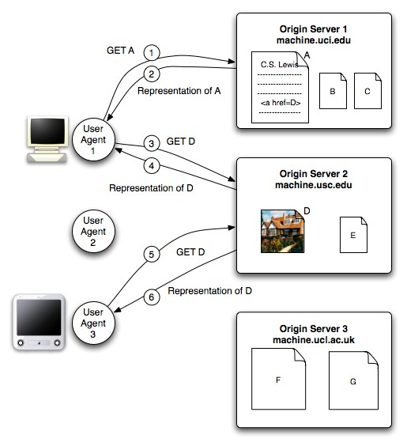
Architecture in Action: WWW
And this

Slide 37
WWW in a (Big) Nutshell
The Web is a collection of resources, each of which has a unique name known as a “uniform resource
locator” (URL)
Each resource denotes, informally, some information.
URI’s can be used to determine the identity of a machine on the Internet, known as an origin server, where the value of the resource may be ascertained.
Communication is initiated by clients, known as user agents, who make requests to servers.
  Web browsers are common instances of user agents.

Slide 38
WWW in a (Big) Nutshell (cont’d)
Resources can be manipulated through their representations.
  HTML is a very common representation language used on the Web.
All communication between user agents and origin servers must be performed by a simple, generic protocol (HTTP), which offers the command methods GET, POST, etc.
Communication between user agents and origin servers is fully self-contained.
  (So-called “stateless interactions”)

Slide 39
WWW’s Architecture
Architecture of the Web is wholly separate from the code
There is no one piece of code that implements the architecture.
There are multiple pieces of code that implement the various components of the architecture.
  E.g., different Web browsers

Slide 40
WWW’s Architecture (cont’d)
Stylistic constraints of the Web’s architectural style are not apparent in the code
  The effects of the constraints are evident in the Web
One of the world’s most successful applications is only understood adequately from an architectural vantage point.

Slide 41
Architecture in Action (2): @ small scale
Unix command line
ls invoices |
grep
-e august
| sort
Application architecture can be understood based on very few rules
Applications can be composed by non-programmers
  Akin to Lego blocks
A simple architectural concept that can be comprehended and applied by a broad audience

Slide 42
Software Product Line
Motivating example
  A consumer is interested in a 35-inch HDTV with a built-in DVD player for the North American market.
Such a device might contain upwards of a million lines of embedded software.
This particular television/DVD player will be very similar to a 35- inch HDTV without the DVD player, and also to a 35-inch HDTV with a built-in DVD player for the European market, where the TV must be able to handle PAL or SECAM encoded broadcasts, rather than North America’s NTSC format.
These closely related televisions will similarly each have a million or more lines of code embedded within them.

Slide 43
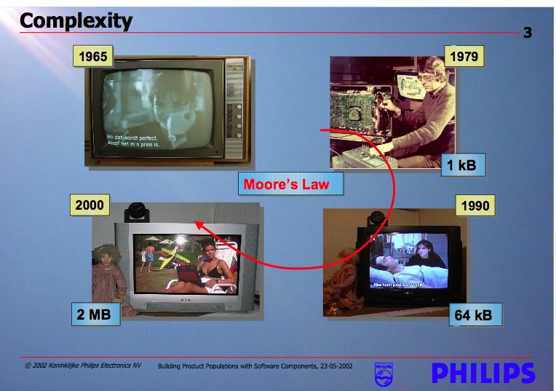
Growing Sophistication of Consumer Devices

Slide 44
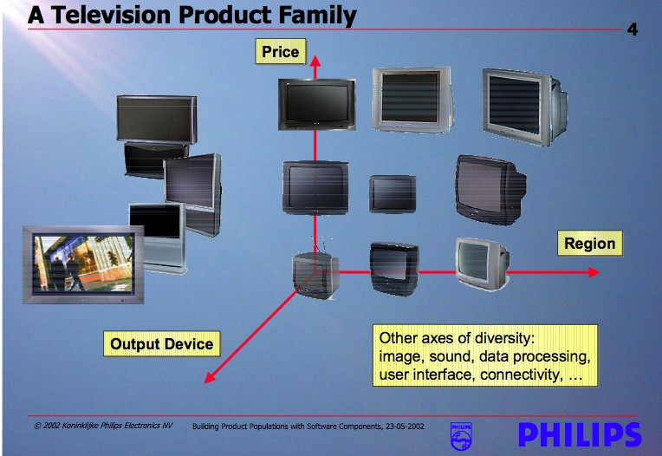
Families of Related Products

Slide 45
The Necessity and Benefit of PLs
Building each of these TVs from scratch would likely put Philips out of business
Reusing structure, behaviors, and component implementations is increasingly important to successful business practice
  It simplifies the software development task
  It reduces the development time and cost
  it improves the overall system reliability
Recognizing and exploiting commonality and variability across products

Slide 46
Reuse as the Big Win
Architecture: reuse of
  Ideas
  Knowledge
  Patterns
  Engineering guidance
  Well-worn experience
Product families: reuse of
  Structure
  Behaviors
  Implementations
  Test suites…

Slide 47
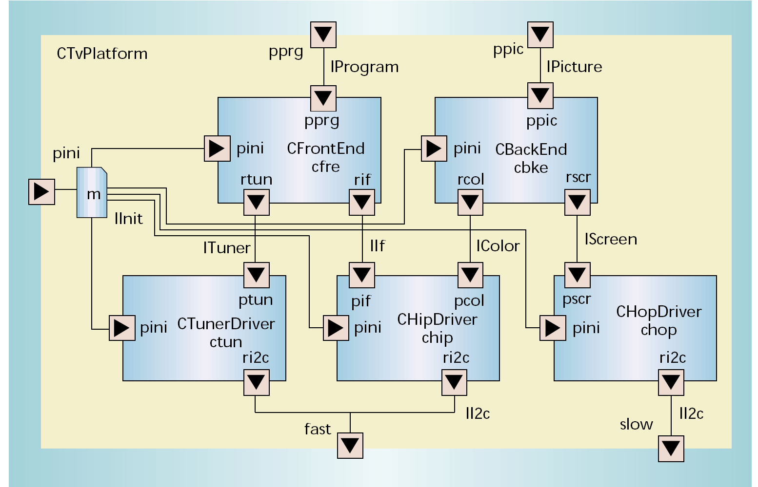
The Centerpiece – Architecture

Slide 48
Let’s give an example
A student management system
  Function: query/update/insert/delete student info
Student
info
client

Slide 49
You can
client
JDBC
Student
database
client
JDBC

Slide 50
You can also
client
Start a new thread to fulfill function
Send a request
socket
server
Student
file
client
socket
socket
listen

Slide 51
Software Architecture Quality Metrics
Availability
Reliability
Modifiability
Performance
Security
Testability
Usability
Supportability

Slide 52
Software Architecture Quality Metrics
Business objectives(T2M,Targeted Market)
Skill of development team and local market of team
Cost to build and Maintain v.s. Benefit
Materialityof Technology
Current System constrain, integration
Migration, migration, migration

Slide 53
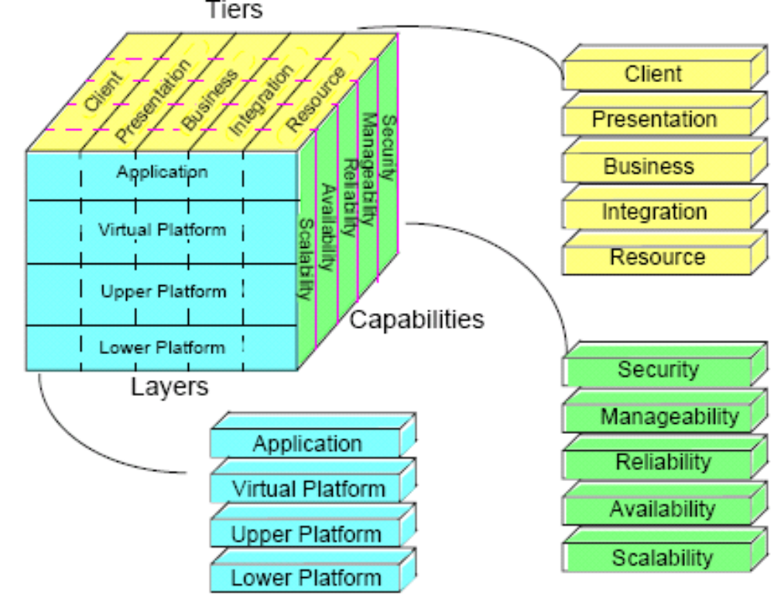
Architecture and the Cube

Slide 54
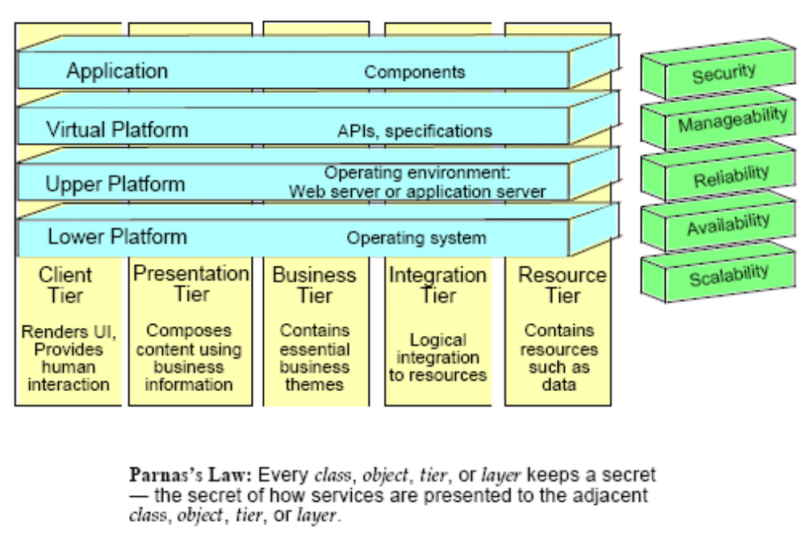
Layers and Tiers

Slide 55
Capabilities
Nonfunctional, observable system qualities:
  Do not represent separate specified functions
  Cannot be satisfied by any one component
Example:
  Retail toy store’s web site cannot handle the load and crashes:
  Two weeks before Christmas
  After a $50 million advertisement campaign
  Expansion of capacity will take six weeks

Slide 56
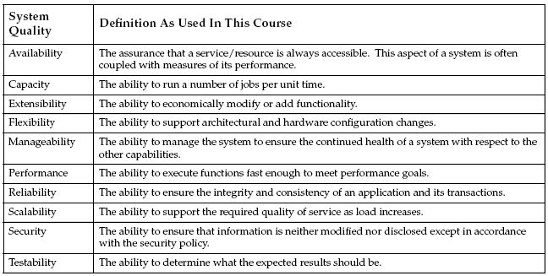
Capabilities

Slide 57
Availability and Reliability
Availability
The assurance that a service or a resource is highly accessible. (time available) / (time possible)
Example – 201 seconds down/week
Reliability
The ability to ensure the integrity and consistency of the application and all of its transactions.
Example – Users will experience failed sessions no more than 1 time in 1000 attempts (99.9 percent reliability).

Slide 58
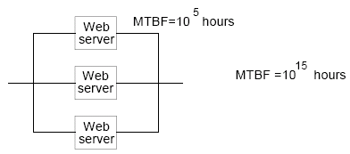
Improving Reliability
Assume a web server has a MTBF of 100,000 hours.
What is the reliability of the following?
Availability increases.

Slide 59
Manageability
The ability to manage the system to ensure the continued health of a system with respect to the other system qualities.
Metric example – Number of staff hours per month to perform normal upgrades.

Slide 60
Flexibility
Is the ability to change architecture to meet new requirements in a cost-efficient manner
Is the key to an available, reliable, and scalable application
Can be improved through location independence of application code

Slide 61

Flexibility
Example
Allows you to change what is affected by changing the presentation language (for example, English to German)?
What must change to add a “fat client” for intense use?

Slide 62
Flexibility Metrics
No standard way of measuring flexibility
Basic measure is cost of change but this depends on what change is probable.
Use change cases to evaluate what in system must change.

Slide 63
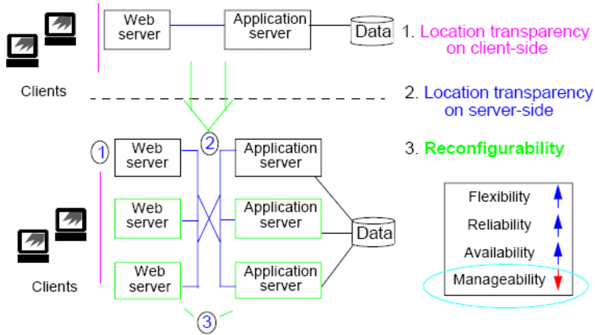
The Effect of Flexibility

Slide 64
Performance
The ability to execute functions fast enough to meet performance goals.
Response time is important to an application.
Identify and control expensive calls.
State performance goals before implementing.
Example—first visible response in browser under maximum specified load occurs in less than 3 seconds, 95 percent of the time. Measurement is made at company external firewall.

Slide 65
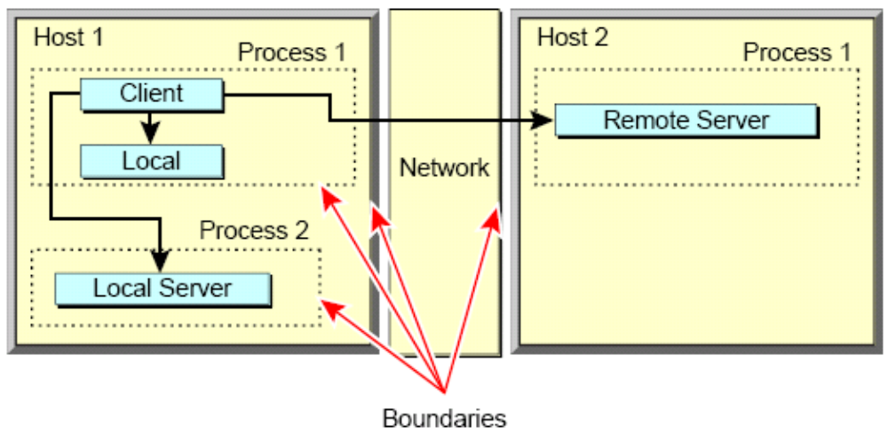
Performance
Identify and control access to expensive process and network boundaries.

Slide 66
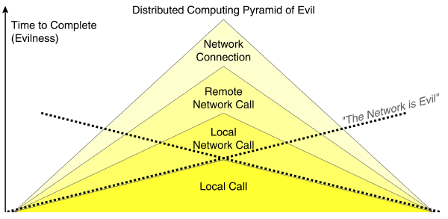
Performance
Identify the class of expensive calls.

Slide 67
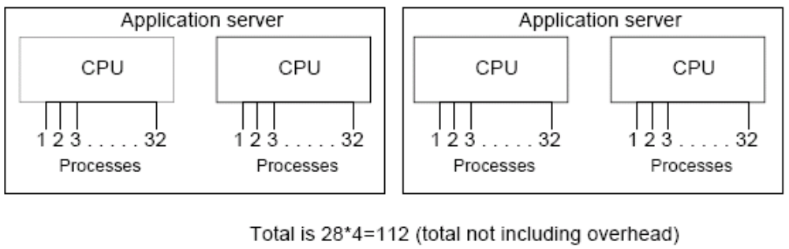
Capacity
The ability to run a certain number of jobs per unit time.
Example

Slide 68
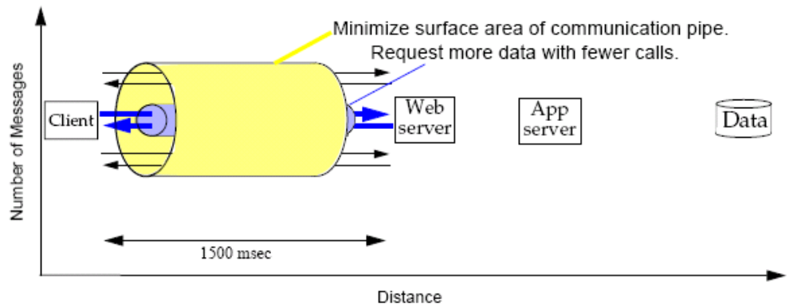
Latency Space
Latency is the inherent communication delay, such as ping time.

Slide 69
Scalability
The ability to economically support the required quality of service as the load increases.
Vertical scalability comes from adding capacity (memory, CPUs) to existing servers.
  Makes fewer demands on the architecture
  Is constrained by resource limits
Horizontal scalability comes from adding servers.
  Distributed state, load balancing

Slide 70
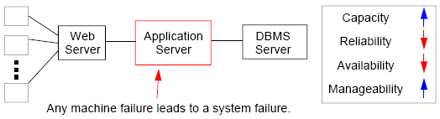
Vertical Scalability

Slide 71
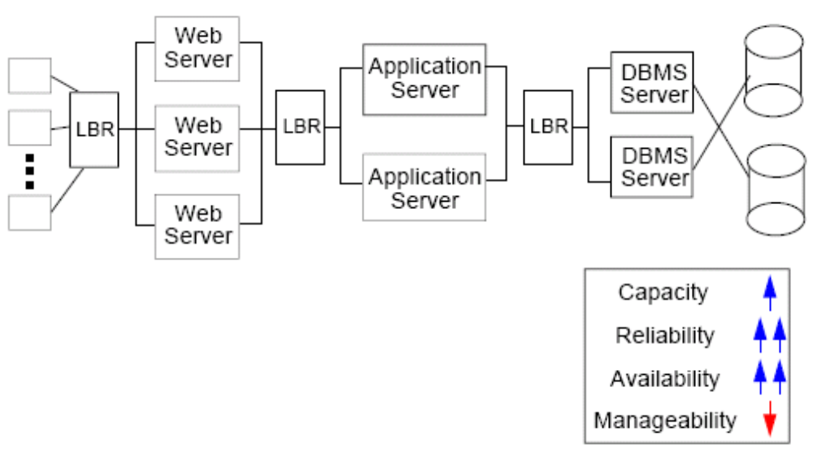
Horizontal Scalability
All Web servers or all application servers must fail for a system failure to occur.

Slide 72
The Effect of Scalability
How are other capabilities driven by scalability?
Availability and reliability are obtained through scalability.
Capacity is affected by scalability:
  One machine handles 500 transactions
or
  5 machines handle 100 transactions each
  50 machines handle 10 transactions each

Slide 73
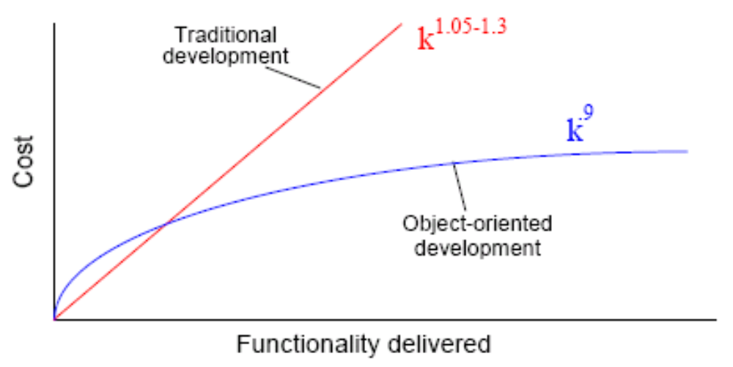
Extensibility
The ability to modify or add functionality without impacting the existing functionality.
Requires careful modeling of the business domain to add new features based on the business model.

Slide 74
Extensibility
Rough guidelines:
More than 25 top-level classes will lead to problems.
Every use case can be directly implemented using domain model methods.
On average, every change touches about 1.3 classes.

Slide 75
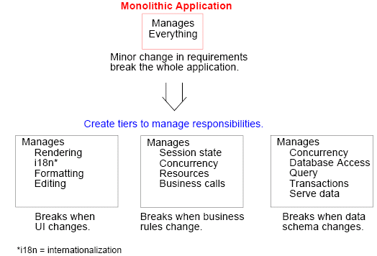
Extensibility

Slide 76
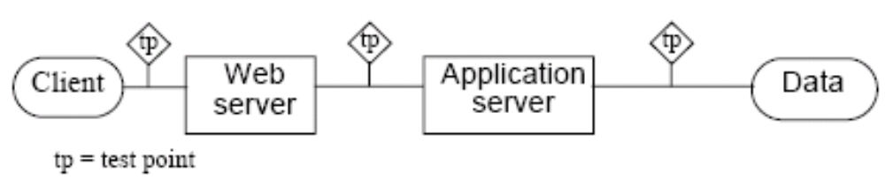
Testability
The ability to determine what the expected results should be.
Multi-tier architecture provides for many test points for intermediate testing and debugging.

Slide 77
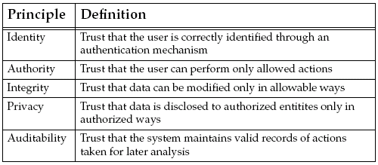
Security

Slide 78
Security
Proper use of technology.
More than just technology.
  Hiring a trusted employee
  Procedural – intrusion detection
  Keep server in locked room
Trade-off between privacy, ease-of-use, and expense

Slide 79
Security Policy
A security policy should state the acceptable risks and costs.
It requires at least 30 hours using the best known attacks to compromise one customer account. Three or more successive login failures will be logged.

Slide 80
Service-based Capabilities
Scalable, available architectures are typically service-based architectures with collections of cooperating, communicating services.
  Small, coherent sets of APIs to the business
  Provides “outlets” for connecting to services
  Decouples clients from implementations
  Proper implementation of services is the key to security, scalability, and availability

Slide 81
Why Service-based Architectures?
Service-based architectures:
Are less brittle
Respond easily to changes in business demands.
Can tune each system for the functionality it provides
Alternatives:
Partition by tiers
Partition by special functions

Slide 82
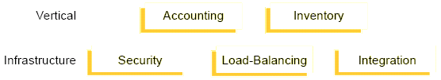
Creating Service-based Architectures
Vertical services:
  Content-based services
  Reflect the business model
Horizontal services:
  Infrastructure-based services
  Accessed at many layers

Slide 83
Heuristics for Developing Service-based Architectures
A service is like a server in Client-Server architecture:
  Represents shared resources
  Accessed concurrently
  Maintaining integrity
Services map to essential business themes, which map to top-level domain objects.

Slide 84
Architectural Design Goals
To achieve capabilities, an architect creates an architecture with the following goals in mind.
  Modularity
  Protection and exposure
  Component extensibility
  Roles and responsibilities
  Contracts
  Pluggable behavior

Slide 85
Modularity
Separate the code into self-sufficient, highly cohesive, low-coupling pieces.
  Modularity creates good code abstractions.
  Modularity hides details.
  Modular code is like a black box.

Slide 86
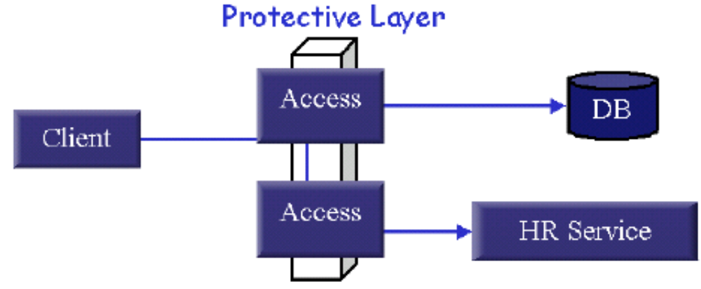
Protection and Exposure
Guard expensive resources to prevent inappropriate use.
Shared resources are usually expensive to access.
Protection mandates controlled exposure using visibility access classes.

Slide 87
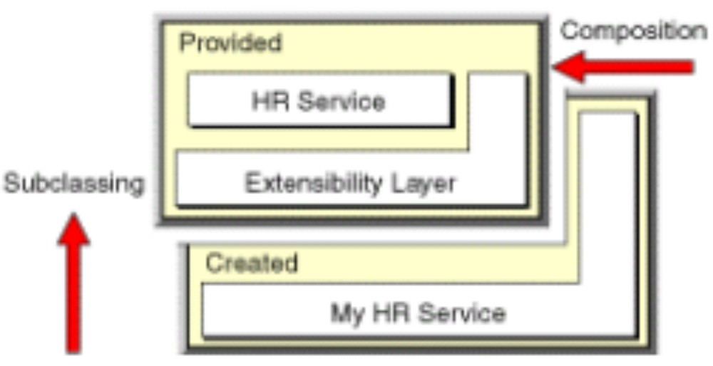
Component Extensibility
Modify or add functionality without impacting the existing functionality.
Subclass
Composition

Slide 88
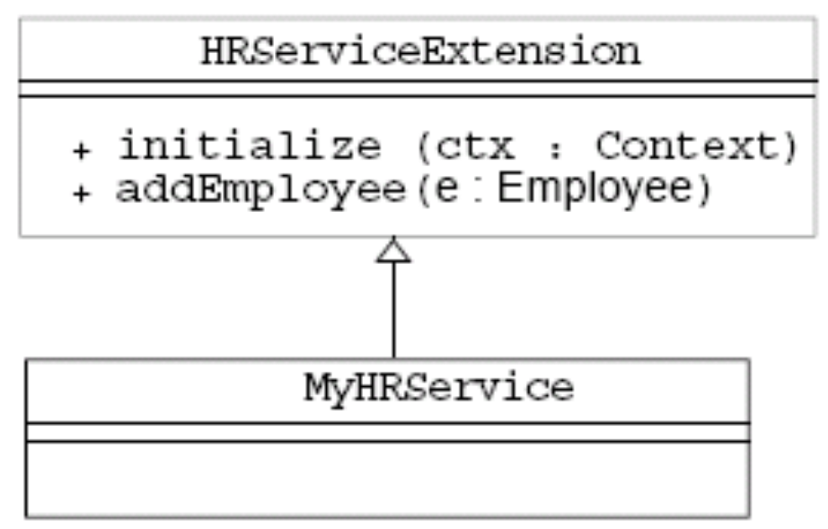
Component Extensibility Using Subclassing
Extending by subclassing creates powerful specialization mechanisms.

Slide 89
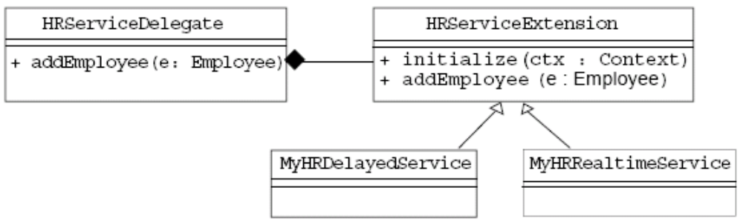
Component Extensibility Using Composition
Composition provides a powerful and dynamic extension mechanism.
Provides for a more “pluggable” architecture.

Slide 90
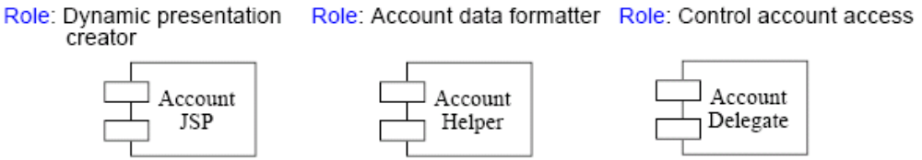
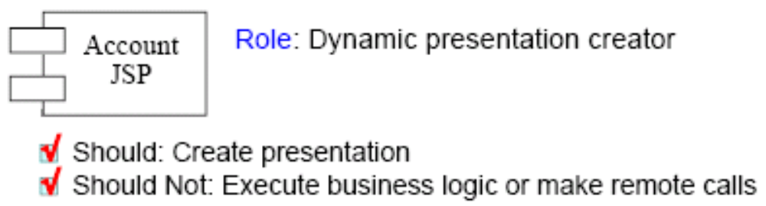
Roles and Responsibilities
To create clear abstractions, you must identify roles and responsibilities.
Identify roles and responsibilities for the abstraction.

Slide 91
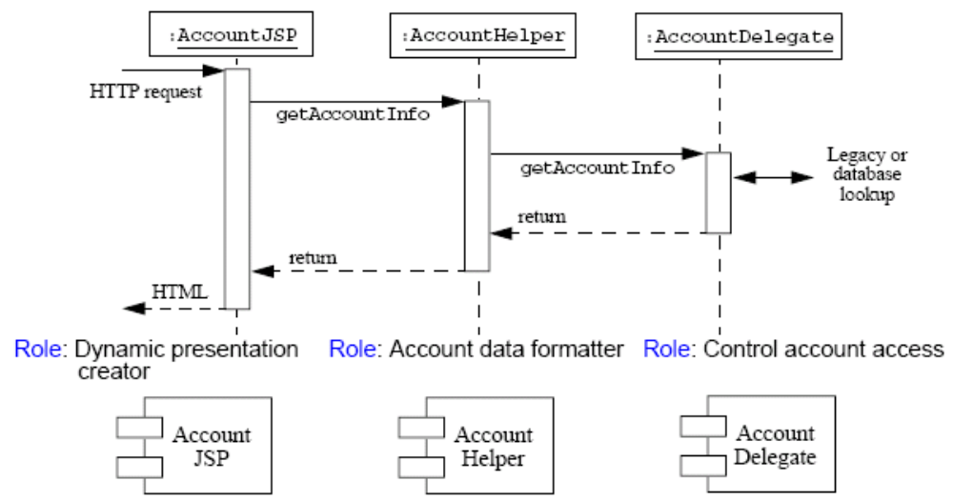
Roles and Responsibilities
Define roles to identify valid data input and output

Slide 92
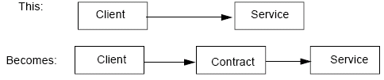
Contracts
Contracts are the client-visible API.
Also known as “programming to the interface.”
Contracts are architecturally represented as abstractions.
Contracts mandate business access and data type.
Identify “pre” and “post” conditions.

Slide 93
Types of Contracts
There are two types of contracts:
  Contract-based – Action and data are explicitly defined in the contract.
  Message-based – Action and data are packaged in the request. The contents of the message are parsed to identify the requested function.

Slide 94
Pluggable Behavior
In general, you expect to use a method by simply passing parameters.
aTextArea.insertText(“This is inserted”, 42);
You can also put complicated behavior into a parameter object, such as fonts, paragraph layouts, and so on in aStyledDocument.
aJTextPane.setStyledDocument(aStyledDocument);
The ability to pass complex objects makes a system more flexible.

Slide 95
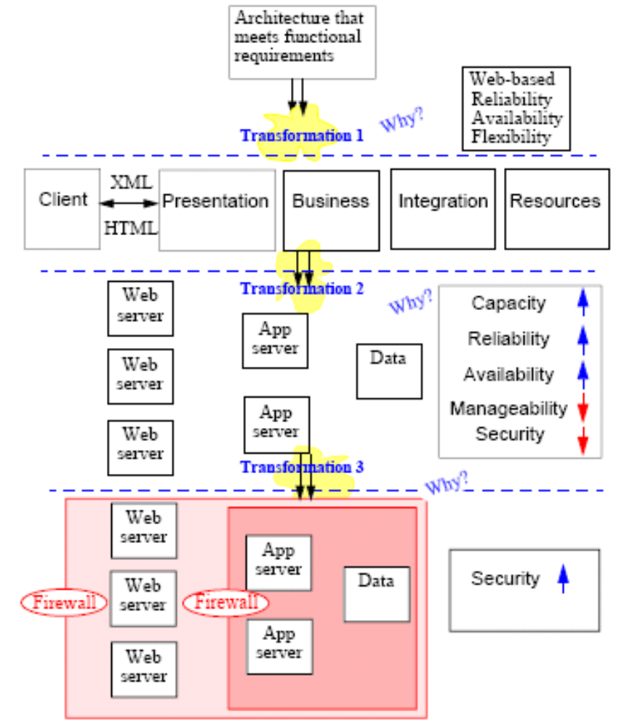
Providing System Requirements

Slide 96
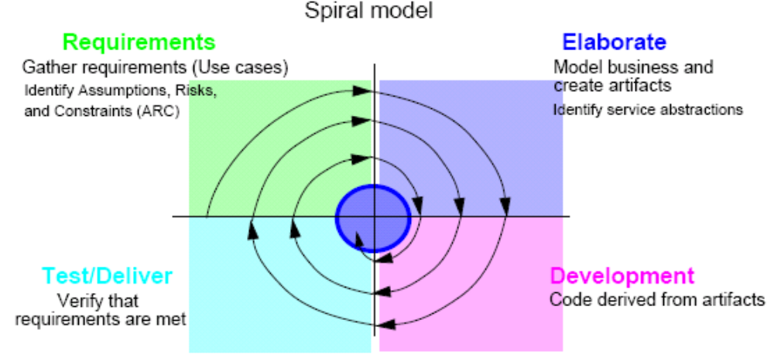
Process
Architects use processes to build a system that meets the requirements.
A process should be iterative and driven by use-cases.

Slide 97
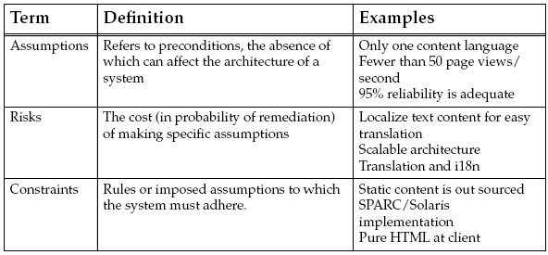
Assumptions, Risks, and Constraints (ARC)
Imperative to identify assumptions, risks and constraints.

Slide 98
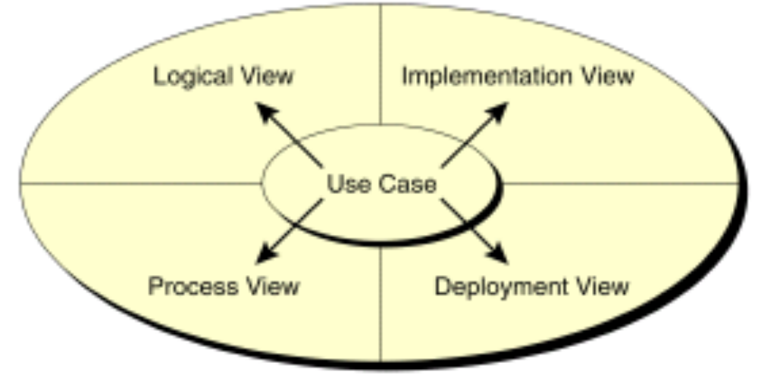
Model the Business
Model the business with use cases.
Use cases drive the architecture at every view.

Slide 99
Check Your Progress
List and define the key architectural capabilities
List and define the key architectural design goals
List and describe the trade-offs that result from architectural decisions.

Slide 100
Think Beyond
How does J2EE technology work with the principles of architecture, specifically capabilities?

Slide 101
Summary
Software Architecture need to
  consider from both technical point of view as well as business point of view
  There are different ways to communicate architecture design
There is no the best architecture for any one software system
Alwaysneed consider
  external constrain, such cost, infrastructure,…
  Maturity of IT organization, not only development, but also operations
Architecture is a live entity,
  therefore, ability to grow, migrate is very important

Slide 102
Architect
What is an architect?

Slide 103
What is Software Architect
Circa 25 BCE, Vitruvius described the role of an architect as:
  The ideal architect should be a man of letters,
  a mathematician, familiar with historical studies,
  a diligent of philosophy,
  acquainted with music,
  not ignorant of medicine,
  learned in the responses of Juri sconsultis,
  familiar with astronomy and astronomical calculations

Slide 104
The Architect’s Role
The architect:
  Visualizes the behavior of the system
  Creates the blueprint for the system
  Defines the way in which the elements of the system work together
  Distinguishes between functional and nonfunctional system requirements
  Is responsible for integrating non-functional requirements into the system

Slide 105
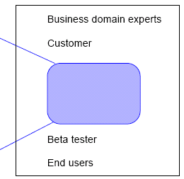
Development Team
The architect is a member of a development team.
  Team leads
  Enterprise modeler
  Architect
  System designers
  Developers
  Testers
  QA staff
  Configuration experts

Slide 106
What Architect Do
Gather System Requirements
Translate requirement to architecture design
Implement proof of concept, define development environment
Develop Architecture Module
Communicate Architecture Design
Be the technical expert
Mentor/help Developers

Slide 107
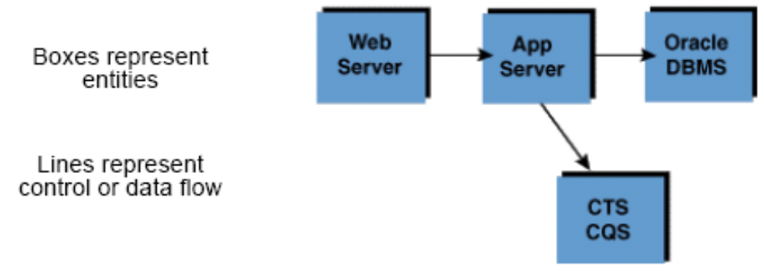
Defining Architecture
Architecture refers to an abstract representation of a system’s components and behaviors.
Architecture does not contain details about implementation.
Architectures are best represented graphically.

Slide 108
Technical Skills
Requirement gathering/Management
Modeling and analysis methodology
Full Software Development Life Cycle
Modern architectural technologies, such as Java EE and .NET
In depth knowledge of programming languages
Network, Security, hardware platforms
Database

Slide 109
None Technical Skills
Facilitation/consulting
Communication/Presentation/Sales skill
Mentoring
Domain Knowledge of area you working on
Leadership
Organizational politics
Business acumen/Strategy

Slide 110
What is a the best Architect
The best architects are
good technologists,
and command respect in the technical community,
but also are good strategists, organizational politicians (in the best sense of the word), consultants and leaders

Slide 111
Things to remember
Focus on people, not technology or techniques.
The greatest architecture model in the world has little value if you can't find a way to work with developers effectivelyand convince them to use it.
Keep it simple.
The simpler the architecture, the greater the chance that it will be understood and actually followedby developers.

Slide 112
Things to remember
Work iteratively and incrementally.
Your architecture will evolve over time due to new requirements, new technological choices, and greater understanding amongst your enterprise architecture team.
Roll up your sleeves.
Developerswon't respect you, and therefore won't accept your architecture, if you aren't willing to get actively involved in their project efforts.

Slide 113
Things to remember
Build it before you talk about it.
Everything works in diagrams but can fail miserably in practice. Just like in the RUP, you should prove your application architecture via technical prototyping; there is no reason why you can't do the same at the enterprise level.
Look at the whole picture.
This is a primary skill of enterprise architects, which is one of the reasons why a multi-view approach is so important to you

Slide 114
Things to remember
7. Make architecture attractive to your customers.
If your enterprise architecture artifacts aren't easy to understand, to access, and to work with, your customers (developers and senior managers) will very likely ignore your work.

Slide 115
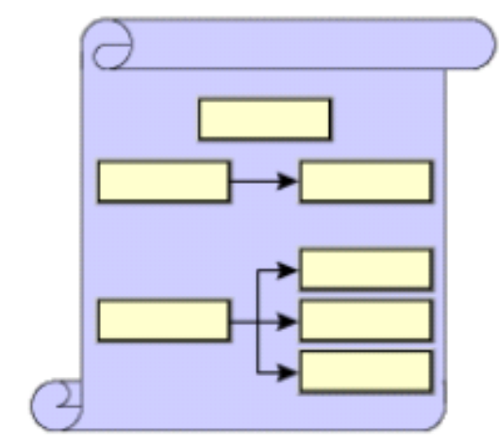
The Art of Architecture
An architect communicates the
design of the system to other
members of the team.
Defining an architecture is a
creative process.
The creative process can have
positive and negative aspects.
Architects try to balance creativity with science in the
form of models, frameworks, and patterns.

Slide 116
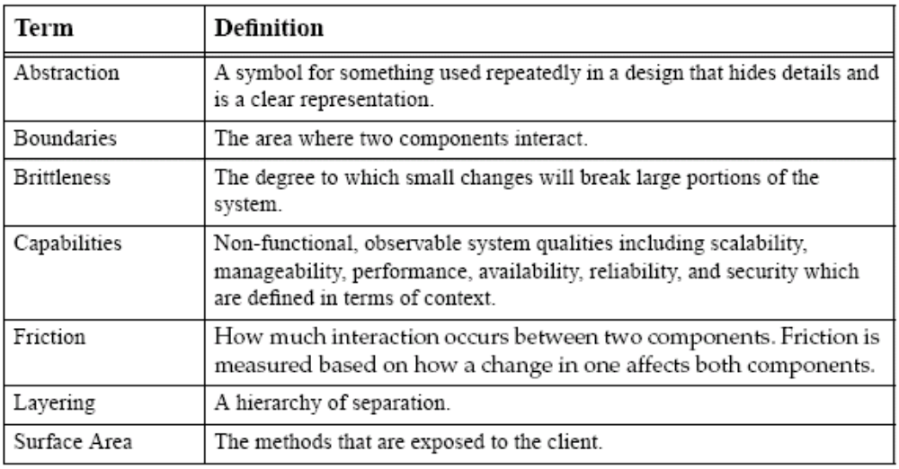
Defining Architecture Terminology

Slide 117
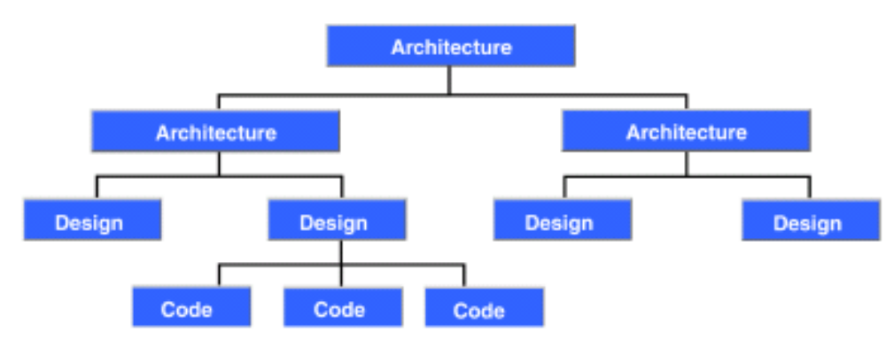
Architecture and Design
Key difference is in the level of details.
Architecture operates at a high level of abstraction.
Design operates at a low level of abstraction.

Slide 118
Architectural Building Blocks
Capabilities and design goals
Process and artifacts
Communication mechanisms
To build an architecture, the architect uses the following:
Architectural fundamentals
Experience:
  Best practices
  Frameworks, patterns, and idioms

Slide 119
Capabilities and Design Goals
Capabilities:
Are non-functional, observable system qualities that affect the long term viability of your architecture.
Depend on the context of your system.
Can be specified, measured, and prioritized.
  Example of specifying reliability — No more than 1 failure per 1000 attempts or 99.9 percent.
Design goals:
Are non-functional, non-observable system qualities designed into a system to achieve the capabilities.

Slide 120
Process and Artifacts
A process consists of an orderly sequence of steps from initiation to delivery to deployment.
The purpose of a process is to:
  Address assumptions
  Minimize the impact of risks
  Identify constraints
Artifacts result from the process.
UML is used to communicate the architecture and design to other members of the team, both present and future.

Slide 121
Communication Mechanisms
HTTP, HTTPS
RMI
IIOP
Messaging
Transactions (ACID)

Slide 122
Architectural Fundamentals
Top-down design approach
Identifying layers, tiers, and services
Establishing service-based architectures
Abstraction

Slide 123
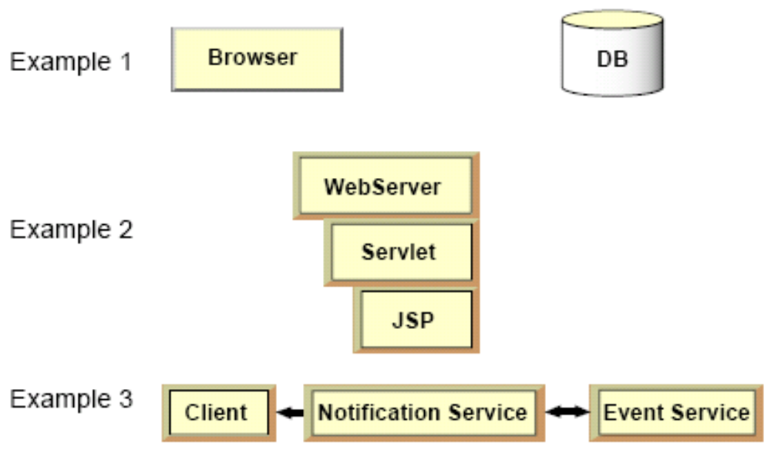
Abstraction
Abstraction refers to creating symbols that hide design details:

Slide 124
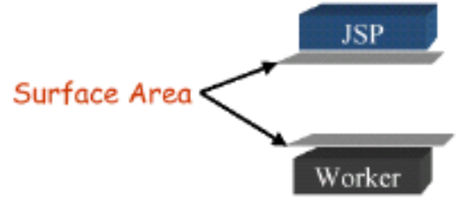
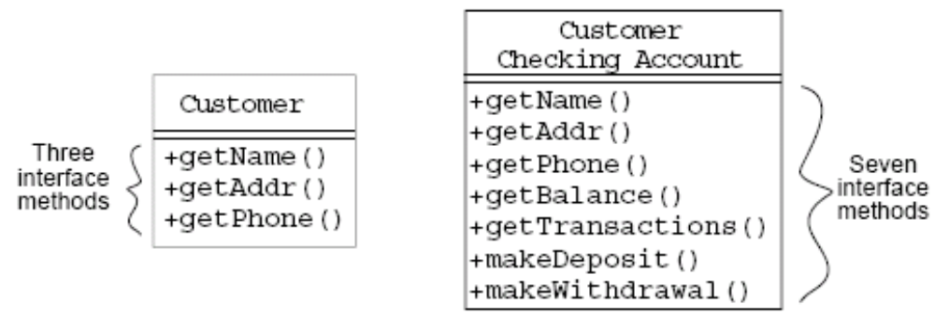
Abstraction – Surface Area
Well-defined modules interact with one another in simple, well-defined ways.
Surface area is the different ways that modules interact.

Slide 125
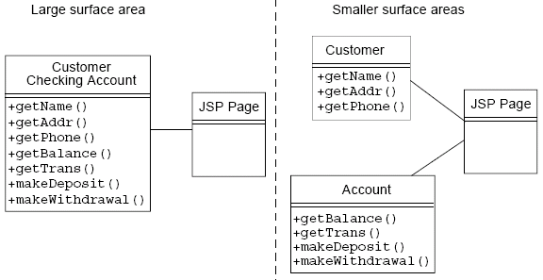
Abstraction – Surface Area
The greater the surface area, the more ways a change in one module can affect another.

Slide 126
Check Your Progress
Define the role of an architect
Define the term “architecture”
Explain architectural terms such as abstraction, boundaries, brittleness, and capabilities
List the differences between “architecture” and “design”
Identify the fundamentals of system architecture
Identify and define key architectural principles
Explain the concept of abstraction, and how it is implemented in system architecture

Slide 127
Think Beyond
The architect has many issues to consider, as discussed in this module.
How absolute are these issues?
Can you think of how they relate to each other?
Can you think of other issues that should be considered?

Slide 128
Conclusion
How do I start
  Become an excellent developer who knows why not just how
  Understand the relationship of underline technical architecture and software systems
  Understand current platform specific architecture
  Know the domain you are working on, become an expert
  Read, read, read, think, think, think

Slide 129
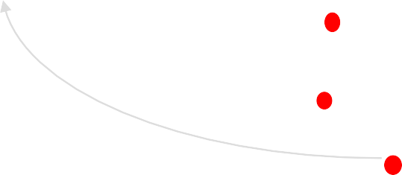
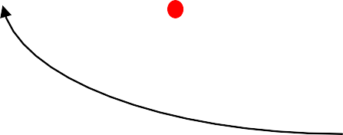
Dimensions of software complexity
Higher technical complexity Embedded, real-time, distributed, fault-tolerant Custom, unprecedented, architecture reengineering High performance
Embedded Automotive Software | Commercial Compiler | Telecom Switch Large-Scale | Defense Weapon System National Air Traf Control System
An average software project
5-10 people
3-9 month duration
3-5 external interfaces
Some unknowns & risks
fic
CASE Tool
Organization/Entity Simulation
Lower management complexity
Small scale
Informal
Single stakeholder
“Products”
Higher management complexity
Large scale
Contractual
Many stake holders
“Projects”
Small Scientific Simulation
IS Application Distributed Objects (Order Entry)
Enterprise IS (Family of IS Applications)
Defense MIS System
IS Application GUI/RDB
(Order Entry)
Business Spreadsheet
Lower technical complexity
Mostly 4GL, or component-based
Application reengineering
Interactive performance

Slide 130
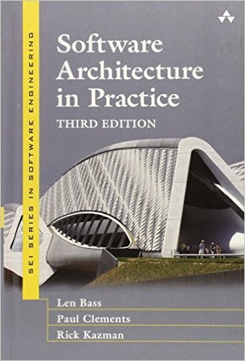
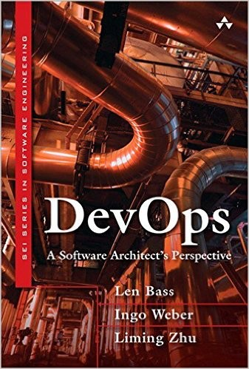





Books

Slide 131
Summary
Software is complex
So are buildings
  And other engineering artifacts
  Building architectures are an attractive source of analogy
Software engineers can learn from other domains
They also need to develop—and have developed—a rich body of their own architectural knowledge and experience

