Slide 1

Software Architecture
SSE USTC Qing Ding
dingqing@ustc.edu.cn
http://staff.ustc.edu.cn/~dingqing

Slide 2

Architectures in Context

Slide 3
Fundamental Understanding
Architecture is a set of principal design decisions about a software system
Three fundamental understandings of software architecture
  Every application has an architecture
  Every application has at least one architect
  Architecture is not a phase of development

Slide 4
Wrong View: Architecture as a Phase
  Treating architecture as a phase denies its foundational role in software development
  More than “high-level design”
  Architecture is also represented, e.g., by object code, source code, …

Slide 5
Context of Software Architecture
Requirements
Design
Implementation
Analysis and Testing
Evolution
Development Process

Slide 6
Requirements Analysis
Traditional SE suggests requirements analysis should remain unsullied by any consideration for a design
However, without reference to existing architectures it becomes difficult to assess practicality, schedules, or costs
  In building architecture we talk about specific rooms…
  …rather than the abstract concept “means for providing shelter”
In engineering new products come from the observation of existing solution and their limitations

Slide 7
New Perspective on Requirements Analysis
Existing designs and architectures provide the solution vocabulary
Our understanding of what works now, and how it works, affects our wants and perceived needs
The insights from our experiences with existing systems
  helps us imagine what might work and
  enables us to assess development time and costs
→ Requirements analysis and consideration of design must be pursued at the same time

Slide 8
Non-Functional Properties (NFP)
NFPs are the result of architectural choices
NFP questions are raised as the result of architectural choices
Specification of NFP might require an architectural framework to even enable their statement
An architectural framework will be required for assessment of whether the properties are achievable

Slide 9
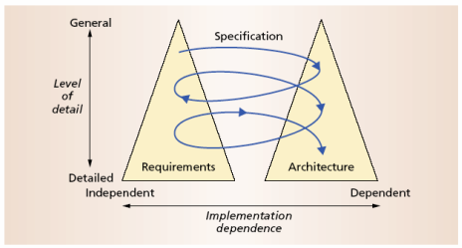
The Twin Peaks Model

Slide 10
Design and Architecture
Design is an activity that pervades software development
It is an activity that creates part of a system’s architecture
Typically in the traditional Design Phase decisions concern
  A system’s structure
  Identification of its primary components
  Their interconnections
Architecture denotes the set of principal design decisions about a system
  That is more than just structure

Slide 11
Architecture-Centric Design
Traditional design phase suggests translating the requirements into algorithms, so a programmer can implement them
Architecture-centric design
  stakeholder issues
  decision about use of COTS component
  overarching style and structure
  package and primary class structure
  deployment issues
  post implementation/deployment issues

Slide 12
Design Techniques
Basic conceptual tools
  Separation of concerns
  Abstraction
  Modularity
Two illustrative widely adapted strategies
  Object-oriented design
  Domain-specific software architectures (DSSA)

Slide 13
Object-Oriented Design (OOD)
Objects
  Main abstraction entity in OOD
  Encapsulations of state with functions for accessing and manipulating that state

Slide 14
Pros and Cons of OOD
Pros
  UML modeling notation
  Design patterns
Cons
  Provides only
    One level of encapsulation (the object)
    One notion of interface
    One type of explicit connector (procedure call)
      Even message passing is realized via procedure calls
  OO programming language might dictate important design decisions
  OOD assumes a shared address space

Slide 15
DSSA
Capturing and characterizing the best solutions and best practices from past projects within a domain
Production of new applications can focus on the points of novel variation
Reuse applicable parts of the architecture and implementation
Applicable for product lines
  →Recall the Philips Koala example discussed in the previous lecture

Slide 16
Implementation
The objective is to create machine-executable source code
  That code should be faithful to the architecture
    Alternatively, it may adapt the architecture
    How much adaptation is allowed?
    Architecturally-relevant vs. -unimportant adaptations
  It must fully develop all outstanding details of the application

Slide 17
Faithful Implementation
All of the structural elements found in the architecture are implemented in the source code
Source code must not utilize major new computational elements that have no corresponding elements in the architecture
Source code must not contain new connections between architectural elements that are not found in the architecture
Is this realistic?
Overly constraining?
What if we deviate from this?

Slide 18
Unfaithful Implementation
The implementation does have an architecture
  It is latent, as opposed to what is documented.
Failure to recognize the distinction between planned and implemented architecture
  robs one of the ability to reason about the application’s architecture in the future
  misleads all stakeholders regarding what they believe they have as opposed to what they really have
  makes any development or evolution strategy that is based on the documented (but inaccurate) architecture doomed to failure

Slide 19
Implementation Strategies
Generative techniques
  e.g. parser generators
Frameworks
  collections of source code with identified places where the engineer must “fill in the blanks”
Middleware
  CORBA, DCOM, RPC, …
Reuse-based techniques
  COTS, open-source, in-house
Writing all code manually

Slide 20
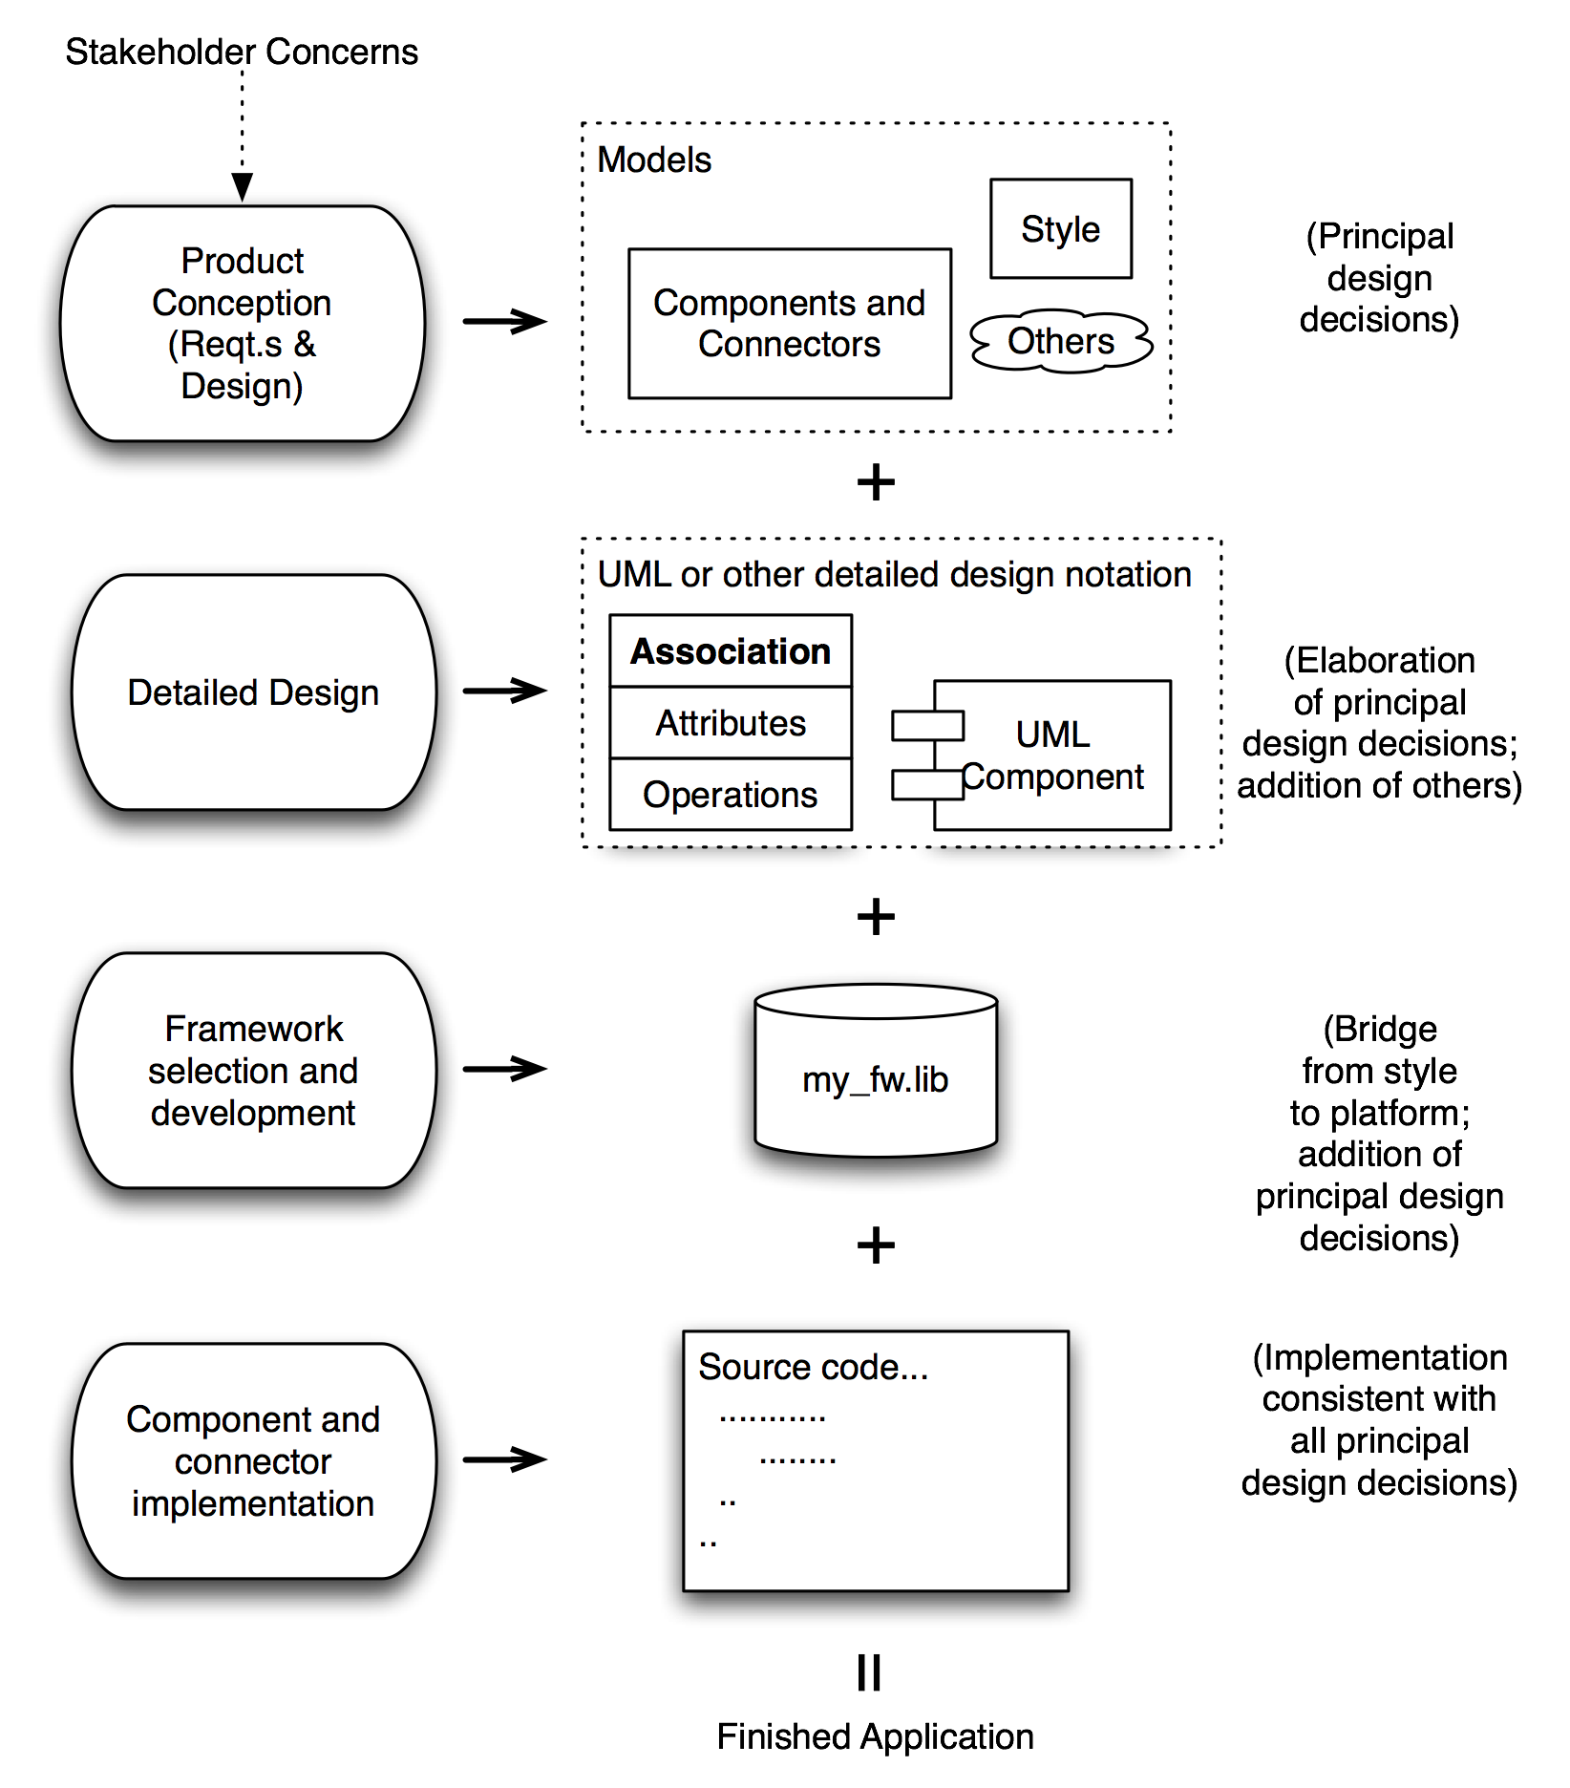
How It All Fits Together

Slide 21
Analysis and Testing
Analysis and testing are activities undertaken to assess the qualities of an artifact
The earlier an error is detected and corrected the lower the aggregate cost
Rigorous representations are required for analysis, so precise questions can be asked and answered

Slide 22
Analysis of Architectural Models
Formal architectural model can be examined for internal consistency and correctness
An analysis on a formal model can reveal
  Component mismatch
  Incomplete specifications
  Undesired communication patterns
  Deadlocks
  Security flaws
It can be used for size and development time estimations

Slide 23
Analysis of Architectural Models (cont’d)
Architectural model
  may be examined for consistency with requirements
  may be used in determining analysis and testing strategies for source code
  may be used to check if an implementation is faithful

Slide 24
Evolution and Maintenance
All activities that chronologically follow the release of an application
Software will evolve
  Regardless of whether one is using an
  architecture-centric development process or not
The traditional software engineering approach to maintenance is largely ad hoc
  Risk of architectural decay and overall quality degradation
Architecture-centric approach
  Sustained focus on an explicit, substantive, modifiable, faithful architectural model

Slide 25
Architecture-Centric Evolution Process
Motivation
Evaluation or assessment
Design and choice of approach
Action
  includes preparation for the next round of adaptation

Slide 26
Processes
Traditional software process discussions make the process activities the focal point
In architecture-centric software engineering the product becomes the focal point
No single “right” software process for architecture-centric software engineering exists

Slide 27
Project Lifecycle Context
We will consider this in more detail later in the course.
We know that whatever lifecycle we use we will need to do the following (and these are all done best by talking about architecture:
  Make a business case for the system
  Understanding requirements that concern quality attributes
  Deciding on architecture
  Documenting architecture
  Analysing and evaluating architecture
  Implementing and testing the system based on architecture
  Ensuring the implementation conforms to the architecture
These take place in all lifecyles but in diﬀerent places

Slide 28
Lifecycle Models
We will consider three models (or classes of models in future lectures):
  The V-model which is a development of waterfall and explicitly includes architectural design as a stage.
  Iterative models as exempliﬁed by Boehm’s spiral model that focusses on project risk management. Here architecture that gives us vision of how development tasks are interrrelated will play a key role as well as ensuring quality requirements are met.
  Agile – here some decisions are more stable than others and the more stable ones concern architectures.

Slide 29
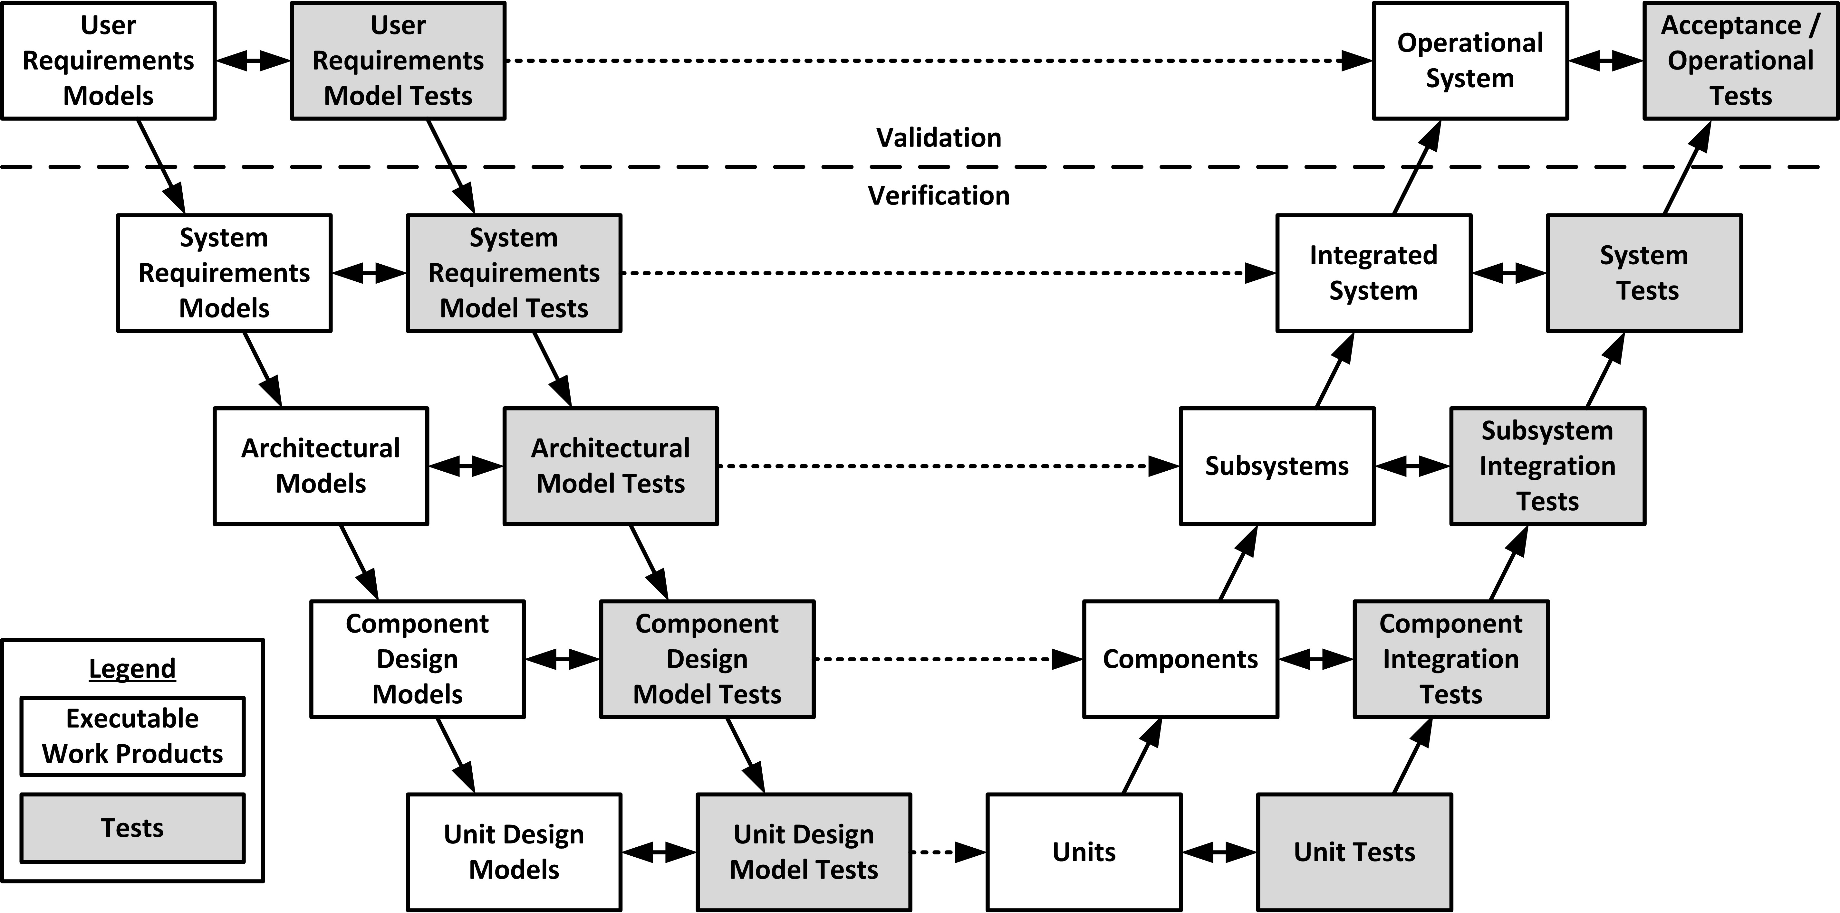
V-model

Slide 30
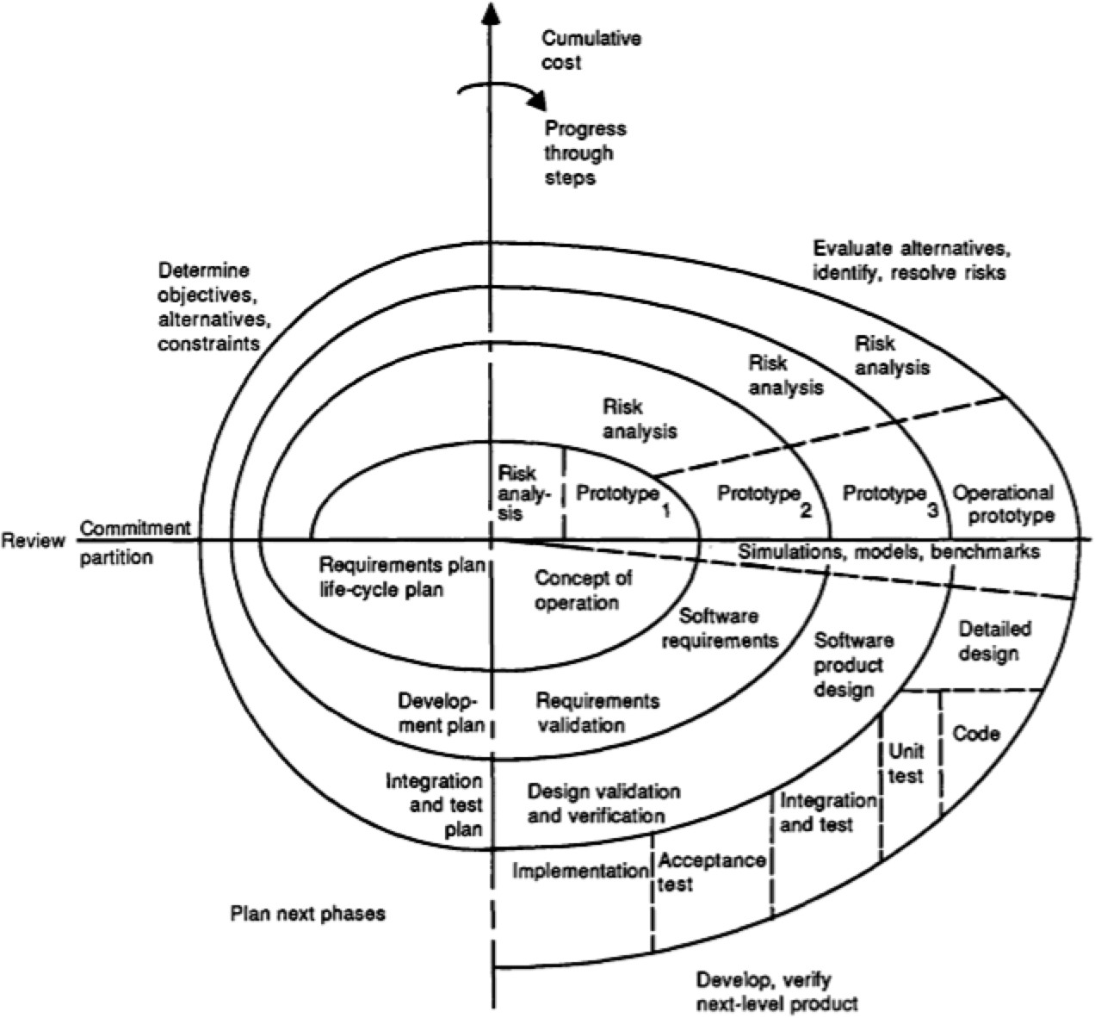
Spiral Model

Slide 31
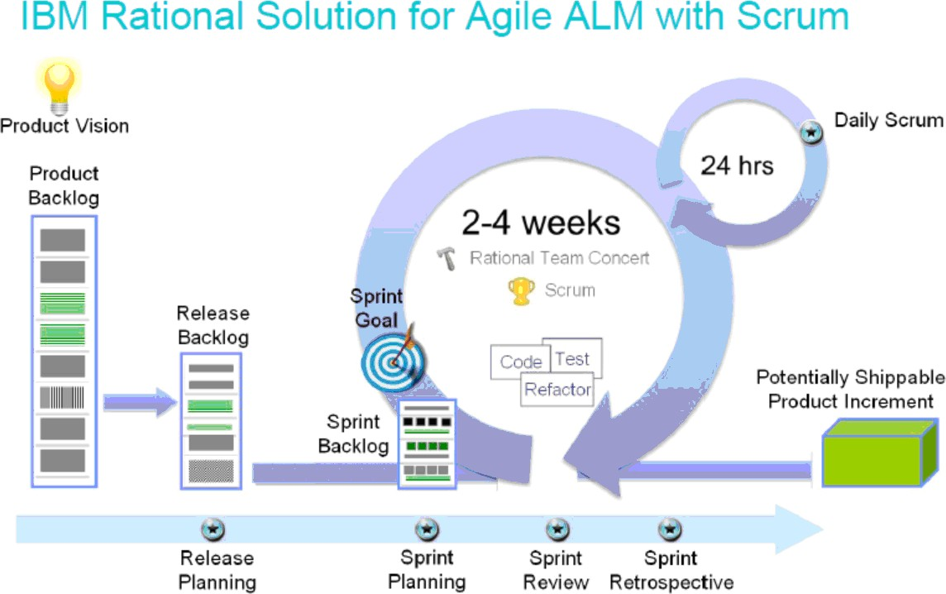
Agile

Slide 32
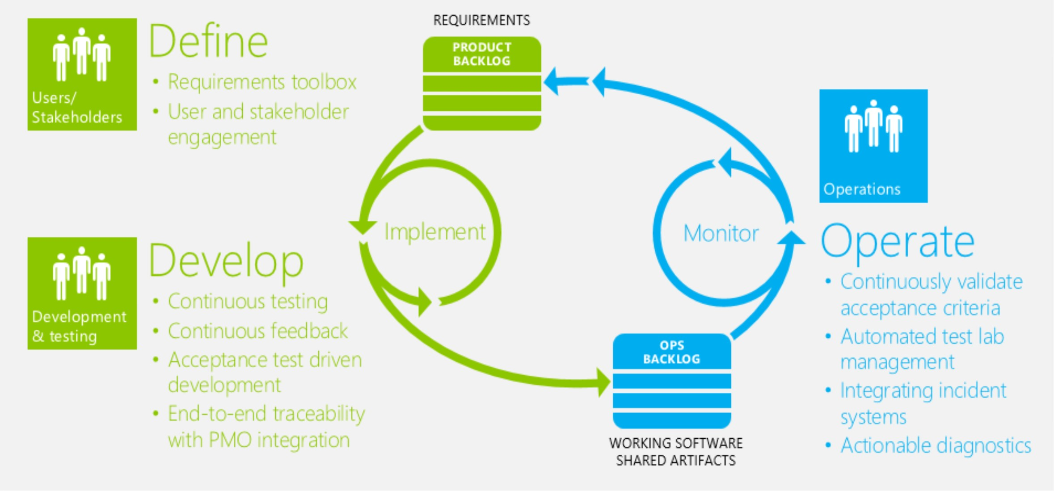
Agile + Devops
hMps://agilepearls.wordpress.com/tag/devops/

Slide 33
Business context
Here we will consider two aspects in later lectures:
  How the organisational structure of stakeholders can drive architectural decisions and shapes decision taking around architecture.
  How architectural expertise drives the structure of development organisations in terms of their functional units and interrelationships.
This is considered in depth in the SEI report: “Rela%ng Business Goals to Architecturally Signiﬁcant Requirements for So:ware Systems”

Slide 34
Professional Context
The architectural perspective gives you as a professional:
  A way of describing your expertise.
  Your skills as an architect will be recognised within organisations you work with.
  You can use architecture as a way of describing your past experience.
  You can specialise in particulr classes of architecture e.g. ﬁnancial architecture.

Slide 35
Managing Attributes
Enables us to manage the key attributes of a system:
  If performance is important we need to manage timing behaviour
  If modiﬁability is important it is important to try to localise functionality so that modiﬁcation is localised to change a function.
  If managing project risk is important it is important to have clear responsibility for delivery of components and good traceability

Slide 36
Managing Change
Allows reasoning about and managing change:
  We can see three levels:
    Inside an element
    Between elements maintaining the architecture
    Requiring architectural change
  These distinctions help in assessing the cost of change
  We can identify likely changes and try to architect to minimize architectural change

Slide 37
Prediction of Attributes
Allows prediction of the key quality attributes
  Should be able to build models on the basis of the architecture that prdict key attributes
  E.g. if we want a system to be scalable:
    the architecture should include:
      capacity information,
      dynamic component creation, and
      dynamic deployment characteristics
    These should be suﬃciently detailed to be able to predict how increases in demand will be serviced

Slide 38
Improves Communication
Allows better communication among stakeholders:
  User has particular requirements in terms of user experience
  Customer needs to know about schedule, budget, meeting regulation in their market
  Project manager needs to know the depndencies in terms of modules and components
These might be accommodated by diﬀerent views of the system that are consistent

Slide 39
Early Design
Carries the earliest (most fundamental) design decisions:
  What are the key quality attributes?
  What architecture gives us control over thses attributes?
  How do we characterise the behaviour of architecture elements?
  E.g. suppose the attribute is that we want to know whether the system is faulty what does this say about architecture?

Slide 40
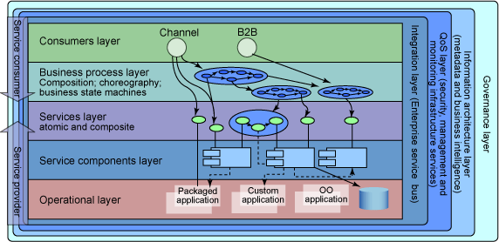
Constraints
Deﬁnes constraints on implementation:
  Architecture speciﬁes the elements and their interaction
  For example, layered architecture usually constrain access to be between adjacent layers

Slide 41
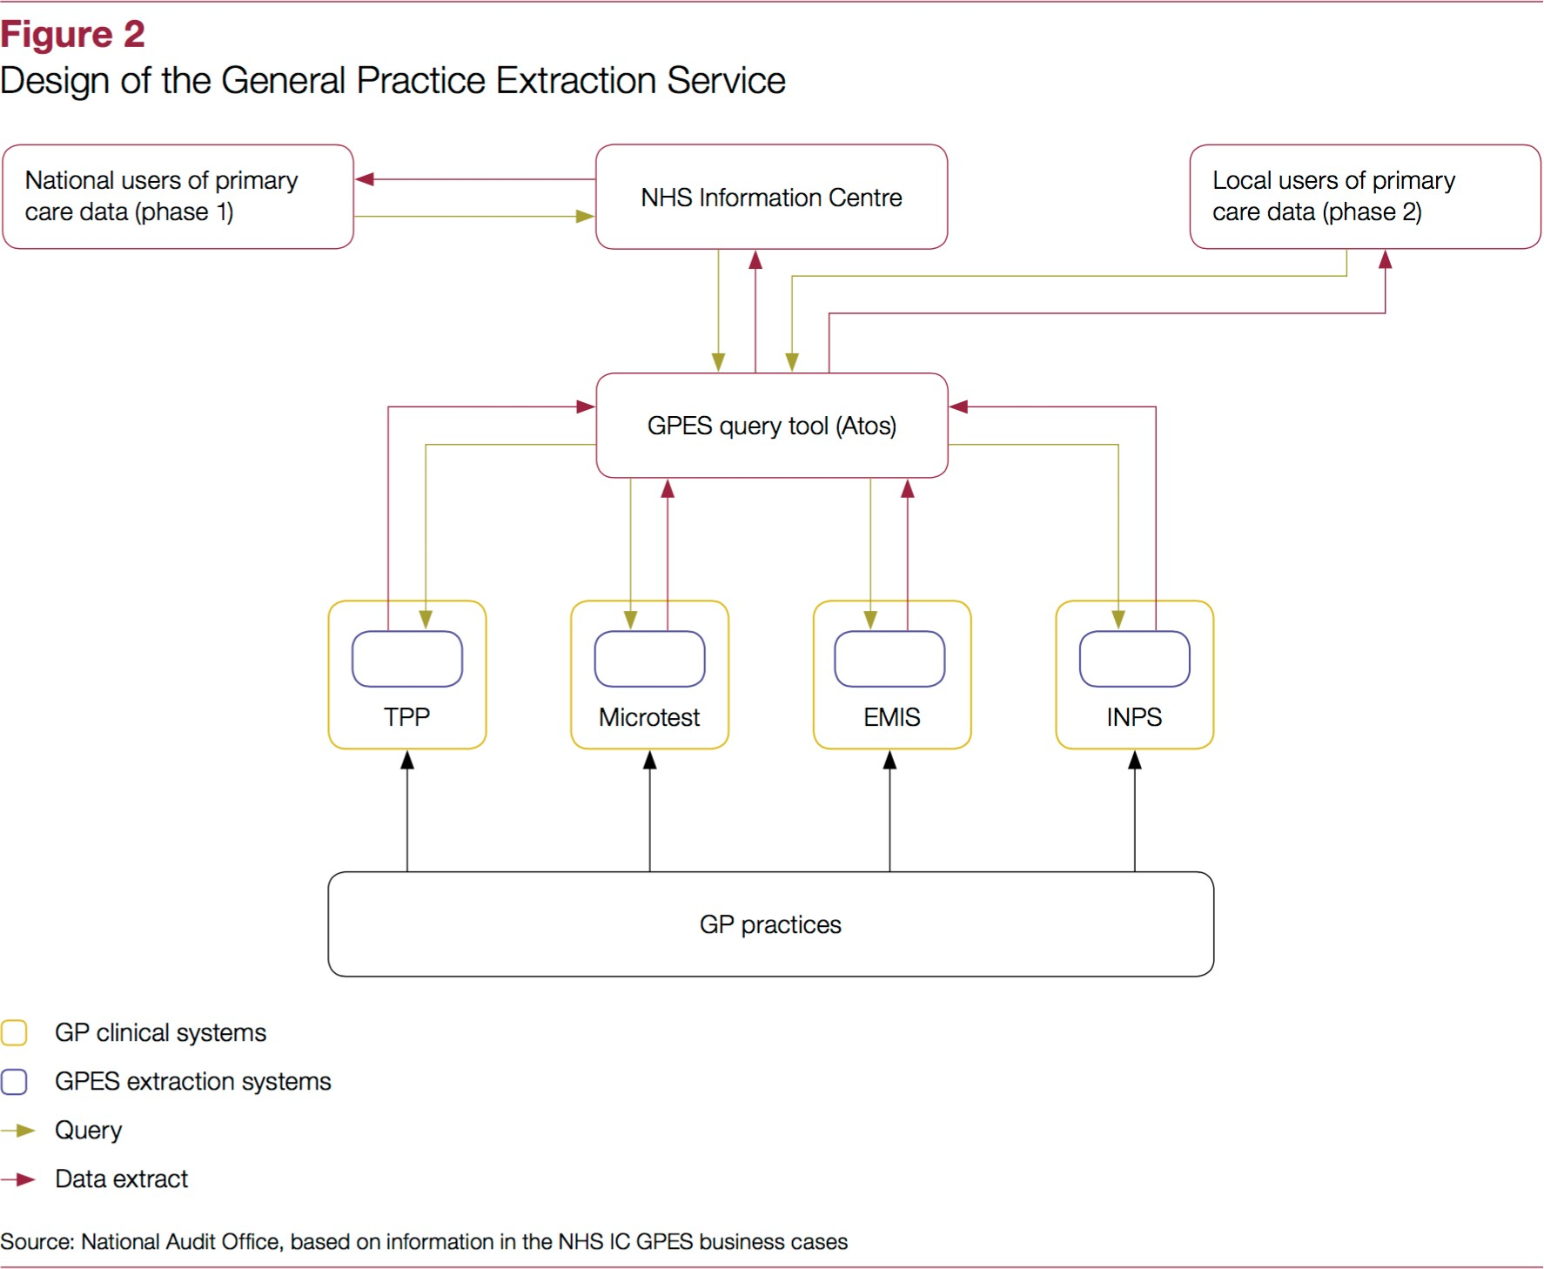
Structure of Organisation
Reﬂects the structure of an organisation:
  Of the development organisation.
  Of the overall organisation
  The work organisation shapes the architecture
  The architecture shapes the work organisation.

Slide 42
Evolutionary Prototyping
Provides the basis for evolutionary prototyping:
  For example:
    Plug and play – early experience of the base functionality + extensibility
    Real time architectures – early experience with scheduling – worst case execution times guide design, and deployment

Slide 43
Cost and Scheduling
Is the key artifact in reasoning about cost and scheduling:
  Capture dependencies
  Estimate required eﬀorts etc
  Allocate eﬀort to elements
  Understand how elements inﬂuence each other
  Use architecture to interpret bottom-up estimates from teams working on elements

Slide 44
Product Line
Can be used as the transferrable, reuseable model at the heart of a product line
  Elements are assets that can copmpose to give new functionality
  Architecture provides the means to compose the elements
  Planned approach to the reuse of architectural elements

Slide 45
Component Level
Focusses on the assembly of components rather than on the creation of the components:
  With well designed elements and architecture we can combine elements from diﬀerent producers provided they conform to interface standards. Brings beneﬁts:
    Decrease time to market
    More reliability
    Lower cost
    Flexibility e.g. using multiple or alternate suppliers for a component.

Slide 46
Channels Development
Restricts design alternatives and channels developer eﬀort in a coordinated way
  Provides a deﬁned context for the developer
  Well deﬁned interfaces and clear ide of the functionality and the quality attributes required
  Clarity on what is an architectural decision and what is a development decision (e.g if fault tolerance is important we don’t want to do that inside a module) we should use architecture.

Slide 47
Training Resource
Provides the basis for training new team members:
  Multiple views provide diﬀerent stakeholder perspectives
  Records interactions between elements
  Abstracts from detail to provide an overview

Slide 48
Contexts Shape Design
The technical context identiﬁes features we want to control and packages a range of other properties.
Standard architecture (parterns, domain speciﬁc architectures etc.) package these.
The other context we consider also help to shape the choice of architecture.
Design uses pre-decided structures and then alters and extends structure as necessary.

Slide 49
Summary (1)
A proper view of software architecture affects every aspect of the classical software engineering activities
The requirements activity is a co-equal partner with design activities
The design activity is enriched by techniques that exploit knowledge gained in previous product developments
The implementation activity
  is centered on creating a faithful implementation of the architecture
  utilizes a variety of techniques to achieve this in a cost-effective manner

Slide 50
Summary (2)
Analysis and testing activities can be focused on and guided by the architecture
Evolution activities revolve around the product’s architecture.
An equal focus on process and product results from a proper understanding of the role of software architecture

