Slide 1

Software Architecture
SSE USTC Qing Ding
dingqing@ustc.edu.cn
http://staff.ustc.edu.cn/~dingqing

Slide 2

Conceptual Architecture

Slide 3
Outline
Definition
Designing Conceptual Architecture
Behaviour Model
Component Stereotypes
Design Guidelines

Slide 4
Simplified Workflow
Exemplary, simplified step-by-step guide to start the conceptual architecture
Identify actors with the systems (e.g. external system, users) Identify data flow
Identify functional requirements
Identify non functional requirements
Prioritise requirements
Define use-cases
Define data items
1
2
3
4
5
6
7

Slide 5
Model abstraction and granularity level
Models can be created at varying levels of abstraction and details E.g., an object-oriented model of a car
At the lowest detail level: car has engine, wheels, brakes, etc.
At the highest detail level: car objects with variables, interacting with other objects
OO programming model abstracts assembly, operating system, hardware, ...

Slide 6
Definition
A software architecture is a collection of models of a software system at various abstraction and detail levels. The models describe:
the system as a whole system components component connections
how component interact to fulfill the system purpose.

Slide 7
Analysis
The results of the requirements analysis:
Functional requirements
Non-functional requirements
Runtime qualities
Non-runtime qualities
Contextual requirements
1
2
3

Slide 8
Design
Design is the process of creating models (recollect the definition of SA) Two basic types of architectural models
Structure and behaviour
Architectural structure is a static model of a system (i.e. how the system is divided into components)
Architectural behaviour is a dynamic model of a system (i.e. how the components interact with each other to perform some useful work)

Slide 9
Architectural views
We can examine a system from different points of view Different kinds of views
Conceptual: components are set of responsibilities and connectors are flow of information
Execution: components are execution units (processes) and connectors are messages between processes
Implementation: components are libraries, source code, files, etc and connectors are protocols, api calls, etc.

Slide 10
Definition
What is conceptual architecture?

Slide 11
Conceptual Architecture
Focuses on domain-level responsibilities
Initial architectural design
First response to stakeholder needs Design by analysing requirements
Contains components and connectors (box-and-line)
→ Provides an at a glance overview of the structure of a system in terms of its functionality

Slide 12
Components in conceptual architecture
Set of related domain-level responsibilities
Initially, responsibilities arise from functional requirements
However, design is an iterative process
Further iterations take into account non-functional requirements

Slide 13
Connectors in conceptual architecture
Connectors indicate that connected components exchange information
Arrows indicate information flow
Labels describe kind of information
In some cases two-directional connectors: labels should be put near arrows
Conceptual components often have no direct counterpart in the final software
... no need to care about physical location

Slide 14
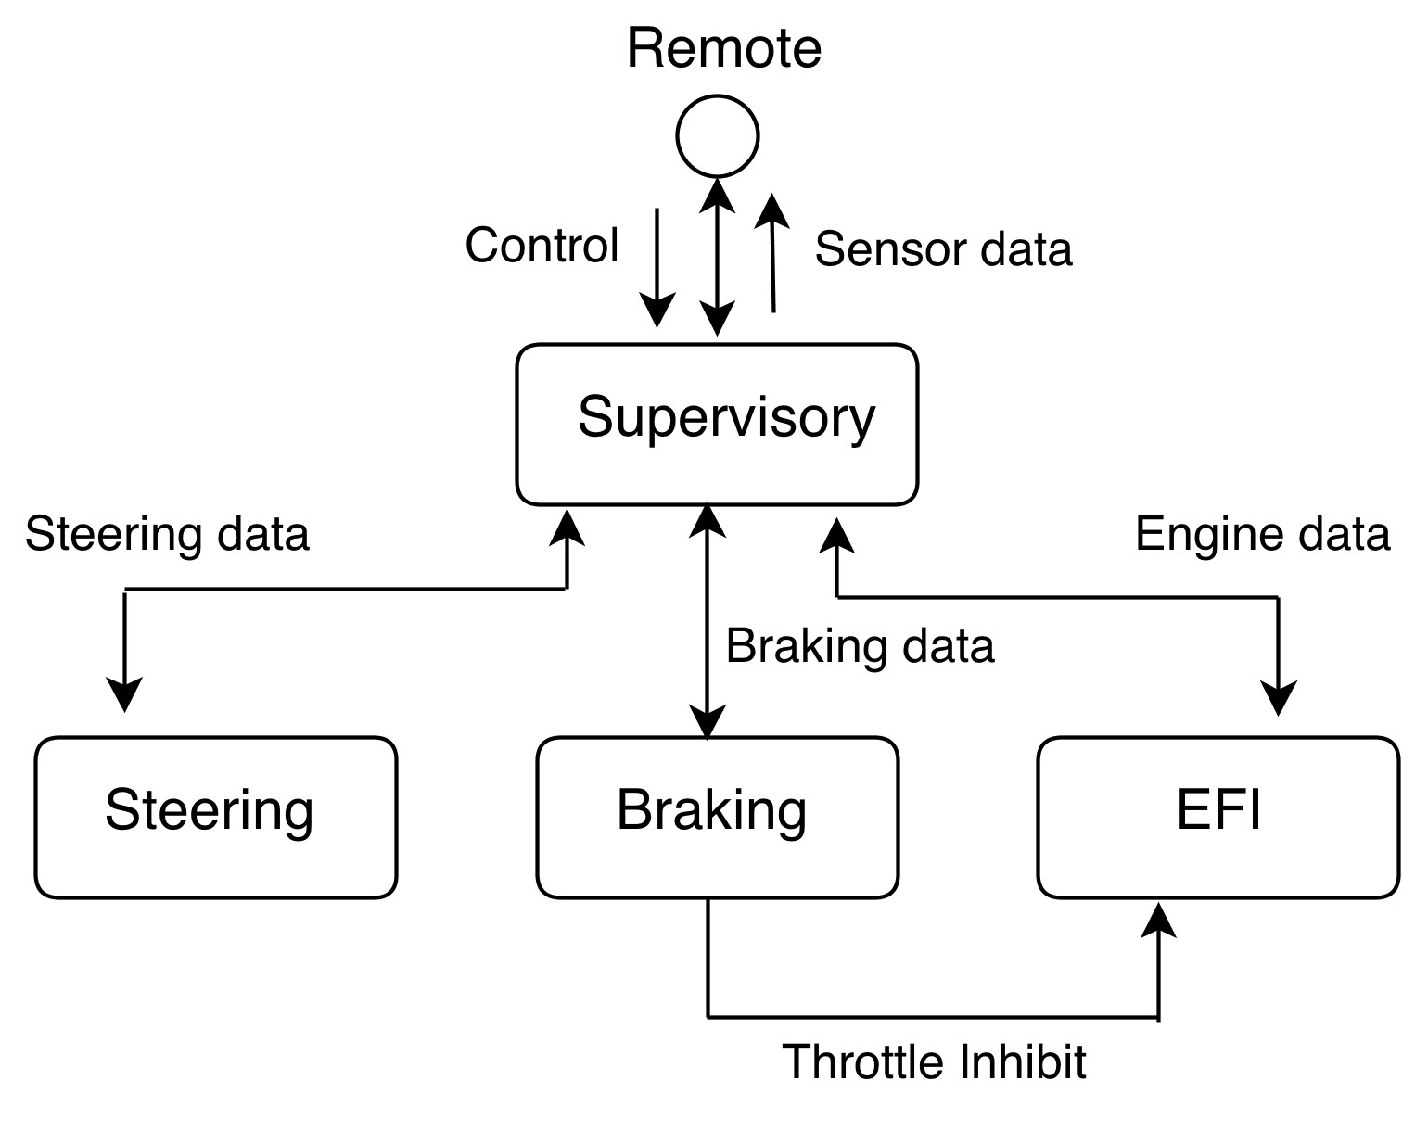
Simple example
Figure: Model-car control system from Software Architecture Primer

Slide 15
Simple example
Supervisory
▶ Receive commands and decode them
▶ Send command data to real-time components
▶ Send selected data to remote interface
Braking
▶ Apply braking force in percentage amount
▶ Generate throttle inhibit signal
Steering
▶ Set steering gear to selected angle
EFI
▶ Control spark and injection timing
▶ Control amount of fuel injected

Slide 16
Designing Conceptual Architecture
How to approach conceptual architecture design?

Slide 17
Design process
Create the initial conceptual architecture from requirements
Elaborate focusing on functionality
Elaborate focusing on quality attributes (non-functional requirements, contextual requirements)
Iterate over 2 and 3
1
2
3
4

Slide 18
Design process
Initial steps
Identify key concepts
▶ Within requirements
▶ Within narratives
Assign key concepts to categories
▶ Data, Function, Stakeholder, System, Abstract Concept

Slide 19
The first step
Underline the key concepts in the requirements (ask yourself does this concept relates to the functionality?)
Copy key concepts onto a sheet of paper (consider each one to see if it is a viable component)
Draw the components and add connectors (add arrows and labels)

Slide 20
Example Application - Functional requirements
UR1: The system is a navigation tool. The system can calculate the following optimal routes.
▶ UR1.1: Shortest path
▶ UR1.2: Fastest route
▶ UR1.3: Most economical (lowest CO2 emissions)
▶ UR1.4: Cheapest
▶ UR1.5: Pleasant
⋆ UR1.5.1: Quietest
⋆ UR1.5.2: Most sightseeing spots
⋆ UR1.5.3: Along rivers and through parks

Slide 21
Example Application - Functional requirements
UR2: The places are stored in a database
UR3: The connections between the places are stored in the database
UR4: The connections need to contain the transportation mode and provider
UR5: The administrator can add/remove new places and connections
UR6: The user can search for places

Slide 22
Example Application - Functional requirements
UR7: The system needs to interact with external services
▶ UR7.1: The system needs to buy tickets for the tramway
UR8: The system needs to draw the route on a interactive map
UR9: The system needs to provide user management
▶ UR9.1: Register new users
▶ UR9.2: Log-in / Log-out
▶ UR9.3: Store user preferences
▶ UR9.4: Store credentials for purchase
...

Slide 23
The second step
Assign every possible concept from the requirements to a category:
Data: information that is stored, processed, etc. → Not directly a component but you might need components for data management
Function: Something done by something → typically components
Stakeholder: users, organizations → never components

Slide 24
The second step
Assign every possible concept in a system narrative to a category:
System: external systems → sometimes you need an interface component
Hardware → physical components
Abstract concept: explanation of something → rarely components With the goal to identify all components...

Slide 25
Key Concepts
navigation tool

Slide 26
Key Concepts
navigation tool Abstract concept
calculate

Slide 27
Key Concepts
navigation tool Abstract concept calculate Function
optimal route

Slide 28
Key Concepts
navigation tool Abstract concept calculate Function
optimal route Abstract concept shortest path

Slide 29
Key Concepts
navigation tool Abstract concept calculate Function
optimal route Abstract concept shortest path Abstract concept fastest route

Slide 30
Key Concepts
navigation tool Abstract concept calculate Function
optimal route Abstract concept shortest path Abstract concept fastest route Abstract concept most economical

Slide 31
Key Concepts
navigation tool Abstract concept calculate Function
optimal route Abstract concept shortest path Abstract concept fastest route Abstract concept
most economical Abstract concept
cheapest

Slide 32
Key Concepts
navigation tool Abstract concept calculate Function
optimal route Abstract concept shortest path Abstract concept fastest route Abstract concept
most economical Abstract concept cheapest Abstract concept pleasant

Slide 33
Key Concepts
navigation tool Abstract concept calculate Function
optimal route Abstract concept shortest path Abstract concept fastest route Abstract concept
most economical Abstract concept cheapest Abstract concept pleasant Abstract concept

Slide 34
Key Concepts
places Data
database Data
connections Data
transportation mode Data administrator Stakeholder add/remove (places) Function user Stakeholder
search Function

Slide 35
Key Concepts
external services System
buy (ticket) Function
ticket Data
tramway Data
draw Function
route Data
interactive map Abstract concept
user management Function
register Function
users Data
log-in / log-out Function
user preference Data
credentials Data
purchase Function

Slide 36
Categorisation
Data | Function | Stakeholder | System | Abs.concept
places | calculate | administrator | external services | navigation tool
database | add/remove (places) | user |  | optimal route
connections | search |  |  | shortest path
transp. mode | buy (ticket) |  |  | fastest route
tramway | draw |  |  | most economical
route | user management |  |  | cheapest
users | register |  |  | pleasant
user preference | log-in / log-out |  |  | interactive map
credentials | purchase
ticket | download
 | register
 | log in

Slide 37
Conceptual Architecture: Best Practice
Start with stakeholders and external systems
Think about the data, data exchange and data storage
Think about active components, that trigger events
Combine the functions into groups of related functionality
Optionally, use narratives as guide how to group the components
→ draw a first iteration
Validate the first iteration

Slide 38
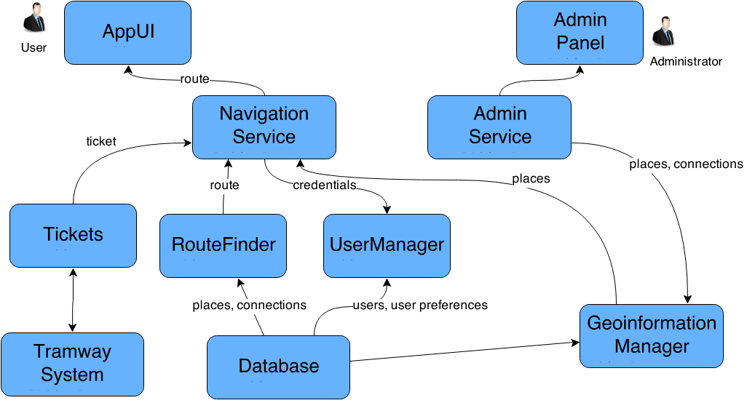
Conceptual Architecture: Iteration 1

Slide 39
Component responsibilities
AppUI
▶ ShowPlaces
▶ DisplayMap
▶ DrawRoute
▶ DisplayTicket
AdminPanel
▶ ListPlaces
▶ ListConnections
NavigationService
▶ StartCalculation
▶ BuyTicket
▶ RouteComputed
▶ TicketPurchased
AdminService
▶ AddPlace
▶ RemovePlace

Slide 40
Component responsibilities
RouteFinder
▶ ComputeRoute
Tickets
▶ ListPrices
▶ StartPurchase
UserManager
▶ RegisterUser
▶ LoginUser
▶ GetSeasonalTickets
GeoinformationManager
▶ AddPlace
▶ RemovePlace
▶ SearchPlace

Slide 41
Iterations
Iterate over functional and non-functional requirements:
Functional seems to be OK
Non-functional: performance as a quality attribute
→ Factor out the search functionality (e.g. search for places, ...) Also, design for change
→ Abstract external systems through interface (e.g. new public transportation system)

Slide 42
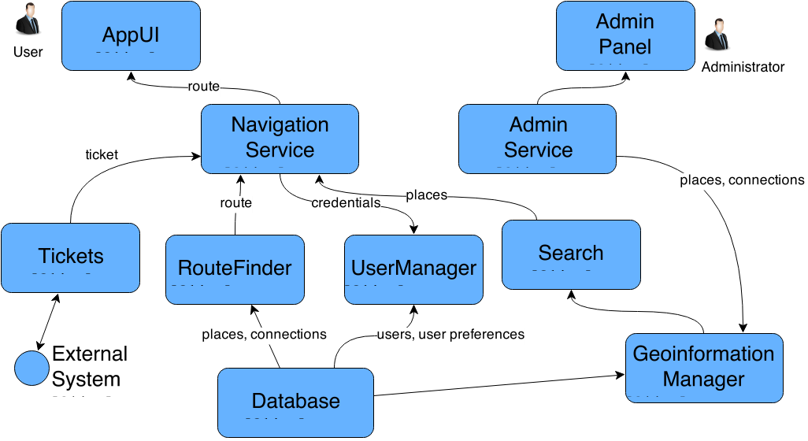
Conceptual Architecture: Iteration 2

Slide 43
Component responsibilities
Search
▶ SearchPlaces
PublicTransportAPI
▶ ListPrices
▶ BuyTicket

Slide 44
Behaviour Model
The dynamic aspect of conceptual architecture?

Slide 45
Behavioural exploration
Until now only structural architecture
We need to take into account behaviour of the system
Typically accomplished through usage narratives
We can take two/three usage scenarios and draw use-case maps

Slide 46
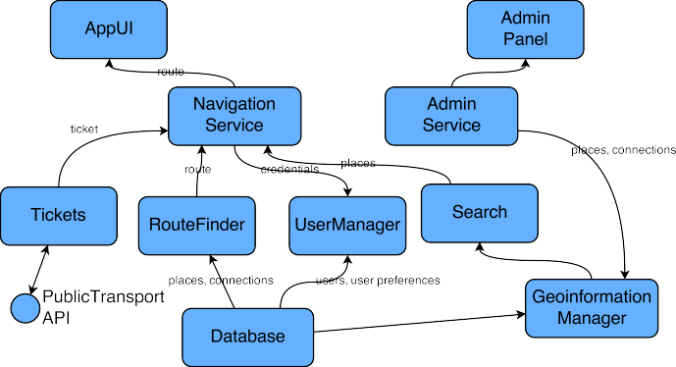
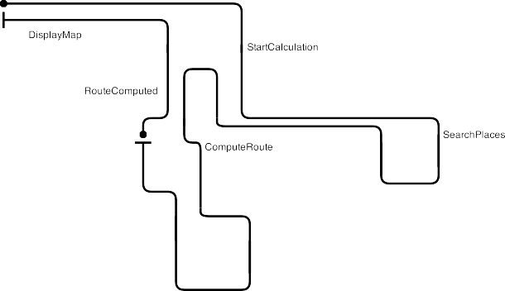
Behavioural exploration

Slide 47

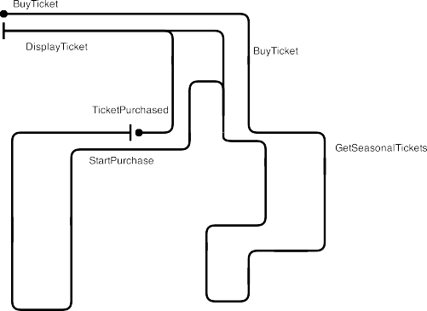
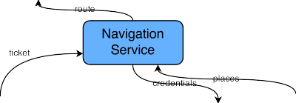
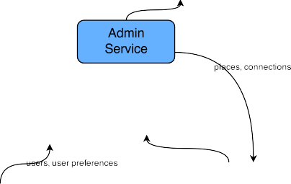





Behavioural exploration

Slide 48
Component Stereotypes
Types of components and connectors in conceptual architecture

Slide 49
Component stereotypes
Adding semantics to components through stereotypes Tagging components to indicate certain properties Presentation component: interactions with users
Persistent storage: persistent data or data from external systems Real-time components: components that handle requests “quickly”

Slide 50
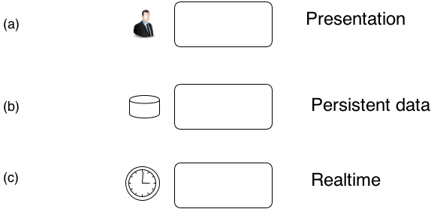
Component stereotypes
Figure: Source: Software Architecture Primer

Slide 51


Component stereotypes

Slide 52
Data Models
Data models capture the nature of information in the domain
If data exchanged between components is complex we might need to create data models
In our case: datasets and calculations
In both cases we need to define a format, e.g. UML

Slide 53
Script of Conceptual Architecture
Steps of developing the conceptual architecture
1
Clarify components & responsibilities
▶ → e.g. by use of use-case maps
Clarify connectors
▶ → e.g. by labelling information flow
Evaluate behaviour (against expected scenarios) Identify stereotypes & structures
Define the data structure & models Simplify architecture
2
3
4
5
6

Slide 54
Design Guidelines
Practical aspects of conceptual architecture?

Slide 55
Conceptual arch. design rules
Guidelines for defining components
Granularity Cohesion Coupling

Slide 56
Conceptual arch. design rules
Granularity of components
Amount of functionality assigned to a single component
Depends on the context of the component

Slide 57
Conceptual arch. design rules
Avoid blobs: components that have too much responsibilities
Recognized by: one component has all the responsibility, others have single responsibilities
Reason 1: too much details in responsibilities
Reason 2: too lazy too divide responsibilities
Put more effort in dividing responsibilities

Slide 58
Conceptual arch. design rules
Avoid command clusters: a couple of components all with a single responsibility but all interconnected
Recognized by: too many connectors between a set of components
Reason: responsibilities are in fact related
Combine components into a single component

Slide 59
Cohesion
Cohesion: how well are the responsibilities of a component related to each other
If the relationship is high, then the cohesion is high as well
High cohesion is considered to be good, as it makes the architecture easier to understand
Will help to maintain the system
Will help to design components that will be reused

Slide 60
Coupling
Coupling: degree to which software components depend on each other
The degree is influenced on a couple of aspects (more than in OO languages)
E.g. how generic is the protocol?

Slide 61
Degree of Coupling
Loose coupling vs. tight coupling
These are the both extremes
In existing systems this is often a continuum
Components might be tightly in one aspect and loosely coupled in another

Slide 62
Aspects of Coupling
Level
Loose Coupling
Tight Coupling
Physical coupling
Physic intermediary
Direct physical link re- quired
Synchronous
Communication style
Type system
Asynchronous
Data-centric, contained messages
self-
OO-Style, object trees Central control
complex
Control of process logic
Platform depen- dencies
Distributed logic compo- nents
OS- and programming language independent
Strong OS and pro- gramming language dependencies
Source: Enterprise SOA

Slide 63
Consequences of Tight Coupling
If one software component changes, the other (dependant) components need to be changed as well
API/protocol specific to the needed requirements Often enforced by cross-cutting concerns
Typically it is easier (less effort) to create tightly coupled components

Slide 64
Consequences of Loose Coupling
Components can be easily exchanged
Components will be better suited to be reused
Components are required to be more generic
E.g. use standard protocols instead of custom ones
Will typically require more effort and better design/planning

Slide 65
Type of Coupling in Regard to Quality Attributes
Coupling has an impact on quality attributes
Loose coupling will typically improve maintainability, evolvability, reusability
Tight coupling will typically improve the achievable performance (and traceability)
For some attributes it is not clear, e.g. testability
⇒ Therefore slight preference to loose coupling

Slide 66
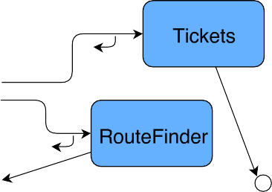
Examples of Coupling

Slide 67
Examples of Coupling
Tight coupling between Service and the RouteFinder
Due to callback (both need to know each other, there might even be a temporal coupling here)
Loose coupling between Tickets and External System
The external system does not need to know the Ticket component
The external system might use a standard protocol
⇒ Easy to exchange the external system

