Slide 1

Software Architecture
SSE USTC Qing Ding
dingqing@ustc.edu.cn
http://staff.ustc.edu.cn/~dingqing

Slide 2

Execution Architecture

Slide 3
Outline
Definition
Design
Stereotypes
Detailed Design
Connecting conceptual and execution views
Behaviour
Execution on the Web

Slide 4
Definition
What is execution architecture?

Slide 5
Execution View
Focuses on the system runtime structure
Hardware elements, subsystems, processes and threads
Suited for examining quality attributes, most-notably runtime attributes
E.g. performance, security, usability, ...
But also e.g. scalability
Similarly to conceptual architecture comprised of components and connectors

Slide 6
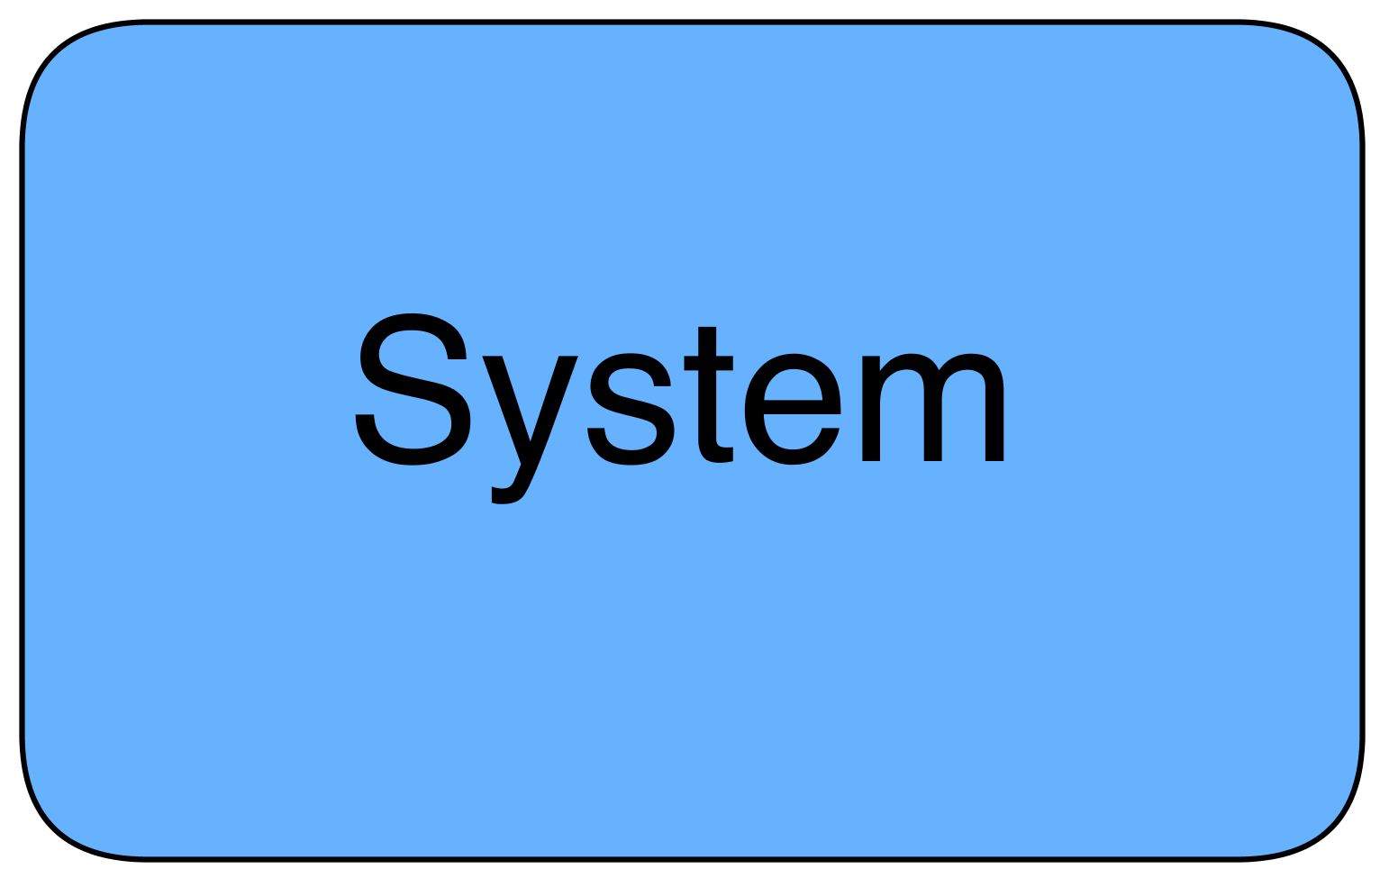
Components in execution architecture
Concurrent components (abstraction created by execution of a software program)
If the system is a single-computer, single-process, single-thread system then the execution architecture is very simple
Figure: The simplest execution architecture

Slide 7
Components in execution architecture
Thus, execution architecture is needed for distributed, concurrent systems
Nowadays, huge majority of systems comes into this category
E.g. network-based systems
E.g. multi-processor systems (multi-core), sometimes abstraction through OS
E.g. multi-threaded systems - GUI systems belong here as well (event-thread)

Slide 8
Components in execution architecture
Hardware - only boundaries
Concurrent subsystems - e.g. a database system
Processes - an OS process, runs on a single computer and has its own memory space
Threads - an OS (or Java) thread - executes concurrently with other threads within the memory space of a parent process
Typically, we have different execution models depending on granularity

Slide 9
Connectors in execution architecture
Connectors indicate that one component calls another
The arrow depicts the call direction
The arrow head points from the calling component to the called component
Three different types of arrows for three different calling scenarios

Slide 10
Connectors in execution architecture
Synchronous communication: the calling components waits for a response of the called component
Asynchronous communication: the calling component does not wait for a response
Callback: The calling component receives a response asynchronously by setting a means by which the called component can send response later

Slide 11
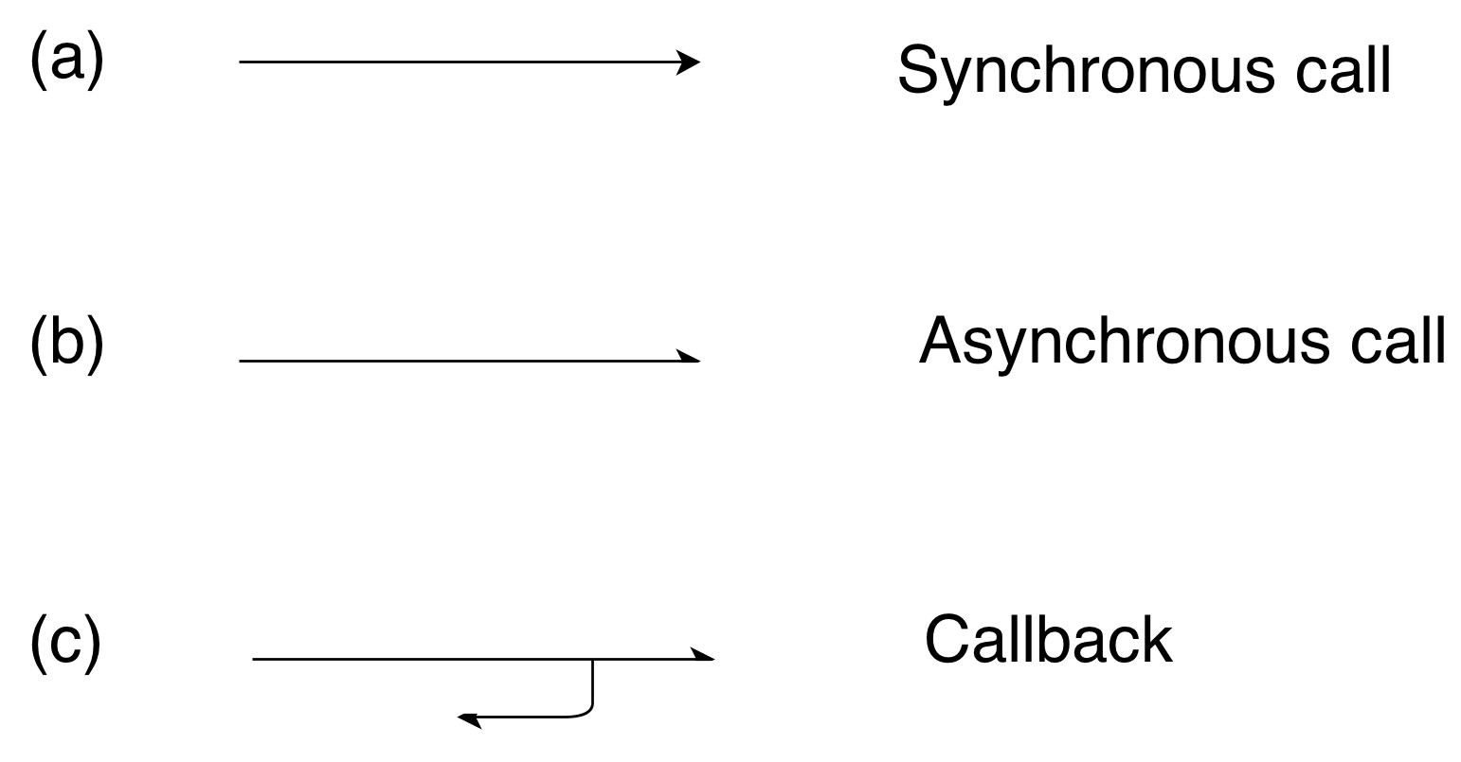
Connectors in execution architecture
Figure: Execution connectors from Software Architecture Primer

Slide 12
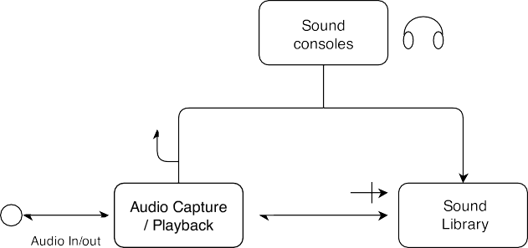
Execution architecture: Example
Figure: Example of execution architecture from Software Architecture Primer

Slide 13
Conceptual vs. Execution arch.
Element | Conceptual | Execution
Components | Domain-level responsibilities | Unit of concurrent activity
Connectors | Information flow | Invocation
Views | Single | Multiple

Slide 14
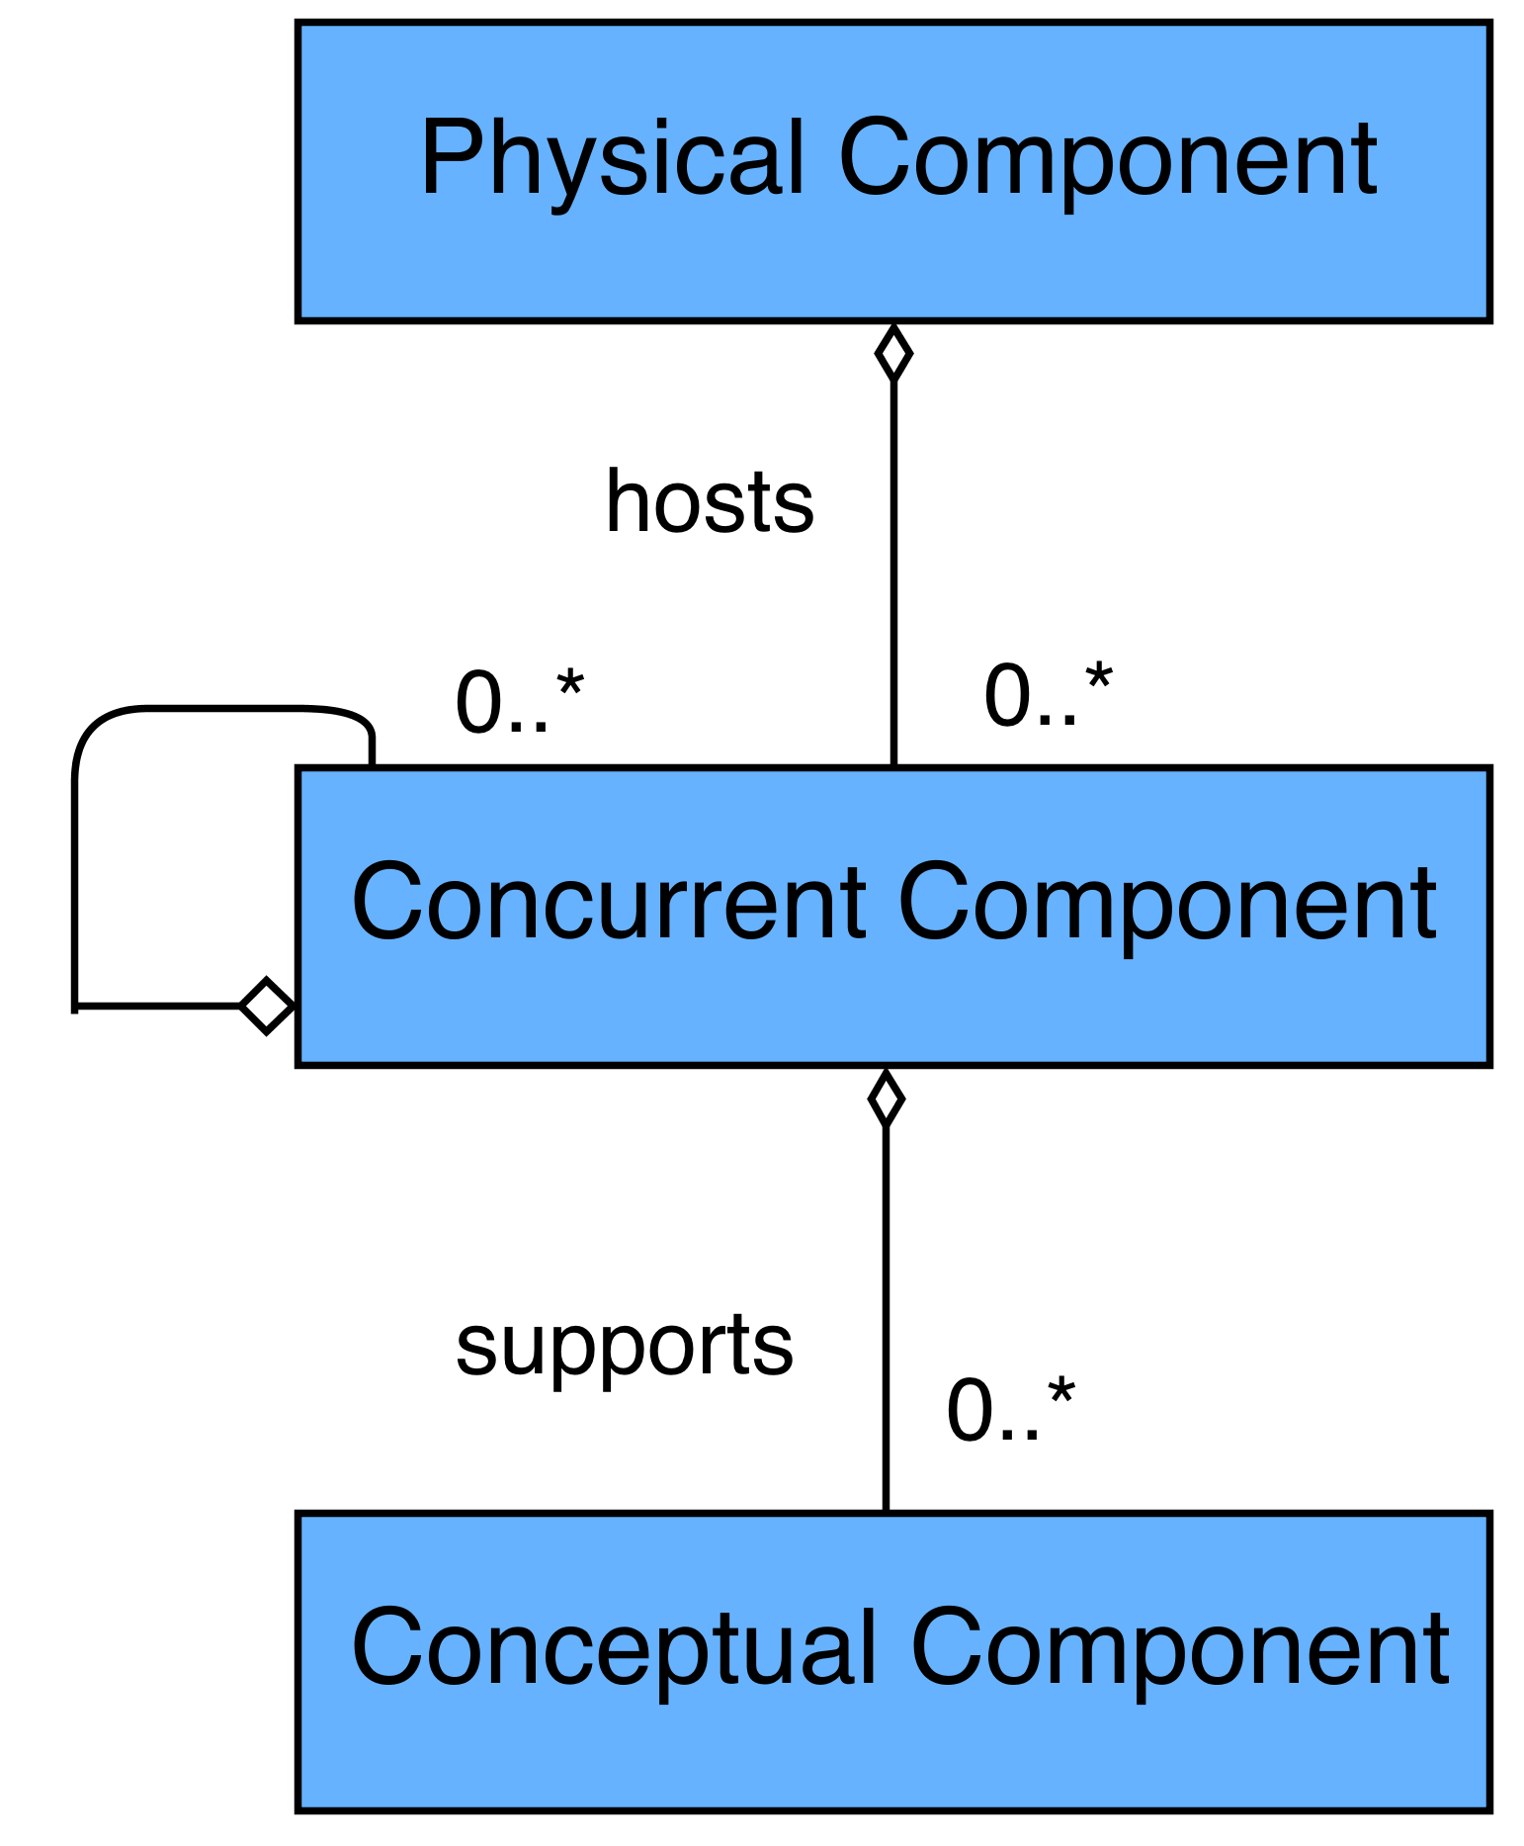
Conceptual vs. Execution arch.
Figure: Conceptual vs. execution from Software Architecture Primer

Slide 15
Design
How to create the execution architecture?

Slide 16
Execution Architecture Design
Here we design a number of different models
Some of them will include physical components, i.e. hardware
Each model is a model at a specific level of granularity
Less details: concurrent subsystems, processes
More details: threads

Slide 17
Concurrent subsystems model
Top-level execution model
To get an overview of the running system
Subsystems can be quite complex and have many processes and/or threads
However, a concurrent subsystem is not something that is clearly defined
In some cases it is clear

Slide 18
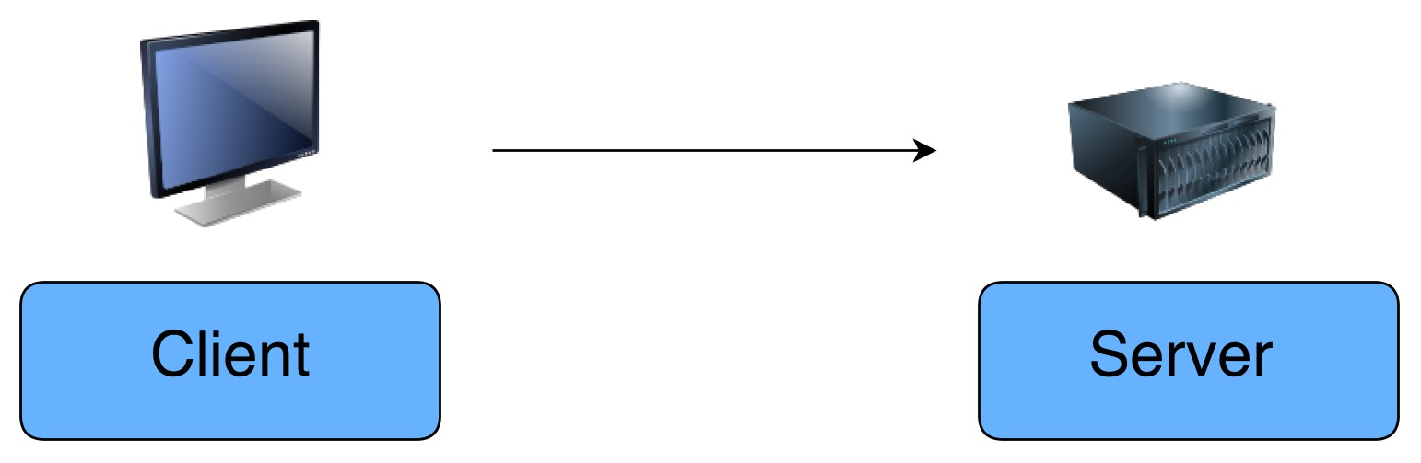
Concurrent subsystems model
Figure: Client-server execution architecture: subsystems

Slide 19
Concurrent subsystems model
A large number of similar processes should be treated as a single unit
E.g. the indexing system of a search engine
A lot of processes there but logically they belong to the same unit
Crawler, parsers, analysers, index updating, ...

Slide 20
Concurrent subsystems model
A process that has a high degree of internal concurrency (threads) should be treated as a concurrent subsystem
E.g. a server is typically a single process but might create threads to handle client requests
Existing systems are best treated as concurrent subsystems
E.g. a file server

Slide 21
Concurrent subsystems model
A concurrent subsystem is always long-lived
Created when the systems is started
Closed when the system is shutdown
Operates throughout the system lifetime

Slide 22
Process model
Restricting a concurrency model to processes depicts the execution structure
Basically, you examine each concurrent subsystem for processes
You do not go into details on external systems
Typically, such models will be only slightly more detailed than concurrent subsystem models

Slide 23
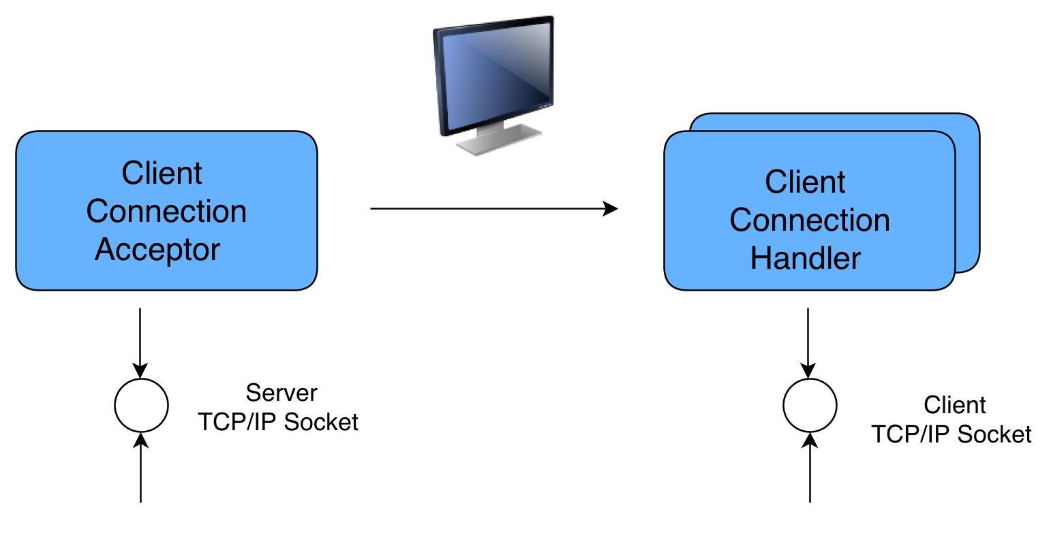
Process model
Figure: Client-server execution architecture: processes

Slide 24
Stereotypes
Common types of components in the execution architecture?

Slide 25
Execution stereotypes
Similarly to conceptual components execution components can belong to stereotypes
Again we will use three different stereotypes
Each stereotype has a particular clearly defined semantics
In execution architecture this semantics describes the kind of concurrent activity

Slide 26
Execution stereotypes
User-initiated: the component performs action because of user input
This components are always user-interfaces
In typical case such components exhibit a certain amount of internal concurrency
E.g. an event thread that listens to user-input events
Enhances responsiveness of user-interface, and in general usability

Slide 27
Execution stereotypes
Active: the component generates activity internally
E.g. components loop continuously or wake up periodically
Typical for real-time portions of the system
E.g. a crawler in a search engine might be an active component
Whenever there is a new page it generates activity and invokes parser, analyser, indexer, ...

Slide 28
Execution stereotypes
Services: the component waits for requests of other components and generates responses for such requests
Typically performs a complex task and has clearly defined protocol for communication with other components
E.g. database, web, file servers
In most cases services are concurrent subsystems that exhibit a large amount of internal concurrency

Slide 29
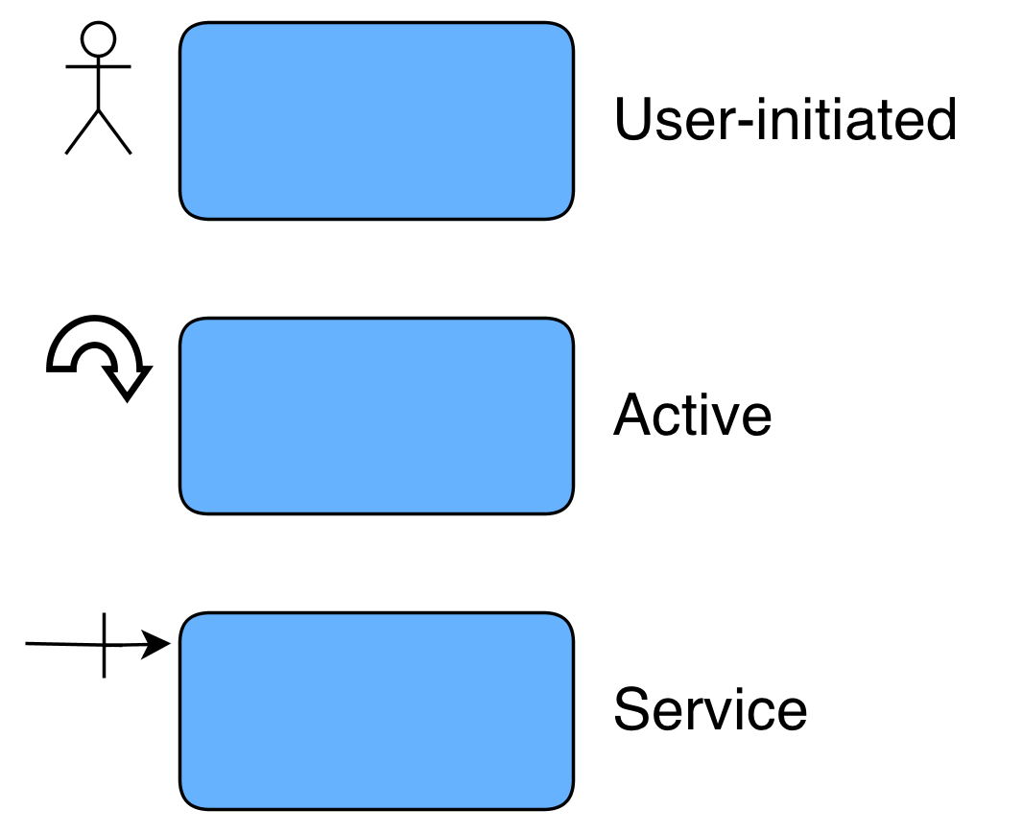
Execution stereotypes
Figure: Execution stereotypes from Software Architecture Primer

Slide 30
Sample Execution Architecture
We start first with the big picture: concurrent systems
Our system is a Web application
What concurrent subsystems do we have?
Obviously: a Web browser and a Web server

Slide 31
Sample Execution Architecture
The (part of) application logic is on the server side
We need a Web server which can run applications
Thus, the Web server is actually a Web application server
Additionally, we have an external system - another concurrent subsystem

Slide 32
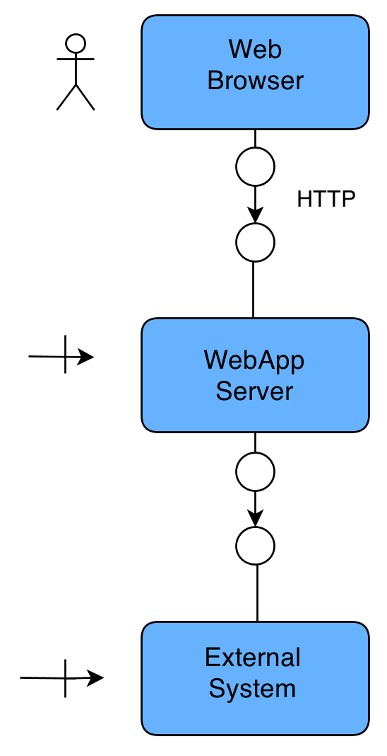
Sample Execution Architecture
Figure: Concurrent subsystem execution architecture

Slide 33
Detailed Design
Fine grained architecture?

Slide 34
Detailed execution model
Includes processes and threads
Threads do not have their own memory space nor they have their own copy of the code in memory
The code is loaded only once by their parent process
The memory is typically shared by the threads
We need to take care about thread synchronization

Slide 35
Quality attributes
Many quality attributes are addressed by the execution architecture
E.g. usability in GUIs is addressed by a special event thread
E.g. a highly reliable component needs a separate execution component
E.g. security typically requires a separate execution component

Slide 36
Example 1: GUI Event Thread
We have a multimedia player, e.g. it executes an animation but the GUI needs to be responsive
Which threads do we have?
How do they communicate?

Slide 37
Example 2: Web server cache with dynamic content
E.g. a wiki system where users edit content
In cache you have all documents + valid/invalid flag
If valid serve from cache
If invalid: reload in cache, set valid flag
How is caching executed?

Slide 38
Example 3: Web server cache with a database server
E.g. a content management system with content stored in a database
What happens when a field is updated in the database?
Note, database server is a separate process
Which threads do we have on the Web server side?

Slide 39
Sources of concurrency
Many reasons why separate, concurrent compontents are beneficial:
Forks in a use-case map require concurrent activities
Components that perform significant amounts of computation are best modeled as concurrent activities (usability, performance)
Network components are also concurrent activities (usability, performance)
Concurrent components might be beneficial if developed by separate teams (loose coupling)
Critical components might be isolated

Slide 40
Sources of concurrency
Downsides of concurrent components:
Realtime components might be isolated from non-realtime components
Latency introduced by context switched between components
Synchronisation overhead due to shared data
Concurrency adds to the complexity of the system (and might hard to find bugs, e.g. Heisenbugs)

Slide 41
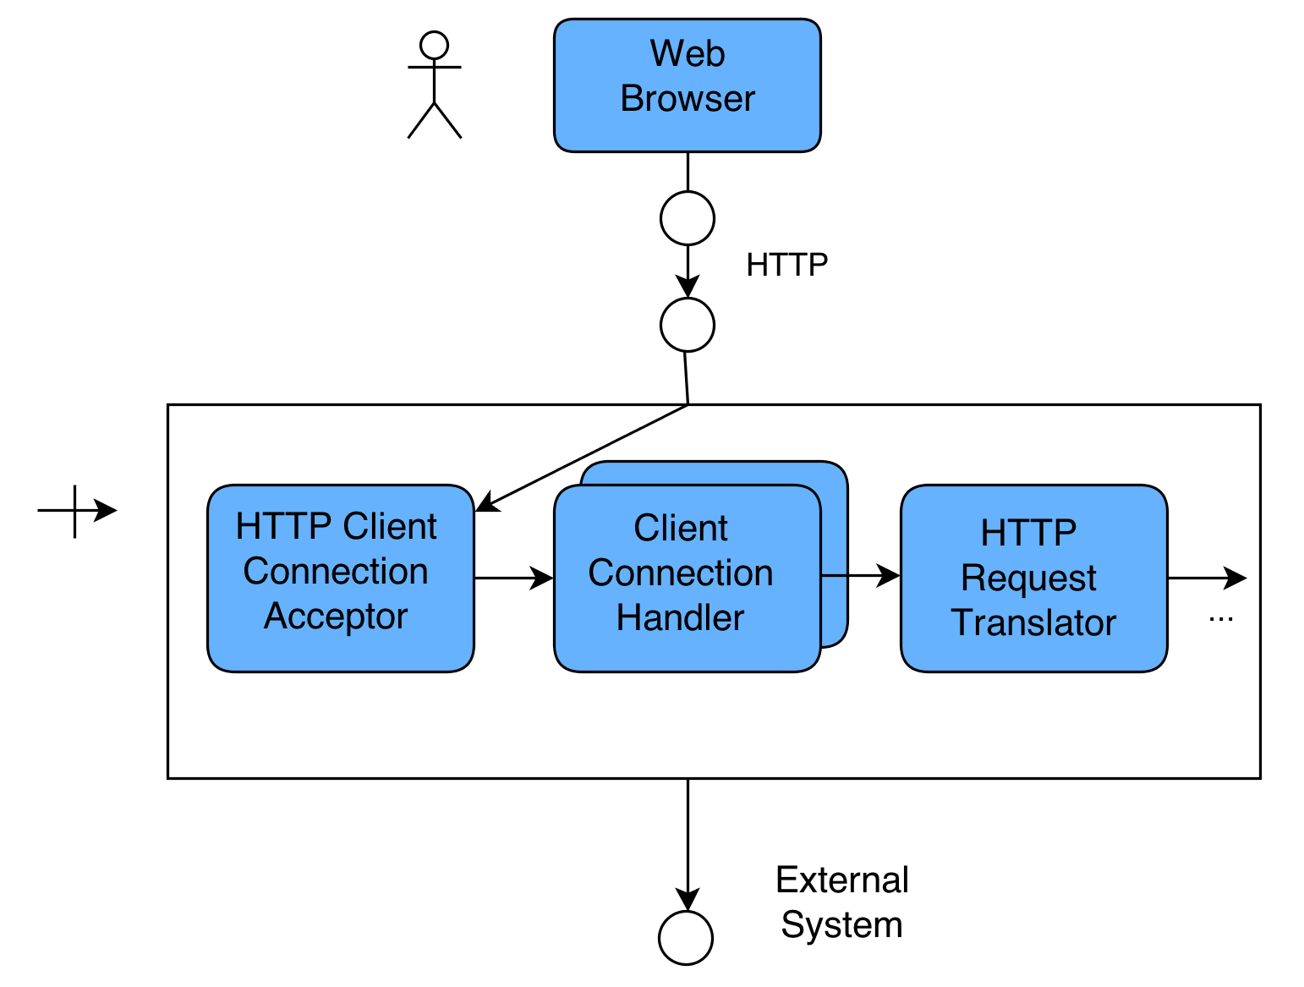
Sample Detailed Execution Architecture
Figure: Detailed execution architecture

Slide 42
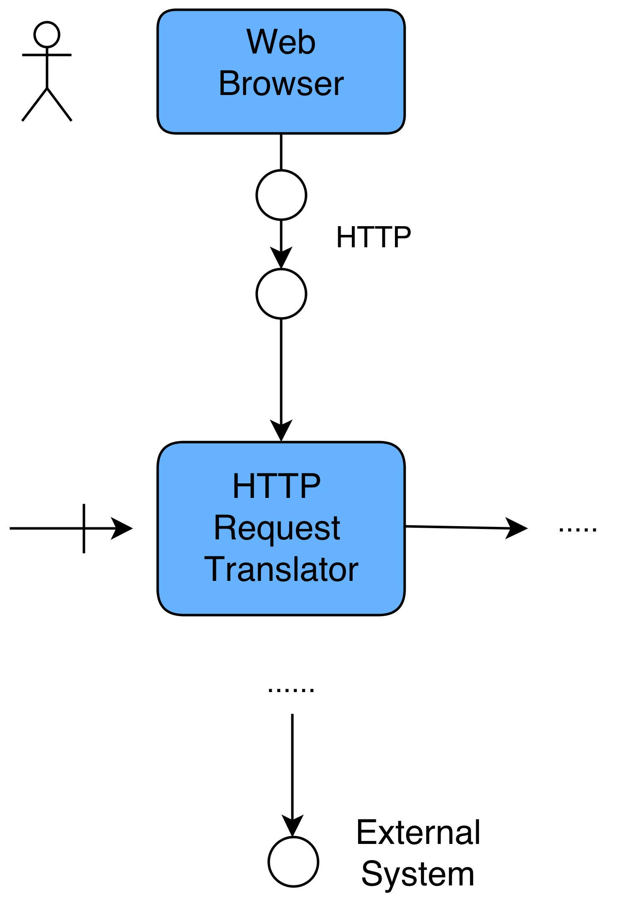
Sample Detailed Execution Architecture
Figure: Detailed execution architecture

Slide 43

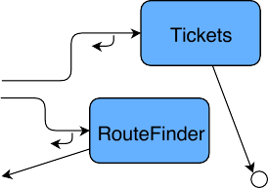
Sample Detailed Execution Architecture
Figure: Detailed execution architecture

Slide 44
Connecting views
Connecting conceptual and execution views

Slide 45
Binding execution and conceptual models
We need to decide where conceptual components reside in the execution architecture
Which of them might be on the users device and which of them in logic component on the server
(Unfortunately) There are no strict rules for this!
Depends on the quality attributes we need to satisfy
E.g. if performance is needed - if large number of users move some conceptual components to the client

Slide 46

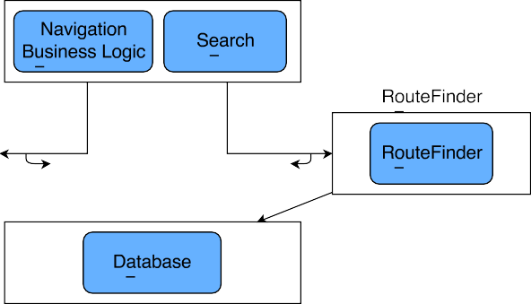
Binding execution and conceptual models
Figure: Binding conceptual and execution architecture for the example application

Slide 47
Behaviour
Implications of the behaviour on the execution architecture?

Slide 48
Execution behaviour
We will use-case maps to model behaviour
Actually we need only to verify that execution architecture supports the desired behaviour
→ find errors in the architecture
We can use the same use-case maps from the conceptual architecture

Slide 49

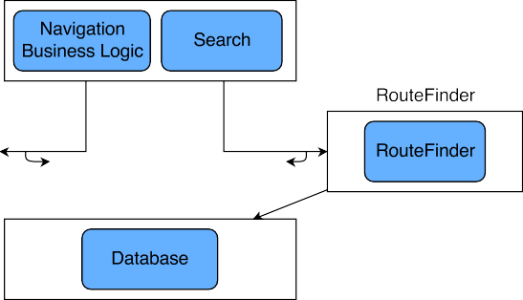
Execution behaviour
Figure: Execution behaviour for use case “new route”

Slide 50
Execution behaviour
Figure: Execution behaviour for use case “buy ticket”

Slide 51
Execution on the Web
Concurrency on the Web

Slide 52
Concurrency on the Web
We had concurrency on the server side
With introduction of AJAX it is possible to have concurrency in a browser
You can communicate asynchronously with the server
If you decide to do so then you have to think about the updating strategy

Slide 53
Concurrency on the Web
How do we communicate asynchronously HTTP
There is no native HTTP support for asynchronous communication
You have to simulate this
Typically by polling
HTML5 introduces WebSockets API

Slide 54


Concurrency on the Web
Figure: Asynchronous communication server/client

Slide 55
Conclusions
Use-case maps to find errors (even if they appear redundant)
Don’t overdo documenting dynamic behaviour (only with architectural impact)
In complex scenarios make deployment models, e.g. map concurrent components to physical components
e.g. processors, hardware/software subsystems, network devices Put systems to separate nodes for improved scalability, security
e.g. legacy systems, off-the-shelf systems, critical components Separate realtime components from non-realtime components (But) don’t overdo separate nodes
e.g. costs, maintenance, points of failure, synchronization

