Slide 1


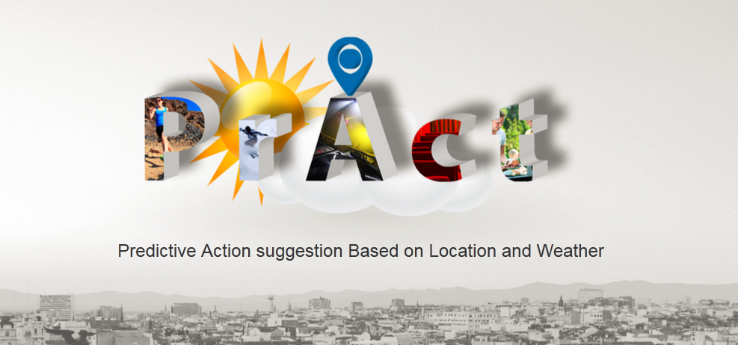
Nadine Engelhardt, Patrick Heinze, Johannes Wingert 24.07.2014, Oshawa

Slide 2

Motivation & Problem
Lack of ideas for activities
Approx. 58 million tweets per day
Suggest activities for a given location
Support planning of leisure time

Slide 3
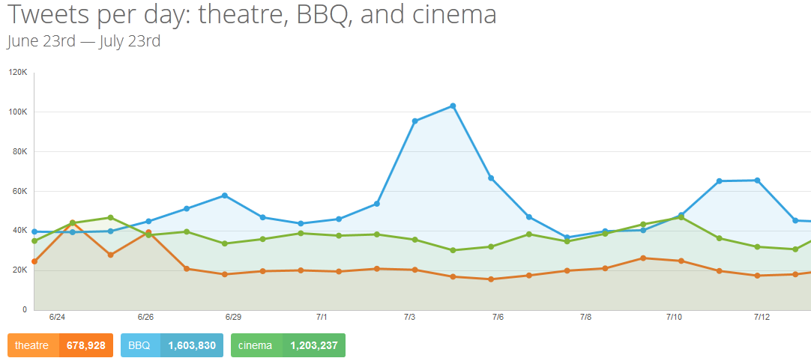
Motivation

Slide 4
Idea
Connect activity tweets with
Historic weather
Geographical location
Learning process of relationship between weather and activities
Predict preferred activities for a given date related to weather forecast

Slide 5



Data Sources
Persisted data
Twitter
Deutscher Wetterdienst (historic weather data)
Live data
Forecast API (weather forecast)
Google geolocation API

Slide 6
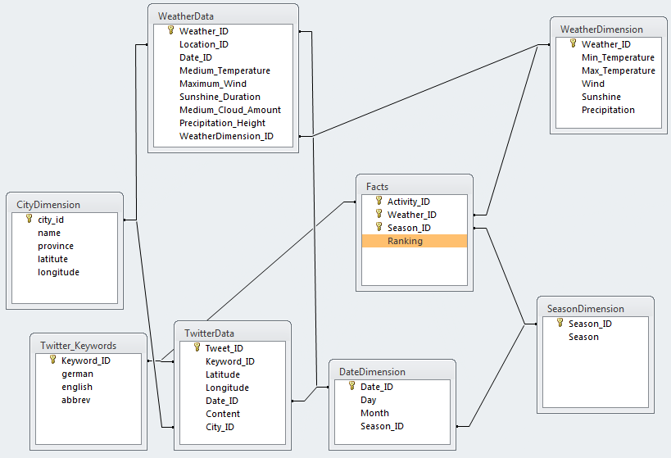
Relationship Model
Notes:
Star schema
ranking depends on activities like cinema, canoeing etc. → connected with twitter data
Ranking depends on weather → classification → hiking more likely if it is not raining
Historic weather data on daily basis for different locations within germany
Season
Decision tree (stored in facts table, so to say)

Slide 7
Live Demo

Slide 8
Outlook
Enlarge database and add historic tweets
Support further weather phenomenons
Prediction based on location
Show activities on map
Allow user to select categories for activities

