Slide 1




Nadine Engelhardt, Patrick Heinze, Johannes Wingert 24.07.2014, Oshawa

Slide 2

Motivation & Problem
Lack of ideas for activities
Approx. 58 million tweets per day
Suggest activities for a given location
Support planning of leisure time

Slide 3
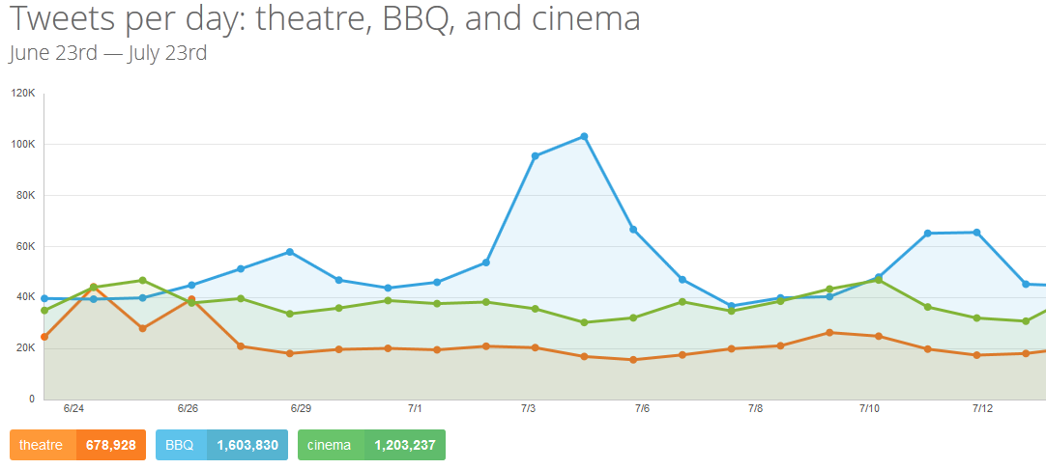
Motivation
Notes:
tipsy.com

Slide 4
Idea
Connect activity tweets with
Historic weather
Geographical location
Learning process of relationship between weather and activities
Predict preferred activities for a given date related to weather forecast

Slide 5



Data Sources
Persisted data
Twitter
Deutscher Wetterdienst (historic weather data)
Live data
Forecast API (weather forecast)
Google geolocation API
Notes:
twitter: 180 requests per 15 minutes, maximum 100 tweets per request → java program
Weather data: parse daily data for each weather station

Slide 6
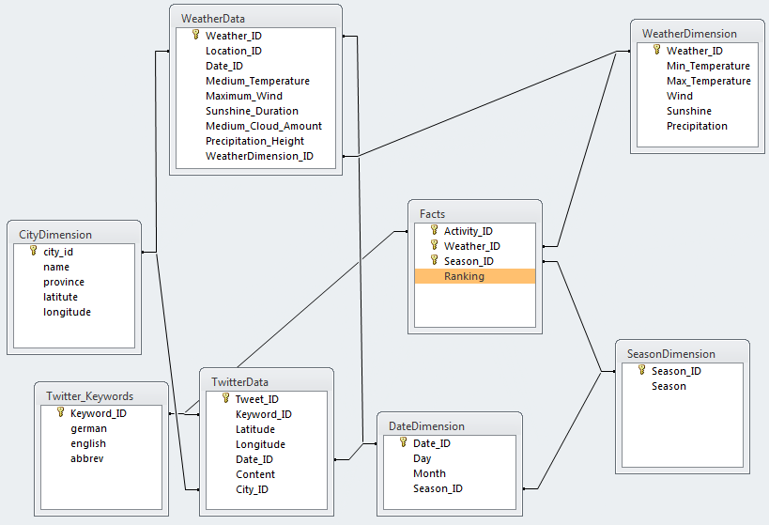
Relationship Model
Notes:
Star schema
ranking depends on activities like cinema, canoeing etc. → connected with twitter data
Ranking depends on weather → classification → hiking more likely if it is not raining
Historic weather data on daily basis for different locations within germany
Connect weatherData with Tweets via date, location is supported by schema as well
Season
(Date dimension without year because only current data available)
Decision tree (stored in facts table, so to say)

Slide 7
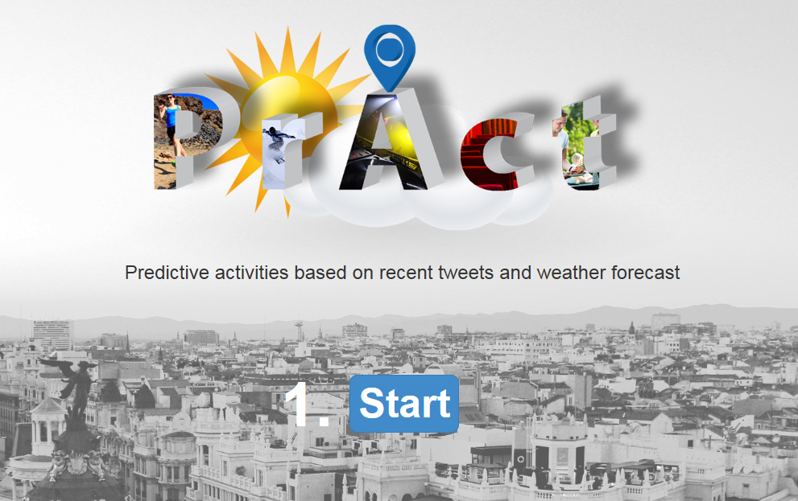
Live Demo

Slide 8
Outlook
Enlarge database and add historic tweets
Support further weather phenomenons
Prediction based on location
Show activities on map
Allow user to select categories for activities

