Slide 1
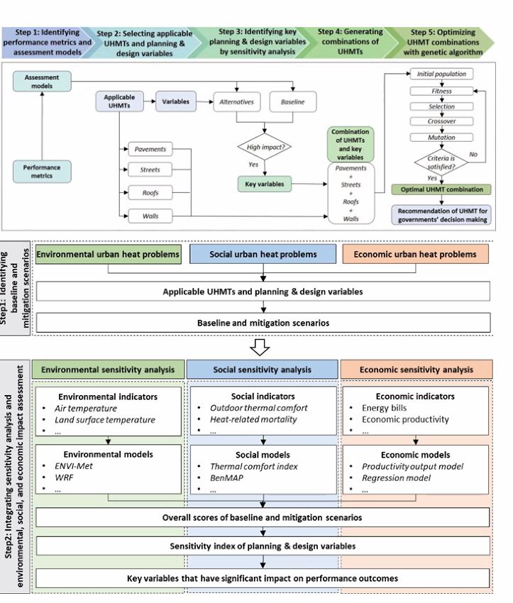

Slide 3
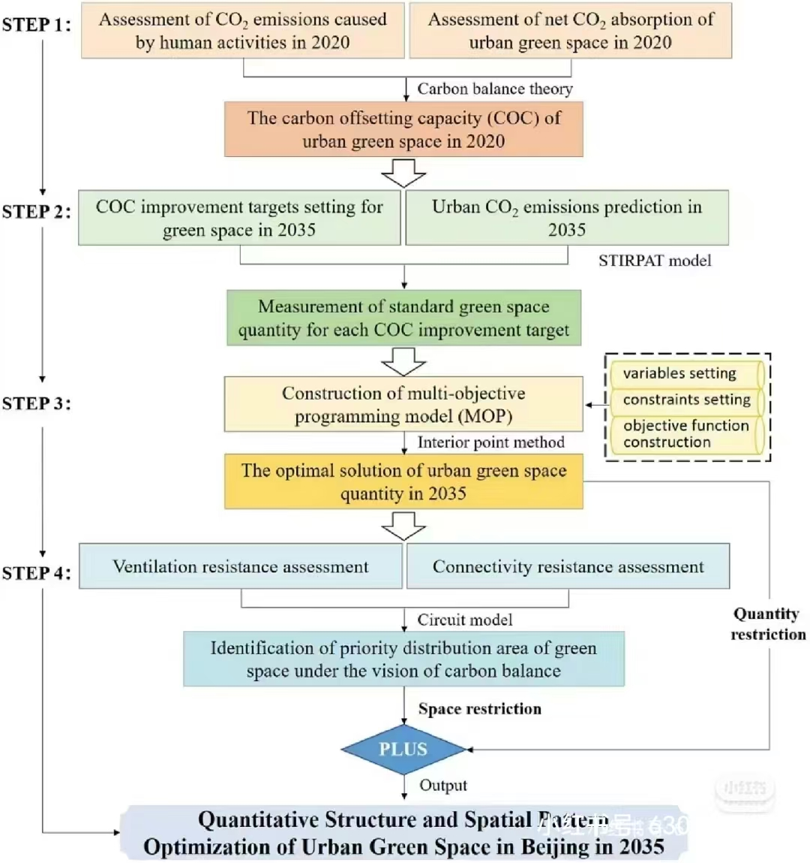

Slide 4
STEP1:
Text
Text
text
Text
STEP1:
Text
Text
text
Text
Text
text
STEP1:
text
text
text
Text
STEP1:
Text
Text
text
text
Text
text
Text
text
Text

Slide 5
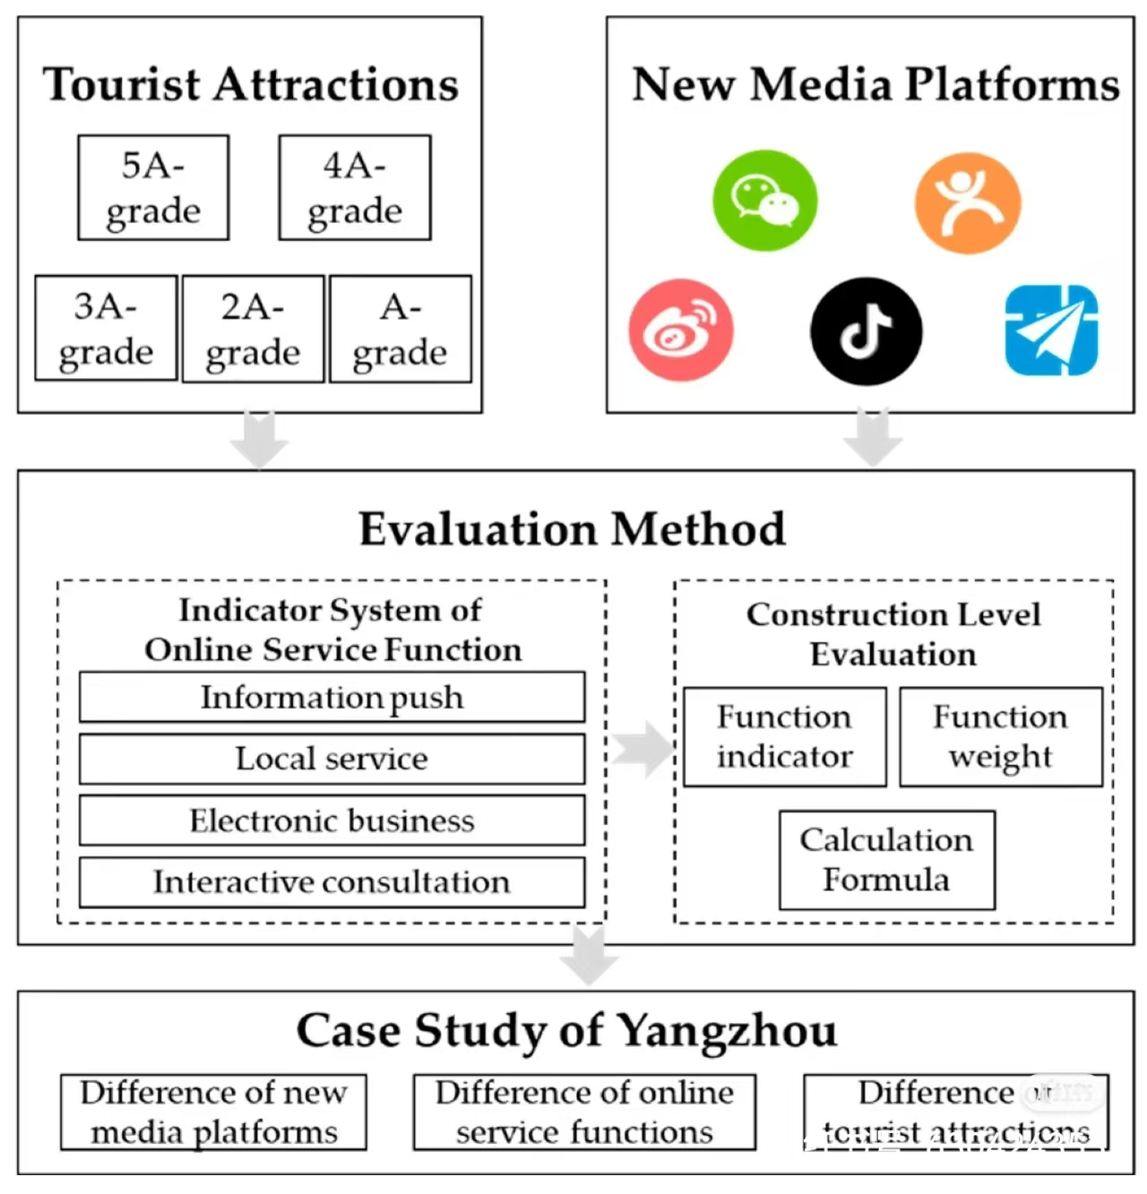

Slide 6

Text Text
Text Text
text
text
text
text
text
text
Text Text
text
text
text
text
text
text
text
text
text
Text Text
text
text
text

Slide 7
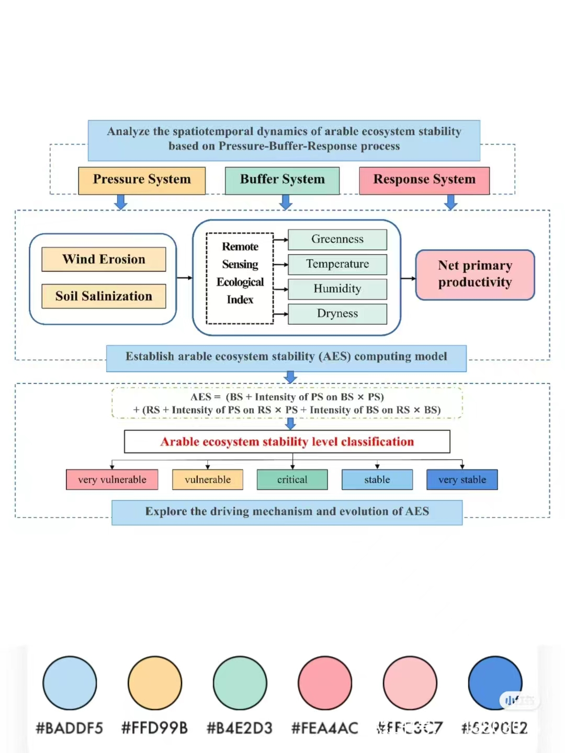

Slide 8
Text Text
Text
Text
Text
Text
Text
Text
Text
Text
Text
Text
Text
Text Text
Text Text
Text
Text
Text
Text
Text
Text
Text Text

Slide 9
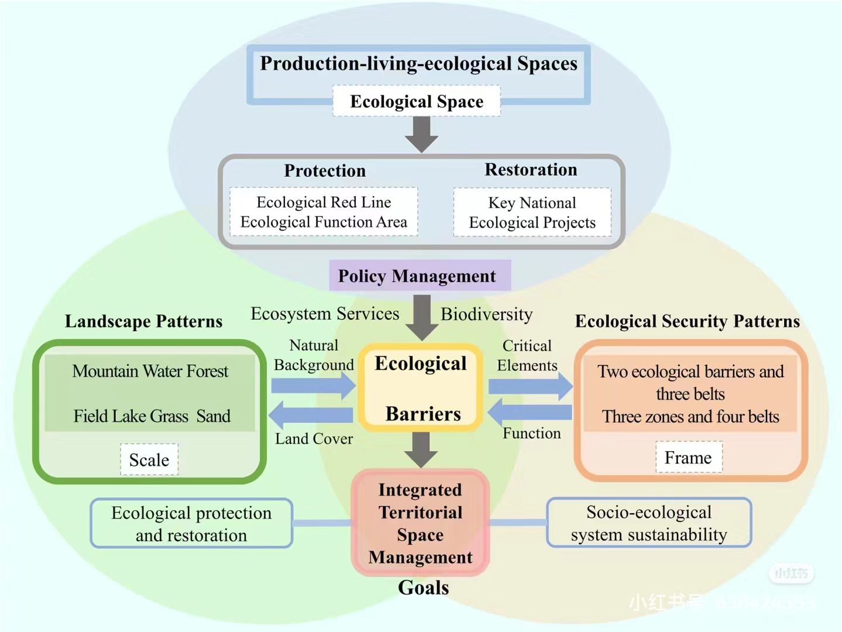

Slide 10
Text
Text
Text
text
text
Text
text
text
text
text

Slide 11
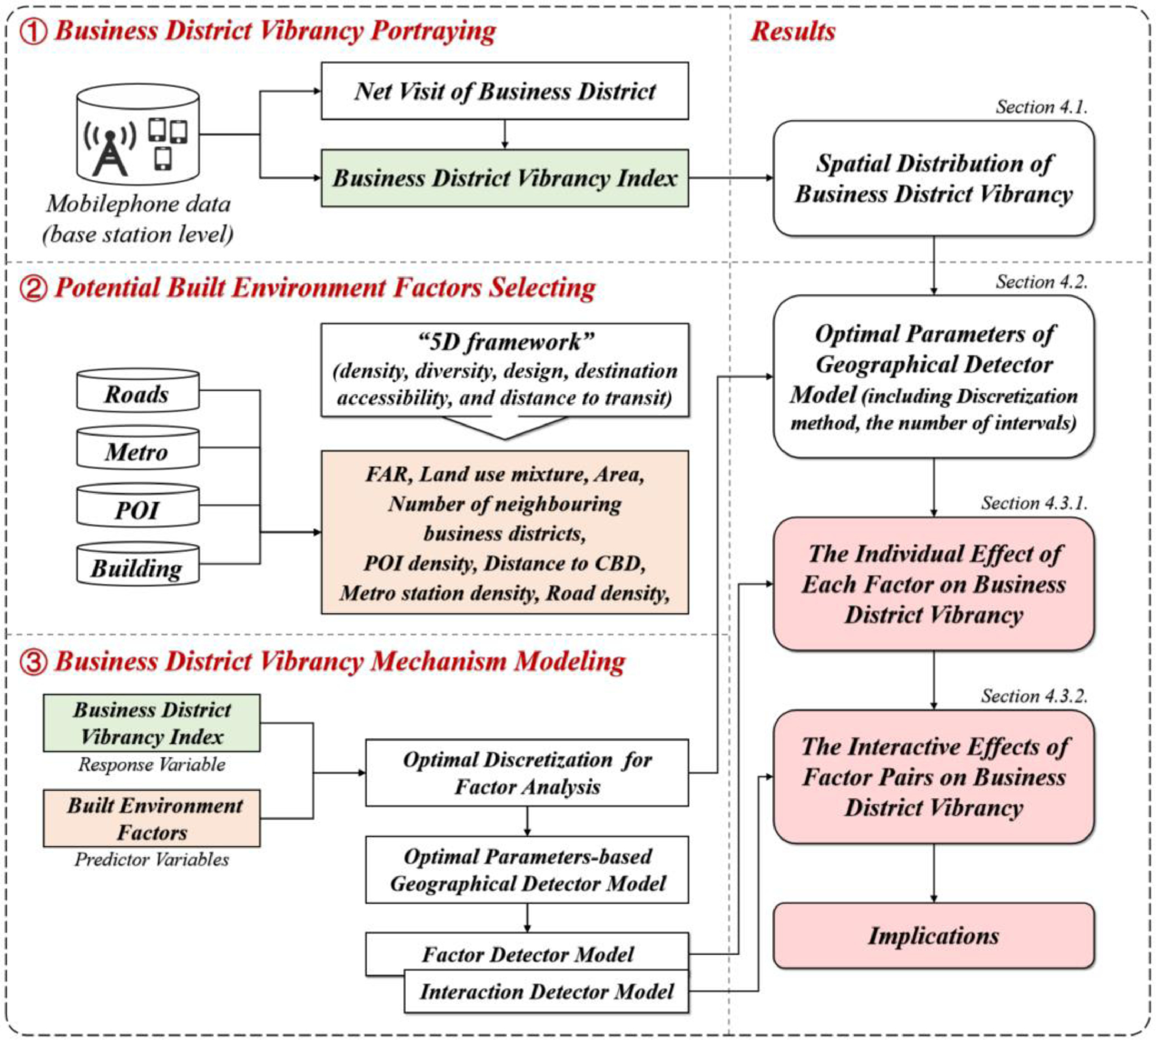

Slide 12


① Text
Text
Text
text
Text
Text
text
②Text
text
Text
Text
Text
text
Text
Text
Text
text
Text
Text
text
text
③Text
text
Text
Text
text
Text
Text
text
Text
Text
Text
Text

Slide 13
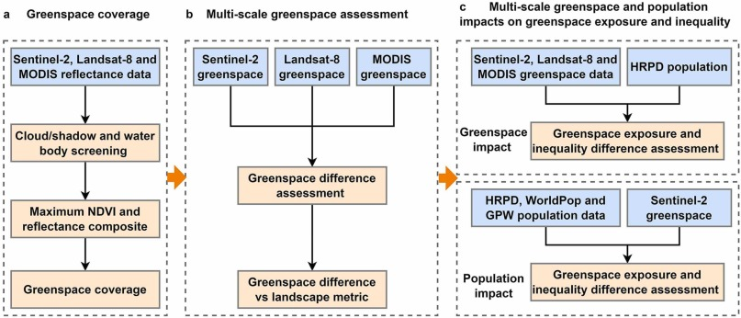
a text
b text
c text

