Slide 1

1DV501
Mini project
Group 7:
Marek Ufnal Eldaras Žutautas, Jianing Yang, Zejian Wang.

Slide 2
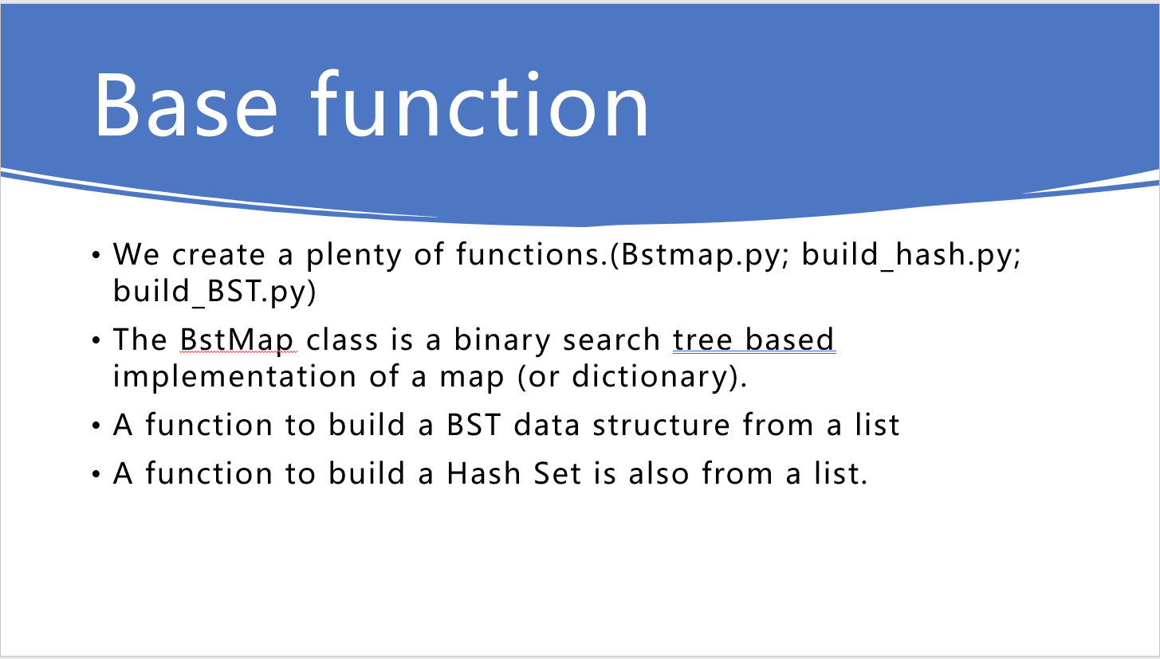
Welcome to our presentation!!!!
Data Structures--Task 2
Hash set
BST
Python vs us --Task 3
Graphs--Task 4
Conclusions

Slide 3
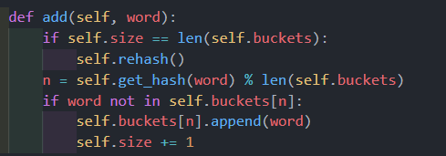
Hash Set
Hash Set - n computing, a hash table (hash map) is a data structure that implements an associative array abstract data type, a structure that can map keys to values.
Adding method

Slide 4
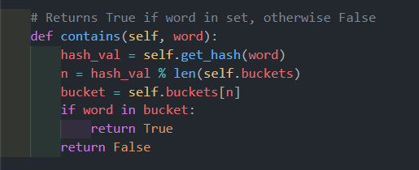
Hash Set
Contains method

Slide 5
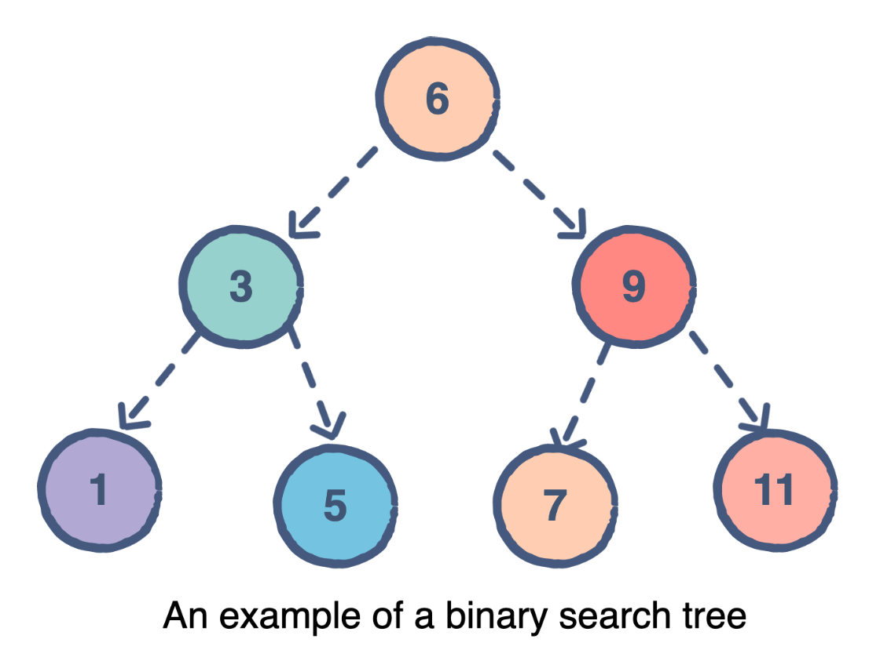
Binary Search Tree
A BstMap is a structure that contains key : value pairs in a network of nodes. Each node in this structure has four different elements.

Slide 6
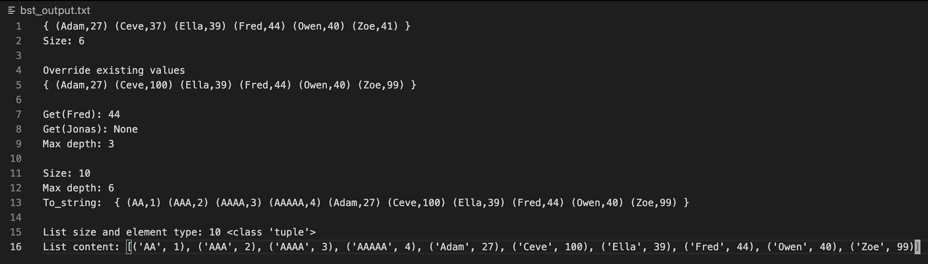
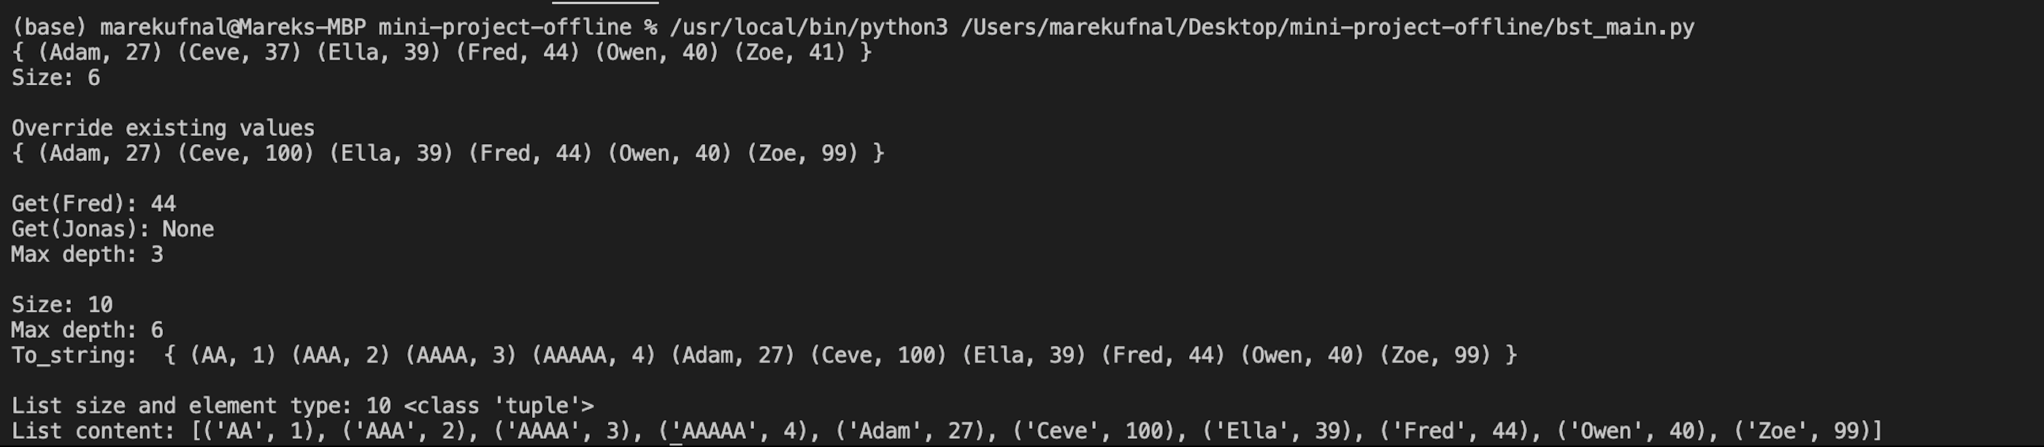
Binary Search Tree

Slide 7
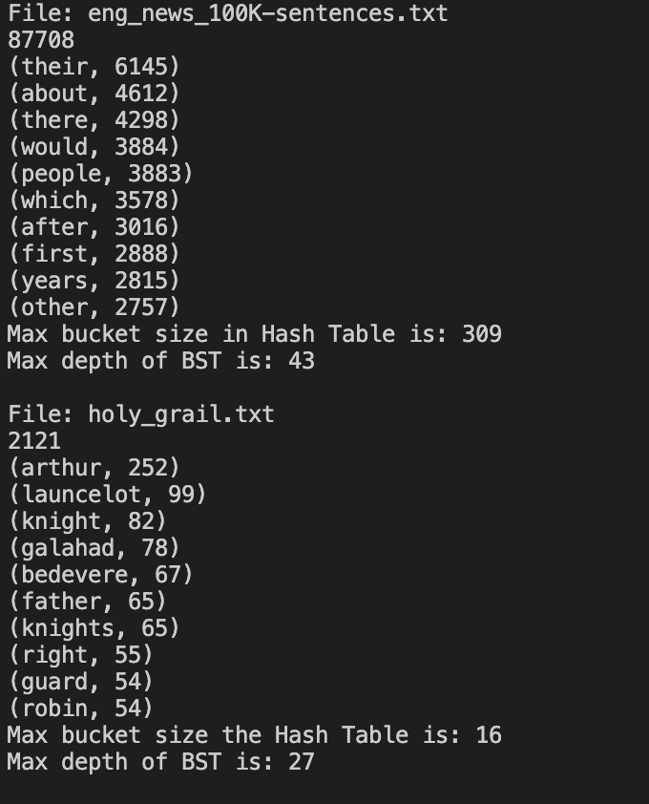
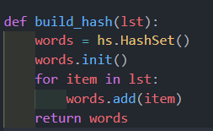
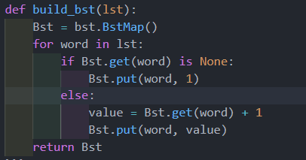
Output for Task 3
Fragments of code

Slide 8

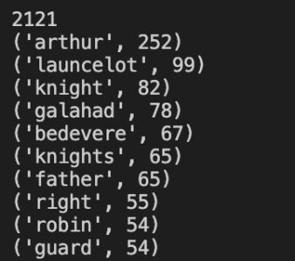
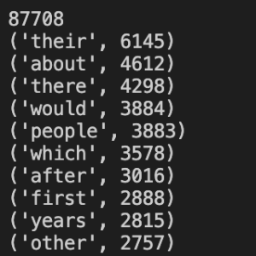
The result was the same as Task1 below

Slide 9
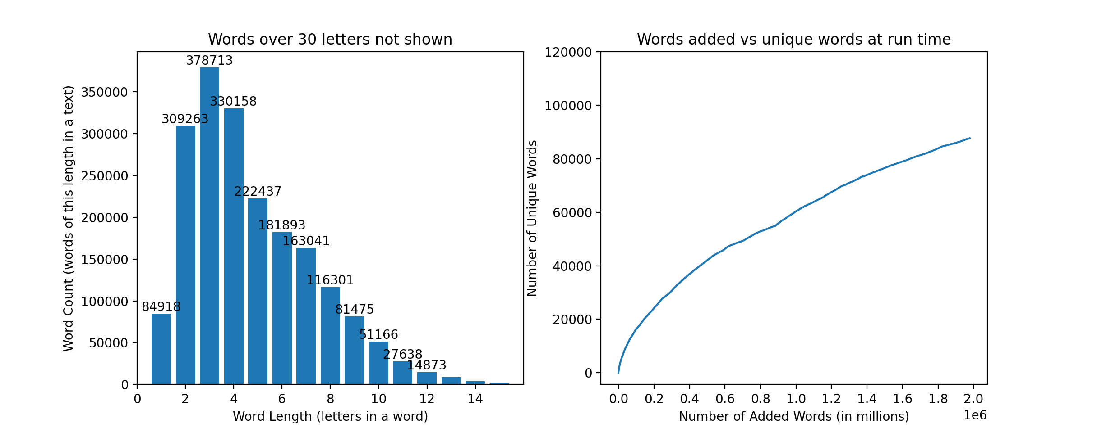
Task 4 Graphs
Word length vs how many words
Unique words vs added words

Slide 10
5.Conclusion
Technical issues:1. git lab.
2. mac os system ,windows system.
3. Directory management.
4. Hashing
Project issues:1. We organised the work by dividing work.
2. We held in-person meetings.
3. Both sub-teams were presenting their work to each other to make sure all members understood what each function.
4. Established communication early using Whatsapp, helped us with organising meetings, as well as sharing ideas.

Slide 11

Thanks

