Slide 2
Data Sources
Naver finance section (”finance.naver.com”)
The list of 30 popular stocks
Search ratio, stock’s information (% price change, trading volume…)
Popularity of stocks
related news & comments/#users on discussion forum
Previous 10days’ Stock information
Fluctuation level

Slide 3
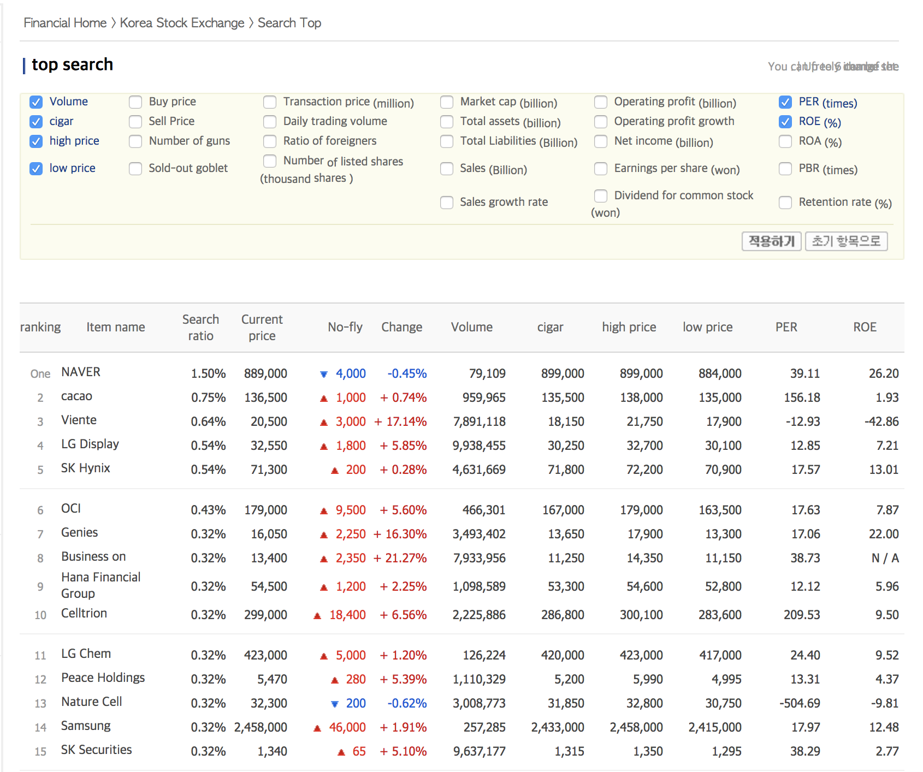
Top Search Ranking

Slide 4
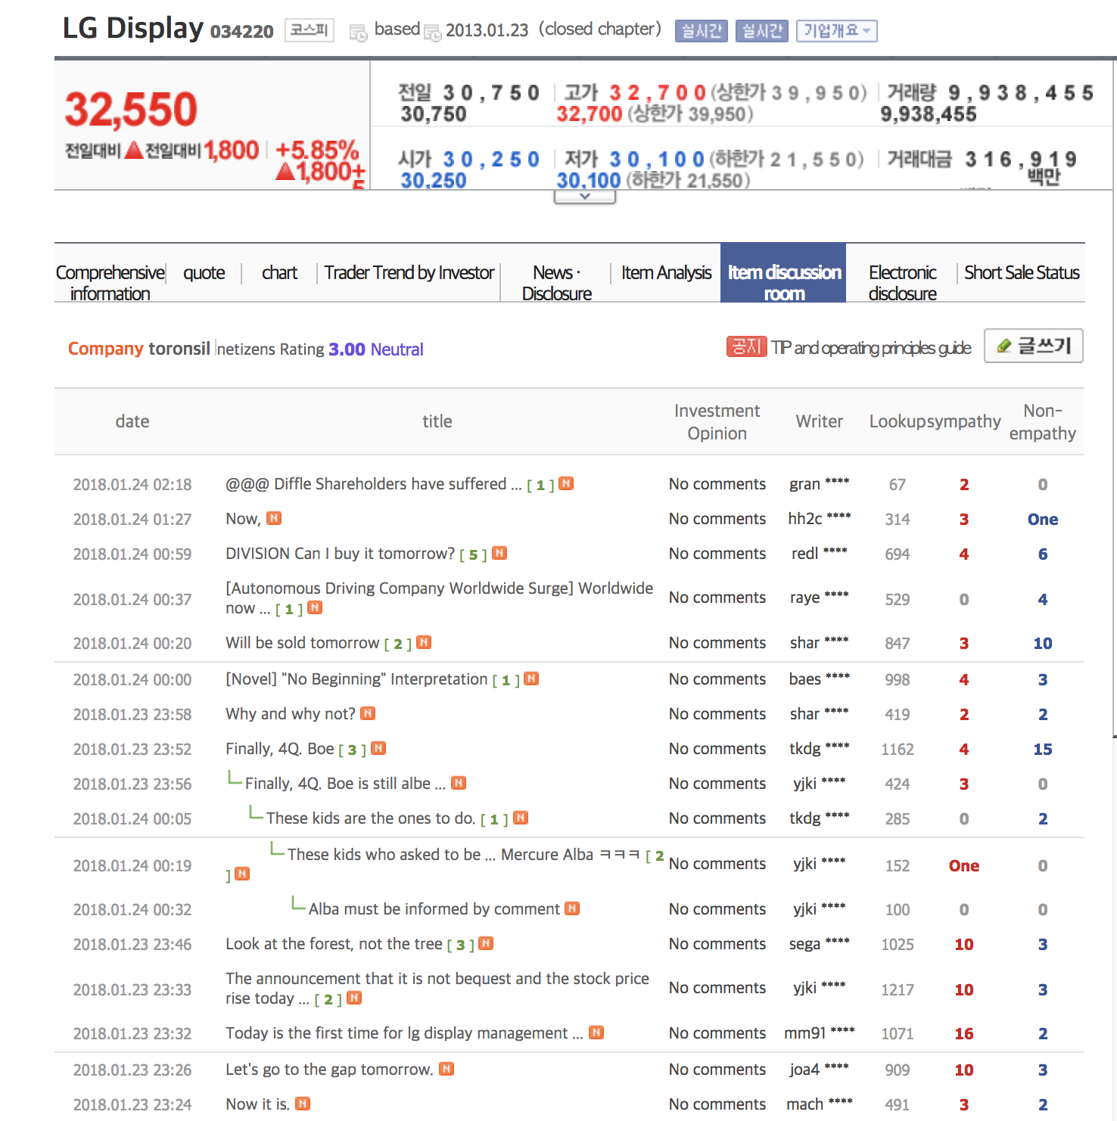
Discussion forum

Slide 5
TOP SEARCH RANKING
Search Ratio
Stock’s Information
% Price Change
Trading Volume
Return on Equity

Slide 6
DISCUSSION FORUM
Number of Users
Comments
Positive / Negative
Number of Look up

