Slide 1



The ER (Entity-Relationship) Model

Slide 2

Agenda
High-level motivation for the E/R model
Entities
Relations
E/R Model

Slide 3
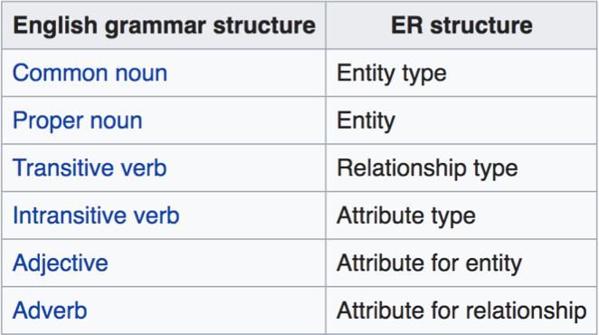
Mapping natural language
Chen proposed the following "rules of thumb" for mapping natural language descriptions into ER diagrams: "English, Chinese and ER diagrams" by Peter Chen.
•

Slide 4





Relationships and Attributes
Relationships may have attributes as well.
since
name
name
category
price
Product
Makes
Company
For example: “since” records when company started making a product
Note: “since” is implicitly unique per pair here! Why?

Slide 5

TYPES OF RELATIONSHIP

Slide 6


Conceptual Crow’s Foot Relationship Symbols

Slide 7



Many-Many Relationships
Focus: binary relationships, such as Sells between Seller and Buyer.
In a many-many relationship, an entity of either set can be connected to many entities of the other set.
– E.g., a seller sells many items; a buyer can buy many items too.

Slide 8


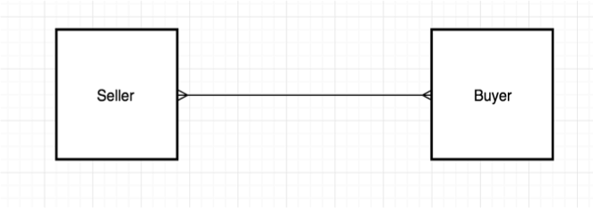
In Pictures:
many-many

Slide 9

Many-One Relationships
Some binary relationships are many -one from one entity set to another.
Each entity of the first set is connected to at most one entity of the second set.
But an entity of the second set can be connected to zero, one, or many entities of the first set.
E.g.: One buyer can have multiple order number, but one order can be bought by only one buyer.

Slide 10

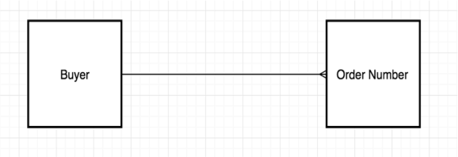
In Pictures:
many-one

Slide 11


One-One Relationships
In a one-one relationship, each entity of either entity set is related to at most one entity of the other set.
Example: Relationship president between entity country and person.
– A person can be the president of only one country. One country can have only one president.

Slide 12

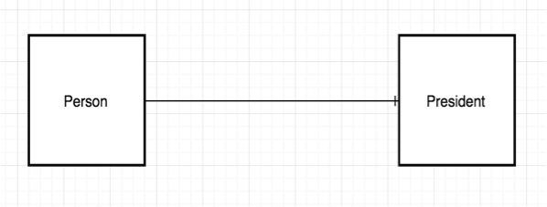
In Pictures

Slide 13

Maximum Cardinality
Relationships are named and classified by their cardinalities, which is a word that means count (as in the number of items in a set)
Each of the three types of binary relationship shown previously has a different maximum cardinality
Maximum cardinality is the maximum number of entity instances that can participate in a relationship instance
– One, many, or some other positive fixed number

Slide 14

Minimum Cardinality
Minimum cardinality is the minimum number of entity instances that must participate in a relationship instance
These values typically assume a value of zero (optional) or one (mandatory)

Slide 15

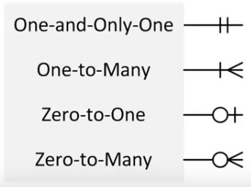
Crow’s Foot Symbols with Cardinalities

Slide 16


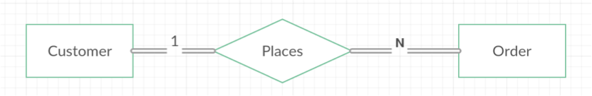
Cardinality Example
Maximum cardinality is many for Order and one for Customer
Minimum cardinality is one for both Customer and Order
Each customer can place one or more orders
Each order is associated with one and only one customer
Crow’s foot Notation
Chen Notation

Slide 17


Entity-Relationship Diagrams
The diagrams in previous slides are called entity-relationship diagrams
Entities represented by rectangles
Relationships represented by lines
Cardinalities represented by Crow’s Foot symbols

Slide 18


HAS-A Relationships
The relationships in the previous slides are called HAS-A relationships
The term is used because each entity instance has a relationship to a second entity instance
An employee has a locker
A locker has an employee
There are also IS-A relationships

Slide 19

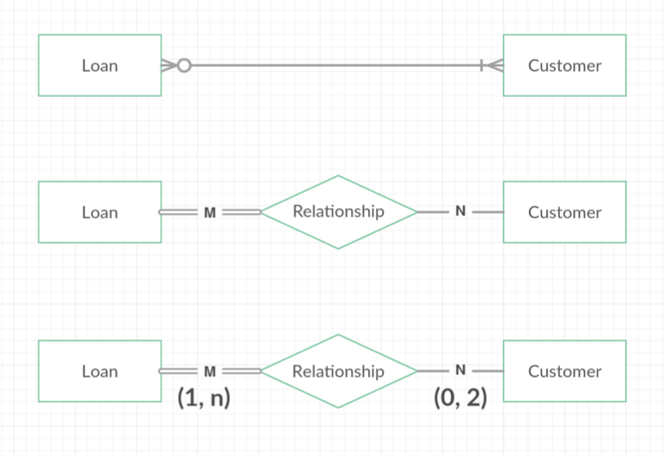









Different Representations
Crow’s foot Notation
Chen Notation
(min,max) constraint

Slide 20
Agenda
More about ER model
ER model to Relation (Table)

Slide 21

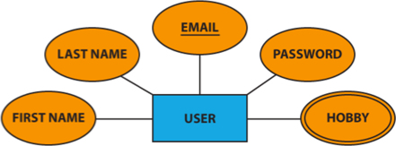
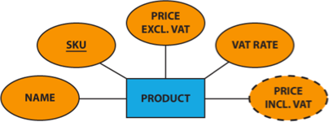






Special Symbols Used
Multivalued Attribute
Derived Attribute

Slide 22

Strong and Weak Entities
A weak entity is an entity whose instances cannot exist in the database without the existence of an instance of another entity
Any entity that is not weak entity is called a strong entity
– Instances of a strong entity can exist in the database independently
The weak entity’s identifier is a combination of the identifier of the owner entity and the partial key of the weak entity.

Slide 23


In E/R Diagrams
name
number
name
Players
Teams
Plays- on
Double diamond for supporting many-one relationship with Weak Entity.
Double rectangle for the weak entity set.

Slide 24


Example: Weak Entity Set
name is almost a key for football players, but there might be two with the same name.
number is certainly not a key, since players on two teams could have the same number.
But number, together with the team name related to the player should be unique.

Slide 25

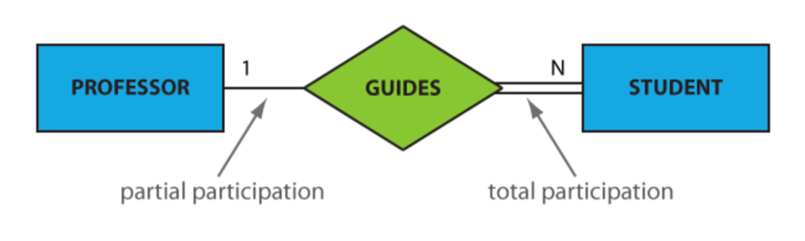
Partial vs Total Participation
An entity set may participate in a relation either totally or partially.
Total participation means that every entity in the set is involved in the relationship
depicted as a double line.
Partial participation means that not all entities in the set are involved in the relationship, e.g., not every professor guides a student
depicted by a single line.

Slide 26
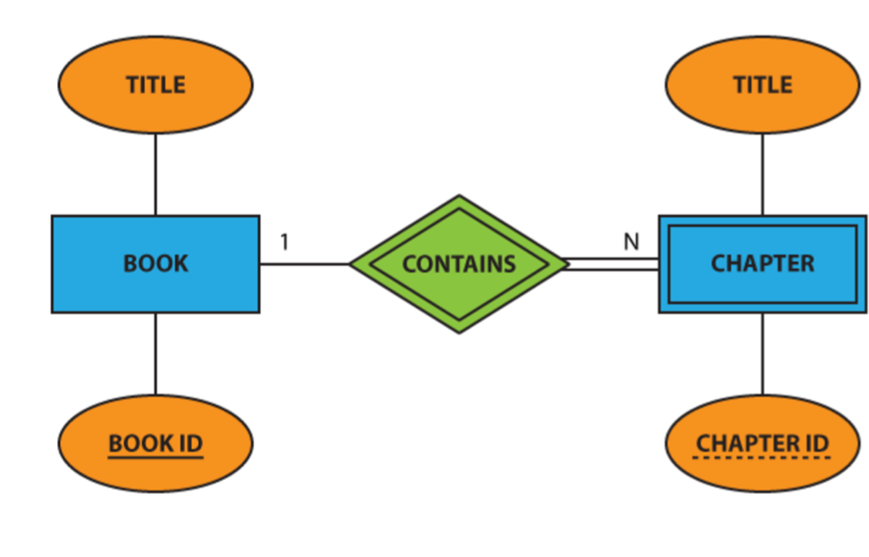
Weak Entity , Total Participation and Partial Key

Slide 27

(min, max) constraint
Min = 0 implies partial participation
Min > 0 implies total participation

Slide 28



Modeling Subclasses
Some objects in a class may be special, i.e. worthy of their own class
Define a new class?
But what if we want to maintain connection to current class?
Better: define a subclass
Ex:
Products
Software products
Educational products
We can define subclasses in E/R!

Slide 29
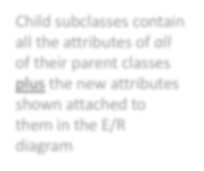

Modeling Subclasses
name
price
Child subclasses contain all the attributes of all of their parent classes plus the new attributes shown attached to them in the E/R diagram
Product
isA
Software Product
Educational Product
platforms
ageGroup

Slide 30

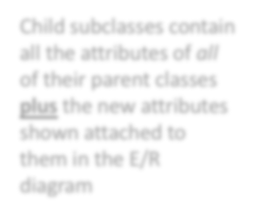

Understanding Subclasses
Think in terms of records; ex:
Child subclasses contain all the attributes of all of their parent classes plus the new attributes shown attached to them in the E/R diagram
name
– Product
name
price
price
– SoftwareProduct
Product
name
price
platforms
– EducationalProduct
isA
name
Software Product
Educational Product
price
ageGroup
platforms
ageGroup

Slide 31

Product
Think like tables…
name | price | category
Gizmo | 99 | gadget
Camera | 49 | photo
Toy | 39 | gadget
name
price
Product
Sw.Product
name | platforms
Gizmo | unix
isA
Ed.Product
Software Product
Educational Product
name | ageGroup
Gizmo | todler
Toy | retired
platforms
ageGroup

Slide 32

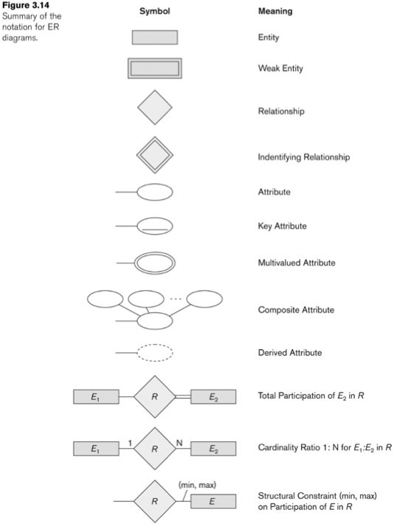
Summary
Summary
Identifying Relationship

Slide 33

Design Theory (ER model to Relations)

Slide 34



Entity Sets to Tables
name
ssn | name | lot
123-22-3333 | Alex | 23
234-44-6666 | Bob | 44
567-88-9787 | John | 12
ssn
lot
Employees
CREATE TABLE Employees (
ssn char(11), name varchar(30), lot Integer,
PRIMARY KEY (ssn))

Slide 35
Relationship Sets
A relationship is an association among several entities
Example: 44553 (Peltier) advisor 22222 (Einstein) student entity relationship set instructor entity
A relationship set is a mathematical relation among n ≥ 2 entities, each taken from entity sets
Example:
(44553,22222) ∈ advisor

Slide 36


Relationship Sets (without Constraints) to Tables
name
since
dname
ssn
lot
did
budget
Employees
Works_In
Departments
address
Locations
capacity

Slide 37
Relationship Sets (without Constraints) to Tables
CREATE TABLE Works_in(
address varchar(30), since date,
ssn char(11), did integer (30),
PRIMARY | KEY | (ssn, did, address),
FOREIGN | KEY | (ssn) REFERENCES Employees,
FOREIGN | KEY | (address) REFERENCES Locations,
FOREIGN ) | KEY | (did) REFERENCES Departments,

Slide 38


Relationship Sets (without Constraints) to Tables
name
CREATE TABLE Reports_To(
supervisor_ssn char(11),
subordinate_ssn char(11), PRIMARY KEY (supervisor_ssn,
subordinate_ssn),
FOREIGN KEY (supervisor_ssn ) REFERENCES Employees(ssn),
FOREIGN KEY (subordinate_ssn ) REFERENCES Employees(ssn)
ssn
lot
Employees
supervisor
subordinate
)
Reports_To

Slide 39



Relationship Sets (with key Constraints) to Tables
name
since
dname
ssn
lot
did
budget
Employees
Manages
Departments
CREATE TABLE Manages(
ssn char(11), did integer (30), since date,
PRIMARY | KEY | (did),
FOREIGN | KEY | (ssn) REFERENCES Employees,
FOREIGN ) | KEY | (did) REFERENCES Departments,

Slide 40

Better way of doing it
name
since
dname
ssn
lot
did
budget
Employees
Manages
Departments
CREATE TABLE Dept_Mgr(
did integer (30), dname varchar(30), budget float(30), ssn char(11), since date,
PRIMARY KEY (did),
FOREIGN KEY (ssn) REFERENCES Employees,
)

Slide 41
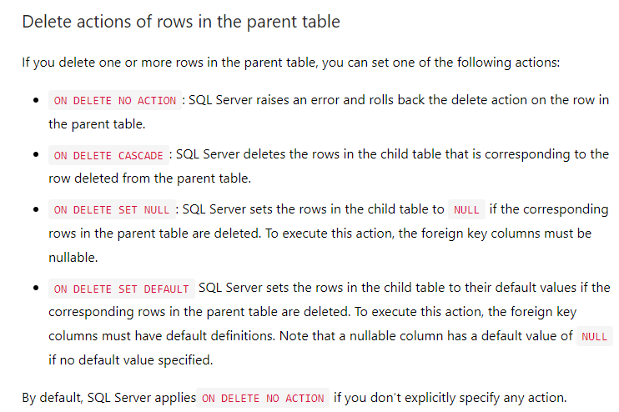

Slide 42
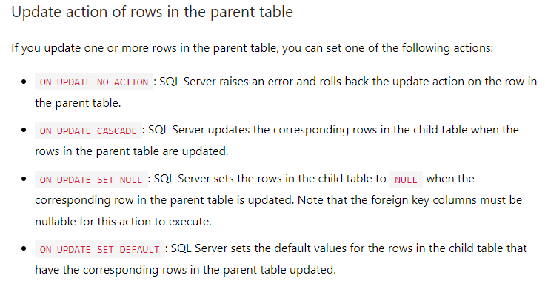

Slide 43




Relationship Sets (with Participation Constraints) to Tables
name
since
dname
ssn
lot
did
budget
Employees
Manages
Departments
CREATE TABLE Dept_Mgr(
did integer (30), dname varchar(30), budget float(30), ssn char(11), since date,
PRIMARY KEY (did),
FOREIGN KEY (ssn) REFERENCES Employees ON DELETE NO ACTION
)
CSC 261, Spring 2018

Slide 44

Translating Weak Entity Sets
name
cost
ssn
lot
pname
age
Employees
Policy
Dependents
CREATE TABLE Dept_Policy(
pname varchar(30), age integer,
cost float, ssn char(11),
PRIMARY KEY (pname, ssn),
FOREIGN KEY (ssn) REFERENCES Employees
ON DELETE CASCADE
)

Slide 45






Translating Class Hierarchies
name
ssn
lot
Employees
Hours_worked
Contract_id
Hourly_wages
isa
Hourly_Emps
Contract Emps

Slide 46

Two options
We can map each of the entity sets Employees, Hourly_Emps, and Contract_Emps to a distinct relation.
We can create just two relations, corresponding to Hourly_Emps and Contract_Emps
Both have their pros and cons
Redundancy
Performance

Slide 47

E/R Summary
E/R diagrams are a visual syntax that allows technical and non-technical people to talk
For conceptual design
Basic constructs: entity, relationship, and
attributes
A good design is faithful to the constraints of the application, but not overzealous

