Slide 1

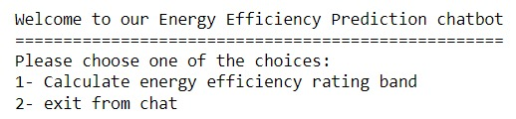
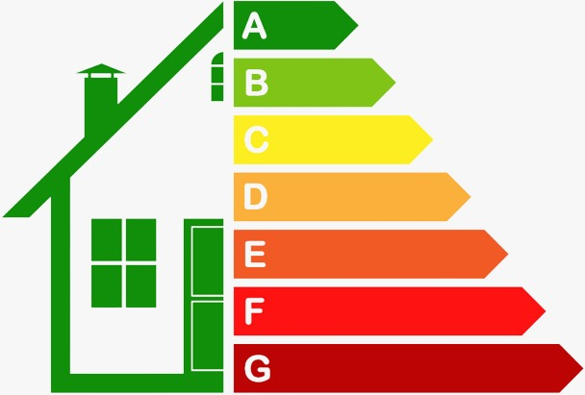
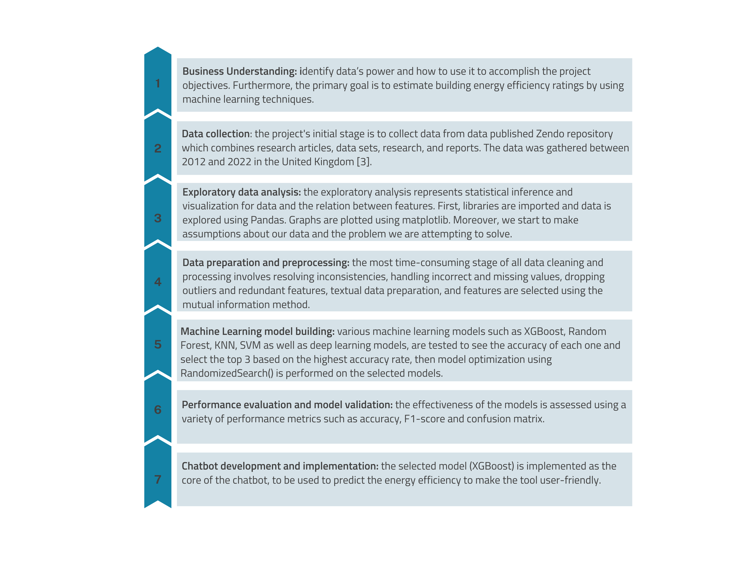
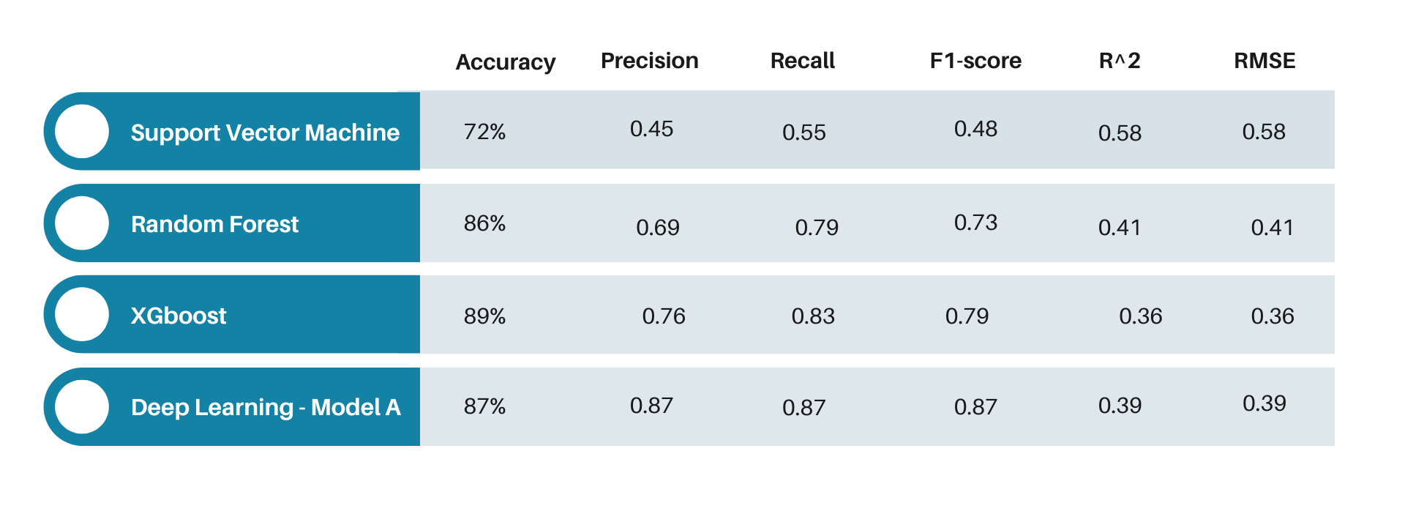
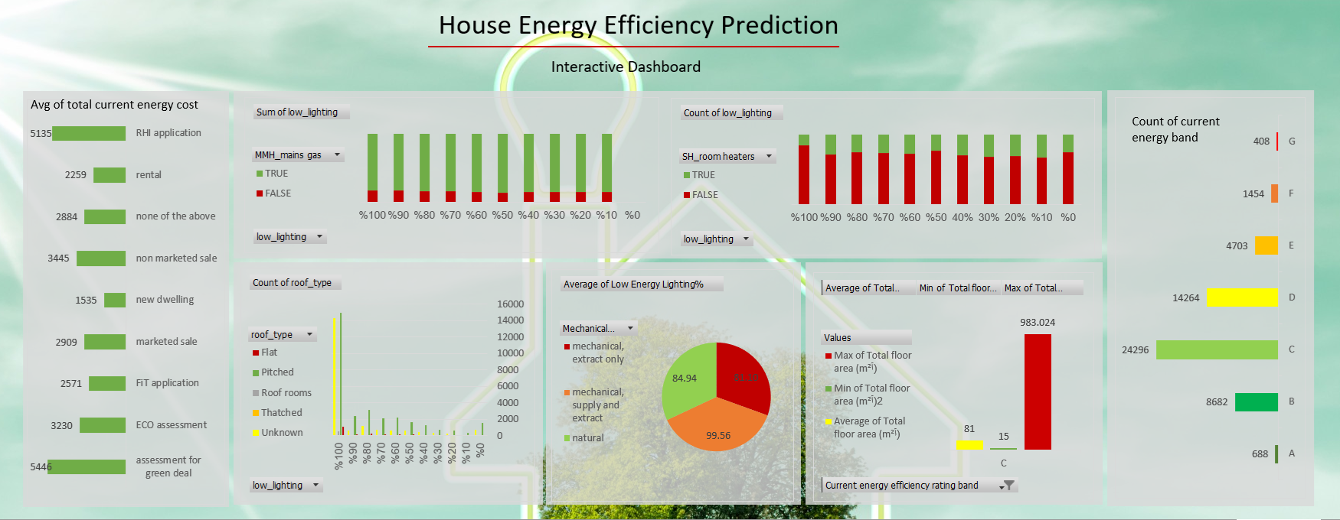
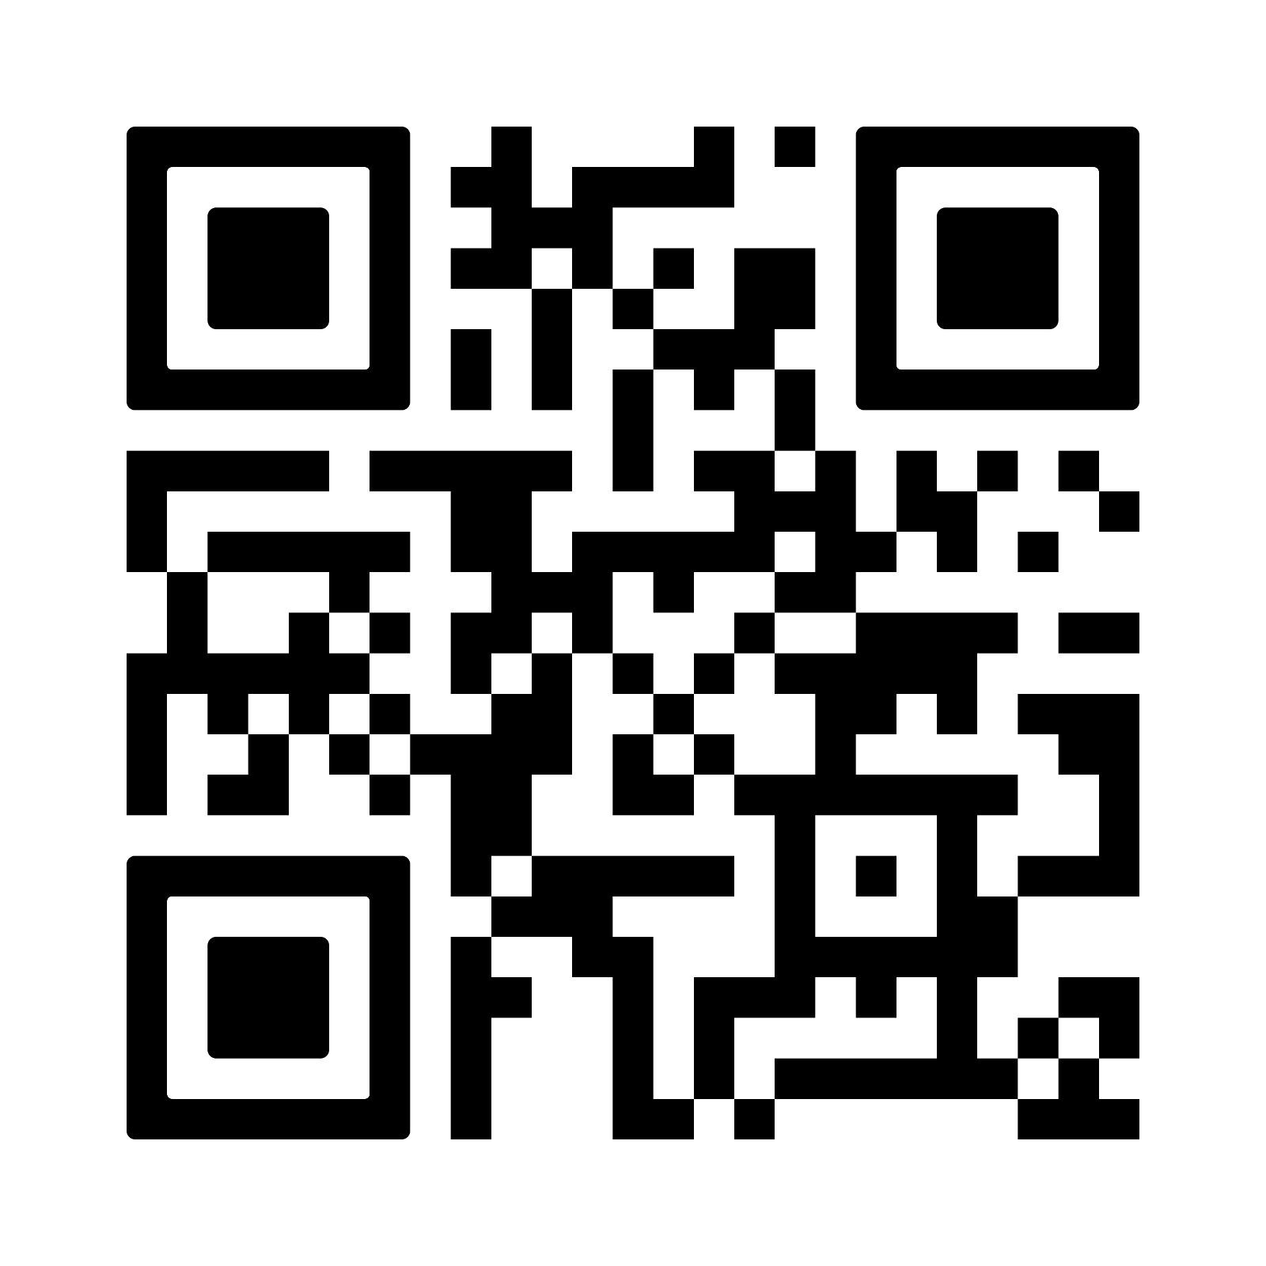
Houses' Energy Efficiency Prediction
Waad Aljehani, Amal Alharthie, Bedar Bahassan, Ghaidaa Allukmani, Dr Ines Boufateh
Department of Information Systems & Technology
Introduction
Results
According to The Energy Statistics Department in the Kingdom of Saudi Arabia, the residential sector has consumed 47.58% of the total electrical energy in 2020 [1].
the kingdom of Saudi Arabia has developed programs as a part of Vision 2030 that concentrates on sustainability such as "Saudi Energy Efficiency Program”. In this framework, the Saudi Energy Efficiency Center focuses on increasing the energy efficiency in production and consumption to preserve KSA natural resources and enhancing the economic and social welfare of KSA population [2].
In this study, we target the residential sector and aim to build a chatbot that will help consumers estimate houses’ energy efficiency.
Suppliers now offer different solutions to save energy, such as choosing LED lights instead of halogen. In addition, consumers are interested in reading the energy label on electrical appliances. All These factors have made it important for customers to consider the energy efficiency aspect when buying or renting a house to save the environment. However, estimating the energy profile is not an easy task for consumers.
To solve this problem, we will apply energy efficiency estimation in houses by using machine learning models and implement it through a chatbot to make the tool user friendly.
SVM had the lowest prediction accuracy (72%) but was the fastest in calculations.
RF contributed to raising the accuracy rate, which was 86%.
Deep ANN after improvement performs excellently at 87%.
XGBoost predicts the energy efficiency rating band and achieves 89% ➔ Validated to be used in the Chatbot.
Objectives
Literature review of Energy Efficiency in Housing domain to distinguish our work by developing new ideas based on Machine Learning to help the consumers in evaluating their houses’ energy efficiency profile.
Data collection, exploration, preparation and pre-processing to ensure a good quality input for our Machine Learning Models.
Model building and validation of the optimal result.
Chatbot development and implementation of machine learning model.
Results communication and recommendations for future work.
Conclusion
We created a prototype of a chatbot that helps predict the energy efficiency rating band for the home after training the models to select the best model with high accuracy which is the XGBoost.
Methodology
References
[1] "Saudi Arabia Energy . "،Available in: https://www.worldometers.info/energy/saudi-arabiaenergy
[2] "Energy & Sustainability “ Available in: https://www.vision2030.gov.sa/thekingdom/explore/energy./
[3] Maoran Sun: “Building Energy Efficiency” Glasgow 27 July. 2022.Available in: https://zenodo.org/record/6913572#.YyxtsKRBy3A.
Acknowledgements
All praise is to Allah, praise in abundance, good and blessed. Our completion of this project could not have been accomplished without the support of Allah. Thanks to Allah for giving us knowledge, guidance, and the opportunity to complete this project and reach our objectives. with full gratitude to everyone who supported us, starting with our parents, and friends who believed in our capabilities to finish this semester. We also address a special thanks to Dr. Ines Boufateh for standing with us step by step and finally, we would like to thank ourselves for completing this project.
Contact Details

