Slide 1
News Classifier
Chow Jun Wei, Esraa Sultan

Slide 2
Problem Definition
To classify a (group of) sentence(s) into their corresponding category. We have 20 categories
Comp.graphics | Comp.os.ms-windows.misc | Comp.sys.ibm.pc.hardware | Comp.sys.mac.hardware
Comp.windows.x | Rec.autos | Rec.motorcycles | Rec.sport.baseball
Rec.sport.hockey | Sci.crypt | Sci.electronics | Sci.med
Sci.space | Misc.forsale | Talk.politics.misc | Talk.politics.guns
Talk.politics.mideast | Talk.religion.misc | Alt.atheism | Soc.religion.christian

Slide 3
Purpose of this presentation
To show how the data looks like, whenever possible. We do not yet show any recommendations from this presentation.

Slide 4
Exploratory Data Analysis (EDA)

Slide 5
The next few slides contain information on before we clean the data.

Slide 6
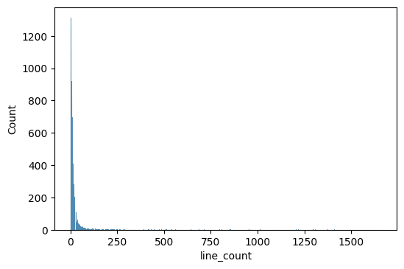
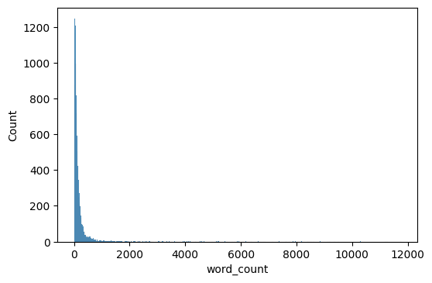
Line number count and word count
Most contains only few sentences; but some are very long.

Slide 7
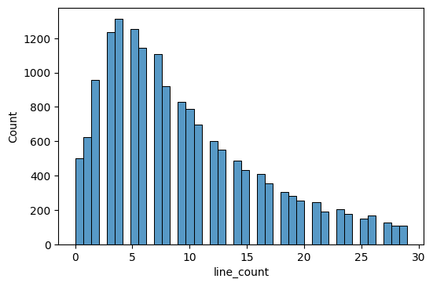
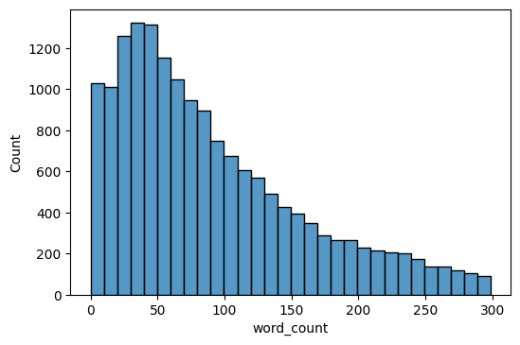
Zoomed in to small range

Slide 8
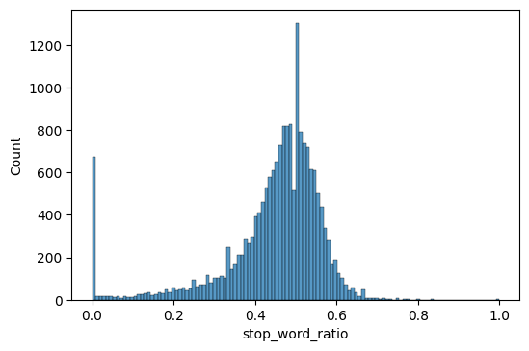

Stop words per word count ratio
On average, half of the words per article are considered stop words.
Notes:
Stop words taken from sklearn.feature_extraction import _stop_words as STOPWORDS

Slide 9
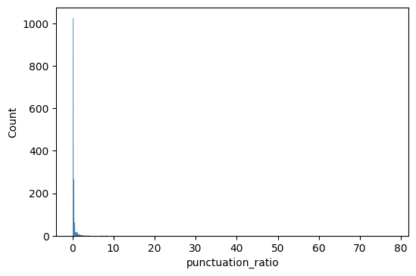
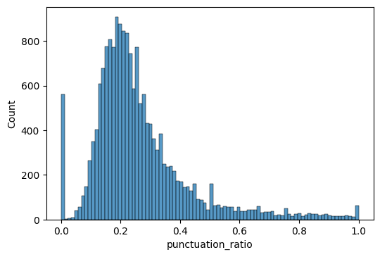
Punctuation to Word Ratio
There are a long tailed distribution, but mostly followed Poisson distribution.
Full
Zoomed in

Slide 10
What changes after cleaning
Not much changes are noticed after cleaning. The statistics does shift a bit (by 0.002) but that’s almost negligible.

Slide 11
Unigrams, Bigrams, Trigrams

Slide 12
Recommended Models (Technical User)
Any Neural Net models shall do good.
One suggests the use of AWD-LSTM from fast.ai.

