Slide 1
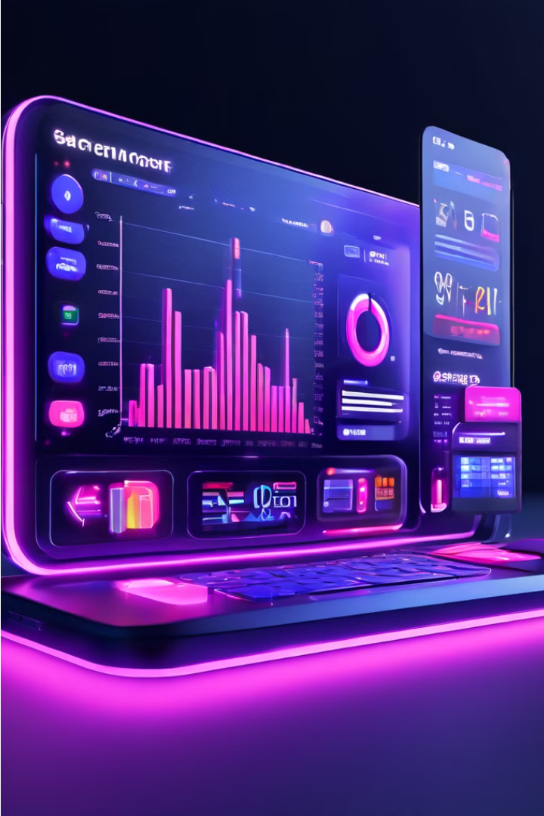
Group 2 : House Broker system
Welcome To Gee’z Broker!
Live Link of our site:
https://geezbroker.jtaborbroker.com/
1

Slide 2
Gee’z Broker System
Overview
The Gee'z Broker System is a web-based platform designed to facilitate the brokerage operations for a single company, Gee'z Broker. This system aims to streamline the brokerage process, providing a secure, efficient, and user-friendly environment for managing real estate transactions, catering specifically to the needs of Gee'z Broker.
2

Slide 3
System Architecture
User Interface
Security issue
Market Data
The Gee’z Broker System features an intuitive and user-friendly interface that allows users to seamlessly access the platform's various functionalities. This includes secure login and registration processes, as well as the ability to execute trades, manage their investment portfolios, and access real-time market data.
At the core of the Broker System is a robust security mechanism that encrypts user passwords, considering that users might reuse passwords across multiple websites. This encryption ensures that no one has access to view plaintext passwords, enhancing overall user security and data protection.
The Gee’z Broker System provides users with access to comprehensive real-time market data, including price quotes, trading volumes, and historical data. This information is presented through advanced analytics and charting tools, enabling users to make informed trading decisions.
3

Slide 4
Functional Requirements
1
User Authentication
2
Property Listing and Search:
The system must support secure login and registration processes, including password encryption and two-factor authentication, to ensure the privacy and protection of user information.
Users must be able to list properties for sale and search for available properties, with the system supporting various search criteria and providing timely updates.
3
Profile Management
4
Messaging and Communication
(future enhancement):
Users should have the ability to view and manage their investment portfolios, including tracking the performance of individual securities and the overall portfolio value.
The system must provide users with tools for real-time messaging and communication, including sending enquiries, receiving responses, and managing conversations with brokers and admins.
4

Slide 5
Non-Functional Requirements
Performance
Security
The Broker System must handle high volumes of transactions with minimal latency to ensure timely execution of trades, maintaining the efficiency and reliability of the platform.
The system must prioritize data privacy and protection against unauthorized access, implementing robust encryption, secure communication protocols, and regular security audits to safeguard user information and transactions.
Scalability
Usability
The Broker System should be designed to scale horizontally, accommodating an increasing number of users and transactions without compromising performance or reliability.
The system should offer an intuitive and user-friendly interface, with easy navigation and accessible features, ensuring a seamless and efficient user experience.
5

Slide 6
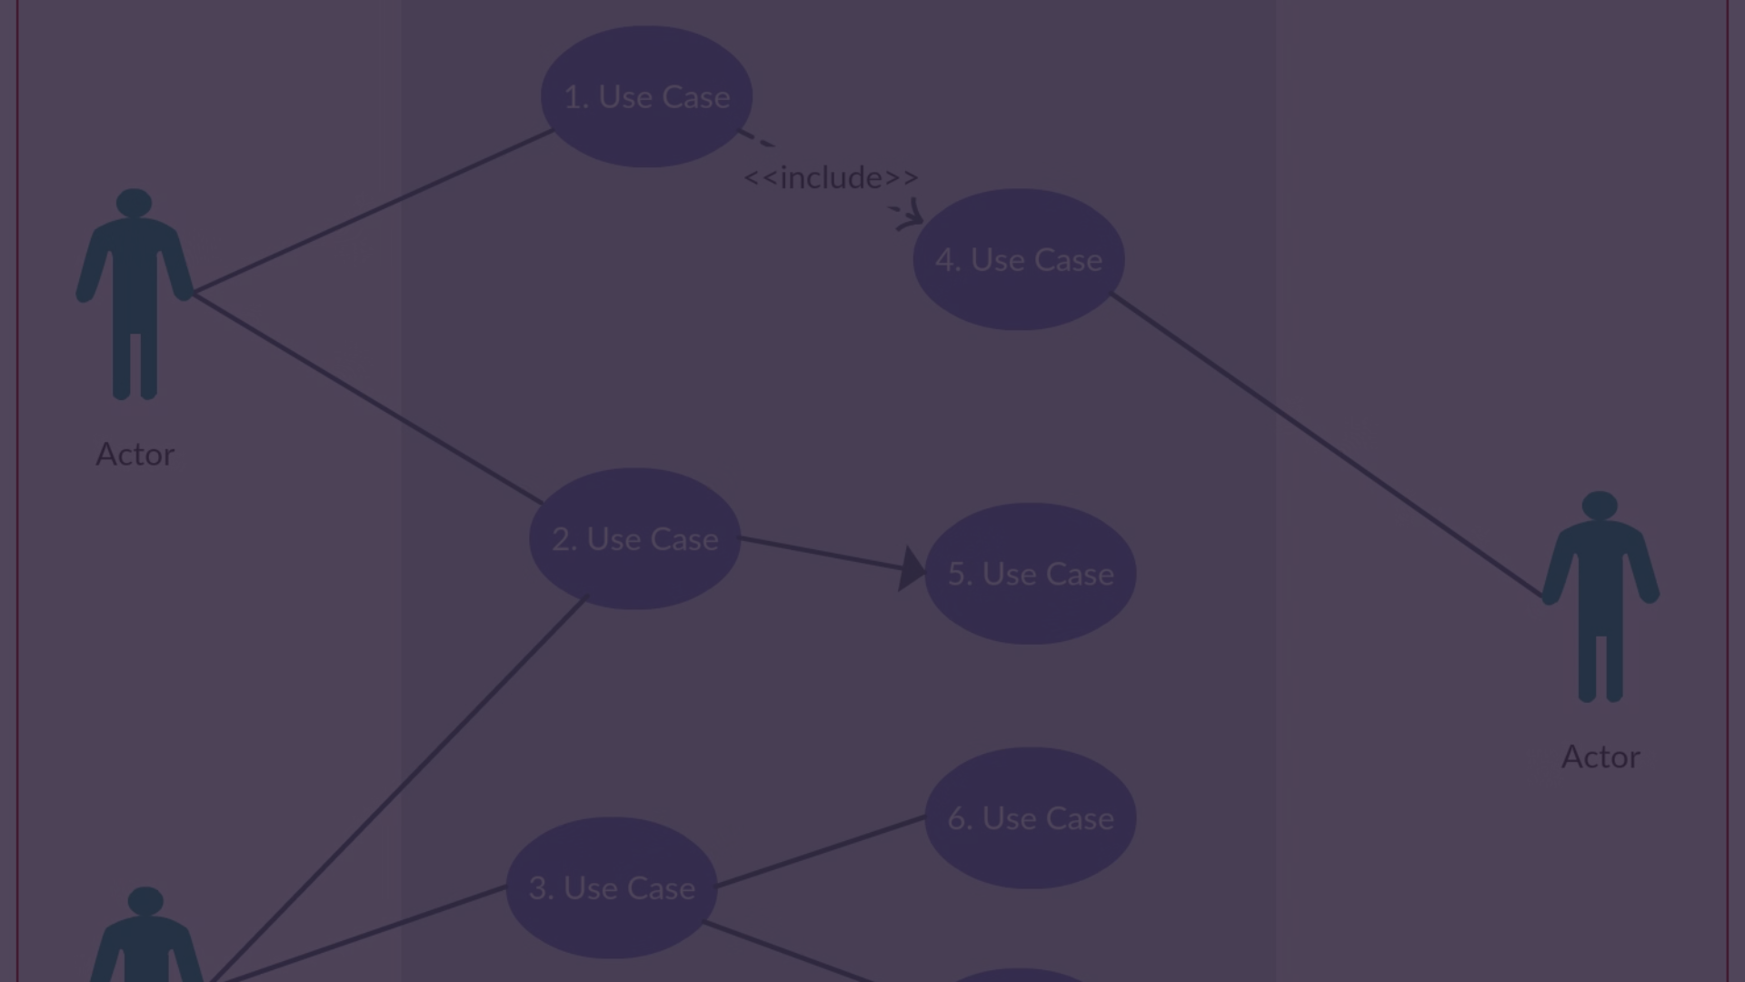
Use Cases
User Login
View Profile
Users log into the Broker System using their credentials, with the system verifying their identity through secure authentication methods to ensure the confidentiality and integrity of user accounts.
Users can access their current investment portfolio, which includes detailed information on each security, performance metrics, and the overall portfolio value, enabling them to monitor their investments.
1
2
3
Send Enquiry
In our system, if a buyer wants to purchase a property, they send an enquiry to the admin. The admin then handles the enquiry and manages the transaction process.
6

Slide 7



Diagrams
Use-case
Sequence
Class
The user interface allows users to interact with the Broker System, initiating actions such as logging in, placing orders, and accessing market data.
Live link:
https://drive.google.com/drive/folders/1ILm5lCUCaQS2B-293jBGCelIh2vCI0xH
The database stores user information, portfolio data, and historical transaction records, providing a secure and reliable storage solution for the Broker System.
Live link:
https://drive.google.com/drive/folders/1ILm5lCUCaQS2B-293jBGCelIh2vCI0xH
The trading engine is responsible for processing and executing buy and sell orders, ensuring the timely and accurate processing of trades.
Live link: https://drive.google.com/drive/folders/1ILm5lCUCaQS2B-293jBGCelIh2vCI0xH
7

Slide 8
Glossary
Broker(‘Delala’ in Amharic)
An individual or firm that arranges transactions between a buyer and a seller for a commission.
Seller(‘shach ’ in Amharic )
An order to buy or sell a security at a specific price or better.
Trade(‘gbyit’ in Amharic)
The action of buying or selling a security.
8

Slide 9




Conclusion
Robust Platform
The Broker System is designed to provide a robust, secure, and user-friendly platform for trading financial securities, addressing both functional and non-functional requirements to deliver an exceptional user experience.
Simplified Exchange
By facilitating the trading process, offering real-time market data, and ensuring the security of transactions, the Broker System aims to empower brokers and traders to make informed decisions and execute trades efficiently.
Scalable Solution
The system's scalable architecture and focus on performance, security, and reliability ensure that the Broker System can accommodate a growing user base and high transaction volumes, making it a comprehensive solution for the financial industry.
9

Slide 10
Future Developments
Mobile Trading
Payment integration
Geographical scope
The Broker System plans to introduce a mobile trading platform for users to access and execute trades on-the-go, enhancing convenience and flexibility. Currently, we work with the J-Tabor mobile app, but in the future, we aim to solely use web and mobile apps.
Currently, payment integration is not possible in the Broker System, but it is planned as a future enhancement.
The Broker System is focused on the Ethiopian real estate market, addressing its unique requirements and regulations. Future expansions may target other African markets, adapting to local real estate practices and laws.
10

