Slide 1
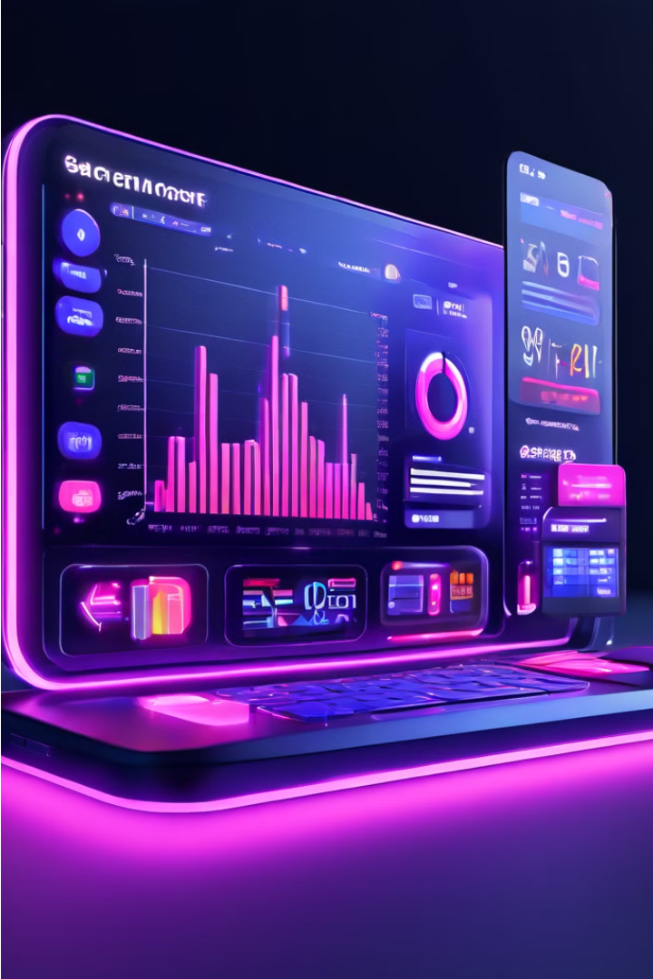
Broker System Overview
The Broker System is a comprehensive platform designed to facilitate the trading of financial securities, providing brokers and traders with a secure, efficient, and user-friendly environment. This system aims to streamline the trading process, offer real-time market data, and ensure the security of transactions and user information, catering to the needs of a growing user base and high transaction volumes.
1

Slide 2
System Architecture
User Interface
Trading Engine
Market Data
The Broker System features an intuitive and user-friendly interface that allows users to seamlessly access the platform's various functionalities. This includes secure login and registration processes, as well as the ability to execute trades, manage their investment portfolios, and access real-time market data.
At the core of the Broker System is the trading engine, responsible for processing and executing buy and sell orders for a variety of financial securities, including stocks, bonds, and derivatives. The trading engine supports different order types, such as market, limit, and stop orders, ensuring efficient and timely execution of trades.
The Broker System provides users with access to comprehensive real-time market data, including price quotes, trading volumes, and historical data. This information is presented through advanced analytics and charting tools, enabling users to make informed trading decisions.
2

Slide 3
Functional Requirements
1
User Authentication
2
Trade Execution
The system must support secure login and registration processes, including password encryption and two-factor authentication, to ensure the privacy and protection of user information.
Users must be able to execute buy and sell orders for various securities, with the system supporting different order types and providing timely execution.
3
Portfolio Management
4
Market Data and Analytics
Users should have the ability to view and manage their investment portfolios, including tracking the performance of individual securities and the overall portfolio value.
The system must provide users with access to real-time market data, including price quotes, trading volumes, and historical data, as well as advanced analytics and charting tools.
3

Slide 4
Non-Functional Requirements
Performance
Security
The Broker System must handle high volumes of transactions with minimal latency to ensure timely execution of trades, maintaining the efficiency and reliability of the platform.
The system must prioritize data privacy and protection against unauthorized access, implementing robust encryption, secure communication protocols, and regular security audits to safeguard user information and transactions.
Scalability
Usability
The Broker System should be designed to scale horizontally, accommodating an increasing number of users and transactions without compromising performance or reliability.
The system should offer an intuitive and user-friendly interface, with easy navigation and accessible features, ensuring a seamless and efficient user experience.
4

Slide 5
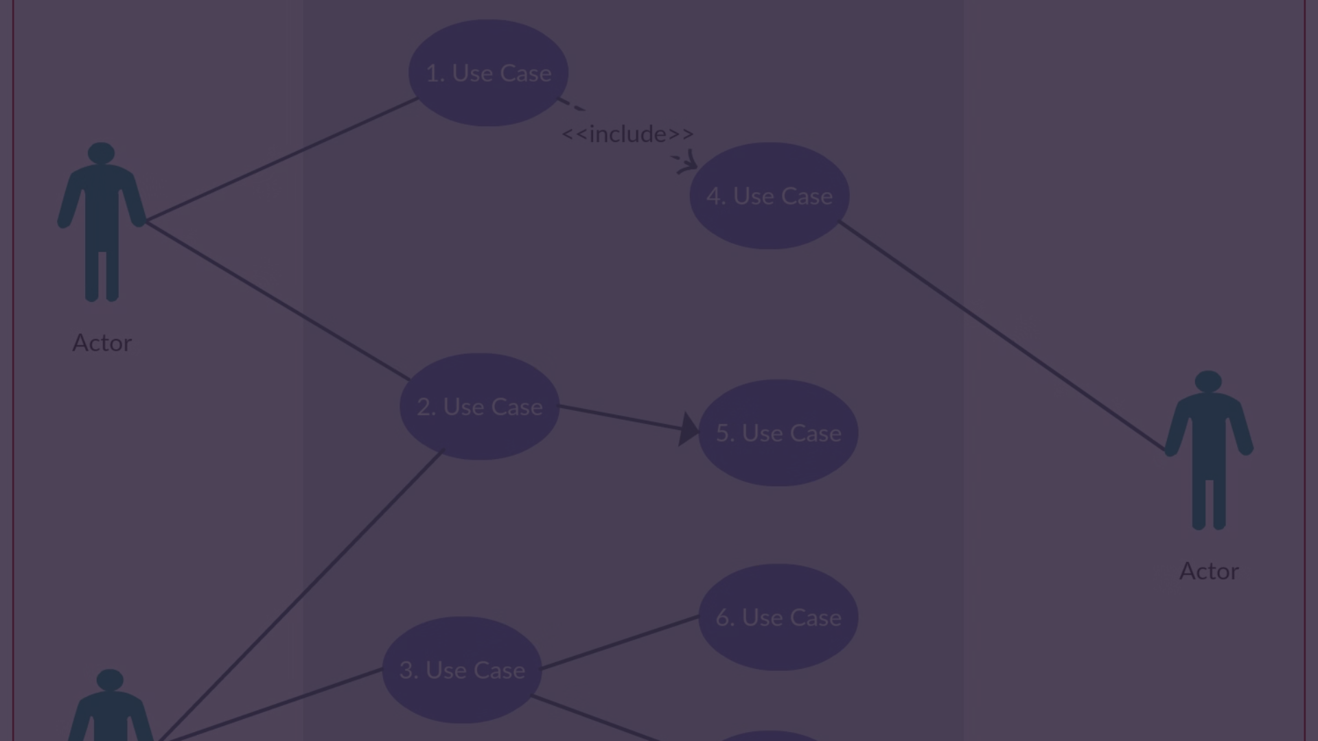
Use Cases
User Login
View Portfolio
Users log into the Broker System using their credentials, with the system verifying their identity through secure authentication methods to ensure the confidentiality and integrity of user accounts.
Users can access their current investment portfolio, which includes detailed information on each security, performance metrics, and the overall portfolio value, enabling them to monitor their investments.
1
2
3
Place Order
Users can place buy or sell orders for various securities, specifying the type of order (market, limit, or stop), quantity, and price. The system processes the order and provides confirmation of execution to the user.
5

Slide 6




Data Flow Diagrams
User Interface
Database
Trading Engine
Market Data
The user interface allows users to interact with the Broker System, initiating actions such as logging in, placing orders, and accessing market data.
The database stores user information, portfolio data, and historical transaction records, providing a secure and reliable storage solution for the Broker System.
The trading engine is responsible for processing and executing buy and sell orders, ensuring the timely and accurate processing of trades.
The market data component provides real-time financial information, such as price quotes and trading volumes, which is essential for users to make informed trading decisions.
6

Slide 7
Glossary
Broker
An individual or firm that arranges transactions between a buyer and a seller for a commission.
Security
A financial instrument that represents an ownership position in a corporation (stock), a creditor relationship with a governmental body or a corporation (bond), or rights to ownership as represented by an option.
Trade
The action of buying or selling a security.
Portfolio
A collection of investments held by an individual or institution.
Market Order
An order to buy or sell a security immediately at the best available current price.
Limit Order
An order to buy or sell a security at a specific price or better.
Stop Order
An order to buy or sell a security once the price reaches a specified point.
7

Slide 8




Conclusion
Robust Platform
The Broker System is designed to provide a robust, secure, and user-friendly platform for trading financial securities, addressing both functional and non-functional requirements to deliver an exceptional user experience.
Streamlined Trading
By facilitating the trading process, offering real-time market data, and ensuring the security of transactions, the Broker System aims to empower brokers and traders to make informed decisions and execute trades efficiently.
Scalable Solution
The system's scalable architecture and focus on performance, security, and reliability ensure that the Broker System can accommodate a growing user base and high transaction volumes, making it a comprehensive solution for the financial industry.
8

Slide 9
Future Developments
Mobile Trading
Artificial Intelligence
Blockchain Integration
The Broker System plans to introduce a mobile trading platform, allowing users to access the system and execute trades on-the-go, further enhancing the convenience and flexibility of the platform.
The Broker System is exploring the integration of blockchain technology to enhance the security and transparency of financial transactions, further solidifying its position as a cutting-edge solution in the evolving fintech landscape.
The incorporation of advanced analytics and machine learning algorithms will enable the Broker System to provide users with personalized investment recommendations and automated trading strategies, empowering them to make more informed and data-driven decisions.
9

