Slide 1
Analysis_Tools_MWLab
5/30/2019, Thomas Rust, PhD

Slide 2
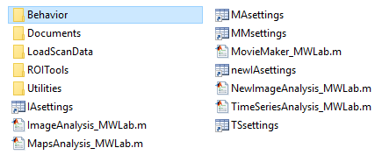
Overview
Review of Current Programs
Questions, Suggestions
Management Discussion

Slide 3
Quick Lesson in MATLAB Graphics Handles
hroot = groot; “get graphics root object”
Root properties: see Children, CurrentFigure, Units, ScreenSize, etc
hfig = figure; -or- hfig=gcf; “get current figure”
Figure properties: (parent = hroot)
hfig.Number(read only); hfig.Name: ‘’; hfig.Color: [0.94 0.94 0.94]
Units: default – ‘pixels’; Position: [680 678 560 420 ]; [left bottom width height]
hfig.Units = “normalized”, hfig.Position = [0.35 0.56 0.29 0.35], (related to hroot.ScreenSize)
hax = Axes(hfig) (hax=gca; “get current axes”)
Axes properties (parent = hfig, …or could be a UIpanel)
Units, position (relative to parent figure)
XLim,XTick, XLabel, etc. plus Y/Z Clim, Colormap, and so on…
CameraPosition, CameraTarget, CameraAngle control 2D-3D views (whoa!)
UIControl objects (pushbutton, checkbox, slider, listbox, etc., see uicontrol properties)
“Callback functions” For help, search: callback definition

Slide 4
Loading Scan Data
LoadFile_MWLab - loads data to command window or GUIs
Scanbox
TTL inputs saved as timestamp w/frame#, line# in info file,
*.ephys files – loaded if available, improves framerate estimates!
ScanImage
TTL inputs saved as times in .tif headers
**data are converted to uint16 w/offset = median of min values of first 60 frames (~4sec@15Hz)**
Latest development: improved framerate estimates!
Neuroplex.m – aux BNC voltages converted to binary signals
MWfile struct : Type, dir, name, size, frames, framerate, im(cell for 2-channel data)
getFileInfo.m, getImageSize.m, getNumChannels.m

Slide 5
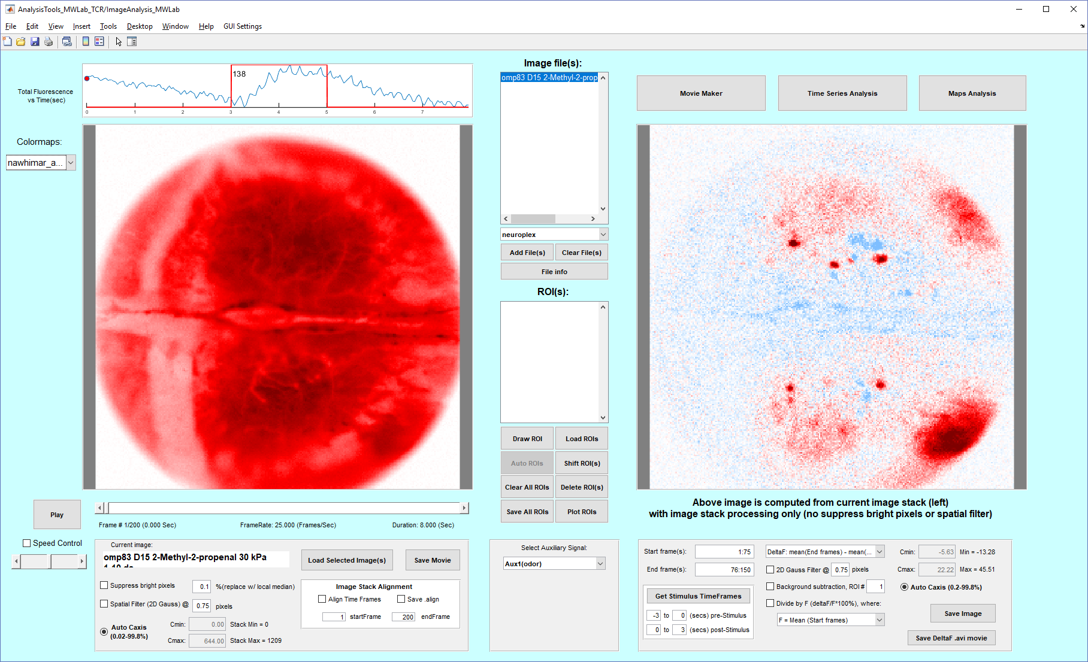
Main Analysis GUI’s
ImageAnalysis
view data from all rigs
make maps w/ all odor trials
MapsAnalysis
MapsData (base, response)
Best tool for drawing ROIs
Export .tif stacks, ORdata
MovieMaker
Avg odor trials, show rois
Make movies w/traces

Slide 6
Time SerieS Analysis
hTS=TimeSeriesAnalysis; (or click on controls figure, type: “hTS = gcf”) see “UserData”
TSdata (full-length time series) - AKA “App Data”
hTS.UserData.TSdata.file().roi().{time,series}
ROIs have sub-frame time shifts (based on centroid y-position)
plotdata{} – current figure(s) w/interpolation and averaging
Example: hTS.UserData.plotdata{}.file().roi().odor().trial().{time,series}
Background ROI subtraction (interpolated to exact times for each ROI)
ROIs combined by weighted “average” (#pixels)
Use Aux signals to get pre- to post-stim frames (see getAllOdorTrials.m)
TSdata interpolated to 150Hz (MATLAB interp1 w/“pchip”)
Low/High pass filters; DF, DF/F calculations are done
Last: Files/Odors/Trials selected & averaged (all trials weighted equally)

Slide 7
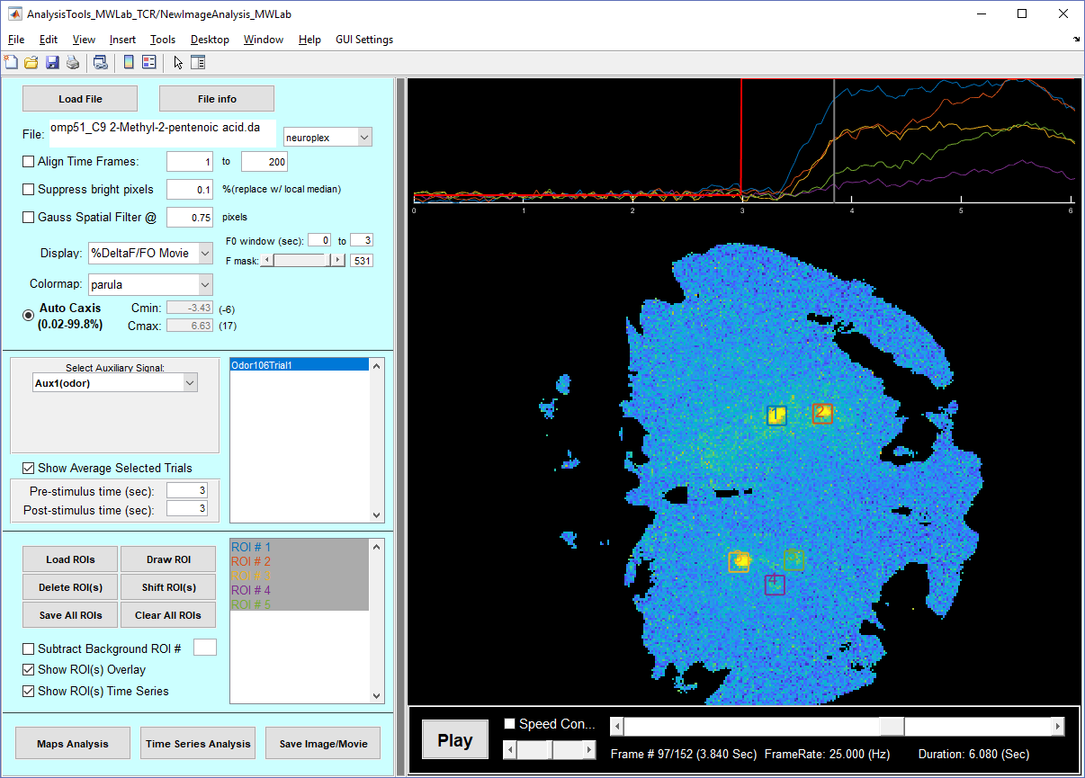
New Image Analysis
Load 1 file - no list
Show Images or Movies (and save)
Select odors/trials, average
Draw ROIs - any frame
Show traces w/Movie
Establish your methods
Open multiple files in other GUIs: TimeSeriesAnalysis or MapsAnalysis, or use doBatchProcessing.m script

Slide 8
Utilities Folder
“getdatatypes.m” and “getauxtypes.m”
doBatchProcessing – copy, edit, run
Alignfiles, alignmeanfiles, make/save mapsdata, (do traces w/ ROIs)
Odor trials processing not currently included
Updates to alignImage, alignMeanImages
getAllOdorTrials (1 file, outputs are not trials - frame indices)
[allOdorTrials] = getAllOdorTrials(auxtype,prestimtime,poststimtime,mwfile)
allOdorTrials.odor().trial().{auxindex,imindex} = which frames to grab
makeMaps
Maps = makeMaps(mwdata, stim2use, baseTimes, respTimes)
Mapsdata.file().odor().trial().{baseframes,baseim,respframes,respim}

Slide 9
Other Folders: ROI Tools/ Behavior/ Docs/
ROIs GUI (drawROI_refine.m) – combines thresholding w/ region growing
Registration GUI
Register images/rois to olfactory bulb coordinate system
See ”OdorRespFile” button in MapsAnalysis
ROIvsOdorGUI.mlapp – new GUI for comparing odor response matrices
BehaviorAnalysis_MWLab (replaces olfactometry.m)
TSdata2BehaviorData.m, TSplotData2olf.m
Use if *.ephys data are available.
DetectSniffsGUI – finds inhalations, exhalations and more (other applications?)
Documents – detailed explanations to help the next programmer (you!)
Also see: “olfactometry_tcrcopy/HopeThisHelps_Olfactometry.docx”

Slide 10
Questions / Suggestions
“Nullius in Verba”
-Don’t take my (or anybody’s) word for it.

Slide 11
Management Discussion
Option #1 – To each his/her own; Make a copy and go…
Option #2 – Put someone in charge of updates
Option #3 – Move it to GITHub (shared ownership)
Other Ideas…

Slide 12
Suggested Future Work
Data Acquisition
Write a dashboard program to drive experiments and trigger 2p imaging rigs
Try: WaveSurfer (https://wavesurfer.janelia.org/) in MATLAB
Data Server / Compute Server (Center for High Performance Computing)
Machine Learning and Data Mining
Automatic ROI selection
Try Trainable WEKA segmentation in ImageJ
Try Suite 2P (convert data to HTF5)
Develop a method to use our existing ROI tools to train Neural Network
Add TSdata & MapsData to experiments Database
NWB – Neurodata w/out borders (structured HTF5 file format)

Slide 13
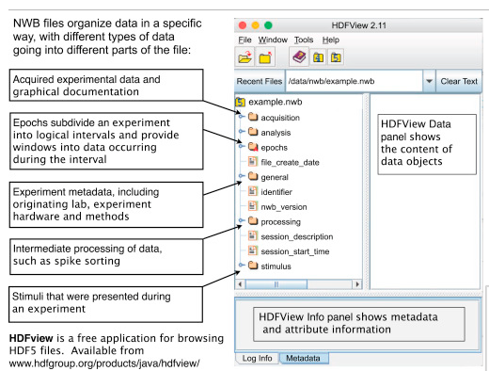
Example NWB File
Resources:
https://www.nwb.org/
https://neurodatawithoutborders.github.io/
Neuron, Vol 88, Issue 4, 18 Nov 2015, 629:634

Slide 14
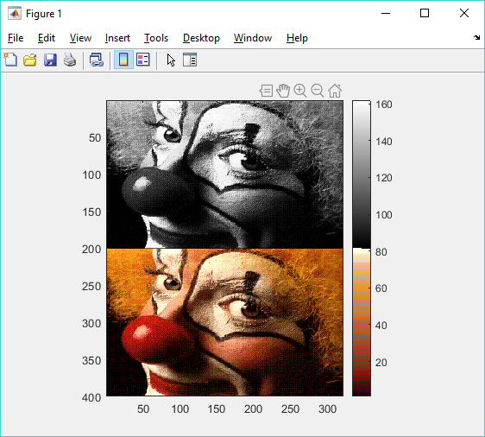
Thank you!
And always remember that success is 50% inspiration and 50% expiration

