Slide 1
Time Series Averaging vs Interleaving
Thomas C. Rust, PhD
Wachowiak Lab
University of Utah

Slide 2
Time Series Average vs Interleave
Combining time series data (traces) in the wake of odor presentations is often employed to improve signal quality
Imaging frames are not usually synchronized perfectly with odor presentations
There are many ways to combine traces
“Averaging” uses interpolation & resampling prior to combining signals
“Interleaving” combines signals first, followed by resampling to obtain uniform temporal spacing

Slide 3
Example Data (pcd196004.tif)

Slide 4
Average Trials Method
Interpolate and upsample(10x)
newTS=interp1(imTimes,time_series,newTimes,'pchip‘);
Select each trial, and time shift to stimulus
Average the trials
Pros: simple approach, works fine for signal information > 2x sampling frequency
Cons: interpolation step filters the signal, as compared to interleaving

Slide 5
Example: Average Trials

Slide 6
Interleave Trials Method
Time shift original trace based on stimulus
Result is a series of interleaved data points with uneven temporal sampling
Interpolate to evenly-spaced time points
See TimeSeriesAnalysis_MWLab.m for details (line ~1000)
Pros: creates a single trial, with higher sampling frequency than original signal (aka “harmonic sampling”)
Cons: Results in high frequency “noise” (usually you will want to apply a Low-pass filter after). Baseline drift may contribute to this effect.

Slide 7
Example: Interleave Trials

Slide 8
Side-by-side
Averaging (left) gives “nice” smooth signal
Interleaving (right) improves high frequency details.
Difference in amplitude is noticeable

Slide 9
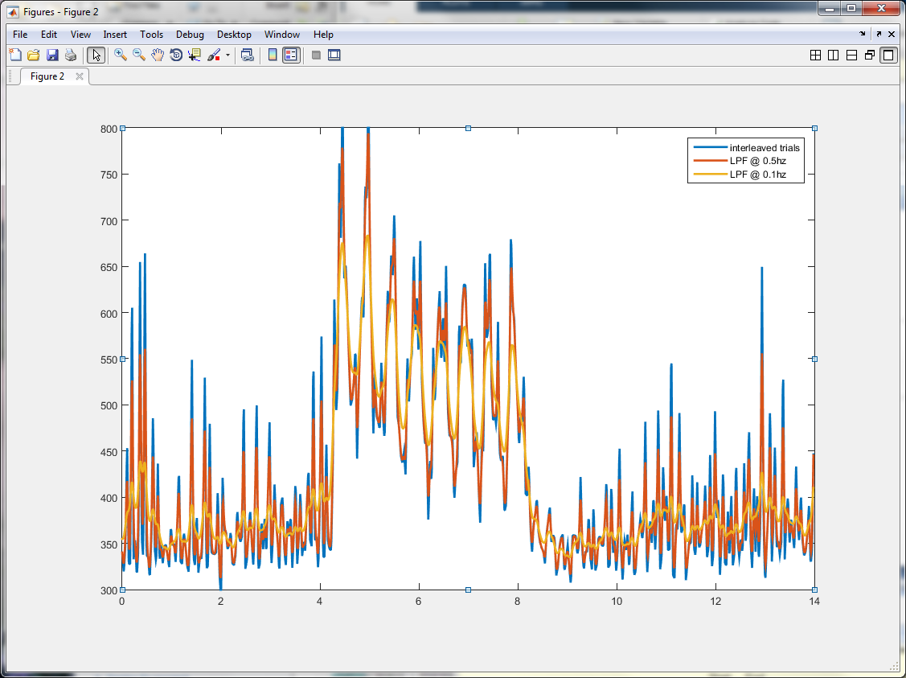
Interleaving w/ post-filter
Increase filter to look more like “averaging”

Slide 10
TEST CASE: Sniff signal w/square wave
Input: 2hz x 8 pulse square wave to represent controlled sniff response signal
4s delay, 4s on, 36sec off, 8 trials
Record: images 128x126 @3.8 Hz per frame
0sec
4s
8s
44s
48s
Etc…
0 frame
15
30
168
183
Etc…
Note: As of 2016, we now acquire images at 15Hz or faster!

Slide 11
Example Images: Trial #1
3.93 – 4.19 sec
Frame # 16
#17
#18
#19
#20
#21
#22
#23
#24
#25
#26
#27
#28
#29
#30
7.86 sec

Slide 12
ROI Images
ROI#1 – FOV
ROI#2 – vertical
ROI#3 – horizontal
ROI#4 – center
ROI#5 - corner
Note: rows are acquired at slightly different times
Background image: mean(frames #16-30)

Slide 13
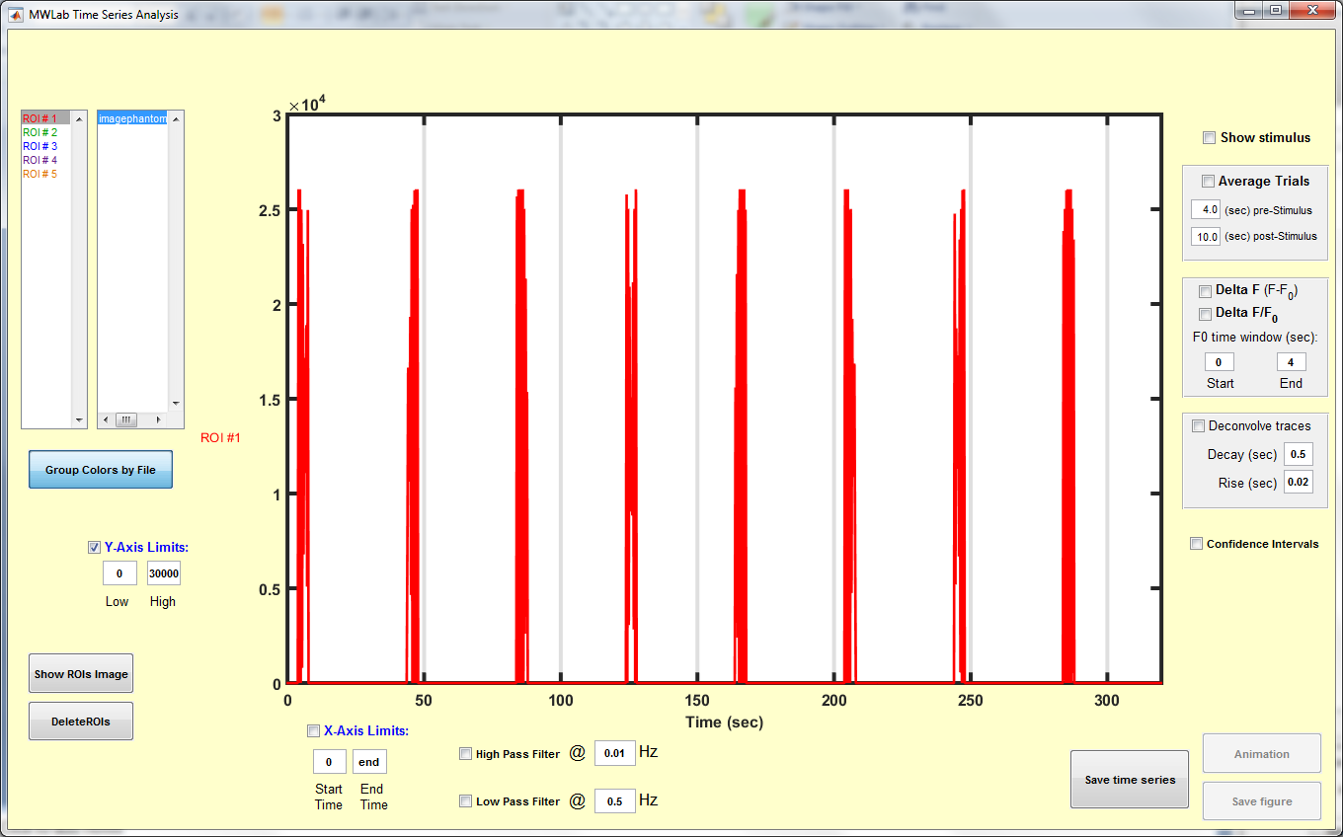
Time Series – ROI#1

Slide 14
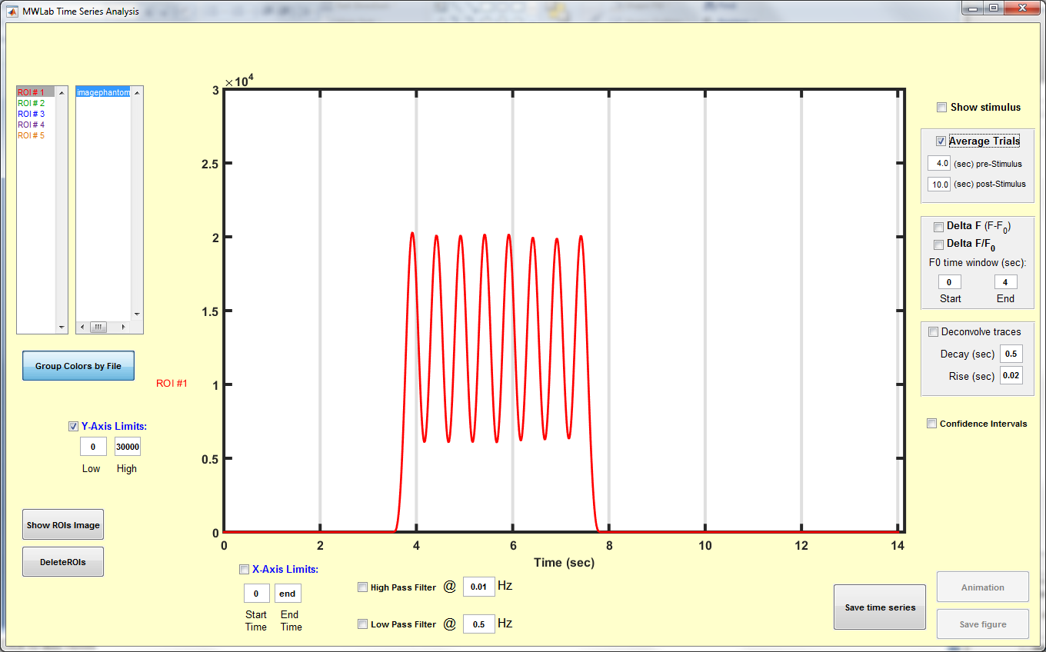
Method #1: Average Trials
ROI#1: Entire Image

Slide 15
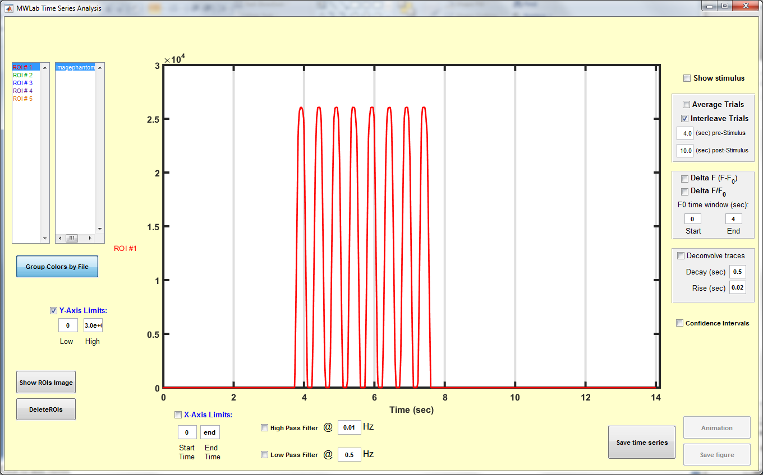
Method #2: Interleave Trials
ROI#1: Entire Image

Slide 16
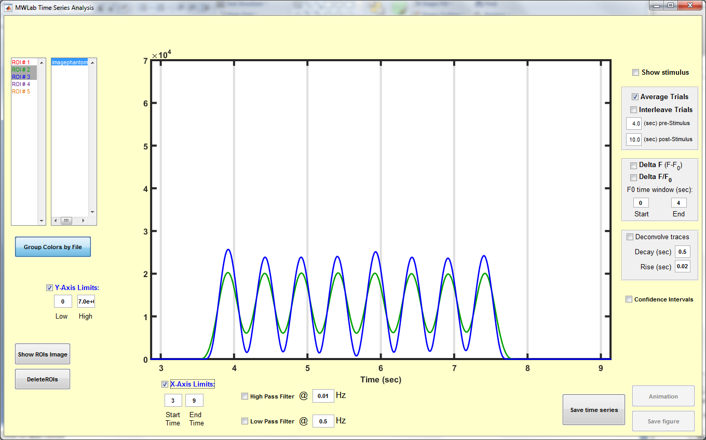
Vertical vs Horizontal ROIs
Method #1: Average Trials

Slide 17
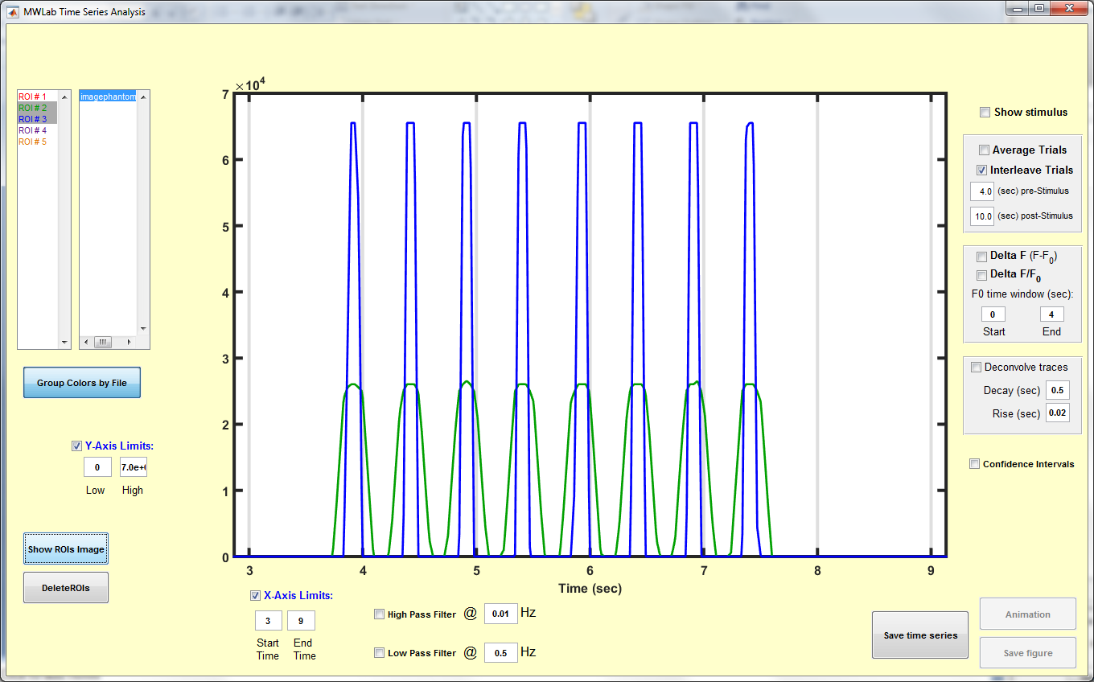
And the winner is… Interleaving
Further improvement for vertical ROI by treating each row of image separately?

Slide 18
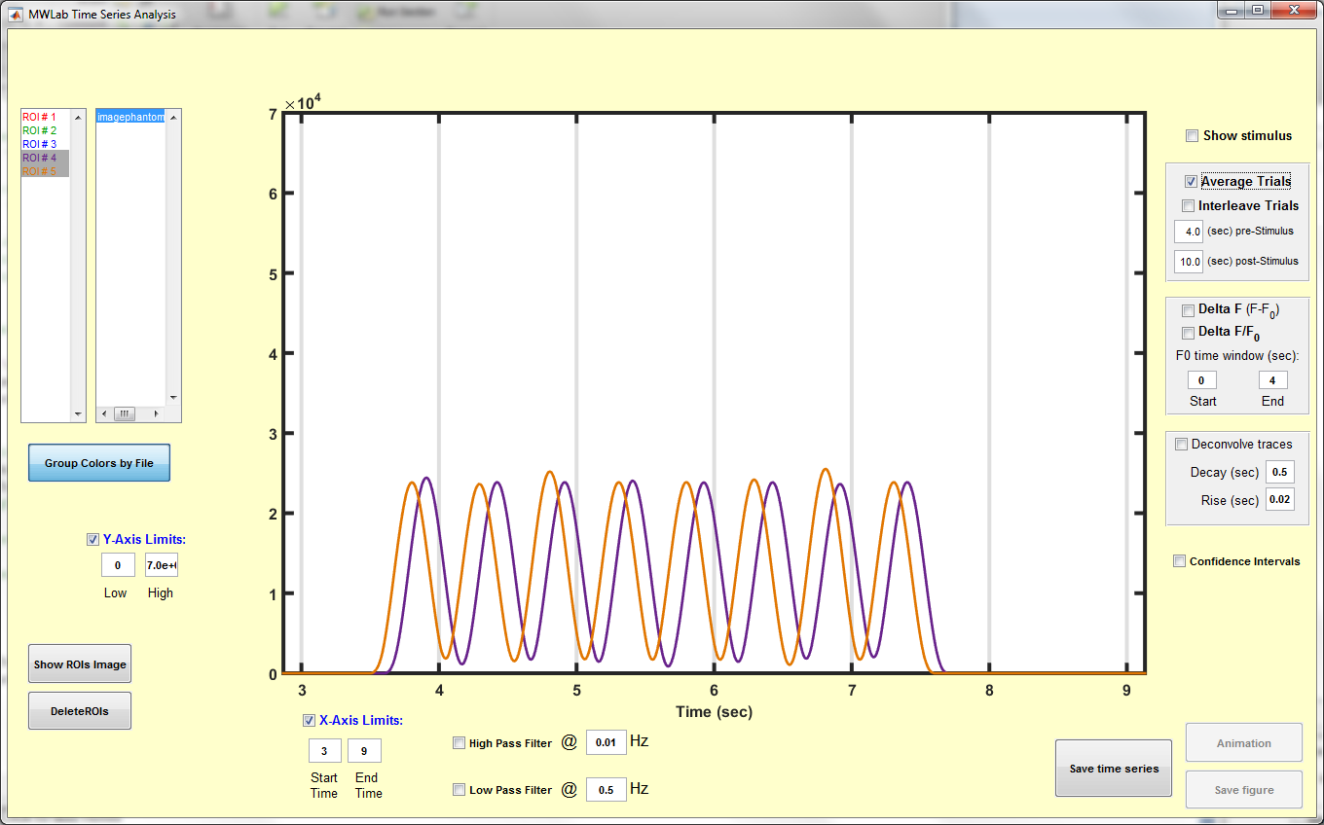
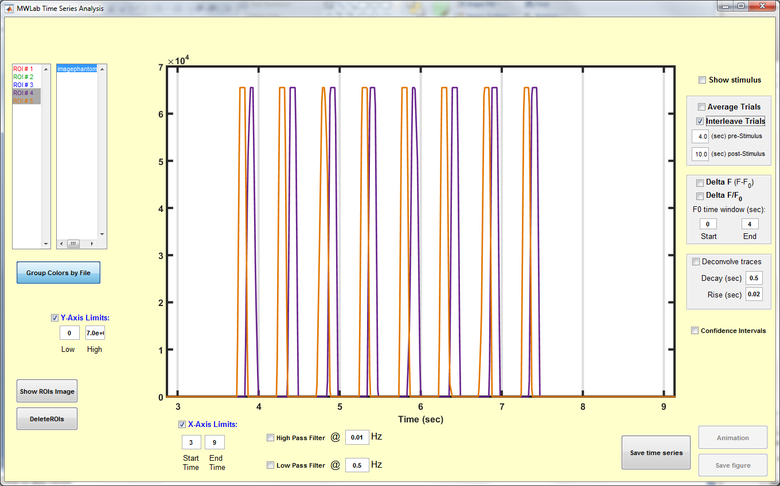
Same result for small ROIs
Method#1: average trials
Method#2: interleave trials

Slide 19
Discussion & Conclusions
Interleaving method is significantly different and recovers high frequency time signals more accurately
Averaging method is essentially a filter
Filter interleaving results to compare
Suggested future work:
Evaluate further using physiological signals
Apply row by row (or pixelwise) time shifts to image data prior to computing time series

