Slide 1
A1 Conceptual Architure of Apollo
Cisc 322 Group 20
YouTube: https://youtu.be/Ud1Wr7h7Yss

Slide 2

Intro
Members:
Yucan Li (Planning, Sequential Diagram, Group Leader) 18yl259@queensu.ca
Yuzhe He (Perception, Prediction) 18yh46@queensu.ca
Xuchuan Mu (Monitor, HMI) 18xm24@queensu.ca
Yiming Zheng (Control, CANBus, PowerPoint Editor) 19yz38@queensu.ca
Wenran Hou (Localization, Video Editor) 18wh10@queensu.ca
Mukun Liu (Map, Routing) 19ml13@queensu.ca

Slide 3

Apollo
Apollo is an open-source platform which enables autonomous driving developed by Baidu. We are focusing on several functional modules inside Open Software Platform including Map Engine, Routing, Localization, Perception, Prediction, Planning, Control, CANBus, Guardian, Monitor and HMI.

Slide 4
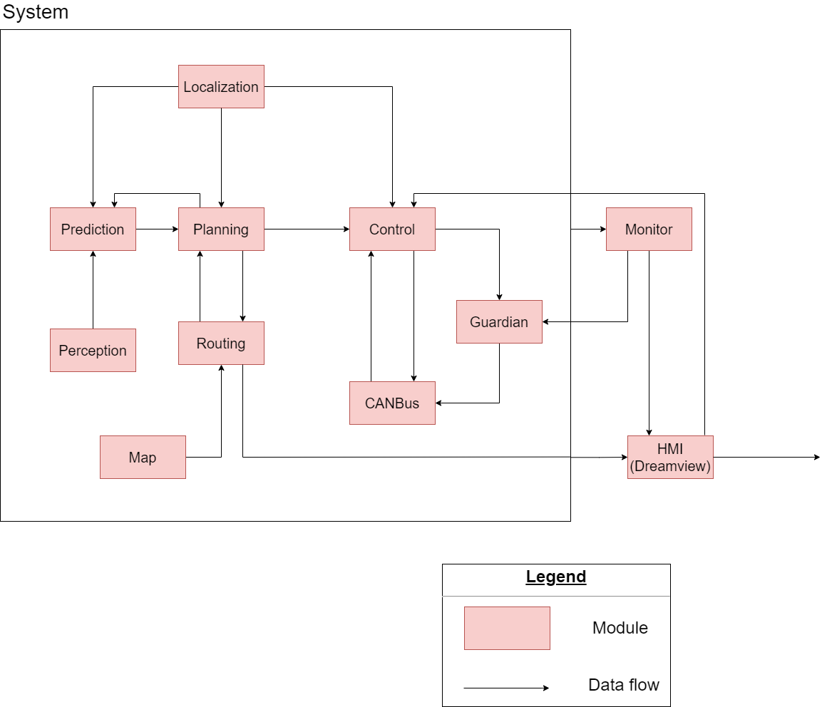
Conceptual Architecture

Slide 5
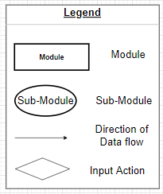
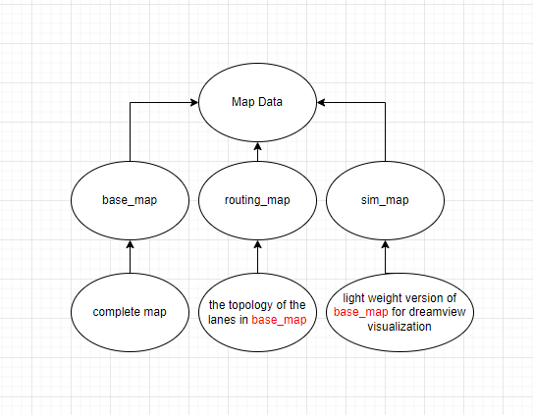
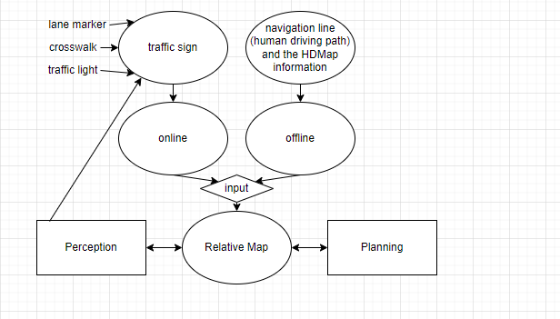

Map
Goal: load the map and provide a series of API for others to use.

Slide 6
Routing
find the shortest route between the departure and destination.
Inputs:
request of routing map info
trajectory of the shortest route

Slide 7
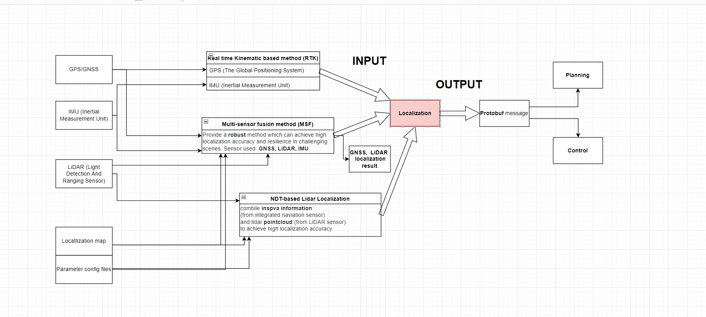
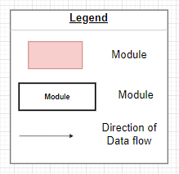
Localization
locate the temporal position of the vehicle an out

Slide 8

Perception
recognize surrounding obstacles

Slide 9
Prediction
predict the movement of obstacles and provide each trajectory a proability value

Slide 10
Planning
plans a suitable trajectory of the vehicle, generates a navigation routing.

Slide 11

Control
commands the vehicle, gives orders including acceleration, speed, and steering

Slide 12
CANBus
CAN(Controller Area Network)
Bus
Chassis

Slide 13
Guardian
The final protection

Slide 14
Monitor
Monitoring the entire system
Hardware monitor
Software monitor

Slide 15

HMI (DreamView)
The web app that visuallize the current state of the vehicle and driving.

Slide 16
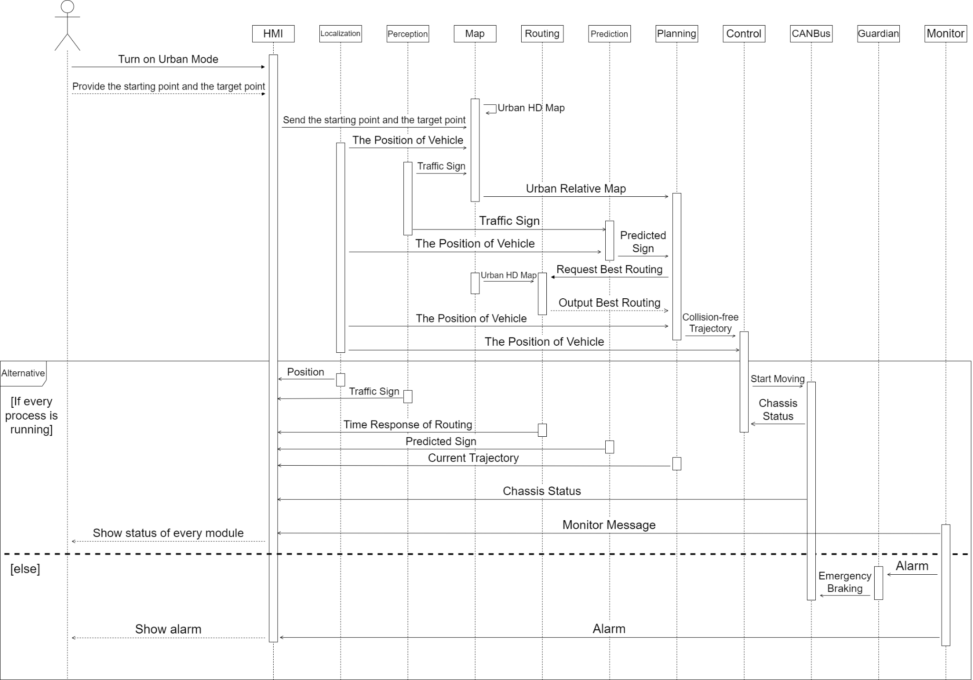
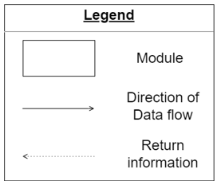
Diagram (Urban Mode)

Slide 17
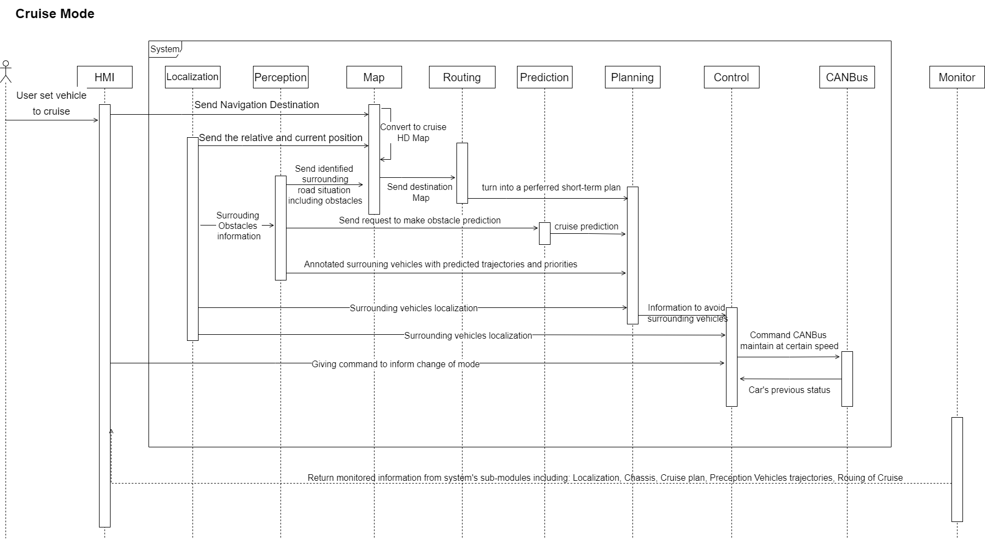
Diagram (Cruise Mode)

Slide 18
Derivation
We met problems like ambiguous documents.

Slide 19
Learned Lesson
We understand how software is built up piece by piece and how each single module plays their role in the system.

Slide 20
Conclusion
Pipe-and-filter architecture style.
The whole sub-modules in Apollo are able to cooperate with each other and perform autonomous driving.
Concurrency: highly automatic and quick responses

Slide 21
Reference
apollo developers‘s centre. Apollo. (n.d.). Retrieved February 19, 2022, from https://apollo.auto/developer/index_cn.html#/

Slide 22
Thanks for watching

