Slide 1
Evolutionary Computing
Chapter 1

Slide 2
Chapter 1: Problems to be solved
Problems can be classified in different ways:
Black box model
Search problems
Optimisation vs constraint satisfaction
NP problems

Slide 3
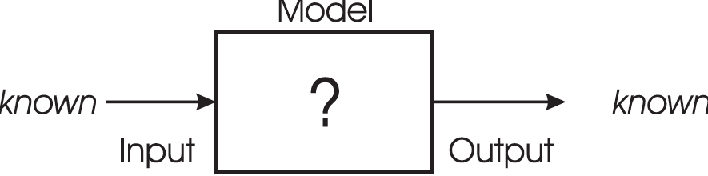
“Black box” model
“Black box” model consists of 3 components
When one component is unknown: new problem type

Slide 4
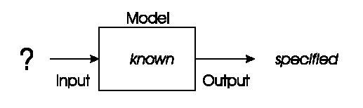
“Black box” model: Optimisation
Model and desired output is known, task is to find inputs
Examples:
Time tables for university, call center, or hospital
Design specifications
Traveling salesman problem (TSP)
Eight-queens problem, etc.

Slide 5
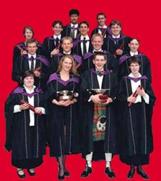
“Black box” model: Optimisation example 1: university timetabling
Enormously big search space
Timetables must be good
“Good” is defined by a number of competing criteria
Timetables must be feasible
Vast majority of search space is infeasible

Slide 6
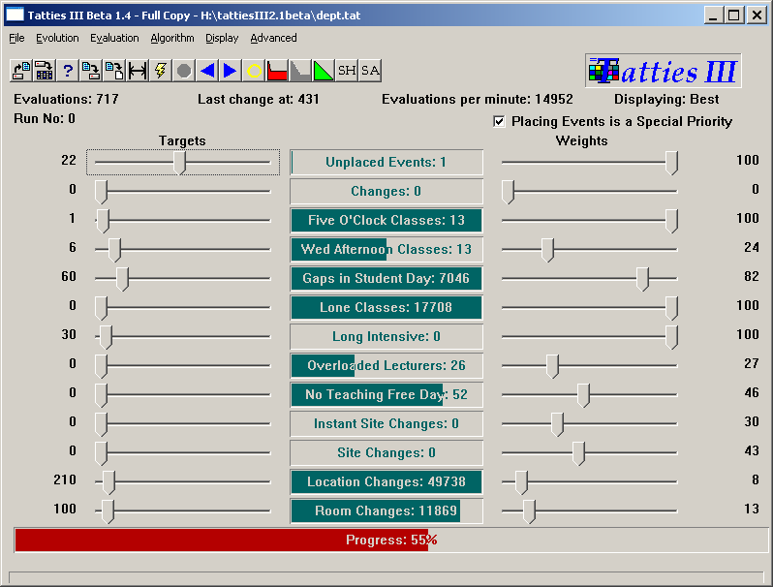

Slide 7
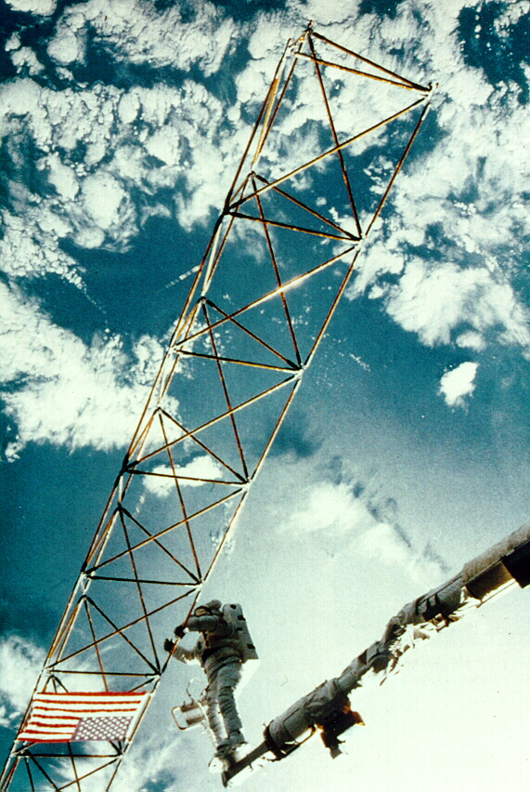
“Black box” model: Optimisation example 2: satellite structure
Optimised satellite designs for NASA to maximize vibration isolation
Evolving: design structures
Fitness: vibration resistance
Evolutionary “creativity”

Slide 8
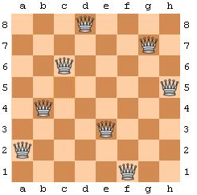
“Black box” model: Optimisation example 3: 8 queens problem
Given an 8-by-8 chessboard and 8 queens
Place the 8 queens on the chessboard without any conflict
Two queens conflict if they share same row, column or diagonal
Can be extended to an n queens problem (n>8)

Slide 9
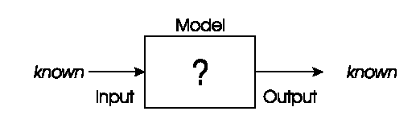
“Black box” model: Modelling
We have corresponding sets of inputs & outputs and seek model that delivers correct output for every known input
Note: modelling problems can be transformed into optimisation problems
Evolutionary machine learning
Predicting stock exchange
Voice control system for smart homes

Slide 10
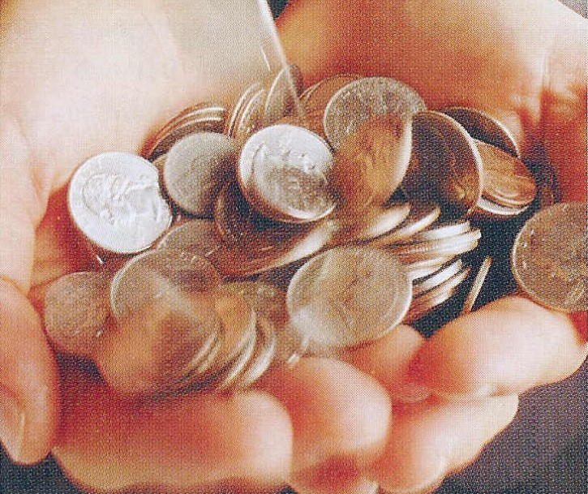
“Black box” model: Modelling example: load applicant creditibility
British bank evolved creditability model to predict loan paying behavior of new applicants
Evolving: prediction models
Fitness: model accuracy on historical data

Slide 11
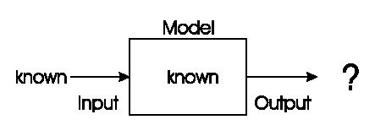
“Black box” model: Simulation
We have a given model and wish to know the outputs that arise under different input conditions
Often used to answer “what-if” questions in evolving dynamic environments
Evolutionary economics, Artificial Life
Weather forecast system
Impact analysis new tax systems

Slide 12

“Black box” model: Simulation example: evolving artificial societies
Simulating trade, economic competition, etc. to calibrate models
Use models to optimise strategies and policies
Evolutionary economy
Survival of the fittest is universal (big/small fish)

Slide 13
“Black box” model: Simulation example 2: biological interpretations
Incest prevention keeps evolution from rapid degeneration
(we knew this)
Multi-parent reproduction, makes evolution more efficient
(this does not exist on Earth in carbon)
2nd sample of Life
Picture censored

Slide 14
Search problems
Simulation is different from optimisation/modelling
Optimisation/modelling problems search through huge space of possibilities
Search space: collection of all objects of interest including the desired solution
Question: how large is the search space for different tours through n cities?
Benefit of classifying these problems: distinction between - search problems, which define search spaces, and
- problem-solvers, which tell how to move through search spaces.

Slide 15
Optimisation vs. constraint satisfaction (1/2)
Objective function: a way of assigning a value to a possible solution that reflects its quality on scale
Number of un-checked queens (maximize)
Length of a tour visiting given set of cities (minimize)
Constraint: binary evaluation telling whether a given requirement holds or not
Find a configuration of eight queens on a chessboard such that no two queens check each other
Find a tour with minimal length where city X is visited after city Y

Slide 16
Optimisation vs. constraint satisfaction (2/2)
When combining the two:
Where do the examples fit?
Note: constraint problems can be transformed into optimisation problems
Question: how can we formulate the 8-queens problem in to a FOP/CSP/COP?
 | Objective function
Constraints | Yes | No
Yes | Constrained optimisation problem | Constraint satisfaction problem
No | Free optimisation problem | No problem

Slide 17
NP problems
We only looked at classifying the problem, not discussed problem solvers
This classification scheme needs the properties of the problem solver
Benefit of this scheme: possible to tell how difficult the problem is
Explain the basics of this classifier for combinatorial optimisation problems (booleans or integers search space)

Slide 18
NP problems: Key notions
Problem size: dimensionality of the problem at hand and number of different values for the problem variables
Running-time: number of operations the algorithm takes to terminate
Worst-case as a function of problem size
Polynomial, super-polynomial, exponential
Problem reduction: transforming current problem into another via mapping

Slide 19
NP problems: Class
The difficultness of a problem can now be classified:
Class P: algorithm can solve the problem in polynomial time (worst-case running-time for problem size n is less than F(n) for some polynomial formula F)
Class NP: problem can be solved and any solution can be verified within polynomial time by some other algorithm (P subset of NP)
Class NP-complete: problem belongs to class NP and any other problem in NP can be reduced to this problem by al algorithm running in polynomial time
Class NP-hard: problem is at least as hard as any other problem in NP-complete but solution cannot necessarily be verified within polynomial time

Slide 20
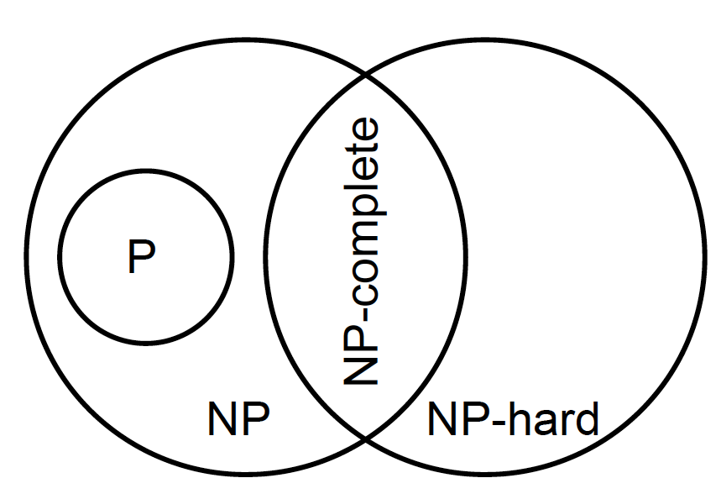
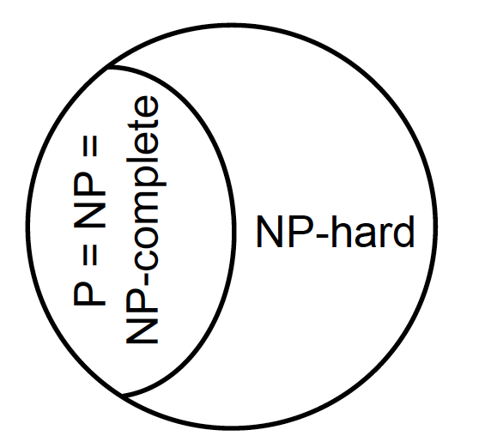
NP problems: Difference between classes
P is different from NP-hard
Not known whether P is different from NP
P ≠ NP P = NP
For now: use of approximation algorithms and metaheuristics

