Slide 1
Evolutionary Computing
Chapter 3

Slide 2
Recap of EC metaphor (1/2)
A population of individuals exists in an environment with limited resources
Competition for those resources causes selection of those fitter individuals that are better adapted to the environment
These individuals act as seeds for the generation of new individuals through recombination and mutation
The new individuals have their fitness evaluated and compete (possibly also with parents) for survival.
Over time Natural selection causes a rise in the fitness of the population

Slide 3
Recap of EC metaphor (2/2)
EAs fall into the category of “generate and test” algorithms
They are stochastic, population-based algorithms
Variation operators (recombination and mutation) create the necessary diversity and thereby facilitate novelty
Selection reduces diversity and acts as a force pushing quality

Slide 4
Chapter 3: What is an Evolutionary Algorithm?
Scheme of an EA
Main EA components:
Representation / evaluation / population
Parent selection / survivor selection
Recombination / mutation
Examples: eight-queens problem
Typical EA behaviour
EAs and global optimisation
EC and neighbourhood search

Slide 5
Scheme of an EA: General scheme of EAs
Parent selection
Parents
Intialization
Recombination
(crossover)
Population
Mutation
Termination
Offspring
Survivor selection

Slide 6
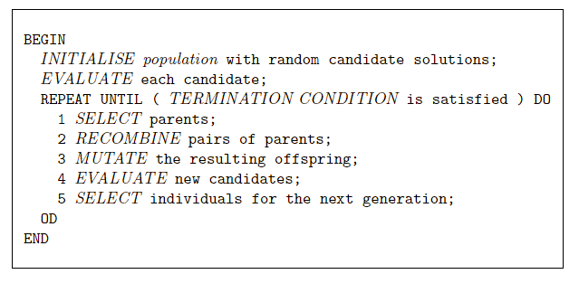
Scheme of an EA: EA scheme in pseudo-code

Slide 7
Scheme of an EA: Common model of evolutionary processes
Population of individuals
Individuals have a fitness
Variation operators: crossover, mutation
Selection towards higher fitness
“survival of the fittest” and
“mating of the fittest”
Neo Darwinism:
Evolutionary progress towards higher life forms
=
Optimization according to some fitness-criterion
(optimization on a fitness landscape)

Slide 8
Scheme of an EA: Two pillars of evolution
There are two competing forces
Increasing population diversity by genetic operators
mutation
recombination
Push towards novelty
Decreasing population diversity by selection
of parents
of survivors
Push towards quality

Slide 9
Main EA components: Representation (1/2)
Role: provides code for candidate solutions that can be manipulated by variation operators
Leads to two levels of existence
phenotype: object in original problem context, the outside
genotype: code to denote that object, the inside (chromosome, “digital DNA”)
Implies two mappings:
Encoding : phenotype=> genotype (not necessarily one to one)
Decoding : genotype=> phenotype (must be one to one)
Chromosomes contain genes, which are in (usually fixed) positions called loci (sing. locus) and have a value (allele)

Slide 10
Main EA components: Representation (2/2)
Example: represent integer values by their binary code
Phenotype space
Genotype space
Encoding
(representation)
10010
18
10
2
9
1001
Decoding
(inverse representation)
In order to find the global optimum, every feasible solution must be represented in genotype space

Slide 11
Main EA components: Evaluation (fitness) function
Role:
Represents the task to solve, the requirements to adapt to (can be seen as “the environment”)
Enables selection (provides basis for comparison)
e.g., some phenotypic traits are advantageous, desirable, e.g. big ears cool better, these traits are rewarded by more offspring that will expectedly carry the same trait
A.k.a. quality function or objective function
Assigns a single real-valued fitness to each phenotype which forms the basis for selection
So the more discrimination (different values) the better
Typically we talk about fitness being maximised
Some problems may be best posed as minimisation problems, but conversion is trivial

Slide 12
Main EA components: Population (1/2)
Role: holds the candidate solutions of the problem as individuals (genotypes)
Formally, a population is a multiset of individuals, i.e. repetitions are possible
Population is the basic unit of evolution, i.e., the population is evolving, not the individuals
Selection operators act on population level
Variation operators act on individual level

Slide 13
Main EA components: Population (2/2)
Some sophisticated EAs also assert a spatial structure on the population e.g., a grid
Selection operators usually take whole population into account i.e., reproductive probabilities are relative to current generation
Diversity of a population refers to the number of different fitnesses / phenotypes / genotypes present (note: not the same thing)

Slide 14
Main EA components: Selection mechanism (1/3)
Role:
Identifies individuals
to become parents
to survive
Pushes population towards higher fitness
Usually probabilistic
high quality solutions more likely to be selected than low quality
but not guaranteed
even worst in current population usually has non-zero probability of being selected
This stochastic nature can aid escape from local optima

Slide 15
Main EA components: Selection mechanism (2/3)
Example: roulette wheel selection
fitness(A) = 3
1/6 = 17%
B
fitness(B) = 1
A
C
fitness(C) = 2
3/6 = 50%
2/6 = 33%
In principle, any selection mechanism can be used for
parent selection as well as for survivor selection

Slide 16
Main EA components: Selection mechanism (3/3)
Survivor selection A.k.a. replacement
Most EAs use fixed population size so need a way of going from (parents + offspring) to next generation
Often deterministic (while parent selection is usually stochastic)
Fitness based : e.g., rank parents + offspring and take best
Age based: make as many offspring as parents and delete all parents
Sometimes a combination of stochastic and deterministic (elitism)

Slide 17
Main EA components: Variation operators
Role: to generate new candidate solutions
Usually divided into two types according to their arity (number of inputs):
Arity 1 : mutation operators
Arity >1 : recombination operators
Arity = 2 typically called crossover
Arity > 2 is formally possible, seldom used in EC
There has been much debate about relative importance of recombination and mutation
Nowadays most EAs use both
Variation operators must match the given representation

Slide 18
Main EA components: Mutation (1/2)
Role: causes small, random variance
Acts on one genotype and delivers another
Element of randomness is essential and differentiates it from other unary heuristic operators
Importance ascribed depends on representation and historical dialect:
Binary GAs – background operator responsible for preserving and introducing diversity
EP for FSM’s / continuous variables – only search operator
GP – hardly used
May guarantee connectedness of search space and hence convergence proofs

Slide 19
Main EA components: Mutation (2/2)
1 1 1 1 1 1 1
before
after
1 1 1 0 1 1 1

Slide 20
Main EA components: Recombination (1/2)
Role: merges information from parents into offspring
Choice of what information to merge is stochastic
Most offspring may be worse, or the same as the parents
Hope is that some are better by combining elements of genotypes that lead to good traits
Principle has been used for millennia by breeders of plants and livestock

Slide 21


Main EA components: Recombination (2/2)
Parents
cut
cut
1 1 1 1 1 1 1
0 0 0 0 0 0 0
1 1 1 0 0 0 0
0 0 0 1 1 1 1
Offspring

Slide 22
Main EA components: Initialisation / Termination
Initialisation usually done at random,
Need to ensure even spread and mixture of possible allele values
Can include existing solutions, or use problem-specific heuristics, to “seed” the population
Termination condition checked every generation
Reaching some (known/hoped for) fitness
Reaching some maximum allowed number of generations
Reaching some minimum level of diversity
Reaching some specified number of generations without fitness improvement

Slide 23
Main EA components: What are the different types of EAs
Historically different flavours of EAs have been associated with different data types to represent solutions
Binary strings : Genetic Algorithms
Real-valued vectors : Evolution Strategies
Finite state Machines: Evolutionary Programming
LISP trees: Genetic Programming
These differences are largely irrelevant, best strategy
choose representation to suit problem
choose variation operators to suit representation
Selection operators only use fitness and so are independent of representation

Slide 24
Example: The 8-queens problem
Place 8 queens on an 8x8 chessboard in
such a way that they cannot check each other

Slide 25
The 8-queens problem: Representation
Phenotype:
a board configuration
Genotype:
a permutation of
the numbers 1–8
Possible mapping
1
3
5
2
6
4
7
8

Slide 26
The 8-queens problem: Fitness evaluation
Penalty of one queen: the number of queens she can check
Penalty of a configuration: the sum of penalties of all queens
Note: penalty is to be minimized
Fitness of a configuration: inverse penalty to be maximized

Slide 27
The 8-queens problem: Mutation
Small variation in one permutation, e.g.:
swapping values of two randomly chosen positions,
1
3
5
2
6
4
7
8
1
3
7
2
6
4
5
8

Slide 28
The 8-queens problem: Recombination
Combining two permutations into two new permutations:
choose random crossover point
copy first parts into children
create second part by inserting values from other parent:
in the order they appear there
beginning after crossover point
skipping values already in child
1
3
5
2
6
4
7
8
1
3
5
4
2
8
7
6
8
7
6
5
4
3
2
1
8
7
6
2
4
1
3
5

Slide 29
The 8-queens problem: Selection
Parent selection:
Pick 5 parents and take best two to undergo crossover
Survivor selection (replacement)
When inserting a new child into the population, choose an existing member to replace by:
sorting the whole population by decreasing fitness
enumerating this list from high to low
replacing the first with a fitness lower than the given child

Slide 30
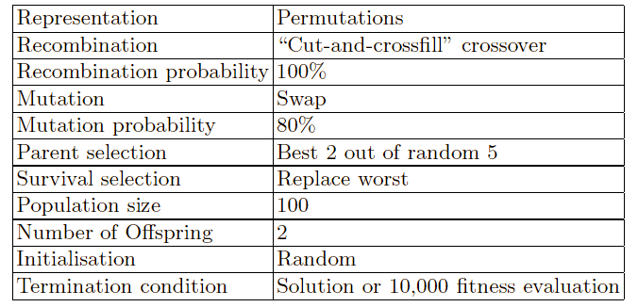
The 8-queens problem: Summary
Note that is only one possible
set of choices of operators and parameters

Slide 31
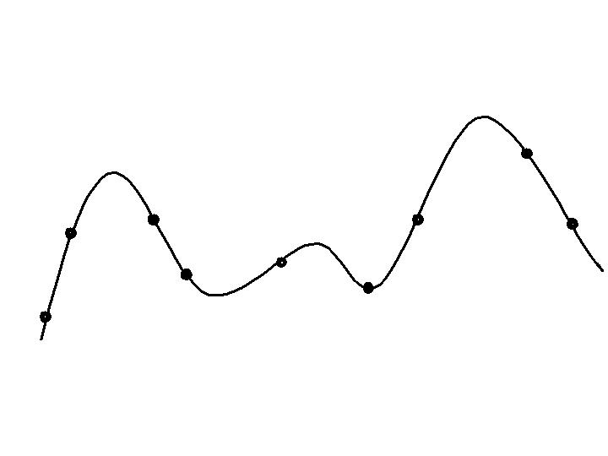
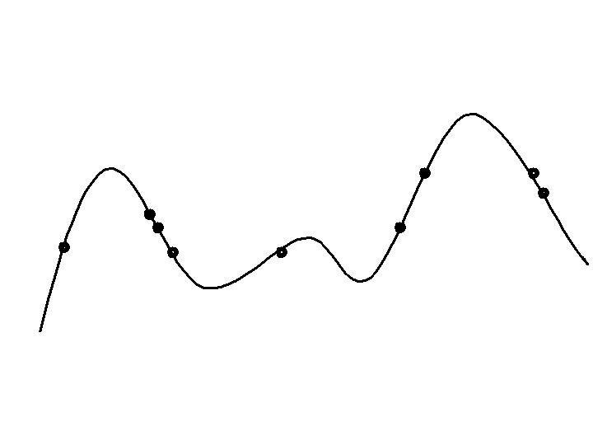
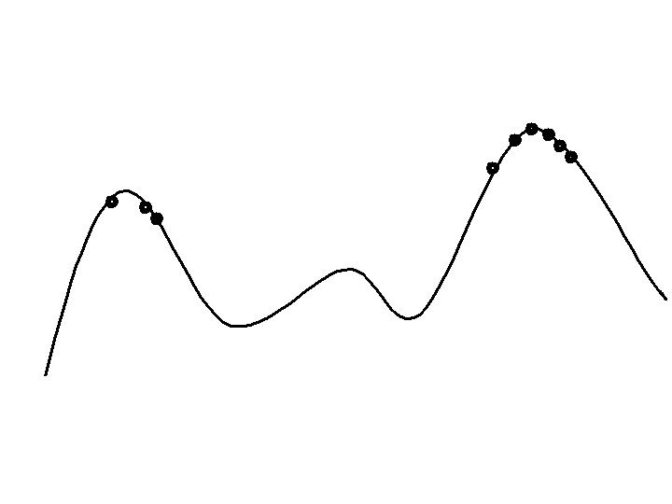
Typical EA behaviour: Stages
Stages in optimising on a 1-dimensional fitness landscape
Early stage:
quasi-random population distribution
Mid-stage:
population arranged around/on hills
Late stage:
population concentrated on high hills

Slide 32
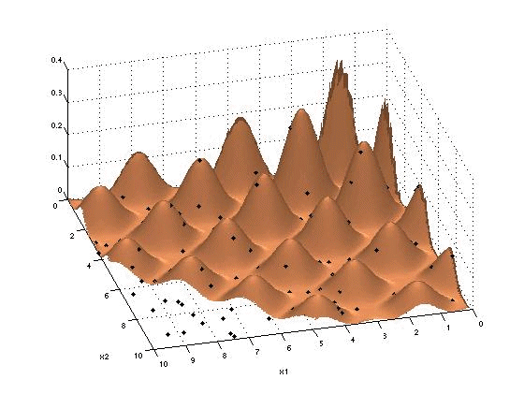
Typical EA behaviour: Working of an EA demo (1/2)
Searching a fitness landscape without “niching”

Slide 33
Typical EA behaviour: Working of an EA demo (2/2)
Searching a fitness landscape with “niching”

Slide 34
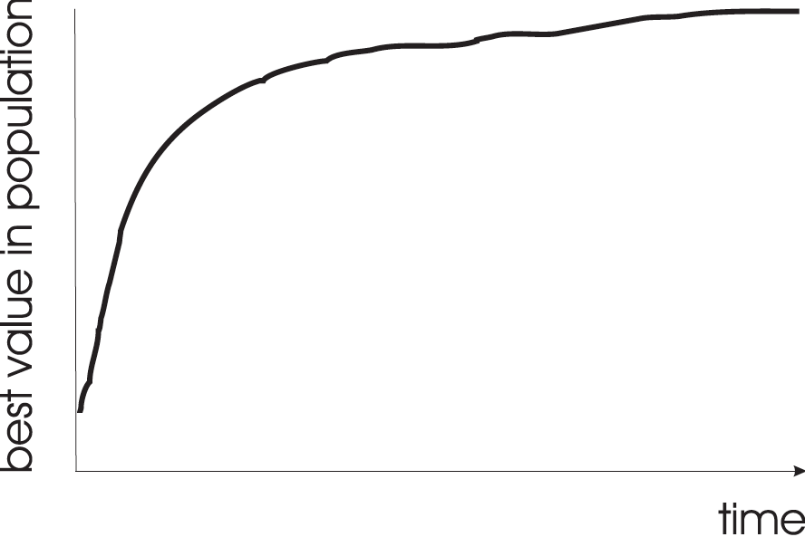
Typical EA behaviour: Typical run: progression of fitness
Typical run of an EA shows so-called “anytime behavior”

Slide 35
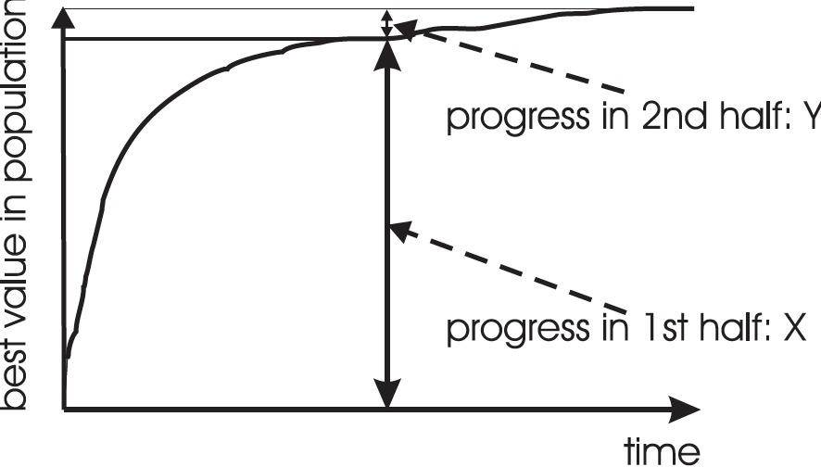
Typical EA behaviour: Are long runs beneficial?
Answer:
It depends on how much you want the last bit of progress
May be better to do more short runs

Slide 36
Typical EA behaviour: Is it worth expending effort on smart initialisation?
Best fitness in population
F
F: fitness after smart initialisation
T: time needed to reach level F after random initialisation
T
Time (number of generations)
Answer: it depends.
- Possibly good, if good solutions/methods exist.
- Care is needed, see chapter/lecture on hybridisation.

Slide 37
Typical EA behaviour: Evolutionary Algorithms in context
There are many views on the use of EAs as robust problem solving tools
For most problems a problem-specific tool may:
perform better than a generic search algorithm on most instances,
have limited utility,
not do well on all instances
Goal is to provide robust tools that provide:
evenly good performance
over a range of problems and instances

Slide 38
Typical EA behaviour: EAs as problem solvers: Goldberg view (1989)
Special, problem tailored method
Evolutionary algorithm
Performance of methods on problems
Random search
Scale of “all” problems

Slide 39
Typical EA behaviour: EAs and domain knowledge
Trend in the 90’s:
adding problem specific knowledge to EAs
(special variation operators, repair, etc)
Result: EA performance curve “deformation”:
better on problems of the given type
worse on problems different from given type
amount of added knowledge is variable
Recent theory suggests the search for an “all-purpose” algorithm may be fruitless

Slide 40
Typical EA behaviour: EAs as problem solvers: Michalewicz view (1996)
EA 4
EA 2
EA 3
EA 1
Performance of methods on problems
P
Scale of “all” problems

Slide 41
EC and global optimisation
Global Optimisation: search for finding best solution x* out of some fixed set S
Deterministic approaches
e.g. box decomposition (branch and bound etc)
Guarantee to find x* ,
May have bounds on runtime, usually super-polynomial
Heuristic Approaches (generate and test)
rules for deciding which x ∈ S to generate next
no guarantees that best solutions found are globally optimal
no bounds on runtime
“I don’t care if it works as long as it converges”
vs.
“I don’t care if it converges as long as it works”

Slide 42
EC and neighbourhood search
Many heuristics impose a neighbourhood structure on S
Such heuristics may guarantee that best point found is locally optimal e.g. Hill-Climbers:
But problems often exhibit many local optima
Often very quick to identify good solutions
EAs are distinguished by:
Use of population,
Use of multiple, stochastic search operators
Especially variation operators with arity >1
Stochastic selection
Question: what is the neighbourhood in an EA?

