Slide 1
Evolutionary Computing
Chapter 4

Slide 2
Chapter 4: Representation, Mutation, and Recombination
Role of representation and variation operators
Most common representation of genomes:
Binary
Integer
Real-Valued or Floating-Point
Permutation
Tree

Slide 3
Scheme of an EA: General scheme of EAs
Parent selection
Parents
Intialization
Recombination
(crossover)
Population
Mutation
Termination
Offspring
Survivor selection

Slide 4
Role of representation and variation operators
First stage of building an EA and most difficult one: choose right representation for the problem
Variation operators: mutation and crossover
Type of variation operators needed depends on chosen representation
TSP problem
What are possible representations?

Slide 5
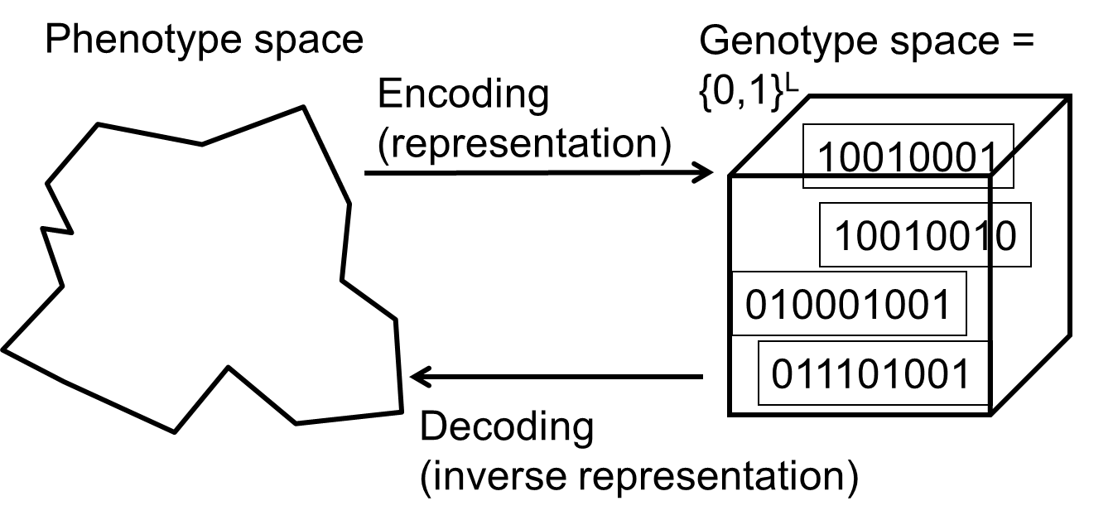
Binary Representation
One of the earliest representations
Genotype consists of a string of binary digits

Slide 6
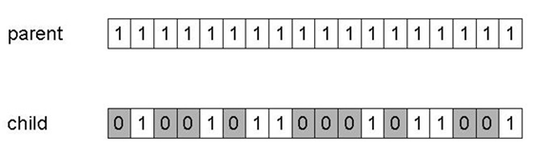
Binary Representation: Mutation
Alter each gene independently with a probability p_{m}
p_{m} is called the mutation rate
Typically between 1/pop_size and 1/ chromosome_length
Mutation can cause variable effect (use gray coding)

Slide 7
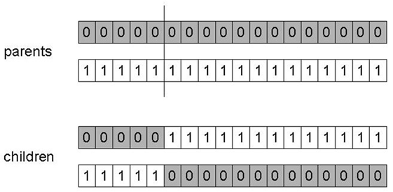
Binary Representation: 1-point crossover
Choose a random point on the two parents
Split parents at this crossover point
Create children by exchanging tails
P_{c} typically in range (0.6, 0.9)

Slide 8
Binary Representation: Alternative Crossover Operators
Why do we need other crossover(s)?
Performance with 1-point crossover depends on the order that variables occur in the representation
More likely to keep together genes that are near each other
Can never keep together genes from opposite ends of string
This is known as Positional Bias
Can be exploited if we know about the structure of our problem, but this is not usually the case

Slide 9
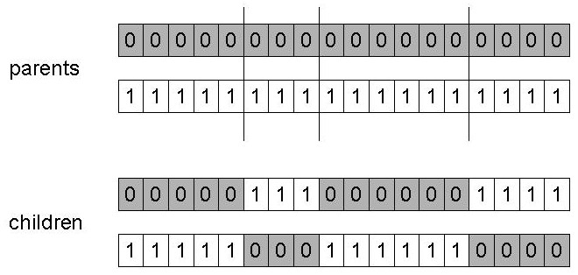
Binary Representation: n-point crossover
Choose n random crossover points
Split along those points
Glue parts, alternating between parents
Generalisation of 1-point (still some positional bias)

Slide 10
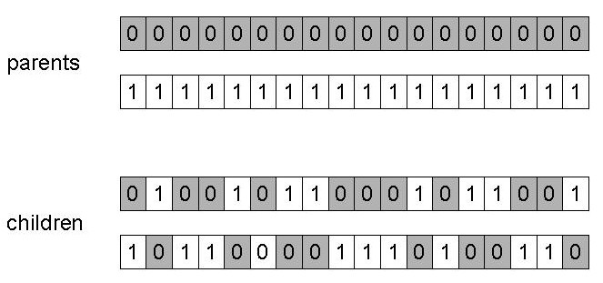
Binary Representation: Uniform crossover
Assign 'heads' to one parent, 'tails' to the other
Flip a coin for each gene of the first child
Make an inverse copy of the gene for the second child
Inheritance is independent of position

Slide 11
Binary Representation: Crossover OR mutation? (1/3)
Decade long debate: which one is better / necessary / main-background
Answer (at least, rather wide agreement):
it depends on the problem, but
in general, it is good to have both
both have another role
mutation-only-EA is possible, xover-only-EA would not work

Slide 12
Binary Representation: Crossover OR mutation? (2/3)
Exploration: Discovering promising areas in the search space, i.e. gaining information on the problem
Exploitation: Optimising within a promising area, i.e. using information
There is co-operation AND competition between them
Crossover is explorative, it makes a big jump to an area somewhere “in between” two (parent) areas
Mutation is exploitative, it creates random small diversions, thereby staying near (in the area of ) the parent

Slide 13
Binary Representation: Crossover OR mutation? (3/3)
Only crossover can combine information from two parents
Only mutation can introduce new information (alleles)
Crossover does not change the allele frequencies of the population (thought experiment: 50% 0’s on first bit in the population, ?% after performing n crossovers)
To hit the optimum you often need a ‘lucky’ mutation

Slide 14
Integer Representation
Nowadays it is generally accepted that it is better to encode numerical variables directly (integers, floating point variables)
Some problems naturally have integer variables, e.g. image processing parameters
Others take categorical values from a fixed set e.g. {blue, green, yellow, pink}
N-point / uniform crossover operators work
Extend bit-flipping mutation to make
“creep” i.e. more likely to move to similar value
Adding a small (positive or negative) value to each gene with probability p.
Random resetting (esp. categorical variables)
With probability p_{m} a new value is chosen at random
Same recombination as for binary representation

Slide 15
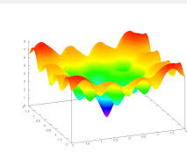
Real-Valued or Floating-Point Representation
Many problems occur as real valued problems, e.g. continuous parameter optimisation f : ℜ ^{n} → ℜ
Illustration: Ackley’s function (often used in EC)

Slide 16
Real-Valued or Floating-Point Representation: Mapping real values on bit strings
z ∈ [x,y] ⊆ ℜ represented by {a₁,…,a_{L}} ∈ {0,1}^{L}
[x,y] → {0,1}^{L} must be invertible (one phenotype per genotype)
Γ: {0,1}^{L} → [x,y] defines the representation
Only 2^{L} values out of infinite are represented
L determines possible maximum precision of solution
High precision → long chromosomes (slow evolution)

Slide 17
Real-Valued or Floating-Point Representation: Uniform Mutation
General scheme of floating point mutations
Uniform Mutation
Analogous to bit-flipping (binary) or random resetting (integers)

Slide 18
Real-Valued or Floating-Point Representation: Nonuniform Mutation
Non-uniform mutations:
Many methods proposed, such as time-varying range of change etc.
Most schemes are probabilistic but usually only make a small change to value
Most common method is to add random deviate to each variable separately, taken from N(0, σ) Gaussian distribution and then curtail to range
x’_{i} = x_{i} + N(0,σ)
Standard deviation σ, mutation step size, controls amount of change (2/3 of drawings will lie in range (- σ to + σ))

Slide 19
Real-Valued or Floating-Point Representation: Self-Adaptive Mutation (1/2)
Step-sizes are included in the genome and undergo variation and selection themselves: ⟨ x₁,…,x_{n}, σ ⟩
Mutation step size is not set by user but coevolves with solution
Different mutation strategies may be appropriate in different stages of the evolutionary search process.

Slide 20
Real-Valued or Floating-Point Representation: Self-Adaptive Mutation (2/2)
Mutate σ first
Net mutation effect: ⟨ x, σ ⟩ → ⟨ x’, σ’ ⟩
Order is important:
first σ → σ’ (see later how)
then x → x’ = x + N(0,σ’)
Rationale: new ⟨ x’ ,σ’ ⟩ is evaluated twice
Primary: x’ is good if f(x’) is good
Secondary: σ’ is good if the x’ it created is good
Reversing mutation order this would not work

Slide 21
Real-Valued or Floating-Point Representation: Uncorrelated mutation with one σ (1/2)
Chromosomes: ⟨ x₁,…,x_{n}, σ ⟩
σ’ = σ • exp(τ • N(0,1))
x’_{i} = x_{i} + σ’ • N_{i}(0,1)
Typically the “learning rate” τ ∝ 1/ n^{½}
And we have a boundary rule σ’ < ε₀ ⇒ σ’ = ε₀

Slide 22
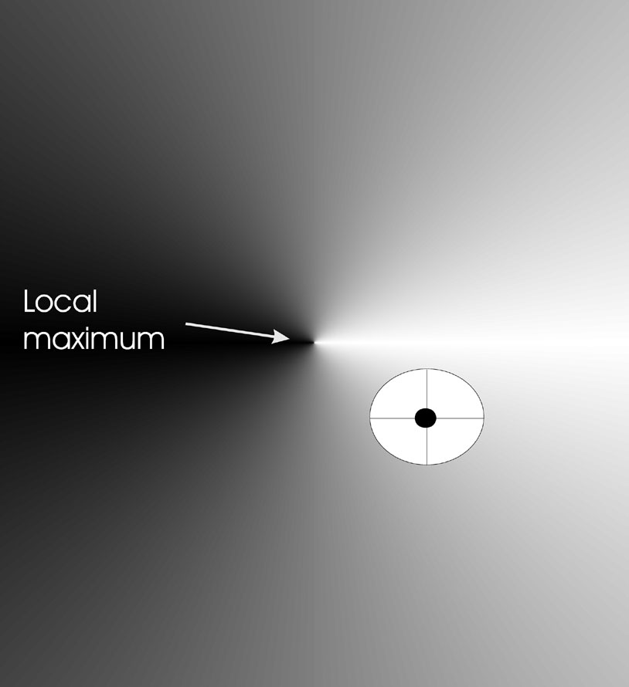
Real-Valued or Floating-Point Representation: Uncorrelated mutation with one σ (2/2)
Mutants with equal likelihood
Circle: mutants having the same chance to be created

Slide 23
Real-Valued or Floating-Point Representation: Uncorrelated mutation with n σ’s (1/2)
Chromosomes: ⟨ x₁,…,x_{n}, σ₁,…, σ_{n} ⟩
σ’_{i} = σ_{i} • exp(τ’ • N(0,1) + τ • N_{i} (0,1))
x’_{i} = x_{i} + σ’_{i} • N_{i} (0,1)
Two learning rate parameters:
τ’ overall learning rate
τ coordinate wise learning rate
τ’ ∝ 1/(2 n)^{½} and τ ∝ 1/(2 n^{½}) ^{½}
Boundary rule: σ_{i}’ < ε₀ ⇒ σ_{i}’ = ε₀

Slide 24
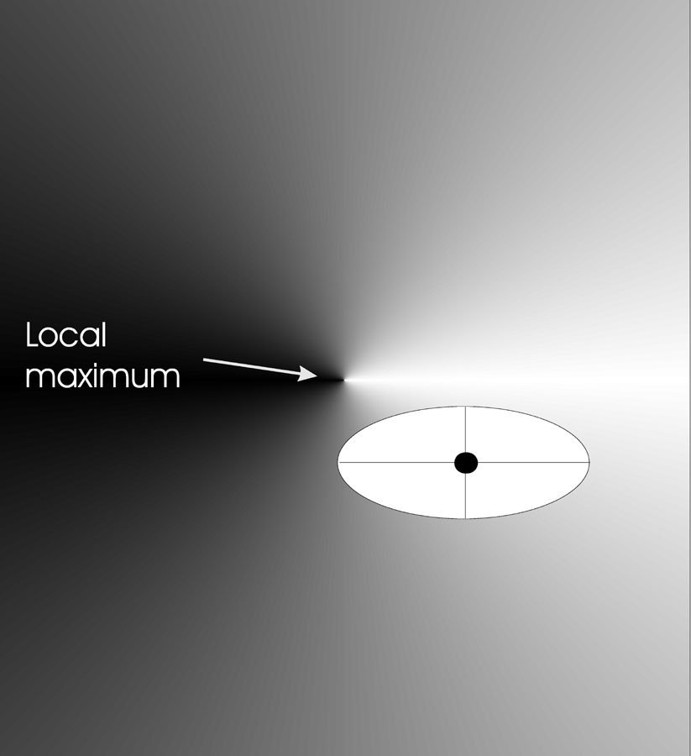
Real-Valued or Floating-Point Representation: Uncorrelated mutation with n σ’s (2/2)
Mutants with equal likelihood
Ellipse: mutants having the same chance to be created

Slide 25
Real-Valued or Floating-Point Representation: Correlated mutations (1/3)
Chromosomes: ⟨ x₁,…,x_{n}, σ₁,…, σ_{n} ,α₁,…, α_{k} ⟩
where k = n • (n-1)/2
Covariance matrix C is defined as:
c_{ii} = σ_{i}²
c_{ij} = 0 if i and j are not correlated
c_{ij} = ½ • ( σ_{i}² - σ_{j}² ) • tan(2 α_{ij}) if i and j are correlated
Note the numbering / indices of the α‘s

Slide 26
Real-Valued or Floating-Point Representation: Correlated mutations (2/3)
The mutation mechanism is then:
σ’_{i} = σ_{i} • exp(τ’ • N(0,1) + τ • N_{i} (0,1))
α’_{j} = α_{j} + β • N (0,1)
x ’ = x + N(0,C’)
x stands for the vector ⟨ x₁,…,x_{n} ⟩
C’ is the covariance matrix C after mutation of the α values
τ ∝ 1/(2 n)^{½} and τ ∝ 1/(2 n^{½}) ^{½} and β ≈ 5°
σ_{i}’ < ε₀ ⇒ σ_{i}’ = ε₀ and
| α’_{j} | > π ⇒ α’_{j} = α’_{j} - 2 π sign(α’_{j})
NB Covariance Matrix Adaptation Evolution Strategy (CMA-ES) is probably the best EA for numerical optimisation, cf. CEC-2005 competition

Slide 27
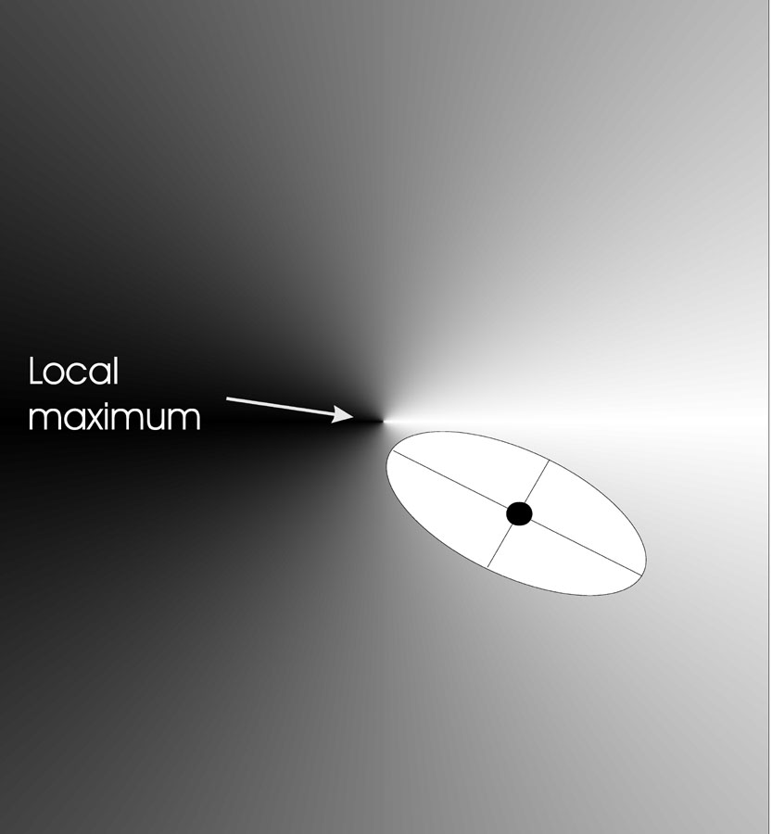
Real-Valued or Floating-Point Representation: Correlated mutations (3/3)
Mutants with equal likelihood
Ellipse: mutants having the same chance to be created

Slide 28
Real-Valued or Floating-Point Representation: Crossover operators
Discrete:
each allele value in offspring z comes from one of its parents (x,y) with equal probability: z_{i} = x_{i} or y_{i}
Could use n-point or uniform
Intermediate
exploits idea of creating children “between” parents (hence a.k.a. arithmetic recombination)
z_{i} = α x_{i} + (1 - α) y_{i} where α : 0 ≤ α ≤ 1.
The parameter α can be:
constant: uniform arithmetical crossover
variable (e.g. depend on the age of the population)
picked at random every time

Slide 29
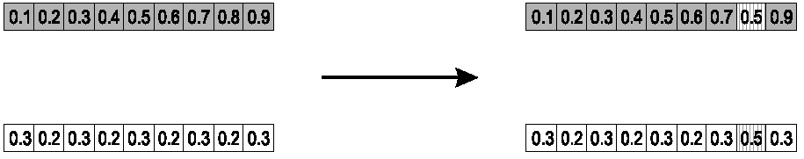
Real-Valued or Floating-Point Representation: Single arithmetic crossover
Parents: ⟨x₁,…,x_{n} ⟩ and ⟨y₁,…,y_{n}⟩
Pick a single gene (k) at random,
child₁ is:
Reverse for other child. e.g. with α = 0.5

Slide 30
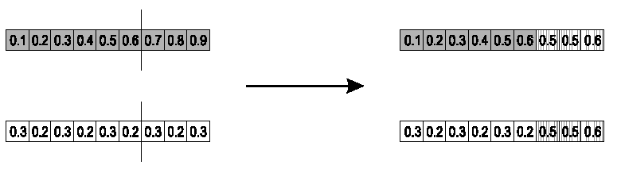
Real-Valued or Floating-Point Representation: Simple arithmetic crossover
Parents: ⟨x₁,…,x_{n} ⟩ and ⟨y₁,…,y_{n}⟩
Pick a random gene (k) after this point mix values
child₁ is:
reverse for other child. e.g. with α = 0.5

Slide 31
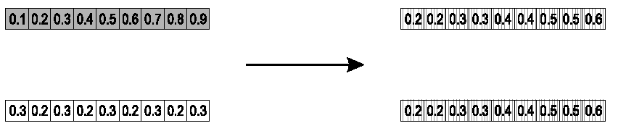
Real-Valued or Floating-Point Representation: Whole arithmetic crossover
Most commonly used
Parents: ⟨x₁,…,x_{n} ⟩ and ⟨y₁,…,y_{n}⟩
Child₁ is:
reverse for other child. e.g. with α = 0.5

Slide 32
Real-Valued or Floating-Point Representation: Blend Crossover
Parents: ⟨x₁,…,x_{n} ⟩ and ⟨y₁,…,y_{n}⟩
Assume x_{i} < y_{i}
d_{i} = y_{i} – x_{i}
Random sample z_{i}= [x_{i} – αd_{i}, x_{i} + αd_{i}]
Original authors had best results with α = 0.5

Slide 33
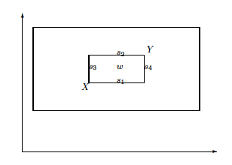
Real-Valued or Floating-Point Representation: Overview different possible offspring
Single arithmetic:
{s₁, s_{2,} s₃, s₄}
Simple arithmetic / whole arithmetic:
inner box (w = alpha 0.5)
Blend crossover:
outer box

Slide 34
Real-Valued or Floating-Point Representation: Multi-parent recombination
Recall that we are not constricted by the practicalities of nature
Noting that mutation uses n = 1 parent, and “traditional” crossover n = 2, the extension to n > 2 is natural to examine
Been around since 1960s, still rare but studies indicate useful

Slide 35
Real-Valued or Floating-Point Representation: Multi-parent recombination, type 1
Idea: segment and recombine parents
Example: diagonal crossover for n parents:
Choose n-1 crossover points (same in each parent)
Compose n children from the segments of the parents in along a “diagonal”, wrapping around
This operator generalises 1-point crossover

Slide 36
Real-Valued or Floating-Point Representation: Multi-parent recombination, type 2
Idea: arithmetical combination of (real valued) alleles
Example: arithmetic crossover for n parents:
i-th allele in child is the average of the parents’ i-th alleles
Creates center of mass as child
Odd in genetic algorithms, long known and used in evolution strategies

Slide 37
Permutation Representations
Ordering/sequencing problems form a special type
Task is (or can be solved by) arranging some objects in a certain order
Example: production scheduling: important thing is which elements are scheduled before others (order)
Example: Travelling Salesman Problem (TSP) : important thing is which elements occur next to each other (adjacency)
These problems are generally expressed as a permutation:
if there are n variables then the representation is as a list of n integers, each of which occurs exactly once

Slide 38
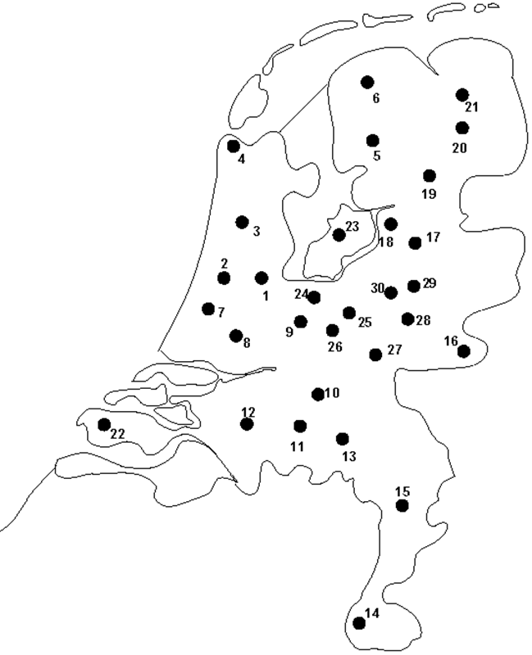
Permutation Representation: TSP example
Problem:
Given n cities
Find a complete tour with minimal length
Encoding:
Label the cities 1, 2, … , n
One complete tour is one permutation (e.g. for n =4 [1,2,3,4], [3,4,2,1] are OK)
Search space is BIG:
for 30 cities there are 30! ≈ 10³² possible tours

Slide 39
Permutation Representations: Mutation
Normal mutation operators lead to inadmissible solutions
e.g. bit-wise mutation: let gene i have value j
changing to some other value k would mean that k occurred twice and j no longer occurred
Therefore must change at least two values
Mutation parameter now reflects the probability that some operator is applied once to the whole string, rather than individually in each position

Slide 40
Permutation Representations: Swap mutation
Pick two alleles at random and swap their positions

Slide 41
Permutation Representations: Insert Mutation
Pick two allele values at random
Move the second to follow the first, shifting the rest along to accommodate
Note that this preserves most of the order and the adjacency information

Slide 42
Permutation Representations: Scramble mutation
Pick a subset of genes at random
Randomly rearrange the alleles in those positions

Slide 43
Permutation Representations: Inversion mutation
Pick two alleles at random and then invert the substring between them.
Preserves most adjacency information (only breaks two links) but disruptive of order information

Slide 44
Permutation Representations: Crossover operators
“Normal” crossover operators will often lead to inadmissible solutions
Many specialised operators have been devised which focus on combining order or adjacency information from the two parents
1 2 3 4 5
1 2 3 2 1
5 4 3 2 1
5 4 3 4 5

Slide 45
Permutation Representations: Order 1 crossover (1/2)
Idea is to preserve relative order that elements occur
Informal procedure:
1. Choose an arbitrary part from the first parent
2. Copy this part to the first child
3. Copy the numbers that are not in the first part, to the first child:
starting right from cut point of the copied part,
using the order of the second parent
and wrapping around at the end
4. Analogous for the second child, with parent roles reversed

Slide 46
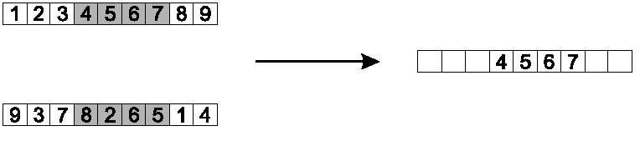
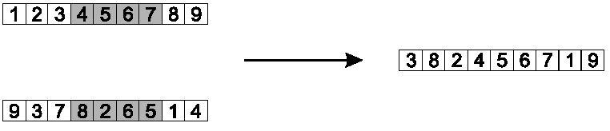
Permutation Representations: Order 1 crossover (2/2)
Copy randomly selected set from first parent
Copy rest from second parent in order 1,9,3,8,2

Slide 47
Permutation Representations: Partially Mapped Crossover (PMX) (1/2)
Informal procedure for parents P1 and P2:
Choose random segment and copy it from P1
Starting from the first crossover point look for elements in that segment of P2 that have not been copied
For each of these i look in the offspring to see what element j has been copied in its place from P1
Place i into the position occupied j in P2, since we know that we will not be putting j there (as is already in offspring)
If the place occupied by j in P2 has already been filled in the offspring k, put i in the position occupied by k in P2
Having dealt with the elements from the crossover segment, the rest of the offspring can be filled from P2.
Second child is created analogously

Slide 48
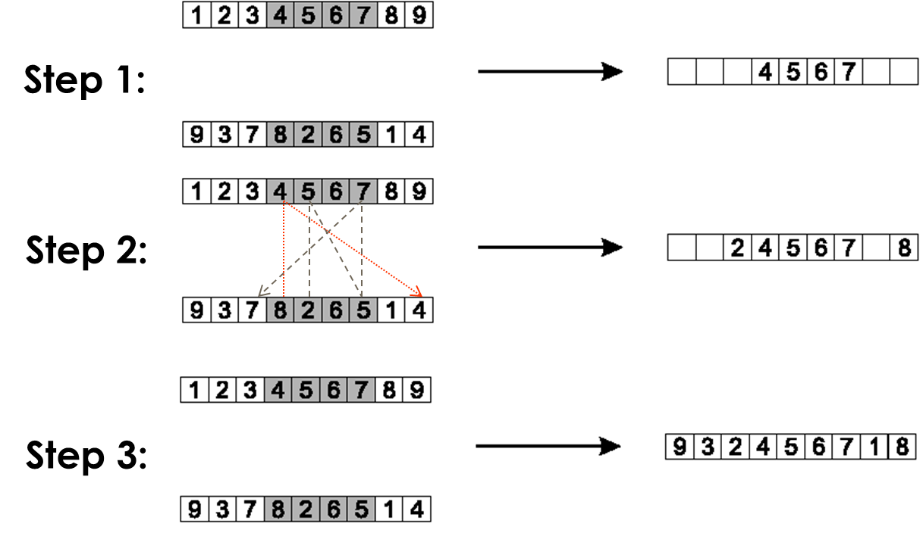
Permutation Representations: Partially Mapped Crossover (PMX) (2/2)

Slide 49
Permutation Representations: Cycle crossover (1/2)
Basic idea:
Each allele comes from one parent together with its position.
Informal procedure:
1. Make a cycle of alleles from P1 in the following way.
(a) Start with the first allele of P1.
(b) Look at the allele at the same position in P2.
(c) Go to the position with the same allele in P1.
(d) Add this allele to the cycle.
(e) Repeat step b through d until you arrive at the first allele of P1.
2. Put the alleles of the cycle in the first child on the positions they have in the first parent.
3. Take next cycle from second parent

Slide 50
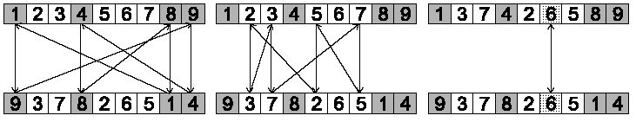

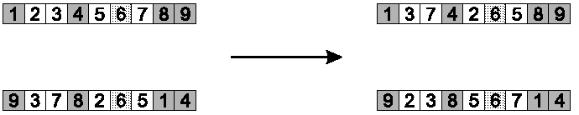
Permutation Representations: Cycle crossover (2/2)
Step 1: identify cycles
Step 2: copy alternate cycles into offspring

Slide 51
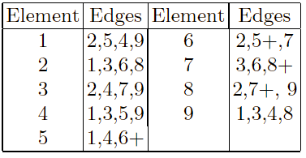
Permutation Representations: Edge Recombination (1/3)
Works by constructing a table listing which edges are present in the two parents, if an edge is common to both, mark with a +
e.g. [1 2 3 4 5 6 7 8 9] and [9 3 7 8 2 6 5 1 4]

Slide 52
Permutation Representations: Edge Recombination (2/3)
Informal procedure: once edge table is constructed
Pick an initial element, entry, at random and put it in the offspring
Set the variable current element = entry
Remove all references to current element from the table
Examine list for current element:
If there is a common edge, pick that to be next element
Otherwise pick the entry in the list which itself has the shortest list
Ties are split at random
In the case of reaching an empty list:
a new element is chosen at random

Slide 53
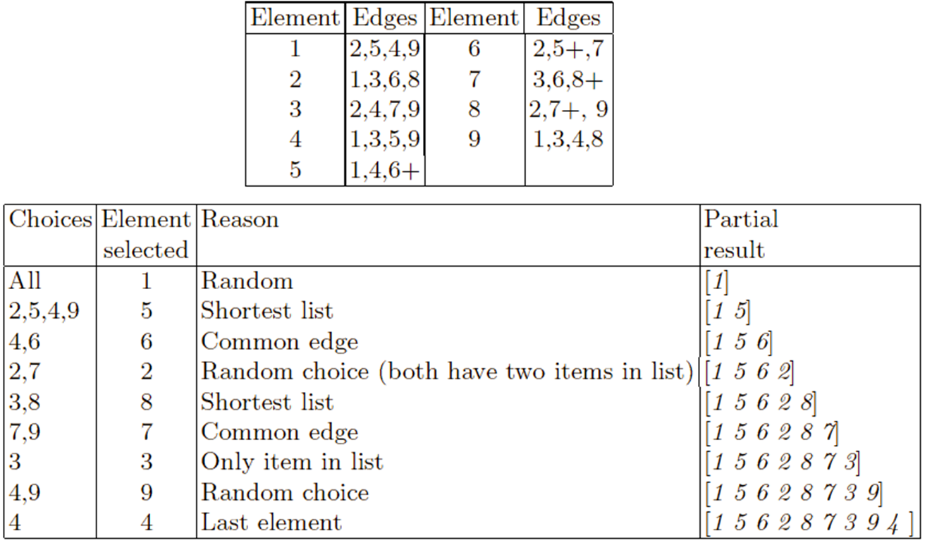
Permutation Representations: Edge Recombination (3/3)

Slide 54
Tree Representation (1/6)
Trees are a universal form, e.g. consider
Arithmetic formula:
Logical formula:
Program:
(x ∧ true) → (( x ∨ y ) ∨ (z ↔ (x ∧ y)))
i =1;
while (i < 20)
{
i = i +1
}

Slide 55
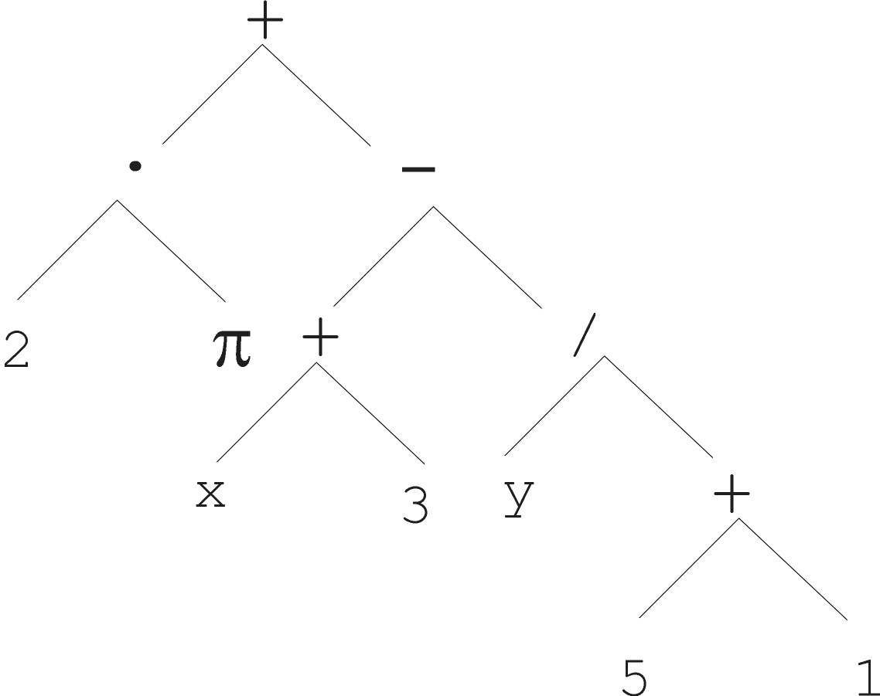
Tree Representation (2/6)

Slide 56
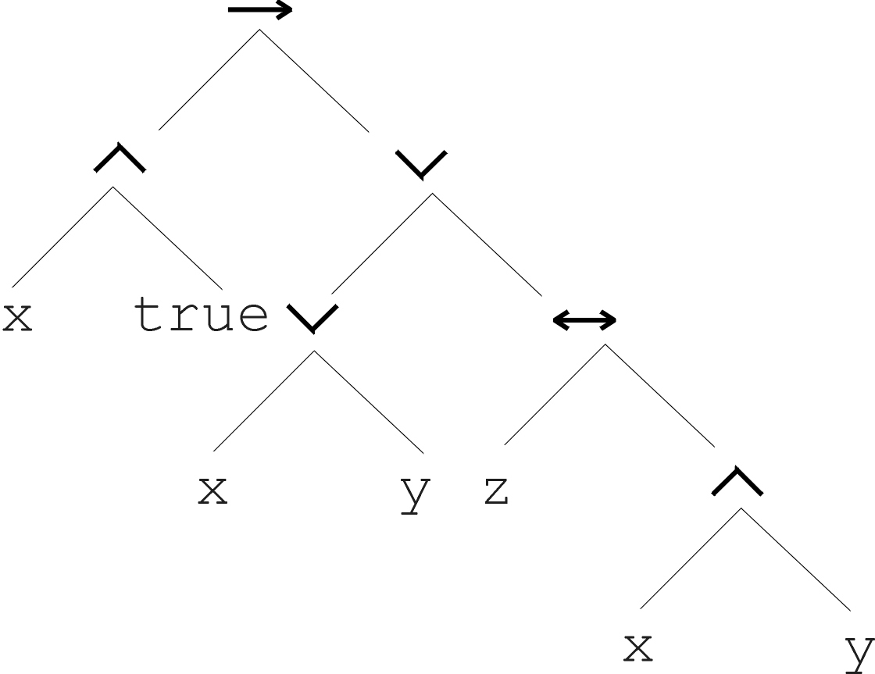
Tree Representation (3/6)
(x ∧ true) → (( x ∨ y ) ∨ (z ↔ (x ∧ y)))

Slide 57
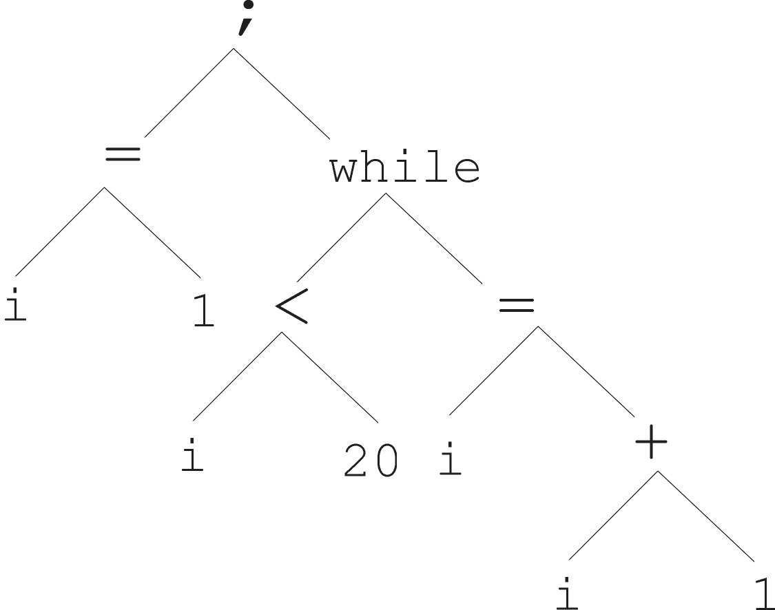
Tree Representation (4/6)
i =1;
while (i < 20)
{
i = i +1
}

Slide 58
Tree Representation (5/6)
In GA, ES, EP chromosomes are linear structures (bit strings, integer string, real-valued vectors, permutations)
Tree shaped chromosomes are non-linear structures
In GA, ES, EP the size of the chromosomes is fixed
Trees in GP may vary in depth and width

Slide 59
Tree Representation (6/6)
Symbolic expressions can be defined by
Terminal set T
Function set F (with the arities of function symbols)
Adopting the following general recursive definition:
Every t ∈ T is a correct expression
f(e₁, …, e_{n}) is a correct expression if f ∈ F, arity(f)=n and e₁, …, e_{n} are correct expressions
There are no other forms of correct expressions
In general, expressions in GP are not typed (closure property: any f ∈ F can take any g ∈ F as argument)

Slide 60
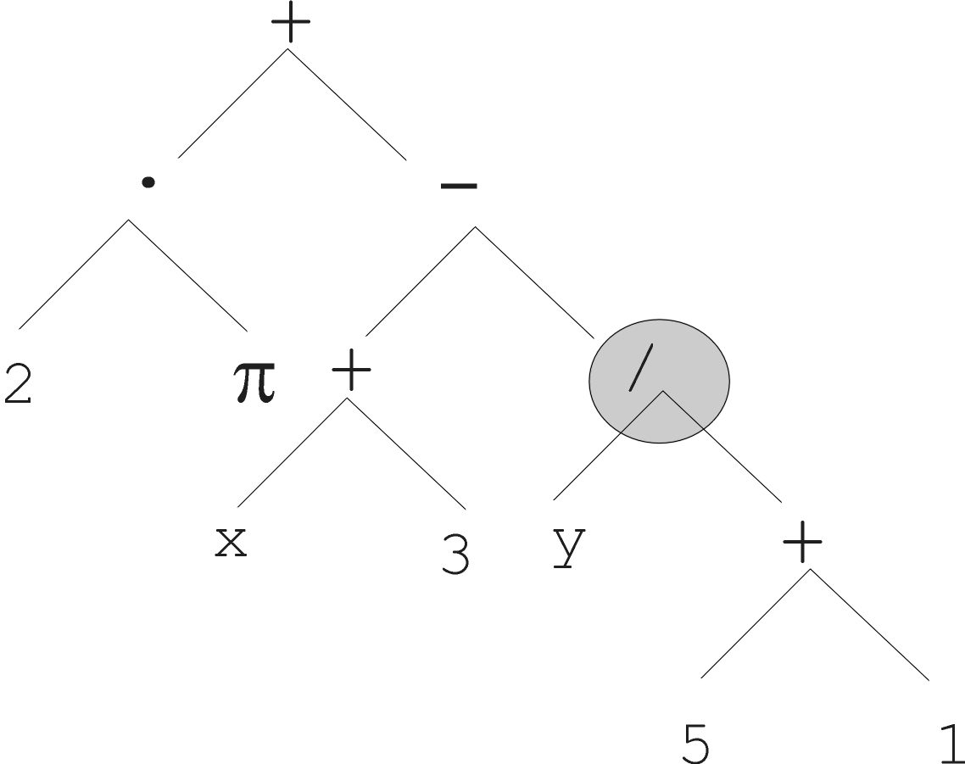
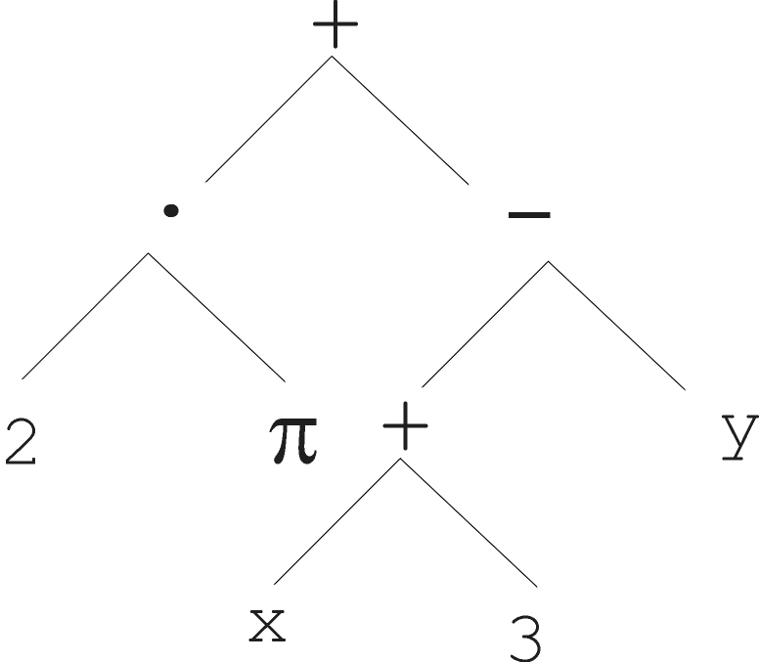
Tree Representation: Mutation (1/2)
Most common mutation: replace randomly chosen subtree by randomly generated tree

Slide 61
Tree Representation: Mutation (2/2)
Mutation has two parameters:
Probability p_{m} to choose mutation
Probability to chose an internal point as the root of the subtree to be replaced
Remarkably p_{m} is advised to be 0 (Koza’92) or very small, like 0.05 (Banzhaf et al. ’98)
The size of the child can exceed the size of the parent

Slide 62
Tree Representation: Recombination (1/2)
Most common recombination: exchange two randomly chosen subtrees among the parents
Recombination has two parameters:
Probability p_{c} to choose recombination
Probability to chose an internal point within each parent as crossover point
The size of offspring can exceed that of the parents

Slide 63
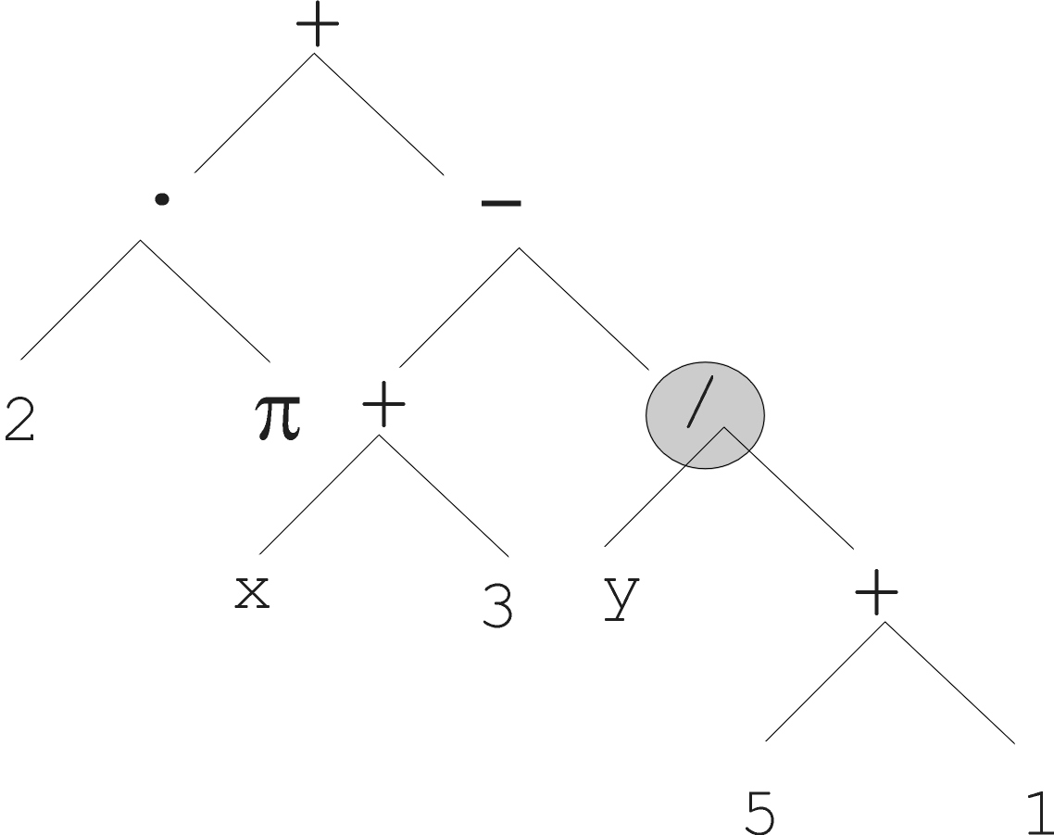
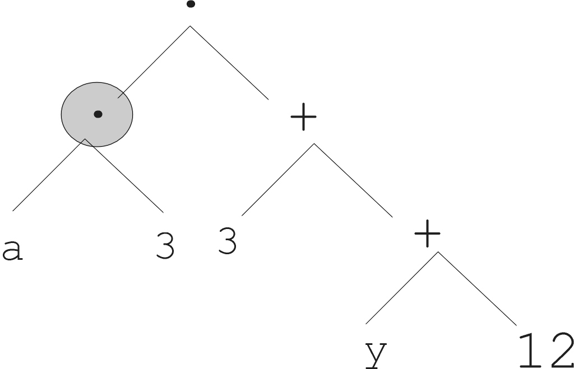
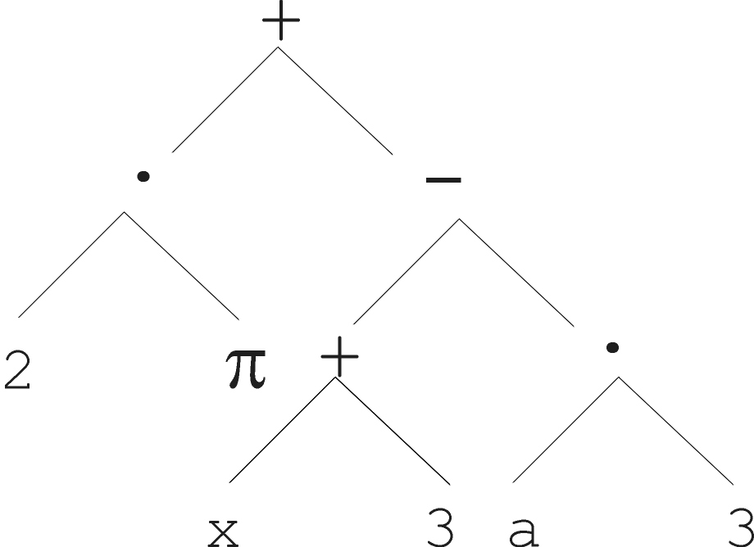
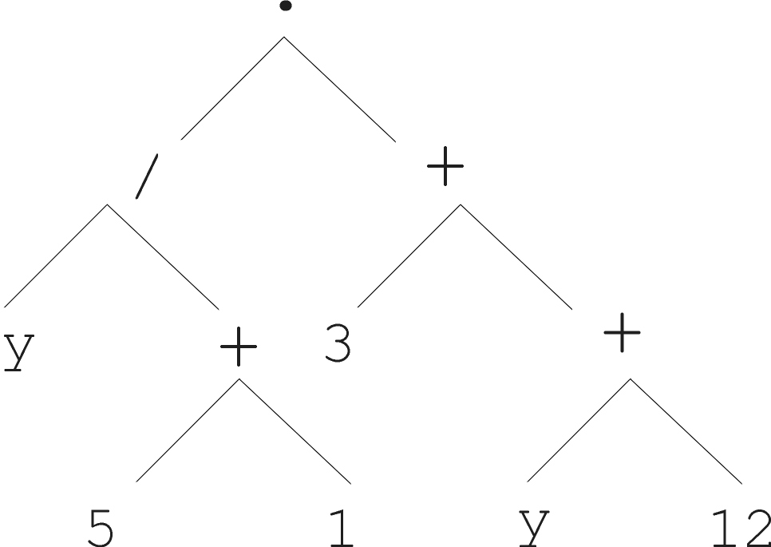
Tree Representation: Recombination (2/2)
Parent 1
Parent 2
Child 1
Child 2

