Slide 1
Evolutionary Computing
Chapter 5

Slide 2
Chapter 5: Fitness, Selection and Population Management
Selection is second fundamental force for evolutionary systems
Components exist of:
Population management models
Selection operators
Preserving diversity

Slide 3
Scheme of an EA: General scheme of EAs
Parent selection
Parents
Intialization
Recombination
(crossover)
Population
Mutation
Termination
Offspring
Survivor selection

Slide 4
Population Management Models: Introduction
Two different population management models exist:
Generational model
each individual survives for exactly one generation
the entire set of parents is replaced by the offspring
Steady-state model
one offspring is generated per generation
one member of population replaced
Generation Gap
The proportion of the population replaced
Parameter = 1.0 for GGA, = 1/pop_size for SSGA

Slide 5
Population Management Models: Fitness based competition
Selection can occur in two places:
Selection from current generation to take part in mating (parent selection)
Selection from parents + offspring to go into next generation (survivor selection)
Selection operators work on whole individual
i.e. they are representation-independent !
Distinction between selection
Operators: define selection probabilities
Algorithms: define how probabilities are implemented

Slide 6
Parent Selection: Fitness-Proportionate Selection
Probability for individual i to be selected for mating in a population size μ with FPS is
Problems include
One highly fit member can rapidly take over if rest of population is much less fit: Premature Convergence
At end of runs when fitnesses are similar, loss of selection pressure
Highly susceptible to function transposition (example next slide)
Scaling can fix last two problems
Windowing:
where β is worst fitness in this (last n) generations
Sigma Scaling:
where c is a constant, usually 2.0

Slide 7
Parent Selection: Rank-based Selection
Attempt to remove problems of FPS by basing selection probabilities on relative rather than absolute fitness
Rank population according to fitness and then base selection probabilities on rank (fittest has rank μ-1 and worst rank 0)
This imposes a sorting overhead on the algorithm, but this is usually negligible compared to the fitness evaluation time

Slide 8
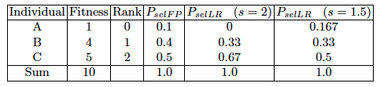
Rank-based Selection: Linear Ranking
Parameterised by factor s: 1 < s ≤ 2
measures advantage of best individual
Simple 3 member example

Slide 9
Rank-based selection: Exponential Ranking
Linear Ranking is limited in selection pressure
Exponential Ranking can allocate more than 2 copies to fittest individual
Normalise constant factor c according to population size
Sample mating pool from the selection probability distribution (roulette wheel, stochastic universal sampling)

Slide 10
Parent Selection: Tournament Selection (1/2)
All methods above rely on global population statistics
Could be a bottleneck esp. on parallel machines, very large population
Relies on presence of external fitness function which might not exist: e.g. evolving game players
Idea for a procedure using only local fitness information:
Pick k members at random then select the best of these
Repeat to select more individuals

Slide 11
Parent Selection: Tournament Selection (2/2)
Probability of selecting i will depend on:
Rank of i
Size of sample k
higher k increases selection pressure
Whether contestants are picked with replacement
Picking without replacement increases selection pressure
Whether fittest contestant always wins (deterministic) or this happens with probability p

Slide 12
Parent Selection: Uniform
Parents are selected by uniform random distribution whenever an operator needs one/some
Uniform parent selection is unbiased - every individual has the same probability to be selected
When working with extremely large populations, over-selection can be used.

Slide 13
Survivor Selection
Managing the process of reducing the working memory of the EA from a set of μ parents and λ offspring to a set of μ individuals forming the next generation
The parent selection mechanisms can also be used for selecting survivors
Survivor selection can be divided into two approaches:
Age-Based Selection
Fitness is not taken into account
In SSGA can implement as “delete-random” (not recommended) or as first-in-first-out (a.k.a. delete-oldest)
Fitness-Based Replacement

Slide 14
Fitness-based replacement (1/2)
Elitism
Always keep at least one copy of the fittest solution so far
Widely used in both population models (GGA, SSGA)
GENITOR: a.k.a. “delete-worst”
From Whitley’s original Steady-State algorithm (he also used linear ranking for parent selection)
Rapid takeover: use with large populations or “no duplicates” policy
Round-robin tournament
P(t): μ parents, P’(t): μ offspring
Pairwise competitions in round-robin format:
Each solution x from P(t) ∪ P’(t) is evaluated against q other randomly chosen solutions
For each comparison, a "win" is assigned if x is better than its opponent
The μ solutions with the greatest number of wins are retained to be parents of the next generation
Parameter q allows tuning selection pressure
Typically q = 10

Slide 15
Fitness-based replacement (2/2)
(μ,λ)-selection
based on the set of children only (λ > μ)
choose best μ
(μ+λ)-selection
based on the set of parents and children
choose best μ
Often (μ,λ)-selection is preferred for:
Better in leaving local optima
Better in following moving optima
Using the + strategy bad σ values can survive in ⟨x,σ⟩ too long if their host x is very fit
λ ≈ 7 • μ is a traditionally good setting (decreasing over the last couple of years, λ ≈ 3 • μ seems more popular lately)

Slide 16
Selection Pressure
Takeover time τ* is a measure to quantify the selection pressure
The number of generations it takes until the application of selection completely fills the population with copies of the best individual
Goldberg and Deb showed:
For proportional selection in a genetic algorithm the takeover time is λln(λ)

Slide 17
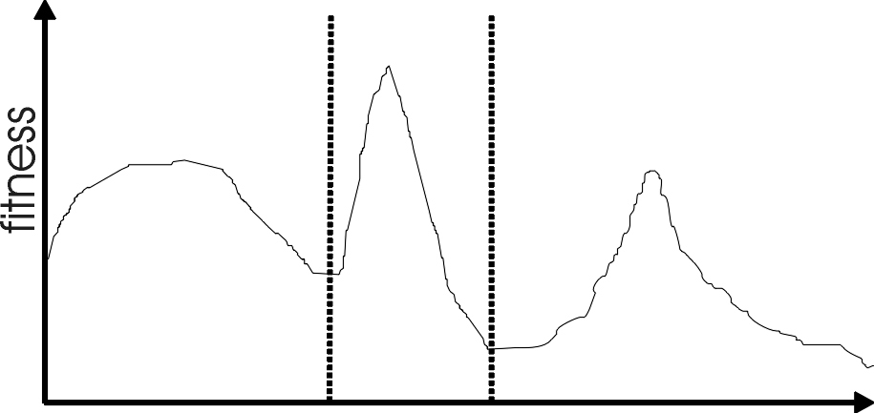
Multimodality
Most interesting problems have more than one locally optimal solution.
Notes:
There are three local optima in this landscape with different sizes basins of attraction. The global optimum is in the middle, and the leftmost local optimum has a broader peak than the rightmost, despite having a smaller basin of attraction.

Slide 18
Multimodality: Genetic Drift
Finite population with global mixing and selection eventually convergence around one optimum
Why?
Often might want to identify several possible peaks
Sub-optimum can be more attractive
Notes:
Might want to identify several peaks e.g. for design example where you might want solution from a broad peak as it may be more stable to minor perturbations

Slide 19
Approaches for Preserving Diversity: Introduction (1/2)
Explicit vs implicit
Implicit approaches:
Impose an equivalent of geographical separation
Impose an equivalent of speciation
Explicit approaches
Make similar individuals compete for resources (fitness)
Make similar individuals compete with each other for survival

Slide 20
Approaches for Preserving Diversity: Introduction (1/2)
Different spaces:
Genotype space
Set of representable solutions
Phenotype space
The end result
Neighbourhood structure may bear little relation with genotype space
Algorithmic space
Equivalent of the geographical space on which life on earth has evolved
Structuring the population of candidate solutions

Slide 21
Explicit Approaches for Preserving Diversity: Fitness Sharing (1/2)
Restricts the number of individuals within a given niche by “sharing” their fitness, so as to allocate individuals to niches in proportion to the niche fitness
need to set the size of the niche σ_{share} in either genotype or phenotype space
run EA as normal but after each generation set

Slide 22
Explicit Approaches for Preserving Diversity: Fitness Sharing (2/2)
Note: if we used sh(d) = 1 for d < σ_{share} then the sum that reduces the fitness would simply count the number of neighbours, i.e., individuals closer than σ_{share}
This creates an advantage of being alone in the neighbourhood
Using 1 – d/ σ_{share} instead of 1 implies that we count distant neighbours less

Slide 23
Explicit Approaches for Preserving Diversity: Crowding (1/2)
Attempts to distribute individuals evenly amongst niches
relies on the assumption that offspring will tend to be close to parents
uses a distance metric in ph/genotype space
randomly shuffle and pair parents, produce 2 offspring
set up the parent vs. child tournaments such that the intertournament distances are minimal

Slide 24
Explicit Approaches for Preserving Diversity: Crowding (2/2)
That is, number the two p’s (parents )and the two o’s (offspring) such that
d(p₁,o₁) + d(p₂,o₂) < d(p₁,o₂) + d(p₂,o₁)
and let o₁ compete with p₁ and o₂ compete with p₂

Slide 25
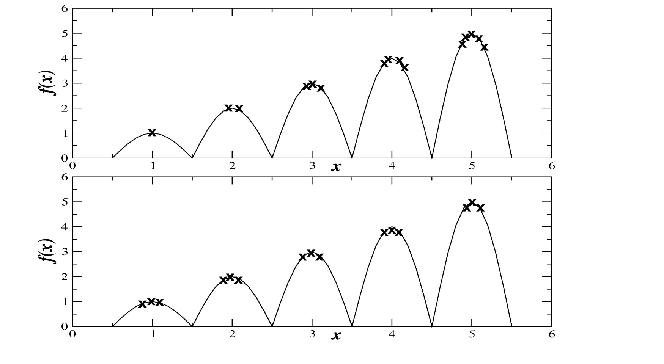
Explicit Approaches for Preserving Diversity: Crowding or Fitness sharing?
Observe the number of individuals per niche

Slide 26
Implicit Approaches for Preserving Diversity: Automatic Speciation
Either only mate with genotypically / phenotypically similar members or
Add bits (tags) to problem representation
that are initially randomly set
subject to recombination and mutation
when selecting partner for recombination, only pick members with a good match

Slide 27
Implicit Approaches for Preserving Diversity: “Island” Model Parallel EAs (1/4)
EA
EA
EA
EA
EA
Periodic migration of individual solutions between populations

Slide 28
Implicit Approaches for Preserving Diversity: “Island” Model Parallel EAs (2/4)
Run multiple populations in parallel
After a (usually fixed) number of generations (an Epoch), exchange individuals with neighbours
Repeat until ending criteria met
Partially inspired by parallel/clustered systems

Slide 29
Island Model: Parameters
How often to exchange individuals ?
too quick and all sub-populations converge to same solution
too slow and waste time
most authors use range~ 25-150 generations
can do it adaptively (stop each pop when no improvement for (say) 25 generations)
How many, which individuals to exchange ?
usually ~2-5, but depends on population size.
Copied vs moved
Martin et al found that better to exchange randomly selected individuals than best
Operators can differ between the sub-populations

Slide 30
Implicit Approaches for Preserving Diversity: Cellular EAs (1/3)
Impose spatial structure (usually grid) in 1 pop
Current
individual
Neighbours

Slide 31
Implicit Approaches for Preserving Diversity: Cellular EAs (2/3)
Consider each individual to exist on a point on a (usually rectangular toroid) grid
Selection (hence recombination) and replacement happen using concept of a neighbourhood a.k.a. deme
Leads to different parts of grid searching different parts of space, good solutions diffuse across grid over a number of gens

Slide 32
Implicit Approaches for Preserving Diversity: Cellular EAs (3/3)
Assume rectangular grid so each individual has 8 immediate neighbours
Equivalent of 1 generation is:
pick individual in pop at random
pick one of its neighbours using roulette wheel
crossover to produce 1 child, mutate
replace individual if fitter
circle through population until done

