Slide 1
The Technology Value Stream
Wade Eckert
CSD 380: DevOps
Module 1.2: The Technology Value Stream
Bellevue University
Professor Nathan Braun
Date: June 13, 2026

Slide 2
What Is a Technology Value Stream?
A technology value stream is the process required to convert a business hypothesis into a technology-enabled service or feature that delivers value to customers.
The value stream begins when work is accepted into development and ends when the change is successfully running in production.
Activities within the value stream include development, testing, deployment, operations, and feedback.
DevOps focuses on improving the speed, quality, and reliability of work moving through the value stream.

Slide 3
Technology Value Streams and the Three Ways
First Way: Flow – move work quickly through the system.
Second Way: Feedback – identify and correct problems rapidly.
Third Way: Continuous Learning – improve through experimentation.
Together these principles reduce delays and improve customer value.

Slide 4
Why Technology Value Streams Matter
Provides visibility into how work moves from concept to customer.
Exposes bottlenecks, delays, and unnecessary handoffs.
Improves delivery speed, quality, and customer satisfaction.
Encourages optimization of the entire system rather than individual tasks.

Slide 5
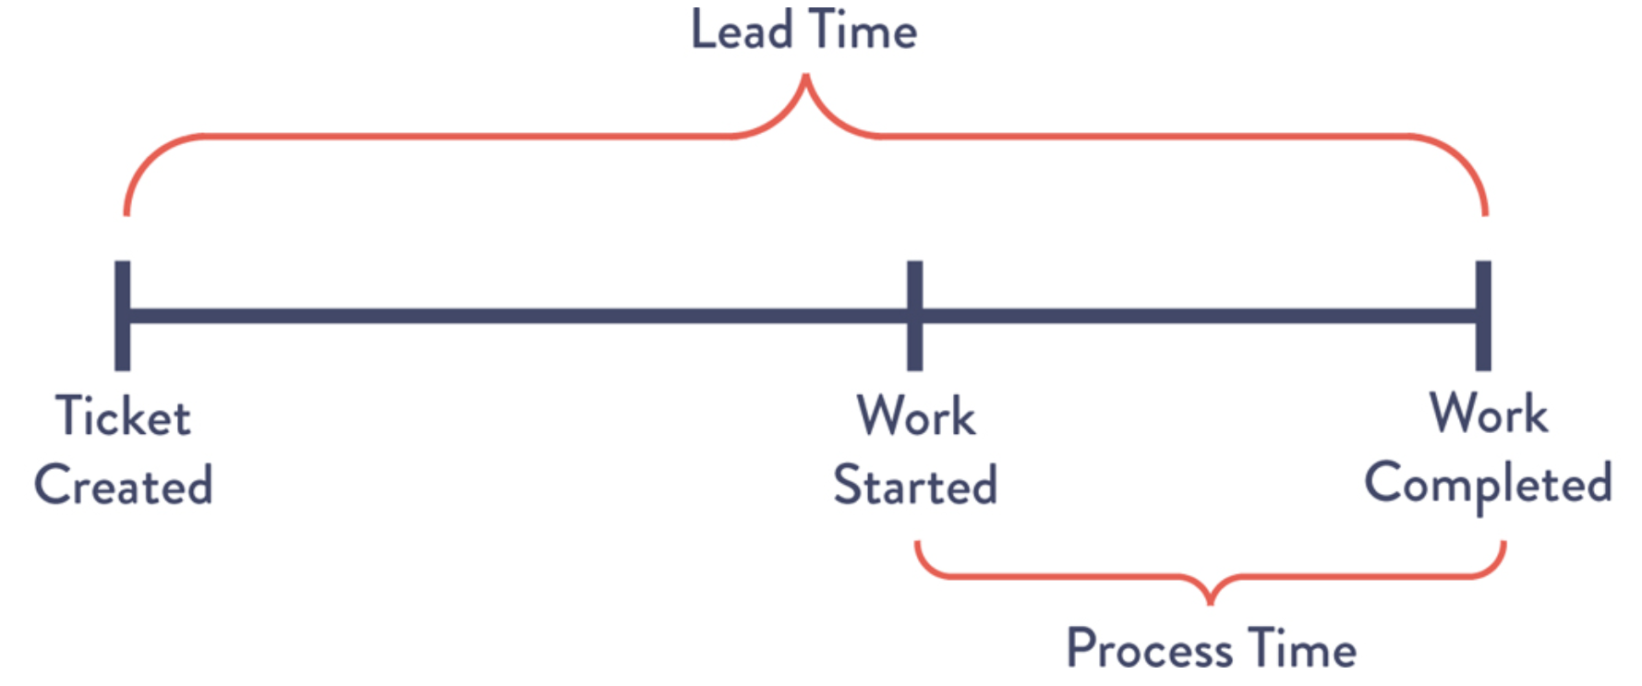
Lead Time vs. Processing Time
Lead Time: total time from request to delivery.
Processing Time: time actively spent working.
Waiting in queues often accounts for most delays.
Reducing lead time is a primary DevOps objective.
Figure 1.1: Lead Time vs. Process Time of a Deployment Operation

Slide 6
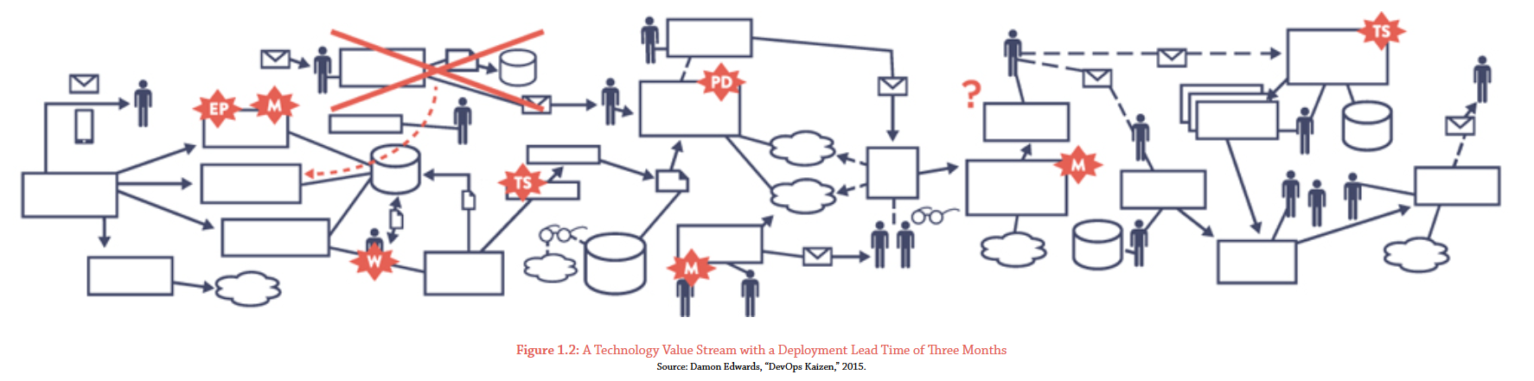
Deployment Lead Times Requiring Months
Large batches, manual approvals, and complex dependencies create delays.
Long lead times slow feedback and increase risk.
Defects are often discovered late in the process.
Organizations become less responsive to customer needs.

Slide 7
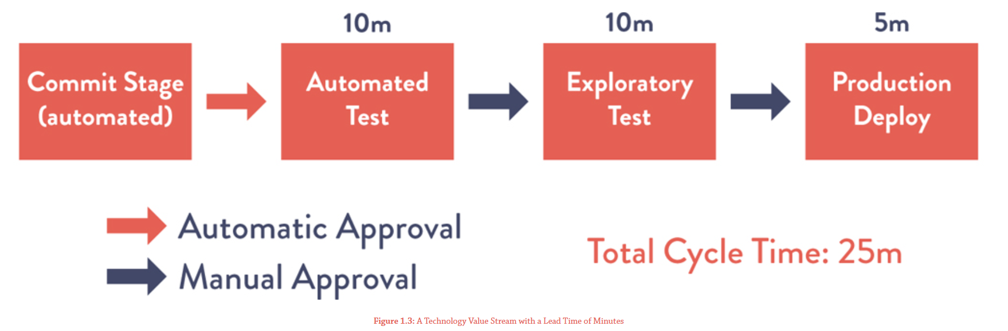
Our DevOps Ideal: Deployment Lead Times of Minutes
Small code changes move rapidly through the pipeline.
Automated testing provides immediate feedback.
Frequent deployments reduce risk and improve quality.
Organizations can deliver value continuously.

Slide 8
Technology Value Stream Metrics
Lead Time – total time required to deliver value.
Flow Efficiency – flow items actively worked on versus total time elapsed.
Flow Velocity – amount of work completed in a period.
Flow Load – active and queued work in the system.
Flow Distribution – balance of work across value streams.

Slide 9
Improving Flow Through DevOps
Continuous Integration enables frequent code integration.
Automated Testing provides fast and reliable feedback.
Small Batch Sizes reduce risk and simplify troubleshooting.
Continuous Improvement helps teams learn and adapt.
These practices support faster and more reliable delivery.

Slide 10
References
Kim, G., Humble, J., Debois, P., & Willis, J. (2021). The DevOps handbook: How to create world-class agility, reliability, & security in technology organizations (2nd ed.). IT Revolution Press.

