Slide 1
System Programming Lab 2 Buffer Size
Lecturer：Professor Pao-Ann Hsiung
Teaching Assistant: Yu-Sheng Lin
Embedded Systems Laboratory
National Chung Cheng University
Chiayi, Taiwan-62102

Slide 2
Outline
Buffer Size
Demo & Requirements
Grading Policies
Turn In
Download

Slide 3
Buffer Size

Slide 4
read
#include<unistd.h>
read(int fd, void * buf, size_t count);
Read count number of data from fd to buf
Return the number of bytes read
Ex: read(STDIN_FILENO, buf,10);

Slide 5
write
#include<unistd.h>
write (int fd, const void * buf,size_t count);
Write count number of data from buf to fd
Return the number of bytes wrote
Ex: write(STDOUT_FILENO, buf,10);

Slide 6
open
#include<fcntl.h>
int open(const char * pathname, int flags, …);
Open or create a file with the flags, return the file descriptor
Flags:
O_RDONLY: read only
O_WRONLY: write only
O_RDWR: read and write
O_DSYNC: have I/O
Ex: each write wait for physical int fd; fd=open(“./myfile",O_RDWR);

Slide 7
fsync
#include<unistd.h>
int fsync(int filedes);
Wait for file writes to disk to complete

Slide 8
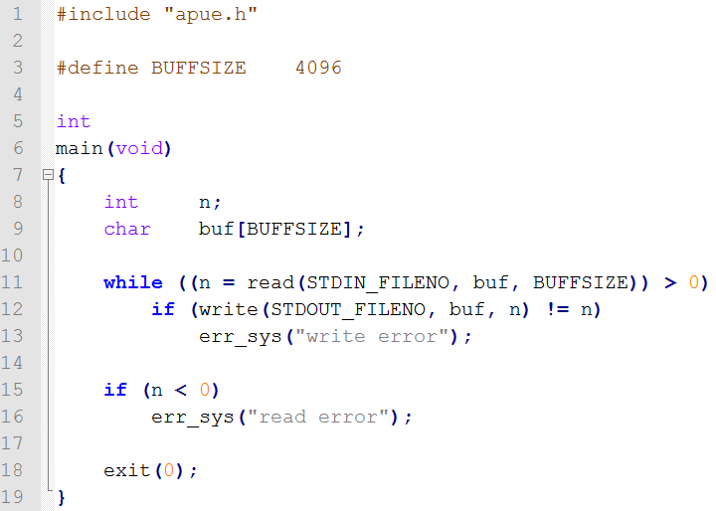
Figure 3.4 buffersize

Slide 9
Demo & Requirements

Slide 10
Demo Part1
Create the files with different sizes
Hint: you can use dd to create these files (man dd or dd –help)
Ex: $dd if=/dev/zero of=500mb_file bs=1024 count=512000
Filename | Size
1mb_file_for_buffSize100 | 1 mb
50mb_file_for_buffSize100 | 50 mb
500mb_file_for_buffSize100 | 500 mb

Slide 11
Demo Part1 (con’t)
Create the files with different sizes
Filename | Size
1mb_file_for_buffSize4096 | 1 mb
50mb_file_for_buffSize4096 | 50 mb
500mb_file_for_buffSize4096 | 500 mb

Slide 12
Demo Part1 (con’t)
Create the files with different sizes
Filename | Size
1mb_file_for_buffSize8192 | 1 mb
50mb_file_for_buffSize8192 | 50 mb
500mb_file_for_buffSize8192 | 500 mb

Slide 13
Demo Part1 (con’t)
Create the files with different sizes
Filename | Size
1mb_file_for_buffSize16384 | 1 mb
50mb_file_for_buffSize16384 | 50 mb
500mb_file_for_buffSize16384 | 500 mb

Slide 14
Demo Part1 (con’t)
Create the files with different sizes
Filename | Size | Buffer size
512mb_file1 | 512 mb | 1024
512mb_file2 | 512 mb | 2048
512mb_file3 | 512 mb | 4096
512mb_file4 | 512 mb | 8192

Slide 15
Demo Part2
Modify Figure 3.4, write data to /dev/null instead of stdout.
Hint: open /dev/null
Compile Figure 3.4 with different BUFFSIZE
Executable Filename | BUFFSIZE
buffsize100 | 100
buffsize4096 | 4096
buffsize8192 | 8192
buffsize16384 | 16384

Slide 16
Demo Part3
Measure the execution time, and fill in the table at next page
You MUST use corresponding file
Ex: $./buffersize100 < 1mb_file_for_buffSize100 $./buffersize16384 < 500mb_file_for_buffSize16384
Hint: you can use time to measure the execution time
Ex: $time ./buffsize16384 < 500mb_file_for_buffSize16384

Slide 17
Demo Part3 (con’t)
file name BUFFSIZE |  | 1mb_file | 50mb_file | 500mb_file
100 | real | 0 | 0.21 | 2.15
 | user | 0.004 | 0.016 | 0.232
 | sys | 0 | 0.192 | 1.912
4096 | real | 0.09 | 0.51 | 4.87
 | user | 0.004 | 0 | 0.016
 | sys | 0 | 0.052 | 0.516
8192 | real | 0.03 | 0.53 | 6.02
 | user | 0 | 0.008 | 0.024
 | sys | 0 | 0.04 | 0.54
16384 | real | 0.01 | 0.5 | 5.1
 | user | 0 | 0.048 | 0.008
 | sys | 0 | 0 | 0.504

Slide 18
Demo Part4
Measure the execution time, and fill in the table at next page
You MUST follow this order:
$./buffsize4096 < 512mb_file1
$./buffsize4096 < 512mb_file2
$./buffsize4096 < 512mb_file2

Slide 19
Demo Part4 (con’t)
file name BUFFSIZE |  | 512mb_file1 | 512mb_file2 | 512mb_file2
4096 | real | 5.8 | 0.1 | 0.1
 | user | 0.036 | 0.016 | 0.016
 | sys | 0.692 | 0.088 | 0.088

Slide 20
Demo Part5
Insert fsync into while loop, and redo Demo Part 4, with 512mb_file3 and 512mb_file4 then fill in the table
file name BUFFSIZE |  | 512mb_file3 | 512mb_file4 | 512mb_file4
4096 | real | 4.99 | 5.05 | 5.05
 | user | 0.012 | 0.008 | 0.008
 | sys | 0.548 | 0.532 | 0.532

Slide 21
Result of Demo (1/2)
Write down the following answers
How do you direct the output file to /dev/null?
The table of Part3 Does the bigger buffsize make IO faster?
The table of Part4 What happened? Why?
The table of Part5 What happened? Why?

Slide 22
Result of Demo
Source file for all Demo
Makefile

Slide 23
Turn In

Slide 24
Turn In
The E-course System
https://ecourse.ccu.edu.tw/
Upload 學號.zip into “Lab 2”
Source files
Makefile
Tables.doc
Answers.doc
Due date
2018/04/10 23:59:59

Slide 25
Turn In (cont’d)
TA’s email:
spta@embedded.cs.ccu.edu.tw

Slide 26
Download

Slide 27
Download command
Code: $wget --no-check-certificate https://ecourse.ccu.edu.tw/29954/textbook/10/2/Lab2.zip

Slide 28
Download
Code: https://ecourse.ccu.edu.tw/29954/textbook/10/2/Lab2.zip
Tables: https://ecourse.ccu.edu.tw/29954/textbook/10/2/Tables.docx
Answers: https://ecourse.ccu.edu.tw/29954/textbook/10/2/Answers.docx

