Slide 1


K-means and DBSCAN Clustering For a Desirable Living Locale

Slide 2

Objective
Cluster Ottawa neighbourhoods based on:
Crime levels
Location
Venue popularity
Who might this help?
New residents
Students new to Ottawa

Slide 3
Data Used
Ottawa Police Service [1]
Common Postal Code Locations
Carleton University [2]
Crime data per neighbourhood, 2015
Foursquare API
Popular venues throughout each neighbourhood

Slide 4
Methodology
Load postal code and crime data into a pandas dataframe
Cluster neighbourhoods with DBSCAN algorithm based on:
Latitude, longitude, and grand total of incidents
Cluster neighbourhoods with k-means algorthim based on:
Top 5 venues returned from Foursquare
Analyze results

Slide 5
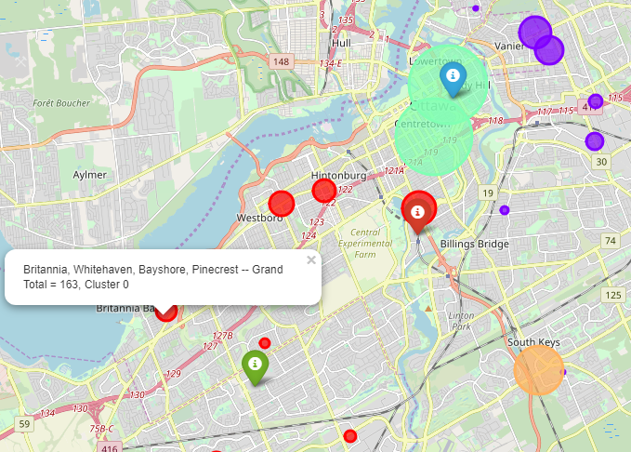
DBSCAN Results
University of Ottawa
Carleton University
Algonquin College

Slide 6
DBSCAN Results
Cluster 3, Total incidents: 609
Cluster 1,
Total incidents: 209
Total incidents: 593
Total incidents: 184
Cluster 0,
Total incidents: 255
Outlier,
Total Incidents:
379

Slide 7
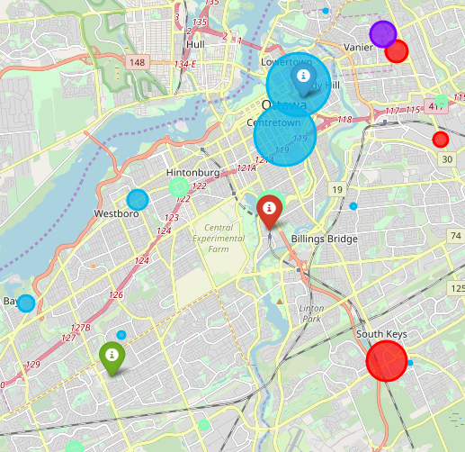
K-means Results
University of Ottawa
Carleton University
Algonquin College

Slide 8
K-means Results
Cluster 2: University of Ottawa
Coffee shops rank as the most common venue
large social spaces dominate (concert halls, stadiums, parks, etc.)
Cluster: 2
Cluster 3: Carleton University
Coffee shops also rank as most common here
Bakeries are popular within this cluster
Cluster: 0
Cluster: 3
Cluster 0: Eastern Ottawa
Grocery and clothing stores are the most popular within this cluster

Slide 9
Conclusion
Students and new residents would be exposed to higher crime levels in the downtown core
Particularly students commuting to (or living on) the University of Ottawa campus
Approximate 50% reduction in reported crimes between the two university locales
Carleton University and Eastern Ottawa share similar crime levels, but factoring in the popular venues for each (such as proximity to grocery stores) will help individuals confirm a new home
Future Analysis
Preprocess venue data to achieve a roughly spherical distribution [3]
This will help identify the most efficient number of clusters for k-means
Incorporate coordinates for each incident
Ideally, current statistics will be available from the Ottawa Police Service
Incorporate rent and utility prices
This will achieve a more realistic model in terms of client needs

Slide 10
References

