Slide 1
Battle DOG
林暐哲
航太系
F44026123

Slide 2
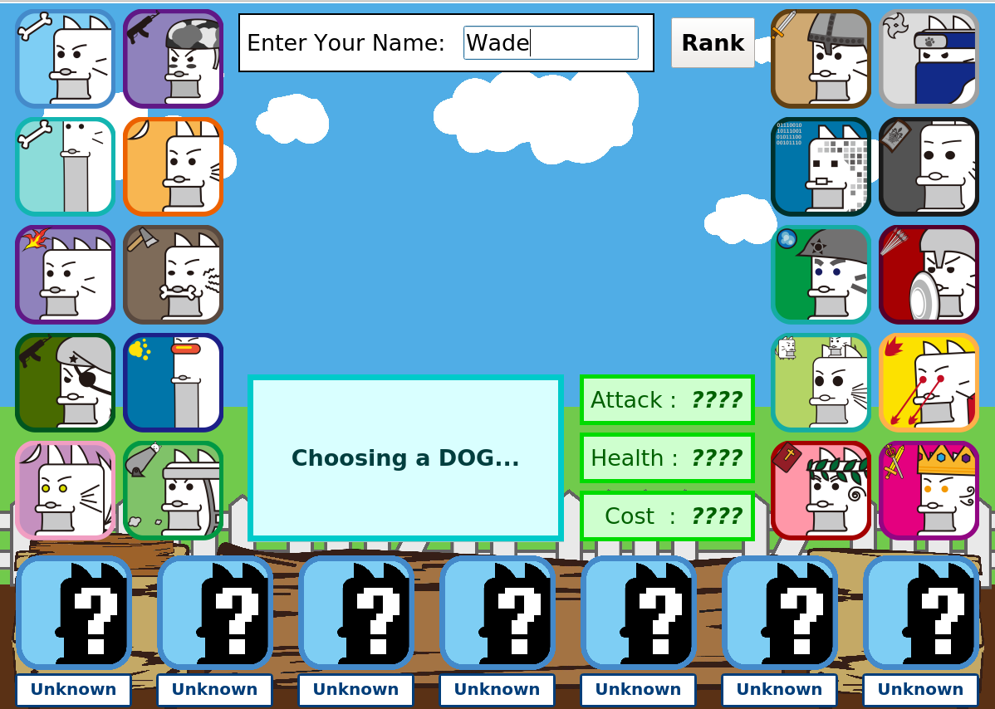
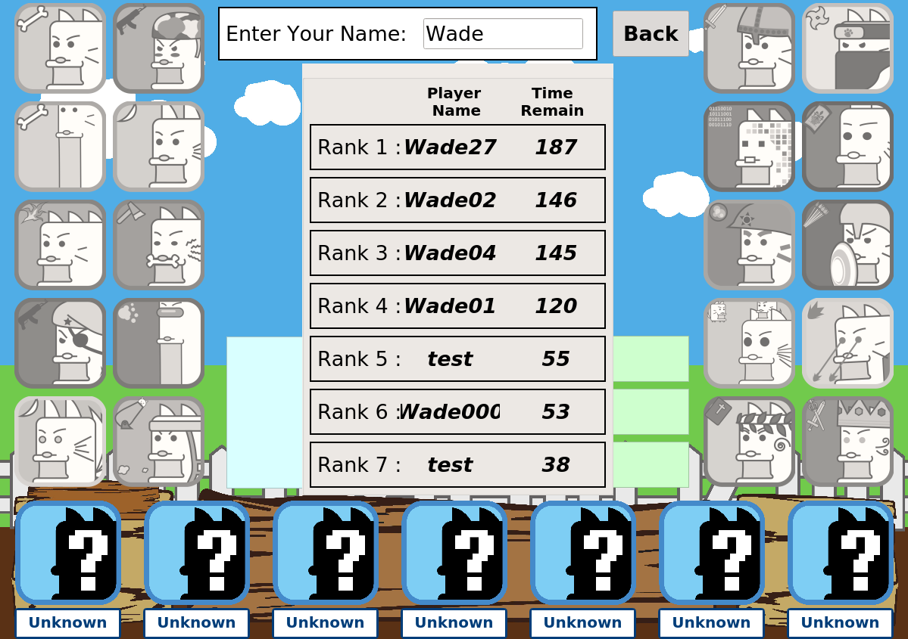
Features
Magic
Manage cards page
Rank
20 minions

Slide 3




















Minions
Dragon
Doggy
Spartan
Shield
Ancient
Superdog
Dox
Robort
TallEX
Bigdog
Dragon
Tall
Nija
Jesus
Commander
Saber
Dragon
Ditch
Catnon
King

Slide 4

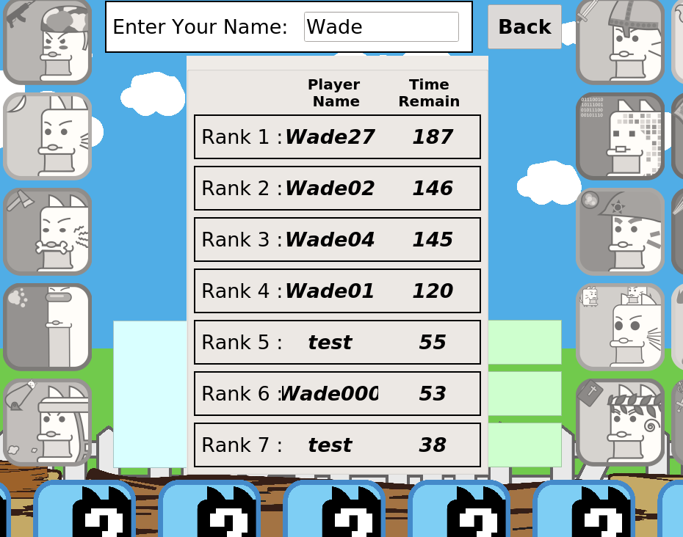
Magic
Rank

