Slide 1
Digital Circuit and System Lab03
2024/03/21
TA: 柯立恆 Li-Heng (Billy) Ke
Institute of Electronics,
National Yang Ming Chiao Tung University

Slide 2
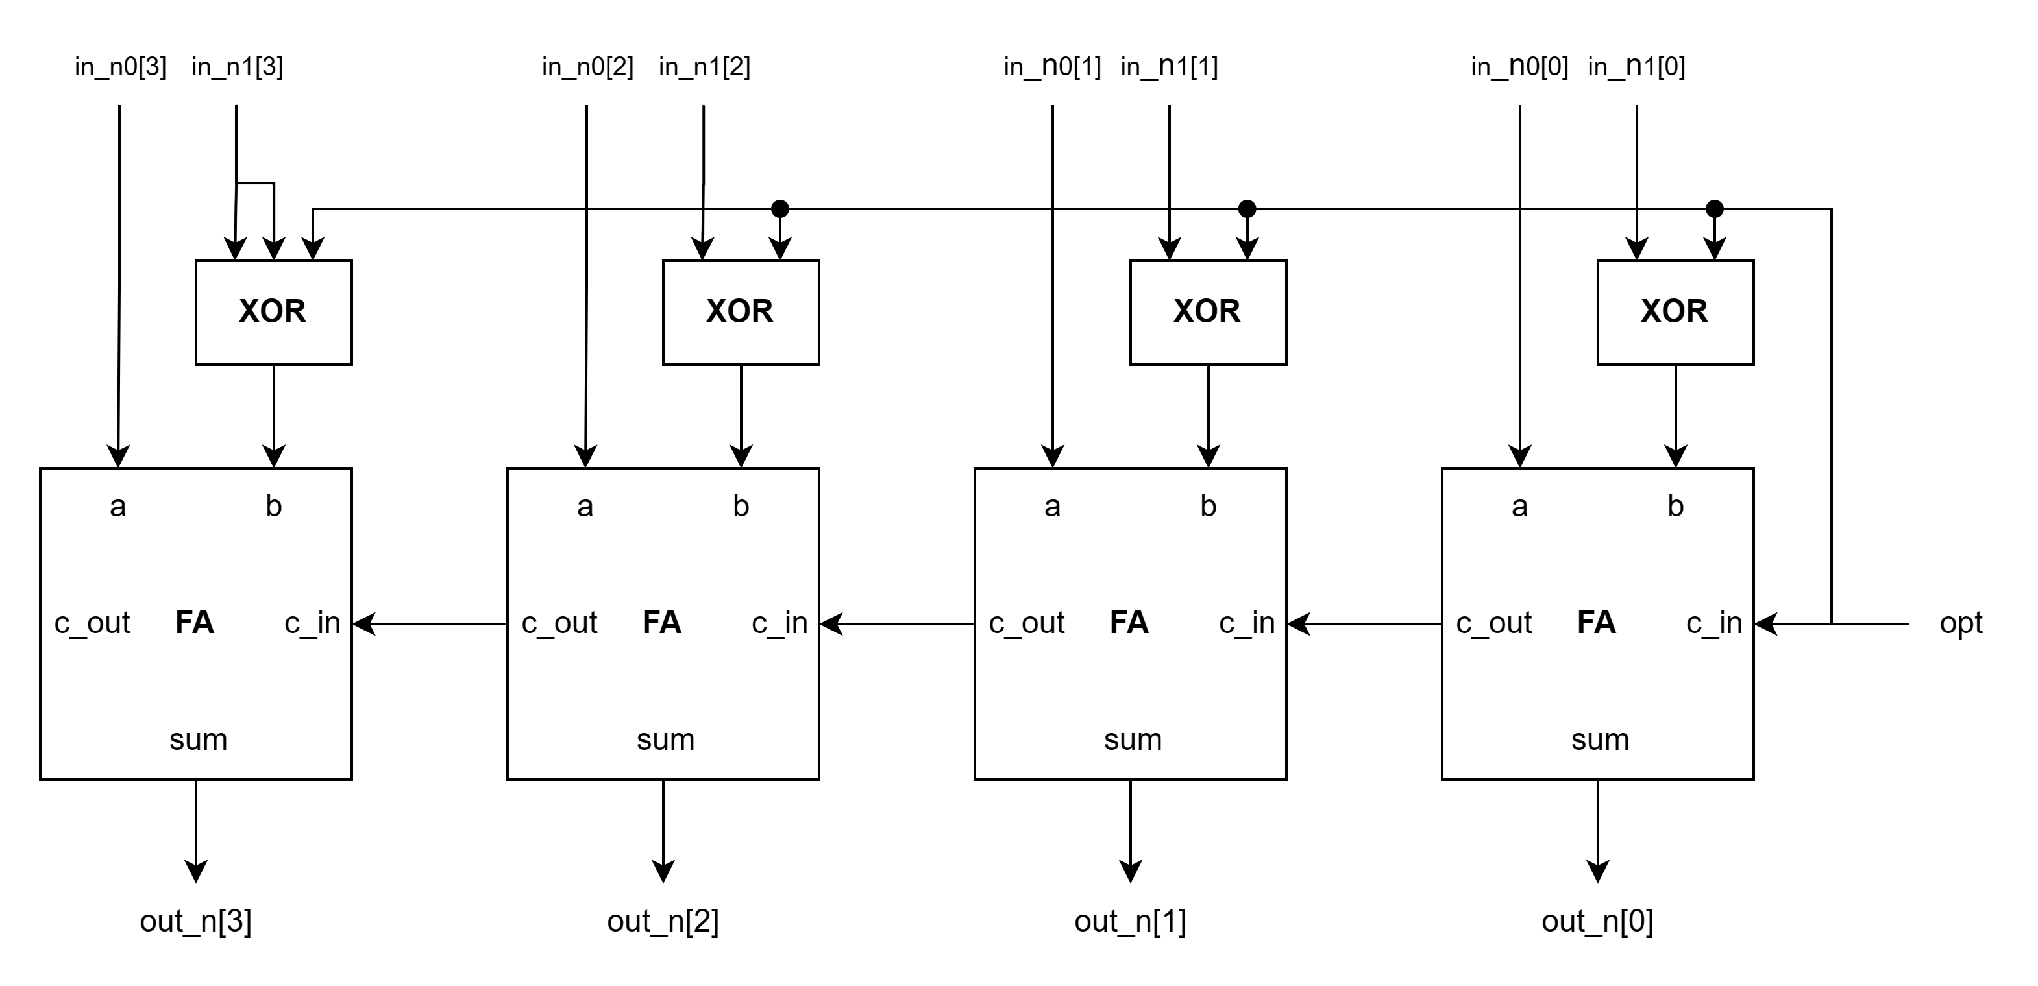
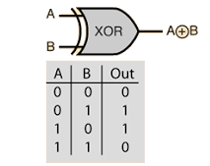

Gate Level Modeling
Using logic gates to implement the functionality of this line of code:
$assign out_n= \left(opt\right) ? in_n0 − in_n1 : in_n0 + in_n1;$
Spec:
You can only use logic gates, HA and FA module(+, -, =, if-else are not allowed)

Slide 3
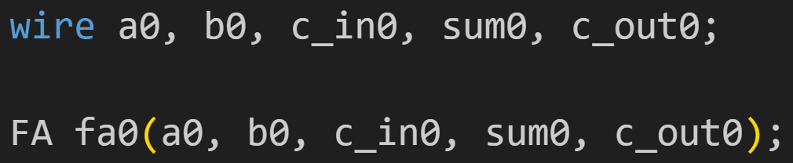
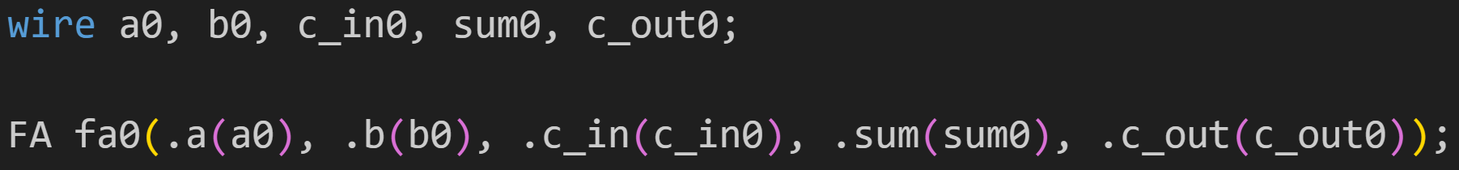
Module connection
Modules connected by port order (implicit)
Order must match correctly. Normally, it not a good idea to connect ports implicitly. It could cause problem in debugging when any new port is added or deleted.
Modules connect by name (explicit)
Use named mapping instead of positional mapping
Name shall match correctly.
You must use this format.

Slide 4
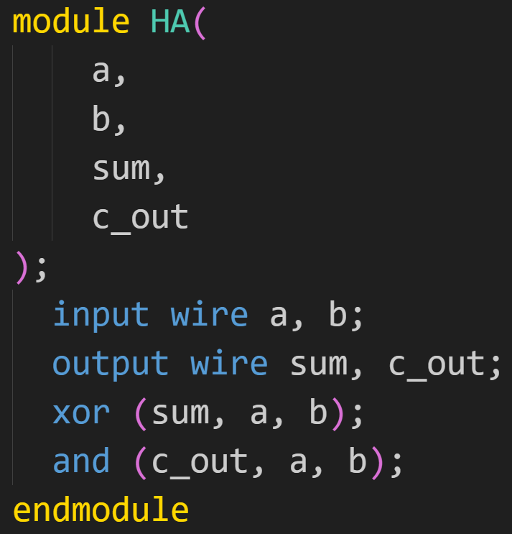
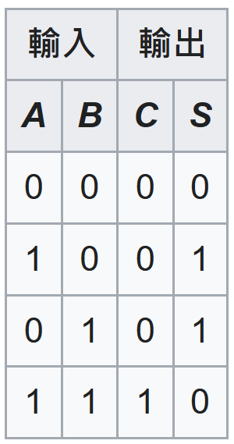
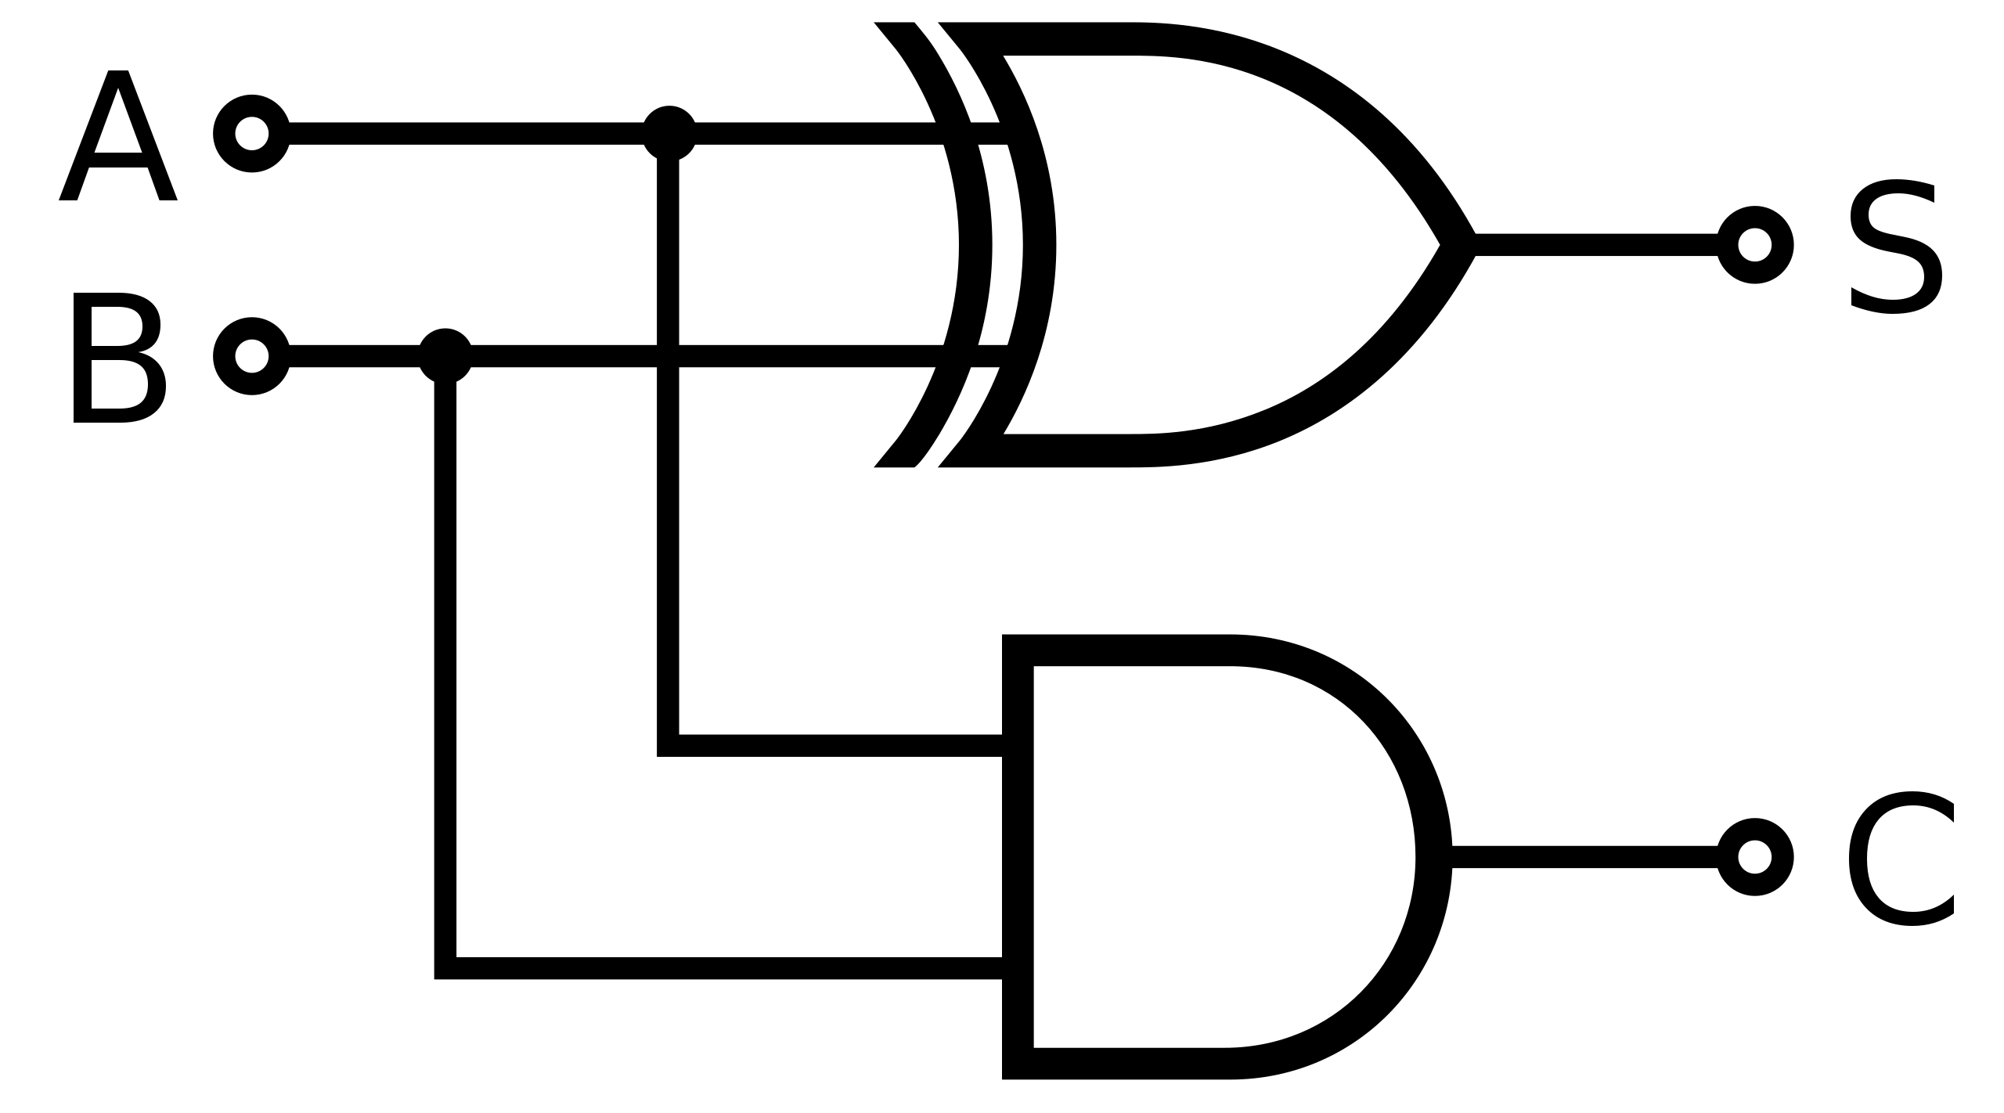
Half Adder

Slide 5
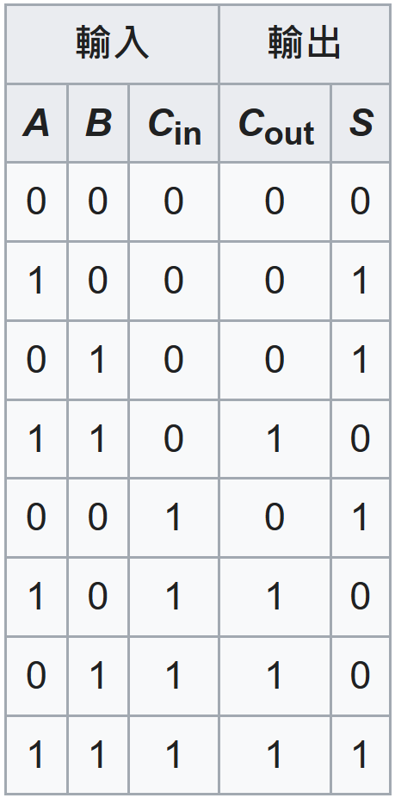
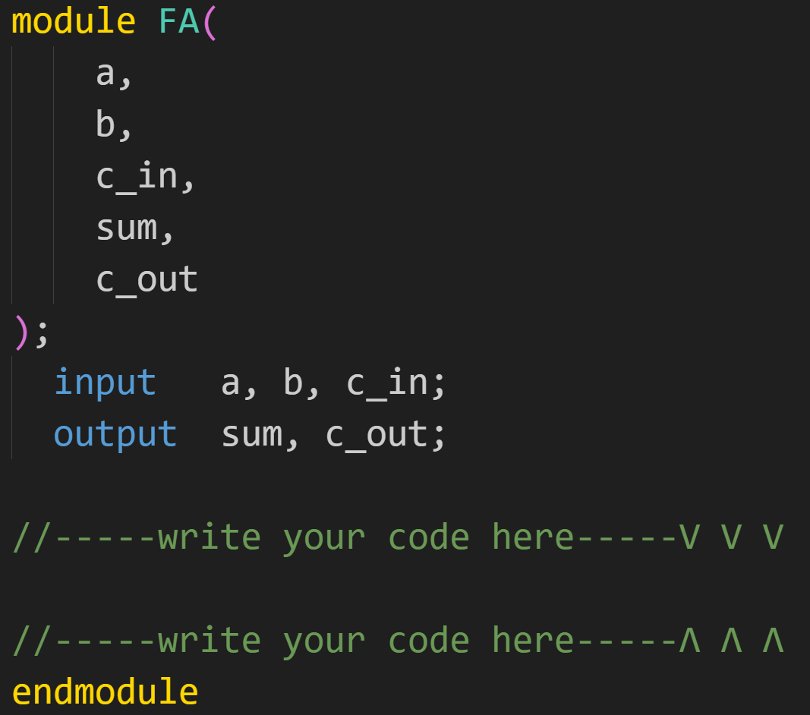
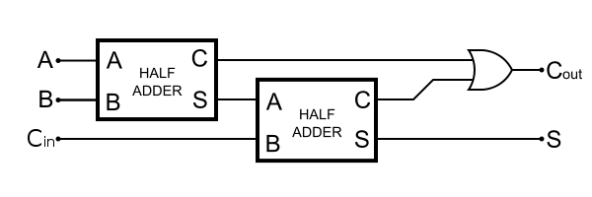
Full Adder

Slide 6
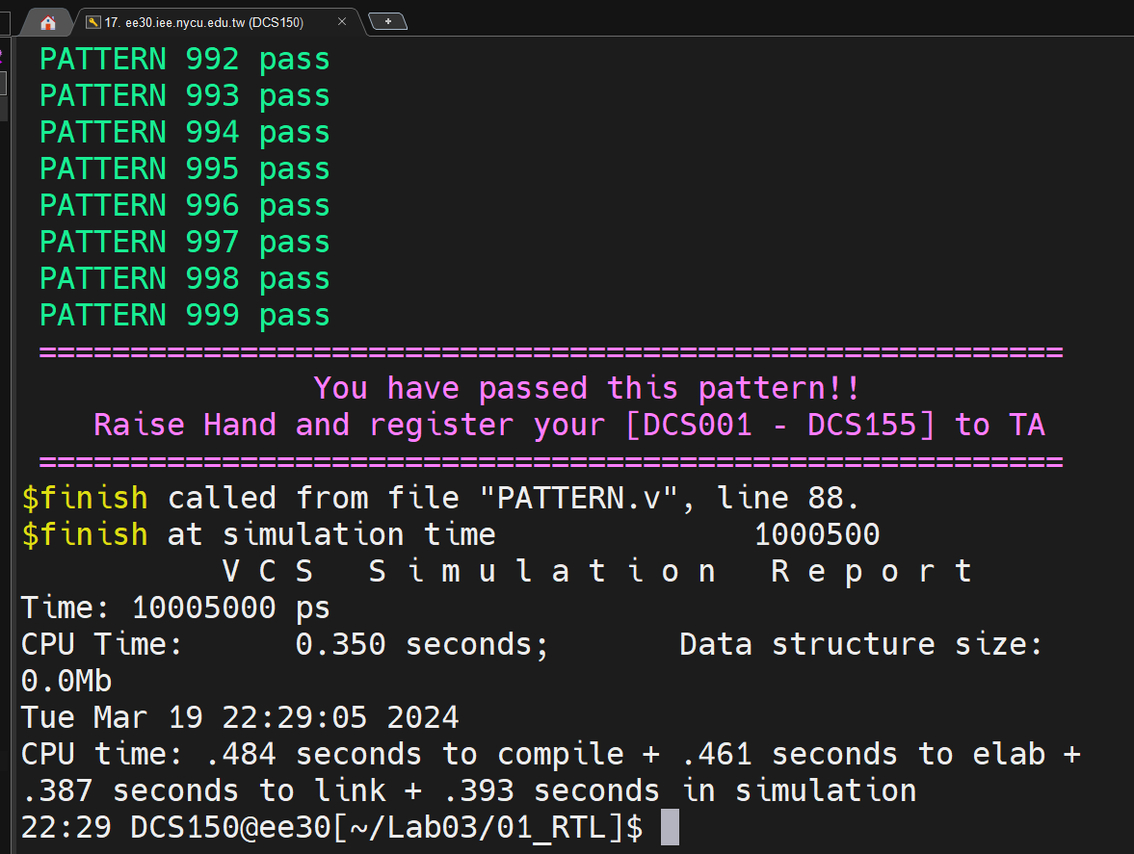
Score
Terminal shows “Your have passed this pattern!!”.
TAs will check your simulation result and code.

Slide 7
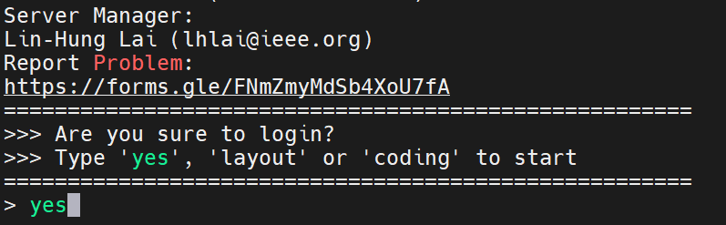
Server log in
Type “yes” when you log in the server.

Slide 8
Command List
Extract files from TA’s directory (home directory):
tar -xvf ~DCSTA01/Lab03.tar
Verilog RTL simulation (01_RTL/):
./01_run_vcs_rtl
Observe waveform to debug
nWave &
find core.fsdb
shift + L for reload fsdb file
Synthesis (02_SYN/) (optional):
./01_run_dc_shell
Gate_level simulation (03_GATE/) (optional):
./01_run_vcs_gate

