Slide 1
Digital Circuit and System Lab06
20240424
TA: 沈品慶 Pin-Ching(Chris),Shen
Institute of Electronics,
National Yang Ming Chiao Tung University

Slide 2
Design
This time, you need to utilize the spec and design in HW2 to finish the lab.
The lab spec are the same as HW2, but this time the cycle time needs to be set below 10(include).
We will provide two preliminary versions for you.
CNN_single.v
CNN_pipeline.v
Notes:
Single版本的會有timing violation以及較大的面積，而pipeline版本則是較多的cycle。

Slide 3
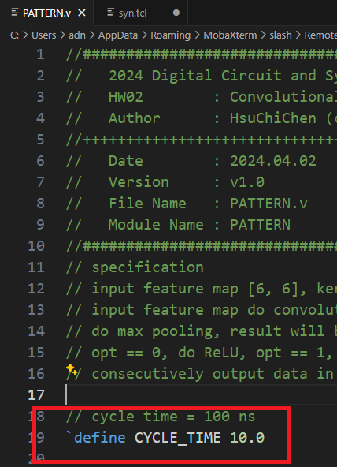
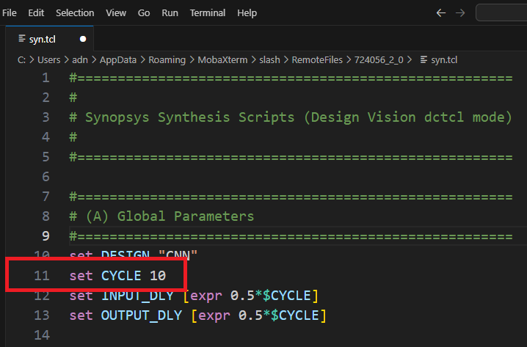
Design
If you want to modify the cycle time, you need to modify both the TCL (Tool Command Language) script and the pattern file.
02_SYN/syn.tcl
00_TESTBED/PATTRN.v

Slide 4
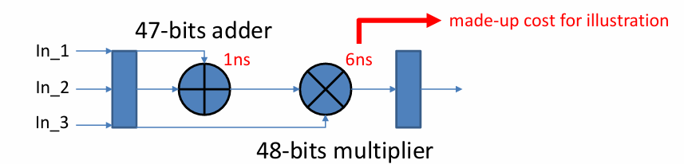
Naïve design
No pipeline, long critical path
critical path = 47-bits adder + 48-bits multiplier = 7ns > cycle time
Timing violation
assume cycle time: 6ns

Slide 5
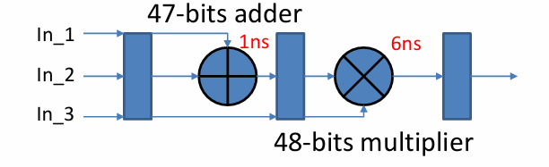
Simple pipeline design
Simply separate adder and multiplier
critical path = max(47-bits adder, 48-bits multiplier) = 6ns = cycle time
Meet design spec
assume cycle time: 6ns

Slide 6
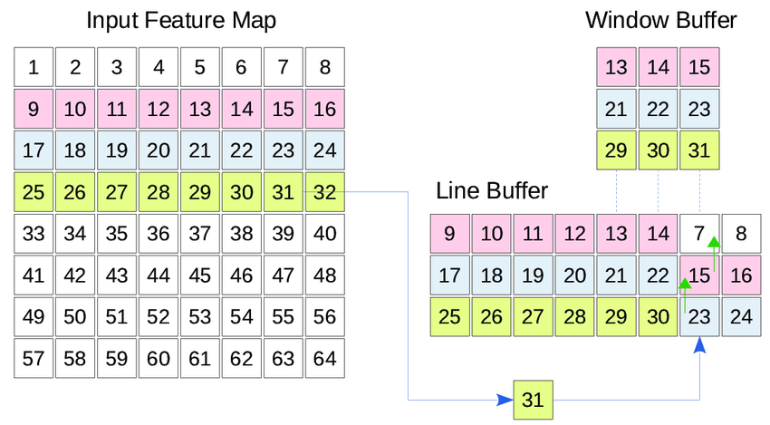
Optimization example
Line buffer
Notes:
實際上一次convolution為3*3的乘加運算，因此可以只需要讀取到第三行的第三個值就可以開始運算。並且只需要紀錄三個行的數據就可以完成運算，並不需要紀錄五行。因此做到這兩項就可以減少延遲和面積。但是要注意實現line buffer時控制電路不要太複雜不然可能會讓面積上升。

Slide 7
Score
Function Validity: 80%
01_RTL, 02_SYN, 03_GATE pass
The execution latency is limited in 1000 cycles. The latency is the clock cycles between the falling edge of the in_valid and the rising edge of the first out_valid.
You can adjust your clock period by yourself, but the maximum period is 10 ns. The precision of clock period is 0.1, for example, 4.5 is allowed, 4.55 is not allowed.
Performance : 20%
Performance = area (us^2) * total cycle (#cycles) * cycle time (ns).
Performance score need to below 37,000,000,000 to pass this lab.
Deadline : 04/28 11:59PM

Slide 8
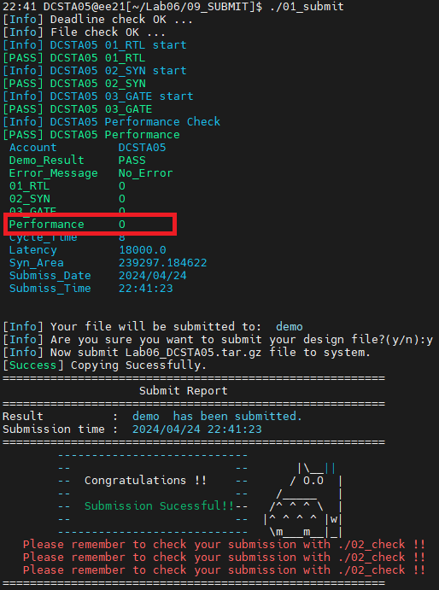
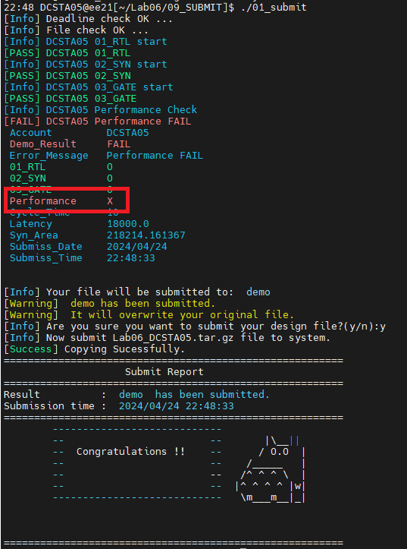
Demo result
Performance score pass
Performance score fail

Slide 9
Command List
Extract files from TA’s directory (home directory): (It will be valid at 16:30 p.m.)
tar -xvf ~DCSTA01/Lab06.tar
Verilog RTL simulation (01_RTL/):
./01_run_vcs_rtl
Synthesis (02_SYN/):
./01_run_dc_shell
./08_check
Gate level simulation (03_GATE/):
./01_run_vcs_gate
Observe waveform to debug
nWave &
find *.fsdb
shift + L for reload fsdb file

Slide 10
Command List
Submit your Lab:
cd 09_SUBMIT
./00_tar 10
10 means the cycle time in this design. You can modify in this Lab.
./01_submit
./02_check

