Slide 1
Digital Circuit and System Lab08 Sorting Network
20240509
TA: 柯立恆 Li-Heng(Billy), Ke
Institute of Electronics,
National Yang Ming Chiao Tung University

Slide 2
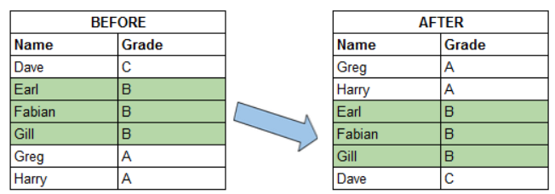
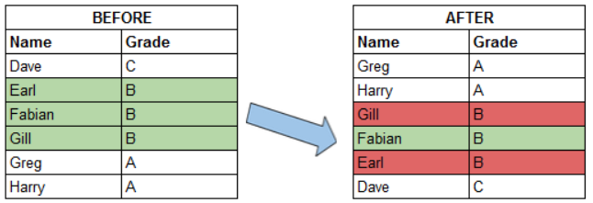
Sorting Network
A stable sorting algorithm maintains the relative order of the items with equal sort keys, while unstable one doesn’t.

Slide 3
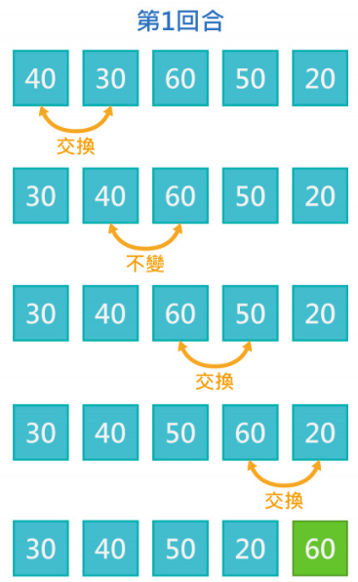
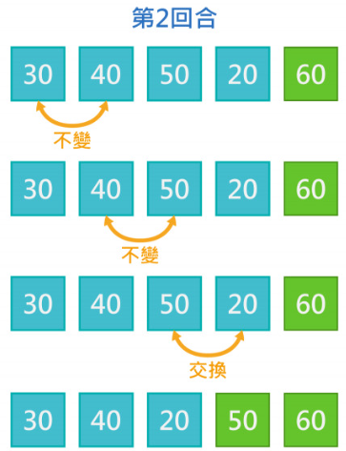
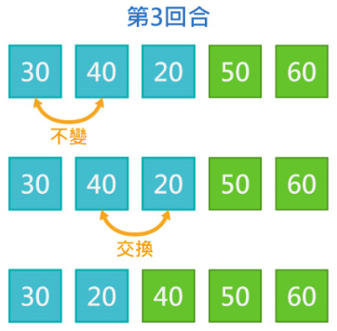
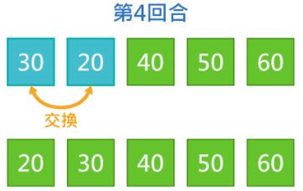
Bubble Sort
A kind of stable sorting algorithm

Slide 4
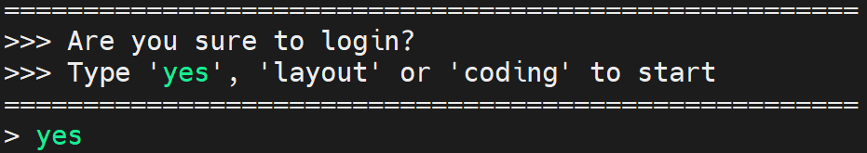
Environmental preparation
type ‘yes’ while you login the server
Source PA
source /RAID2/cad/synopsys/CIC/pa_virtualizer.cshrc
Extract files from TA’s directory (home directory)
tar -xvf ~DCSTA01/Lab08.tar

Slide 5
Lab 08
Complete the sorting network of HW3 in SystemC
Sorting 6 elements

Slide 6
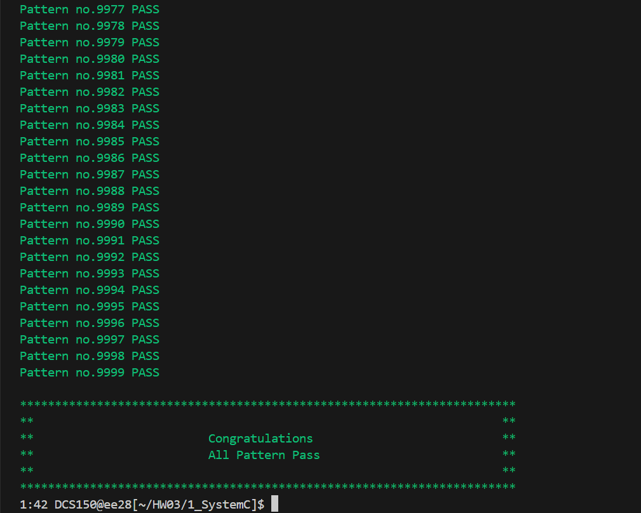
SystemC simulation
Simulation
cd ./Lab08/1_SystemC
make

Slide 7
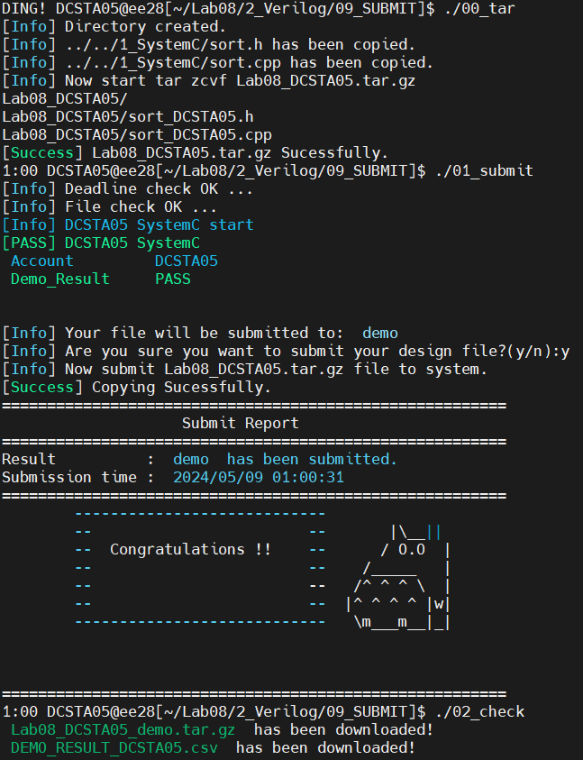
Lab Submission
Submission
cd ../2_Verilog/09_Submit
./00_tar 20
Don’t modify the number in this Lab.
./01_submit
./02_check

Slide 8
Score
Finish this Lab:
Today: 100 points
On Friday: 100 points
On Saturday: 100 points
On Sunday: 100 points
On Monday: 0 points
After Monday: 0 points

