Slide 1
Digital Circuit and System Lab09 Pipeline
20240516
TA: 柯立恆 Li-Heng(Billy), Ke
Institute of Electronics,
National Yang Ming Chiao Tung University

Slide 2
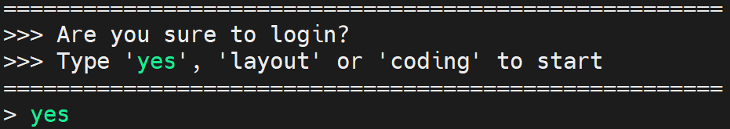
Environmental preparation
type ‘yes’ while you login the server
Extract files from TA’s directory (home directory)
tar -xvf ~DCSTA01/Lab09.tar

Slide 3
Lab09
Design a simple operation
𝑂𝑢𝑡=(𝑖𝑛_1+𝑖𝑛_2)×𝑖𝑛_3
in_1, in_2: 47 bits unsigned number
In_3: 48 bits unsigned number
Out: 96 bits unsigned number
Large bit width multiplier is costly.

Slide 4
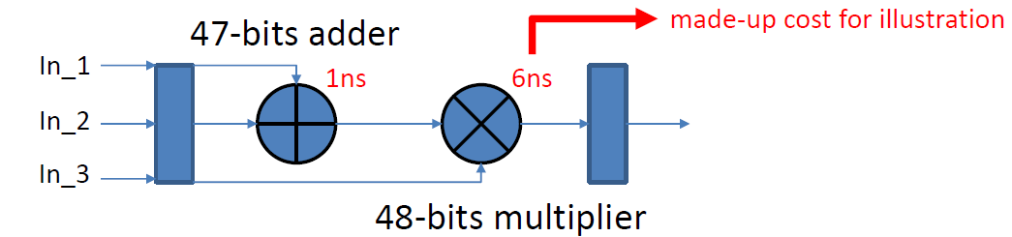
Lab09 - Naïve design
Assume we have a cycle time limit: 5ns
No pipeline -> long critical path
Critical path = 47 bits adder + 48 bits multiplier = 7 ns > 5ns
You will fail this lab!!

Slide 5
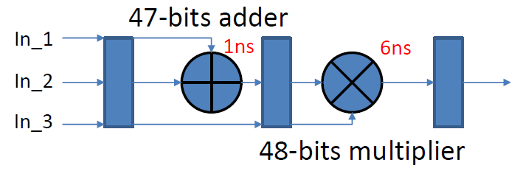
Lab09 - Simple pipeline design
Assume we have a cycle time limit: 5ns
Simply separate adder and multiplier
Critical path = 48 bits multiplier = 6 ns > 5ns
Better, but you still will fail this lab!!

Slide 6
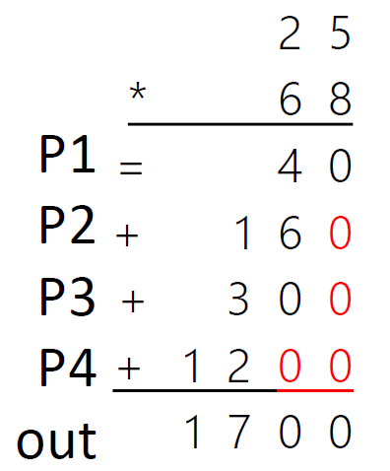
Lab09 - Optimization
You can try to separate the big multiplier to several small multipliers
Example:
25 * 68 = 1700
P1 -> 8 * 5 = 40
P2 -> 8 * 2 = 16
P3 -> 6 * 5 = 30
P4 -> 6 * 2 = 12
P1 + P2 * 10 + P3 * 10 + P4 * 100 = 1700
You can further integrate the pipeline.
Achieve lower critical path.

Slide 7
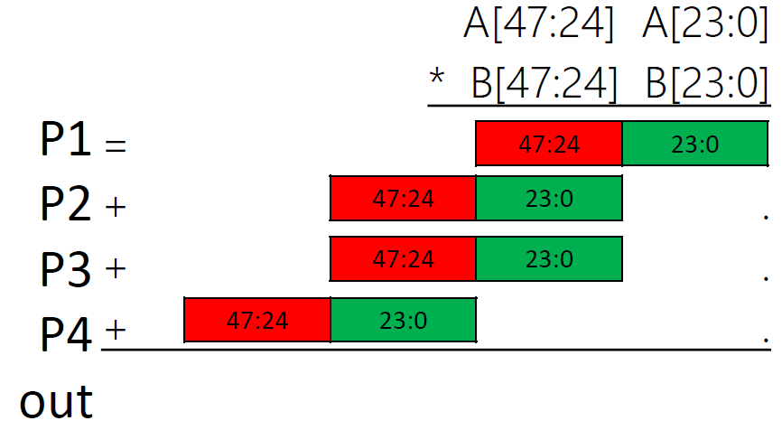
Lab09 - Optimization
In Binary cases : Partition operands A and B into two parts
A[47:0 ] * B[47:0]
=(A[47:24] * 2^24 + A[23:0]) * (B[47:24] * 2^24 + B[23:0])
= A[47:24] * B[47:24] * 2^48
+ A[47:24] * B[23:0] * 2^24
+ B[47:24] * A[23:0] * 2^24
+ A[23:0] * B[23:0]

Slide 8
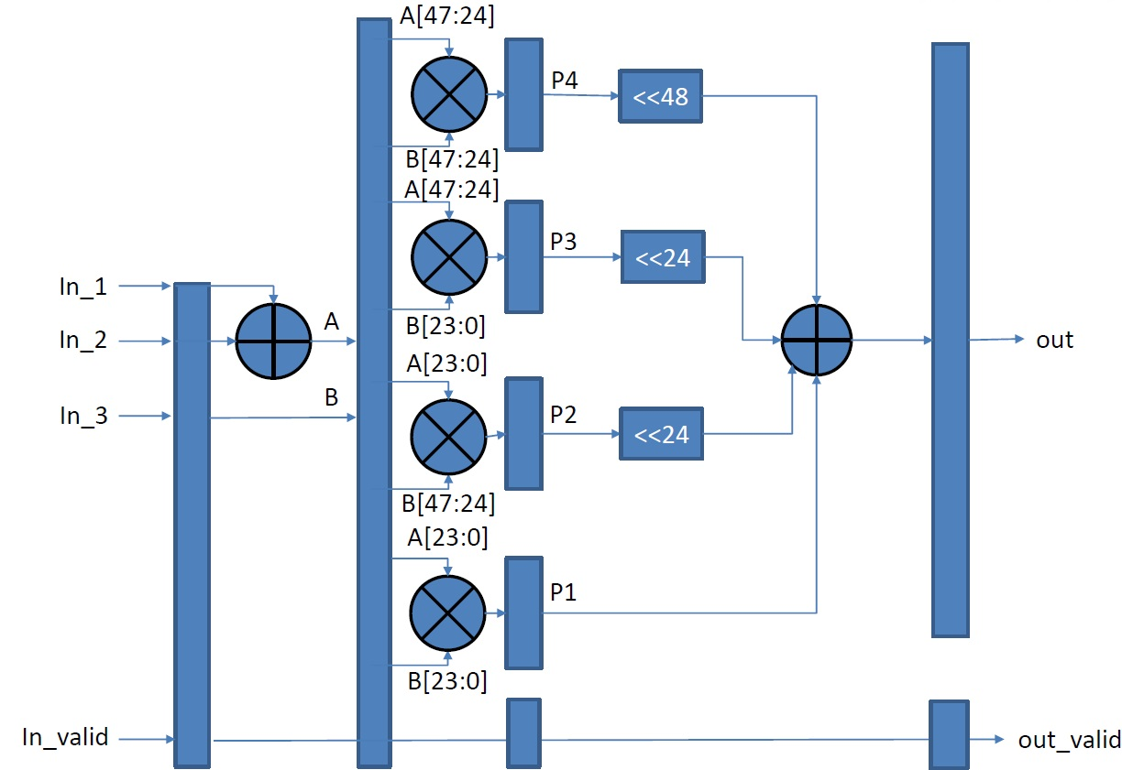
Lab09 – Block diagram
In theory, using the following design should pass the cycle time limit.
But if it still fails, it may be because the pipeline is not sliced finely enough.
Ex : There are multiplexers or any operations connected before or after the multiplication.

Slide 9
Score
Function Validity: 100%
01_RTL, 02_SYN, 03_GATE pass
You can not adjust your clock period by yourself, the clock period is 5 ns.
Deadline : 05/19 11:59PM

Slide 10

Demo result
01_RTL
./01_run_vcs_rtl

Slide 11
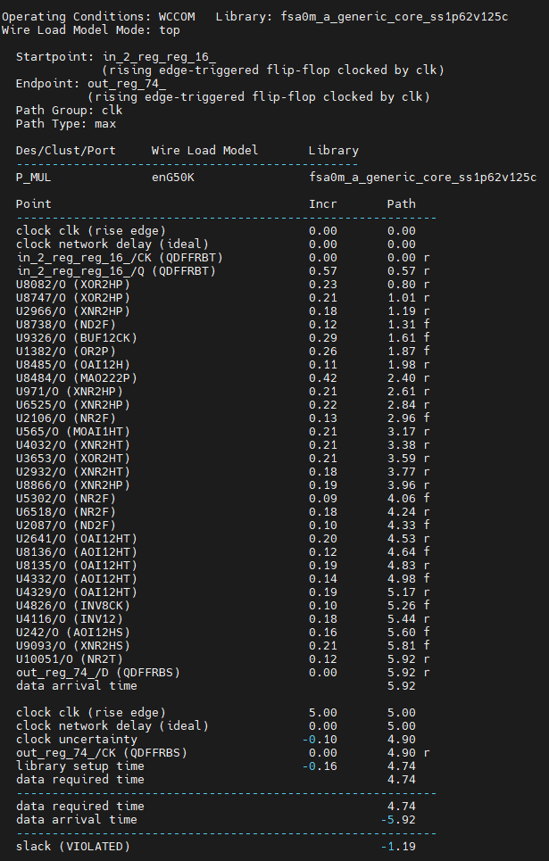
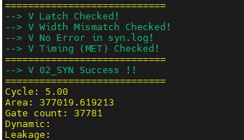
Demo result
02_SYN
./01_run_dc_shell
You can trace your critical path.

Slide 12
Lab Submission
09_SUBMIT
./00_tar 5
Don’t modify the number in this Lab.
./01_submit
./02_check

Slide 13
Command List
Extract files from TA’s directory (home directory): (It will be valid at 16:30 p.m.)
tar -xvf ~DCSTA01/Lab09.tar
Verilog RTL simulation (01_RTL/):
./01_run_vcs_rtl
Synthesis (02_SYN/):
./01_run_dc_shell
./08_check
Gate level simulation (03_GATE/):
./01_run_vcs_gate
Observe waveform to debug
nWave &
find *.fsdb
shift + L for reload fsdb file

