Slide 1
Digital Circuit and System Lab10 FPGA-LED
20240523
TA: 柯立恆 Li-Heng(Billy), Ke
Institute of Electronics,
National Yang Ming Chiao Tung University

Slide 2
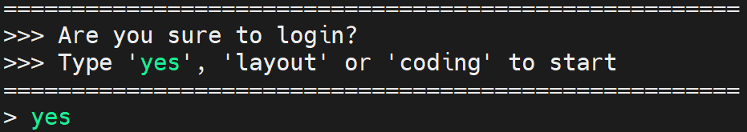
Environmental preparation
type ‘yes’ while you login the server
Extract files from TA’s directory (home directory)
tar -xvf ~DCSTA01/Lab10.tar
Command to open Vivado:
vivado

Slide 3
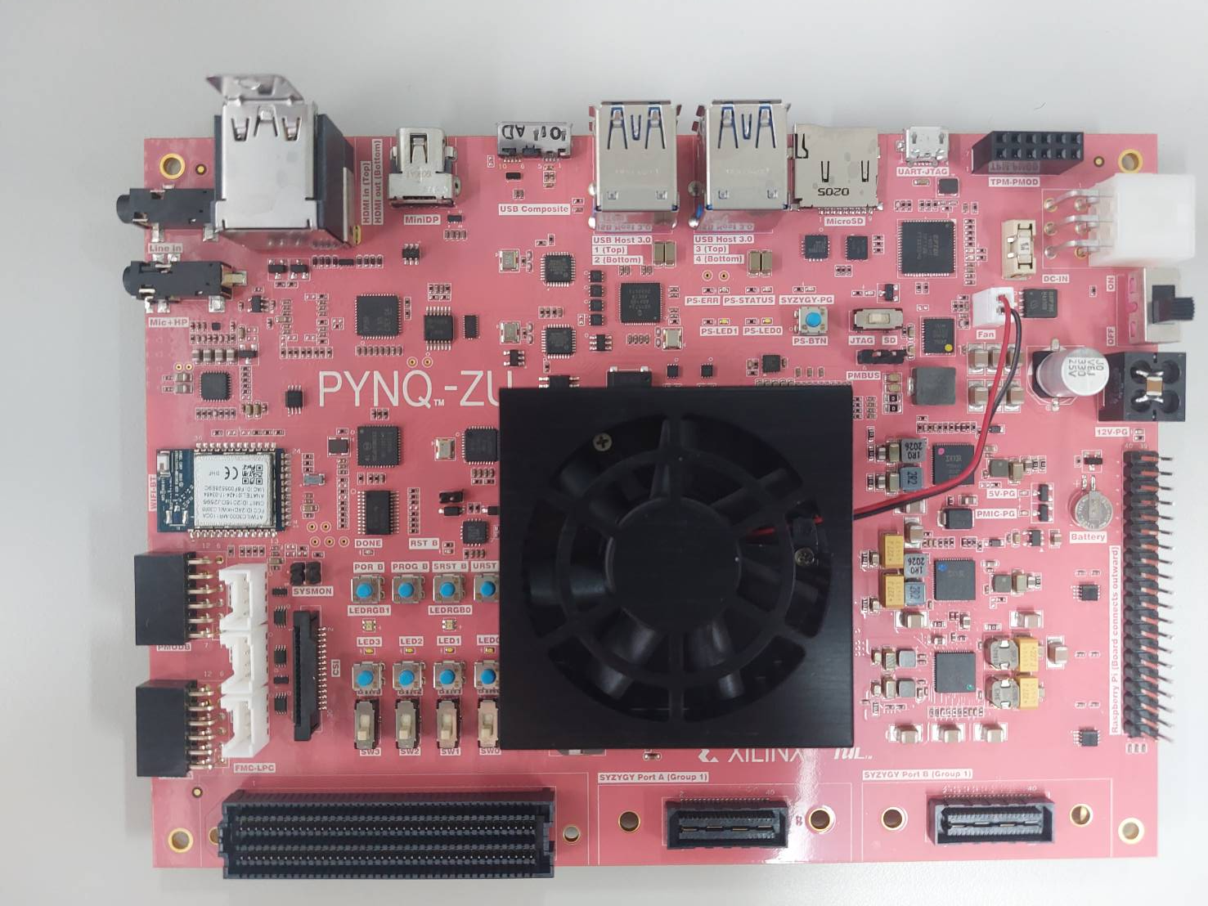
FPGA
FPGA you will use in this Lab.
For LED output’s form
For LED output’s reset
For LED output’s freqency

Slide 4
Lab10 - I/O port
This Lab’s I/O port :
4 button and 1 switch as input.
4 LED as output
Function :
3 button control LED output’s form, only one button can be pressed at a time.
The right most button for LED output’s reset signal.
1 switch control LED output’s frequency, when the switch is turned up, the frequency should be four times the original.

Slide 5
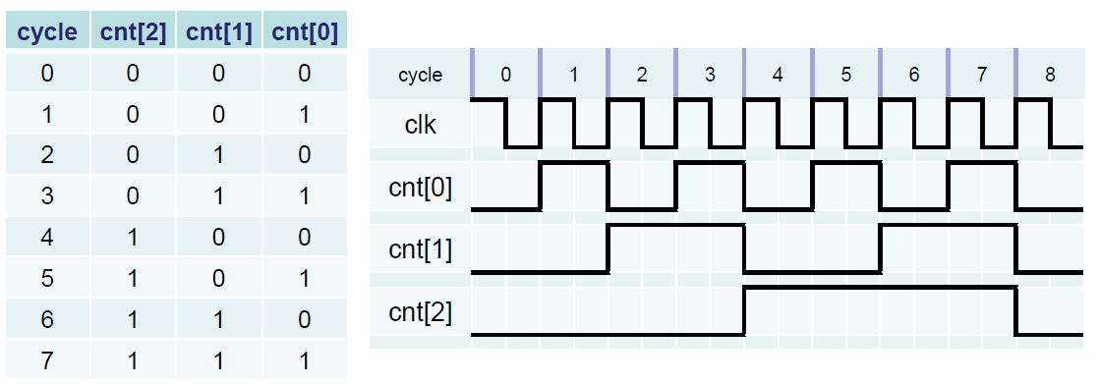
Lab10 – Frequency divider
Through count accumulation, read a certain bit of count as a new clock.
If switch is 0, d_clk freqency is (clk frequency)/(2^25), otherwise d_clk is (clk frequency)/(2^23) (hit : using count[?] to generate d_clk).
You can use a pre-declared count as a freqency divider.

Slide 6
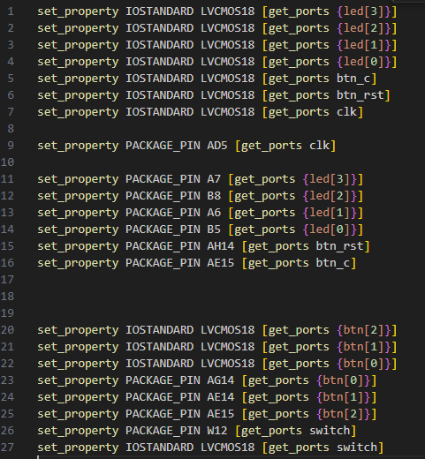
Lab10 – constraint file
You need to follow the constraint file below to build your own constraint file.

Slide 7
Lab10 – LED output form
There are four different LED output forms.
Don’t press any button(000), LED lights from left to right:
Press the left most button (100), all LEDs are on:
Press the second button from the left (010), all LED are off:
Press the third button from the left (001), LED lights from right to left:
Press the right most button, LED lights will return to default stage:
……
……
……
……

Slide 8
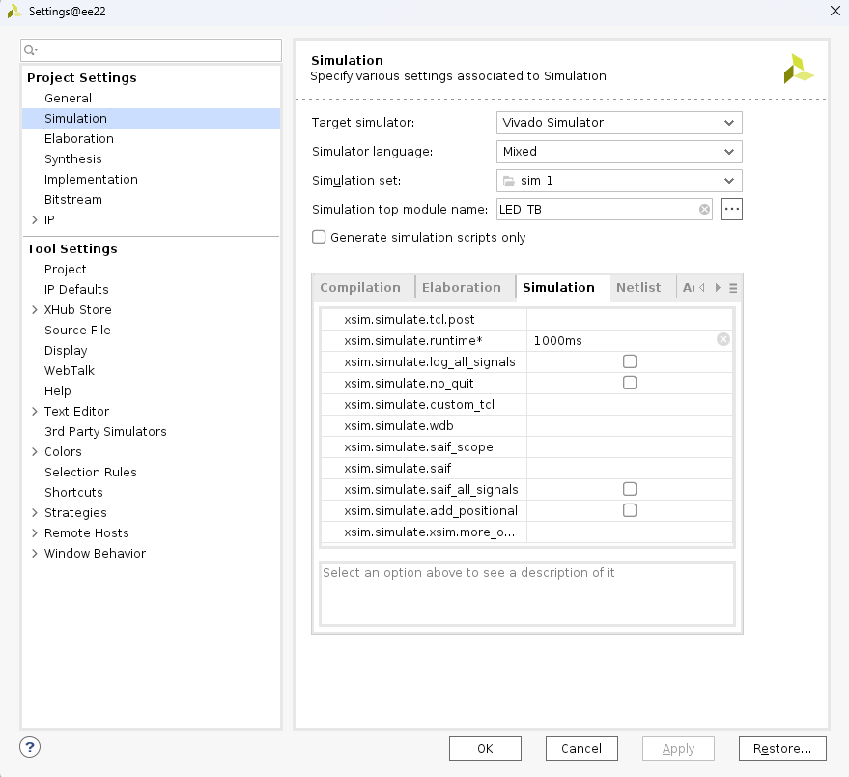
Lab10 – Simulation result
Before your simulation, you need to modify the simulation setting as below:

Slide 9
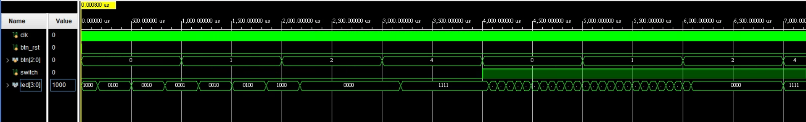
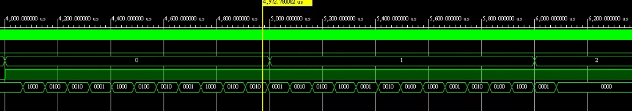
Lab10 – Simulation result
Before actually using the fpga in the lab class, you must simulate it yourself and observe whether the waveform is correct.
The testbench we provided will be a simple version. You can rewrite it yourself for more accurate verification.

Slide 10
Lab Submission
Upload your bitstream file through the link we provided:
Bit stream file’s address in your server account: /RAID2/COURSE/DCS/DCSXXX/Lab10/Lab10.runs/impl_1/LED.bit
After you download your bitstream file, you need to modily the file’s name for submission.
File name: DCS_lab10_groupXX_DCSYYY.bit, XX is your group number, YYY is your server account.
Each student only needs to submit one file.
Deadline : 05/23 16:30PM.

Slide 11
Score
Function Validity: 100%
The demo result on the fpga should be correct.
Only students who are present in ED428 and submit their bitstream files will receive points.

