Slide 1
LAB 1 C++ BASICS & LINUX
UEE 1303
National Chiao Tung University

Slide 2
Grading policy
A:
Hand in on time
Program can be compiled, and the answer is right
B:
Hand in within a week
Program can be compiled, and the answer is right
C:
Hand in within a week
Program can be compiled, but the answer is wrong
0:
Hand in more than one week, or program can not be compiled, or copy

Slide 3
LAB
Lab time : 18:30 – 21:20 every Monday
Classroom : computer PC02, PC03
Brief introduction before every lab
Homework deadline is next Monday.

Slide 4
Outline
C++ basics
Linux basics
Lab1 exercise

Slide 5
C++ Identifiers
An Identifier is a name of variables constant, …
A C++ identifier
Consists of a sequence of letters, digits, and the underscore character ( _ )
Must start with either a letter or an underscore character // avoid doing so in general
Is case-sensitive
Keywords are special identifiers
E.g., if, for, char, …
Cannot be used for user-defined entities

Slide 6
C++ Variables
Variables
Its name is an identifier
is a memory location to store data
Must be declared before its use int number; // declaration & definition
double width, length; // declaration & definition
extern int count; // declaration ONLY, discuss later
Meaningful names!
Naming convention: starting with a lowercase letter
E.g., weight, total_weight, …

Slide 7
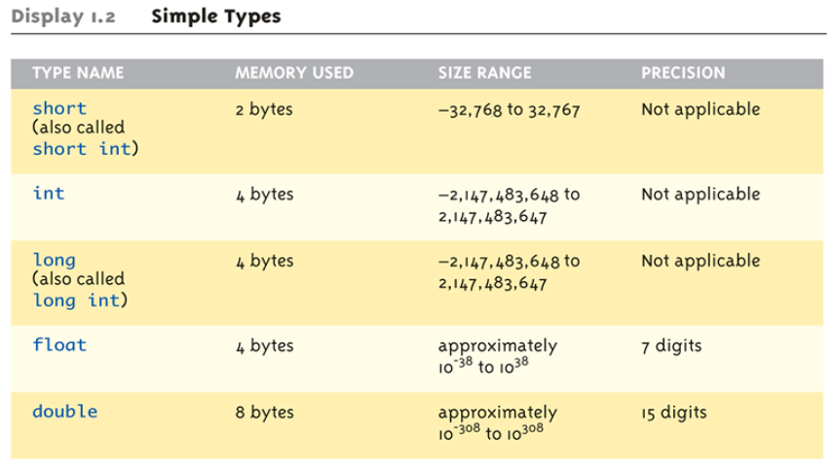
Fundamental Data Types (1/2)

Slide 8
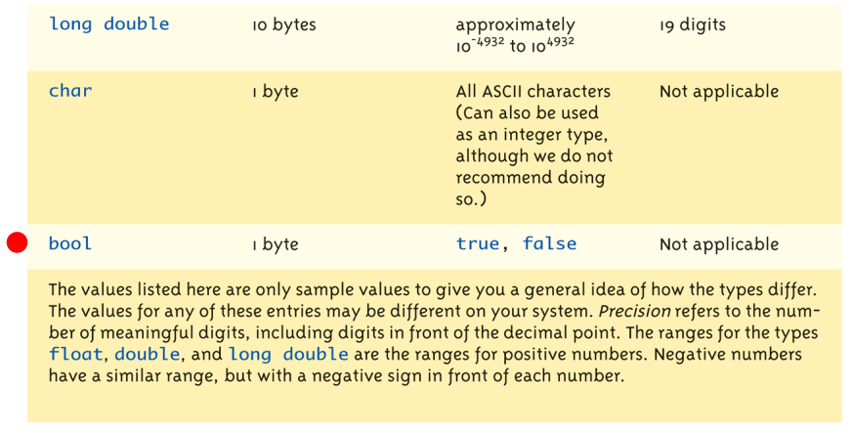
Fundamental Data Types (2/2)

Slide 9
Constants
double money;
money *= (1 + 0.05); //What is 0.05?
const double RATE = 0.05; //all uppercase letters money *= (1 + RATE); // better readability RATE = 0.1; // compilation error
Named constants or declared constants (e.g., RATE)
Better readability and maintainability
Change attempts result in compilation errors!
Named constants MUST be initialized const int myWeight; // compilation error!

Slide 10
Arithmetic Precision
Examples:
17 / 5 evaluates to 3 in C++!
Both operands are integers (Integer division)
17.0 / 5 equals 3.4 in C++!
Highest-order operand is "double type“ (Double "precision" division)
int intVar1 =1, intVar2=2; intVar1 / intVar2;
Result: 0! (Integer division)
Calculations done "one-by-one“
1 / 2 / 3.0 / 4 performs 3 separate divisions.
First 🡺 1 / 2 equals 0
Then 🡺 0 / 3.0 equals 0.0
Then 🡺 0.0 / 4 equals 0.0!
So not necessarily sufficient to change just "one operand" in a large expression

Slide 11
Type Casting
Casting for Variables
C style
double dvar = (double) ivar;
C++ style
double dvar = static_cast<double>(ivar) ;
static_cast<type>(expression)
Two kinds
implicit — also called “automatic“
done for you automatically 17 / 5.5 casting the 17 🡺 17.0
explicit type conversion
programmer specifies conversion with static_cast operator int m; static_cast<double>(m) / 5.5

Slide 12
Libraries
C++ standard libraries
Input/output, math, strings, …
#include <Library_Name>
directive to "add" contents of the specified library file to your program
called "preprocessor directive"
Executes before compilation, and simply “copies” library file into your program file

Slide 13
Namespaces
Namespaces defined:
collection of name definitions
#include <iostream> 1. using namespace std; // avoid this
cout<<“Hello world!”;
2. using std::cout;
cout<<“Hello world!”;
3. std::cout<<“Hello world!”;
includes entire standard library of name definitions

Slide 14
Console Input/Output
I/O objects cin for input, cout for output, cerr for error output
Defined in the C++ library called <iostream>
Must have these lines (called pre-processor directives) near start of file:
#include <iostream> using namespace std;
Tells C++ compiler to use appropriate library so we can use the I/O objects cin, cout, cerr

Slide 15
Console Output
Any data can be outputted to display screen
Variables
Constants
Literals
Expressions (which can include all of above)
cout << numberOfGames << " games played.";
“value” of variable numberOfGames and literal string “games played.” are outputted
Cascading: multiple values in one cout
New lines in output
cout << "Hello World\n";
cout << "Hello World" << endl;

Slide 16
Console Input
cin >> num;
waits on-screen for keyboard entry
value entered at keyboard is "assigned" to num
">>" (extraction operator) points opposite
Think of it as "pointing toward where the data goes“
no literals allowed for cin
Must input to a variable
cin >> 23; // compilation error!

Slide 17
Branch Mechanisms
if-else statements
Choice of two mutually exclusive statements based on condition expression
Syntax: if(<Boolean_expression>){ <true_statement> }else{ <false_statement> }

Slide 18
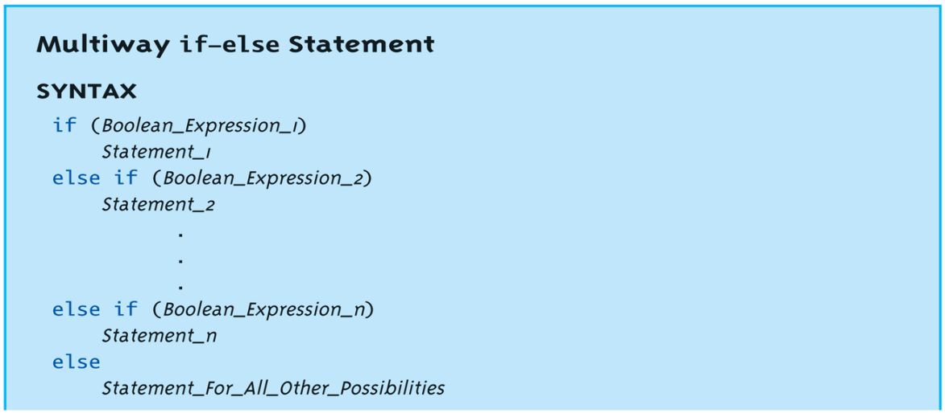
Multiway if-else (1/2)
Avoid “excessive” indenting
Syntax :

Slide 19
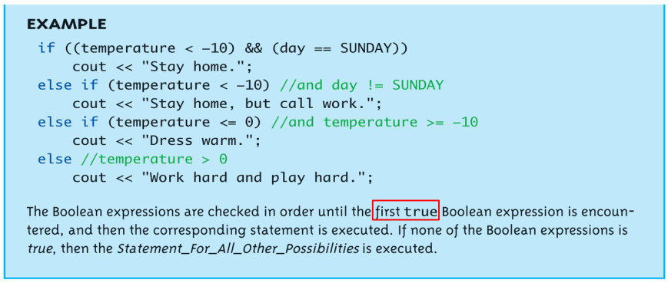
Multiway if-else (2/2)
Example :

Slide 20
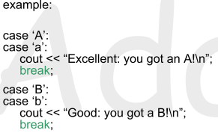
Switch Statement (1/3)
Controlling expression MUST return an integral value
OK: char, int, bool, enum
not OK: float, double, …
Case labels must also be integral values
break and default are optional
Execution “falls thru” until break

Slide 21
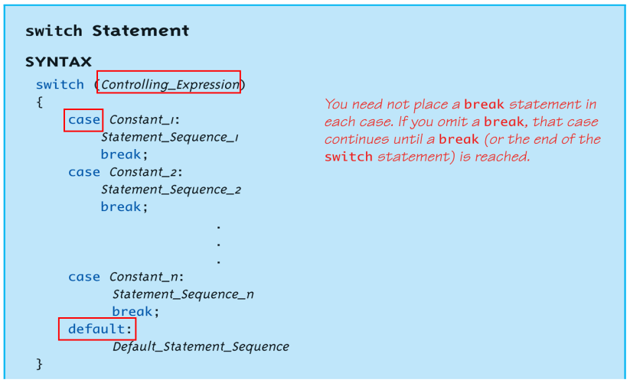
Switch Statement (2/3)
Syntax :

Slide 22
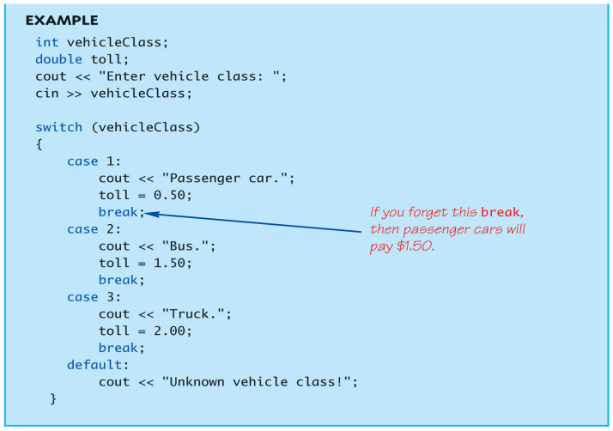
Switch Statement (3/3)
Example :

Slide 23
Loops
3 Types of loops in C++
while
do-while
always enters the loop body at least once
for
appropriate for “counting” loops

Slide 24
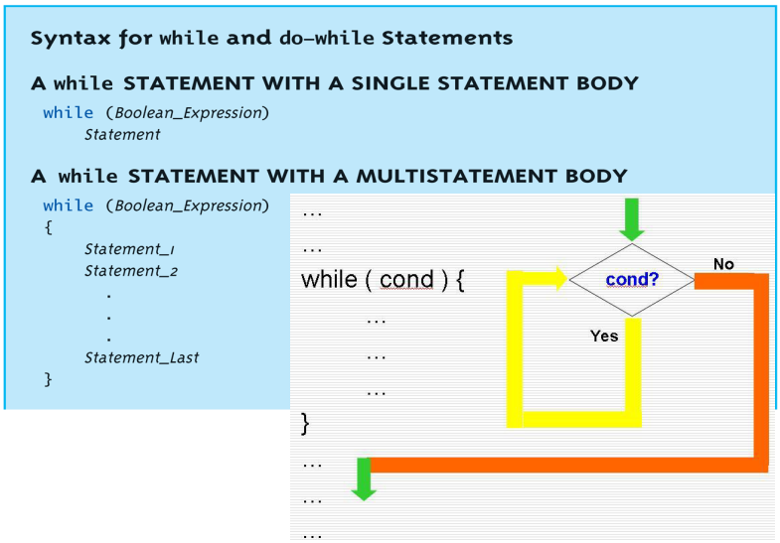
while Loop Syntax

Slide 25
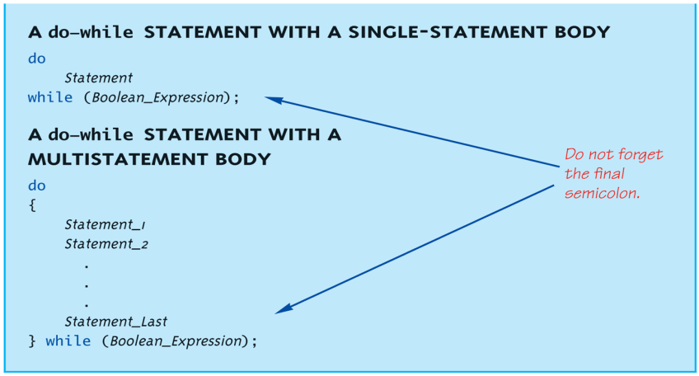
do-while Loop Syntax

Slide 26
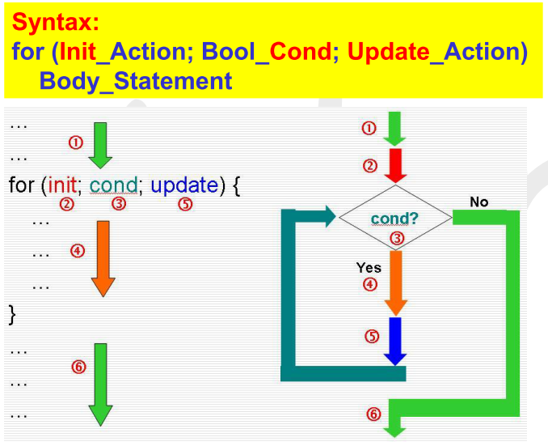
for Loop Syntax

Slide 27
SPECIAL TOPIC - LINUX

Slide 28
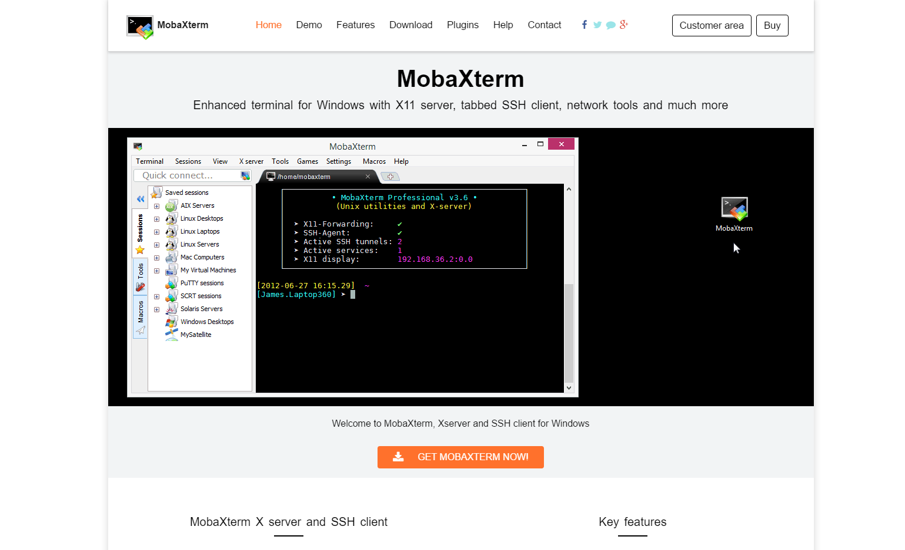
Remote Access - MobaXTerm
http://mobaxterm.mobatek.net
->Download
->Home Edition
->(Portable/Installer Edition)

Slide 29
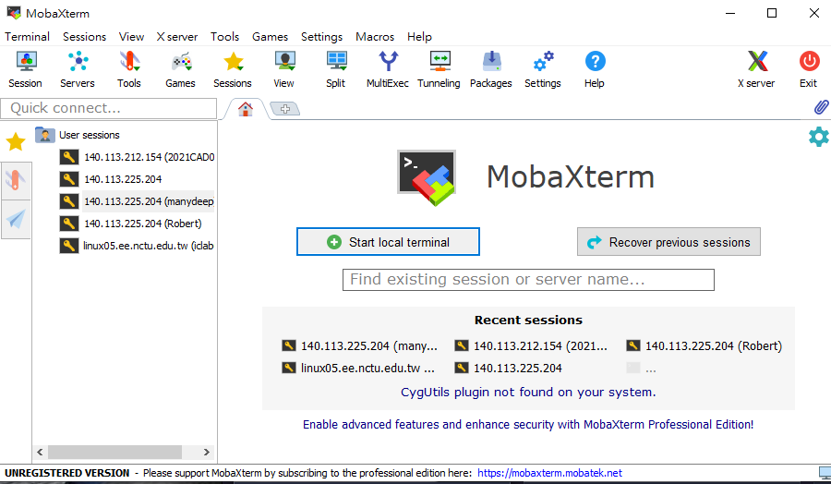
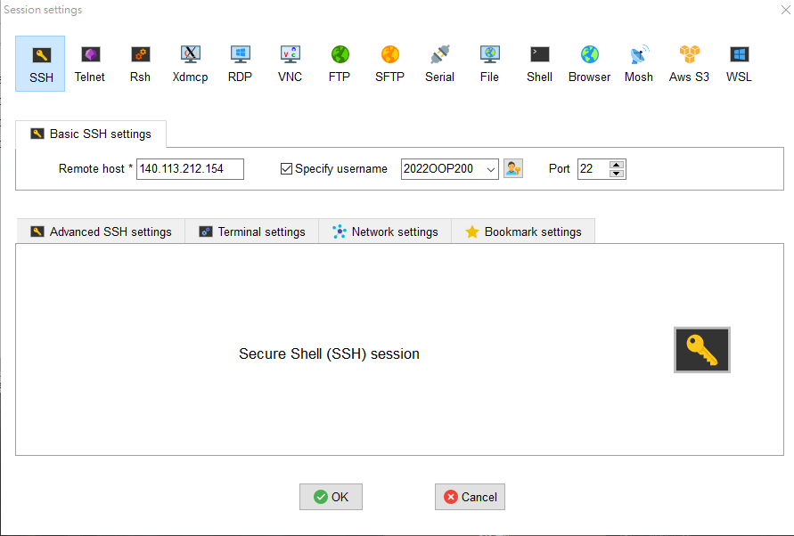
Workstation IP
140.113.212.154
1
2
3
4

Slide 30
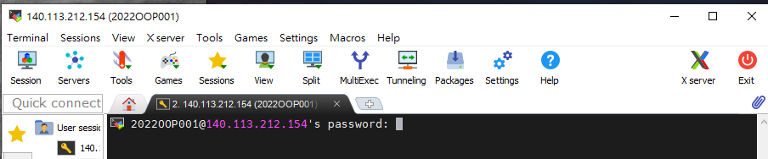
Login
Type your password
Remember to change your password by using this command : passwd

Slide 31
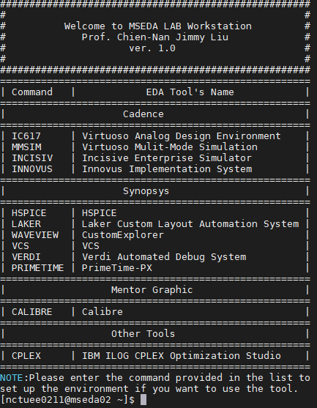
Command Line Interface
Username
Machine Name
Path
[~] = Home directory

Slide 32
Linux Basics – commands
ls : see files in the current directory
ls –n : see files in detail
cd <directory_name> : enter the directory
cd .. : enter the upper directory
mkdir <new_directory_name> : create new directory
rm <file_name> : remove file
rm –r <directory_name> : remove directory
cp <file_name> <directory_name/file_name>: copy file to the directory
mv <file_name> <directory_name/file_name>: move file to the directory

Slide 33




Example - ls,mkdir,cd,cp
ls
rm
mkdir
cd
Note
* . : the current directory
* tab : when you are typing a existing
command you can press tab to let the system finish the typing
cp

Slide 34
Linux Basics – commands (III)
man <Command> : Read the manual of command
tar : Compress/Decompress
tar cvf <file_name> <directory_name> : Compress directory to file
tar xvf <file_name> : Decompress file
passwd – change your password
clear – clear screen
touch – create a new file

Slide 35
Editor - VIM
vim <file_name> : open the file or create new file
There are mainly 2 modes in VIM – Insert Mode and Command Mode
If you want to type anything you have to enter insert mode by pressing i, a or some other button
Now you can type and use your direction key to move your cursor
After you finish typing, press Esc to quit insert mode and go back to command mode

Slide 36
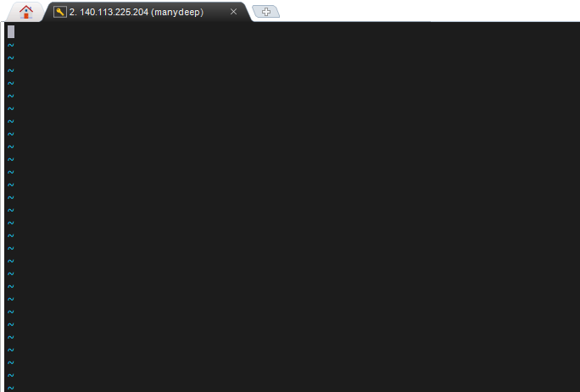
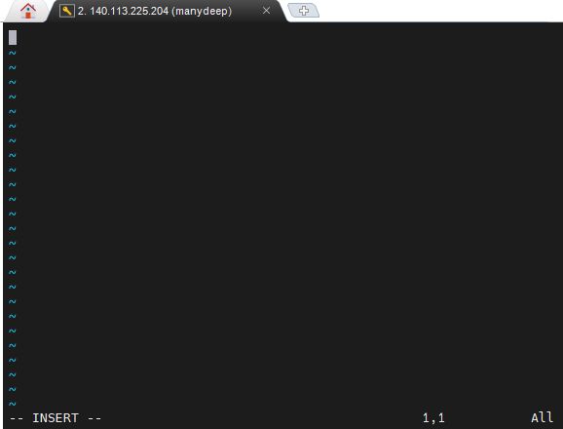
Editor - VIM
Press i

Slide 37
Editor - VIM (II)
You can now enter commands to save your file (Do not forget to press Enter)
:w -> save your file
:wq -> save and quit
:q -> quit
:q! -> quit without saving

Slide 38
Editor – VIM (Advanced)
In command mode:
/<string> -> find string
dd -> delete current line
yy -> copy current line
pp -> paste copied lines
u -> undo
Ctrl + r -> redo
Ctrl + v -> Block Select Mode (3rd mode, Esc to quit, you can d, y, p your selected block)

Slide 39
The other option: Notepad++
https://notepad-plus-plus.org/downloads/
Choose the edition you desired
Plugins->Plugin Manager->NppFTP->Download
NppFTP->Show NppFTP Window
Settings->Profile Settings
Hostname:140.113.212.154
Connection type: SFTP

Slide 40
Compiler – g++
Usage: g++ <option> <file_name>
Options:
-o <file_name> : Name the binary
-std=<standard> : Choose the language standard, for example -std=c++11
-c : Create object file instead of binary
-g : Debug Mode
Ex : g++ main.cpp -o lab1
Ex : g++ -std=c++11 main.cpp -o lab1

Slide 41
Linux Basics - Execute
Run the binary code in your current machine
./<executable binary> <parameters>
Example: ./lab1
Ctrl+C : Terminate the program (infinite loop)

Slide 42

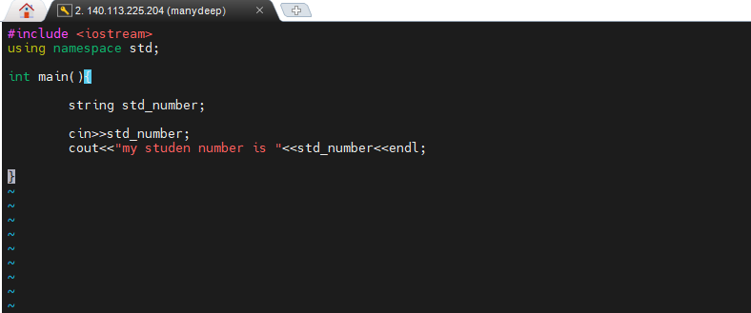
Example
Edit a file named “test.cpp”
vim test.cpp
Remember to use “:w” to save your file

Slide 43


Example
Compile your file
g++ test.cpp –o test

Slide 44
Lab Exercise (1/2)
Make a directory for this lab named “lab1”.
Write a program named “StudentID_lab1.cpp” in the directory.
Put in an integer, then you need to do prime factorization
If this integer can be factorized by a prime more than one time, you don’t need to express it as the power of the prime
Terminate the program if you input 0
Compile and run your program for demo.

Slide 45
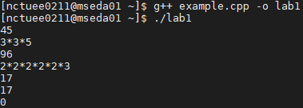
Lab Exercise (2/2)
Example :

Slide 46
Submission
Ask TAs for demo
Try your best to debug your code by yourself
Upload all your cpp to new E3
Naming rule : studentID_lab1.cpp

