Slide 1
Recursion
Lab3

Slide 2
Recursion
The process of solving a problem by reducing it to smaller versions of itself is called “recursion”
Functions call itself recursively
Two parts in the function
※ Executive condition
※ Terminative condition: Losing this part will
enter the infinite loop

Slide 3
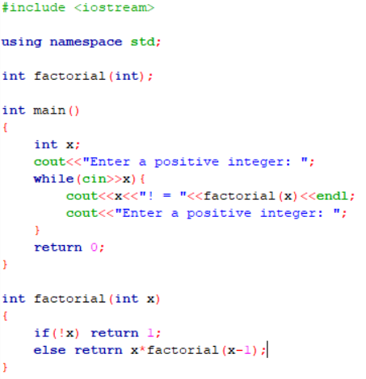
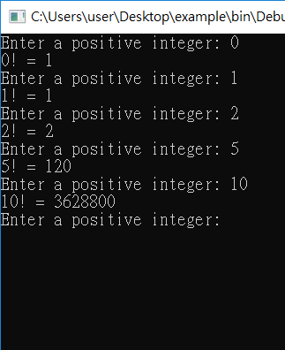
Example (1/2)

Slide 4
Example (2/2)
factorial(5)
10
1
factorial(4)
9
2
factorial(3)
Return
Call
8
3
factorial(2)
7
4
factorial(1)
6
5
factorial(0)

Slide 5
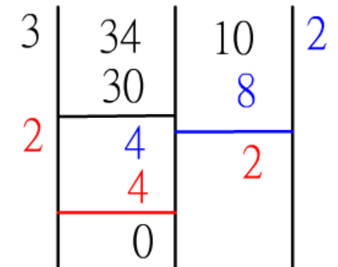

Exercise
Input: two positive numbers
Output: a sequence of process numbers, and a number of greatest common factor (GCD，最大公因數)
Finish this lab by recursion

Slide 6
Submission
Ask TAs for demo
Try your best to debug your code by yourself
Upload all your cpp to new E3
Naming rule : studentID_lab3.cpp

