Slide 1
LAB 4 POINTER & DYNAMIC ARRAY
Department of Electronics Engineering
National Chiao Tung University

Slide 2
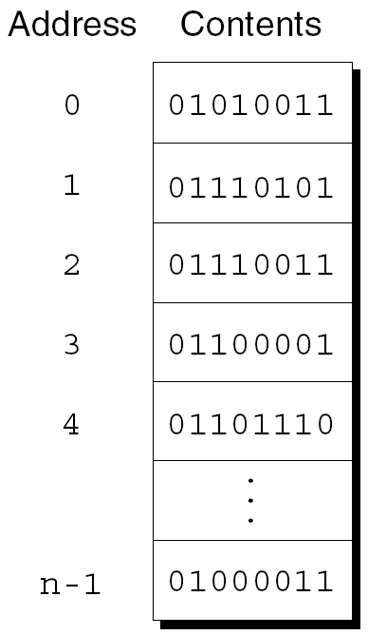
Addresses
Essentially, the computer's memory is made up of bytes.
Each byte has a number, an address, associated with it.
Each byte has a unique address.

Slide 3
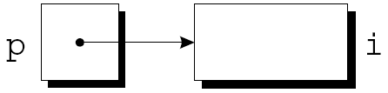
Pointer Variables
Addresses can be stored in pointer variables
When we store the address of a variable i in the pointer variable p, we say that p “points to” i

Slide 4
Declaring Pointer Variables
When a pointer variable is declared, its name must be preceded
by an asterisk *
int *p; /*points only to integers */
p is a pointer variable capable of pointing to objects of type int
Pointer variables can appear in declarations along with other
variables
int i, j, a[10], b[20], *p, *q;

Slide 5


Address and Indirection Operators
& (address) operator : Find the address of a variable
* (indirection) operator : Gain access to the object that a pointer points to
Example:
Output:

Slide 6

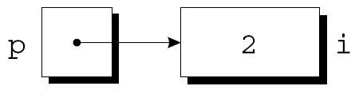
The Indirection Operator
Once a pointer variable points to an object, we can use
the * (indirection) operator to access what’s stored in
the object
Example:
Output:
*p has the same value as i
Changing the value of *p changes the value of i
5

Slide 7
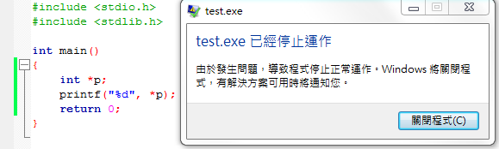
The Indirection Operator
Applying the indirection operator to an uninitialized
pointer variable causes undefined behavior
int *p;
cout<<*p; /*** WRONG ***/

Slide 8
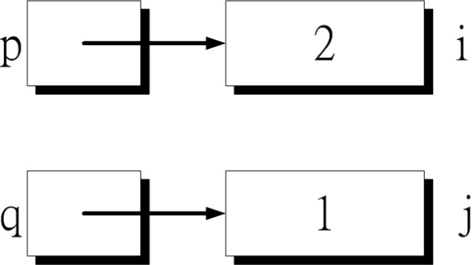
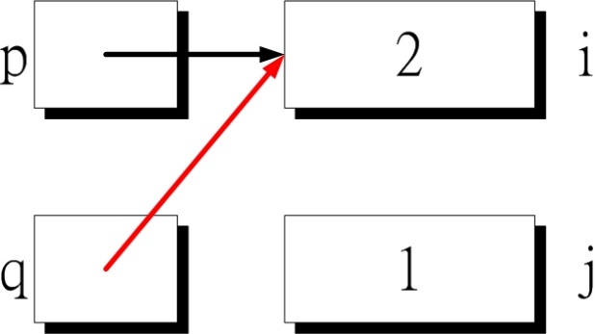
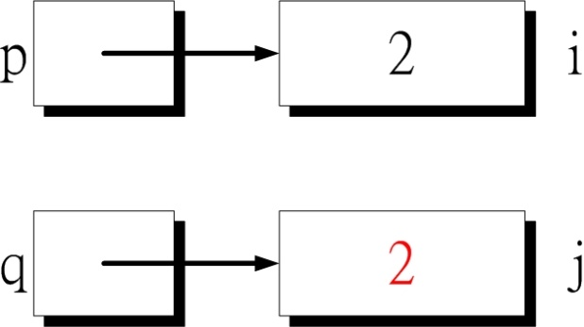
Pointer Assignment
Difference between q = p; and *q = *p;
The first statement is a pointer assignment, but the second
is not
q = p
*q = *p

Slide 9
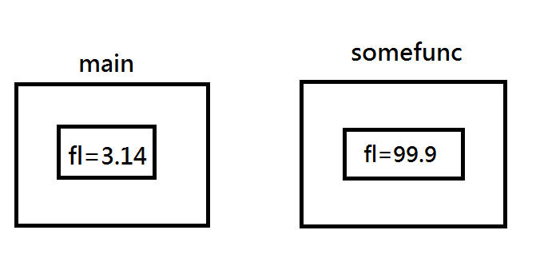
Pass by value
1: #include <stdio.h>
2: void somefunc(float fl)
3: {
4: fl=99.9;
5: }
6: int main()
7: {
8: float fl=3.14;
9: somefunc(fl);
10: cout<<fl;
11: return 0;
12: }
Result？
fl = 3.14

Slide 10
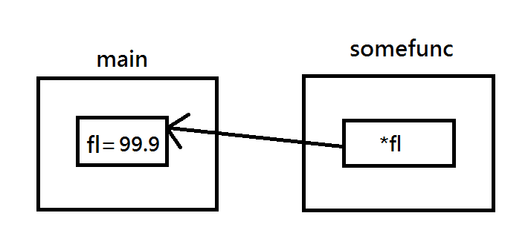
Pass by pointer
1 #include <stdio.h>
2
3 void somefunc(float* fl)
4 {
5 *fl = 99.9;
6 }
7
8 int main()
9 {
10 float fl=3.14;
11 somefunc(&fl);
12 cout<<fl;
13 return 0;
14
15 }
Result？
fl = 99.9

Slide 11
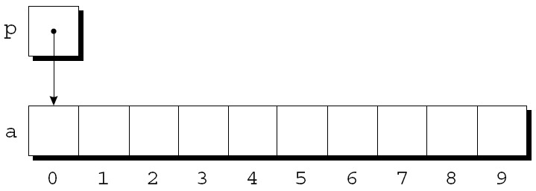
Pointers and Arrays (1/2)
Pointers can point to array elements
int a[10], *p;
p = &a[0];

Slide 12
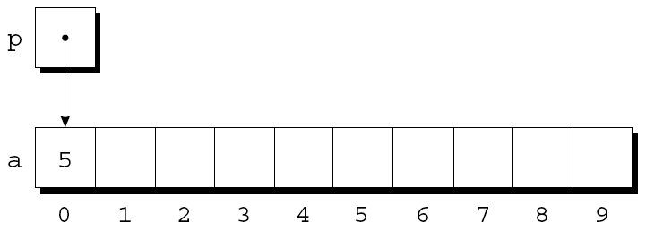
Pointers and Arrays (2/2)
We can now access a[0] through p; for example, we can store the value 5 in a[0] by writing
int *p = &a[0];
*p = 5;

Slide 13
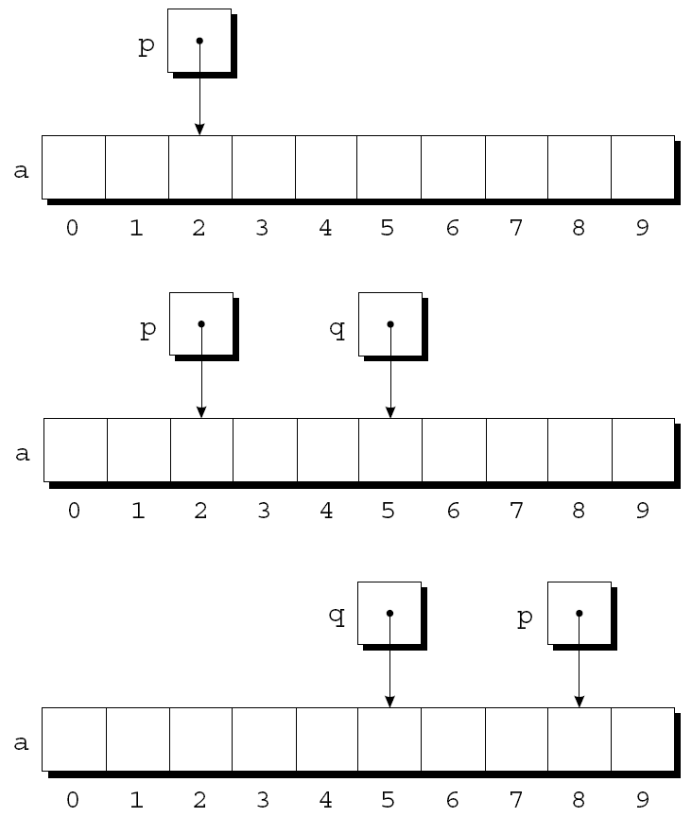
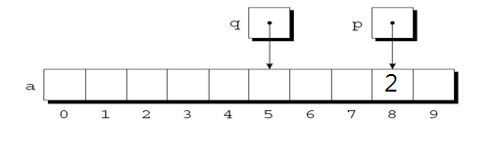
Adding an Integer to a Pointer
Example of pointer addition : int *p,*q;
p = &a[2];
q = p + 3;
p += 6;
*p=2;

Slide 14
Combining the * and ++ Operators
Because the prefix version of ++ takes precedence over *, the compiler sees this as
*++p = j is equal to *(++p) = j
Compare *p++ & *++p
*p++ increment p later
*++p increment p first
Example:
int *p = &a[0];
*p++ = 5 or *p++ = 5 means set a[0] = 5, then p points to a[1]
*++p = 5 or *(++p) = 5 means p points to a[1], then set a[1]=5

Slide 15
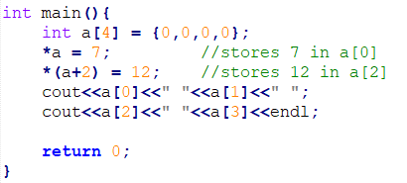
Using an Array Name as a Pointer
Example: Output:
In general, a+i is the same as &a[i]
Both represent a pointer to element i of a
Also, *(a+i) is equivalent to a[i]
Both represent element i itself
Notes:
Suppose that a is declared as follows
int a[4];
Examples of using a as a pointer
*a = 7; /*stores 7 in a[0]*/
*(a+2) = 12; /*stores 12 in a[2]*/

Slide 16
Array Arguments (1/2)
The fact that an array argument is treated as a pointer has some important consequence
For example, the following function modifies an array by storing zero into each of its elements
void store_zeros(int a[], int n)
{
int i;
for(i = 0; i < n; ++i)
a[i] = 0;
}

Slide 17
Array Arguments (2/2)
An array parameter can be declared as a pointer if desired
store_zeros could be defined as follows
void store_zeros(int *a, int n)
{
int i;
for(i = 0; i < n; ++i)
*(a+i)= 0;
}
int main()
{
int a[10];
store_zeros(&a[0],10)
…
}
The compiler treats a[i] as *(a+i)

Slide 18
Standard vs. Dynamic Arrays(1/2)
Standard array
fixed dimensions for array
size for each dimension needs to be a constant
must specified size first (estimate maximum, waste memory)
Example:
const int MAX_SIXE = 1000000;
int Array[Max_SIZE];
but what if we only need 100 integer?

Slide 19
Standard vs. Dynamic Arrays(2/2)
Dynamic Array
size not specified at programming time (can grow and shrink as needed)
determined while program running

Slide 20
Creating Dynamic Arrays
Use new operator
dynamically allocate with pointer variable
treat like standard array
Example:
int size = 0;
cin >> size;
double *ptr;
ptr = new double[size]; // contain size elements // of type double

Slide 21
Deleting Dynamic Arrays
Allocate dynamically at run-time
so should be destroyed at run-time
Continue the previous example
……
ptr = new double[size];
…… //some processing
delete [] ptr;
de-allocate all memory for dynamic array
brackets [] indicate array is there
note that ptr still points there => dangling!
should add “ptr = NULL;” immediately

Slide 22
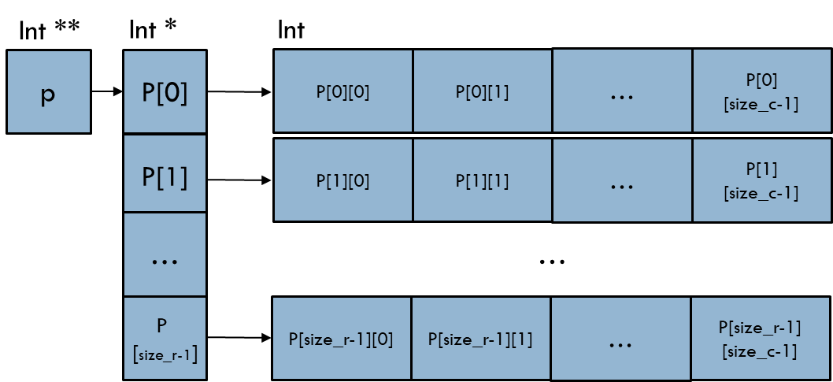
Dynamic Multi-dimensional Arrays
Multi-dimensional arrays are arrays of arrays
Create a size_r * size_c dynamic array
Example:
int **Array2D = new int*[size_r]; // every row has size_c coloumn
for(int i = 0; i < size_r; i++)
*(Array2D+i) = new int[size_c];
//or Array2D[i] = new int[size_c];

Slide 23
Delete Dynamic Arrays
Clean reversely from last allocated memory
Example:
for(int i = 0; i < size_r; i++)
delete [] Array2D[i];
delete [] Array2D;
Array2D = NULL;

Slide 24
Exercise
You will have n numbers and q times of queries. (1<= n,q <=20)
These n numbers are placed in an array which position starts from 1.
Each query includes two numbers a, b which indicate the range from position a to position b. (1<= a,b <=n)
The sum of a range indicates the sum of numbers from position a to position b.
The rules to sum up all the numbers are as follow.
If a is bigger than b , you need to sum up the numbers from a to the end and also the part from start to b.(blue part)
If a is smaller than b you just need to sum up the numbers from a to b.(blue part)
If a is equal to b, than there's only one number, and the number will be the sum.(blue part)

Slide 25
Exercise
Your task is finding the range from queries that has the maximum sum.
Print the range and it's value.
Please follow the output format in next page
The objection of this exercise is to practice dynamic array, so you should use new operator and delete.

Slide 26
Exercise
Input：
10 5
7 1 19 14 8 14 20 10 3 8
3 3
10 1
4 4
8 1
9 9
Output：
Max_range: (8,1); Value: 28

Slide 27
Submission
Ask TAs for demo
Try your best to debug your code by yourself
Upload all your .cpp to new E3
Naming rule : studentID_lab4.cpp

