Slide 1
LAB 5 CLASS -1
Department of Electronics Engineering
National Chiao Tung University

Slide 2
Class
C++ supports object-oriented programming (OOP)
Aim of C++ class is to provide programmer a means for creating new types that can be used as conveniently as built-in types
C++ class is much more powerful than structure in C
not just data members
add member functions
add access control mechanism
Define a class => Define a new type !

Slide 3
Class Definitions
Example:
class Complex{ // name of class type
private: // access specifier
int realPart; // data member declaration
int imaginaryPart; // data member declaration
public: // access specifier
Complex(int=0,int=0); // constructor
~Complex(); // destructor
int get_realPart(); // member function declaration
int get_imaginaryPart(); // member function declaration
};

Slide 4
Private vs. Public (1/3)
Private:
Can’t access outside the class scope
int main(){
Complex comp;
cout << comp.realPart << endl; // error!!
return 0;
}
Can access inside the class scope
int Complex::get_realPart() {return realPart;}

Slide 5
Private vs. Public (2/3)
Public:
Can access through dot ( . ) or arrow ( -> ) outside the class scope
E.g.,
int main(){
Complex comp;
cout << comp.get_realPart() << endl;
return 0;
}

Slide 6
Private vs. Public (3/3)
Both data members and member functions can be either private or public
If you didn’t specify, the default type is private.
Data members are usually private
you do not know exact representation
object is manipulated through member functions
Member functions are usually public
you can use public interface for object manipulations
you still do not know how these member functions get implemented

Slide 7
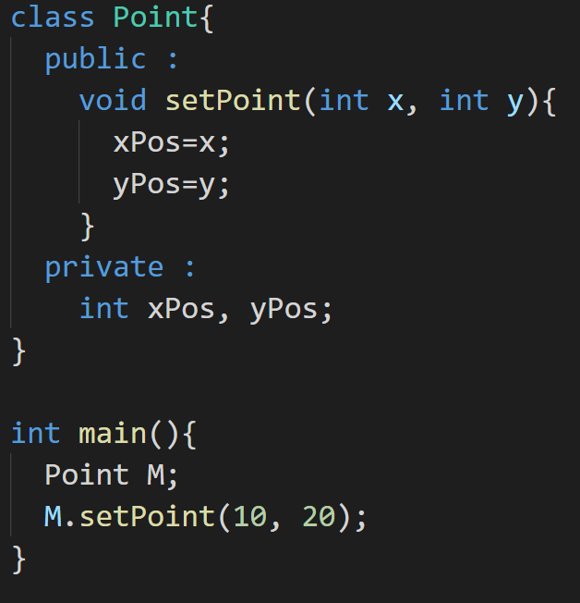
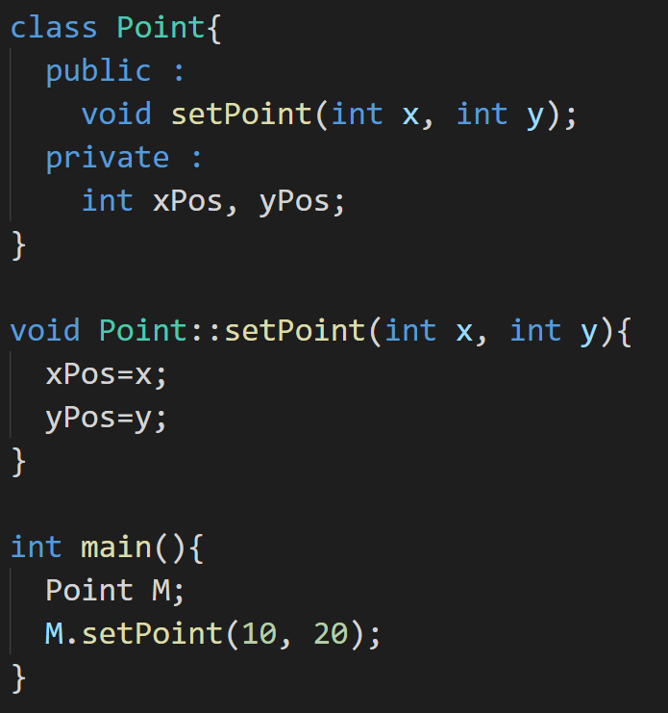
Member Function
We can implement the member function inside the class or outside the class.

Slide 8
Member Function
Example:
int Complex::get_realPart(){
……
}
Like other function definitions
place outside class definition
must specify the class it belongs to
different classes can have member functions with same name
:: is called scope resolution operator

Slide 9
Constructor
A constructor is a special type of member function of a class which initializes objects of a class.
In C++, constructor is automatically called when object(instance of class) is created. It is special member function of the class because it does not have any return type.
A class can have many kinds of constructors.

Slide 10
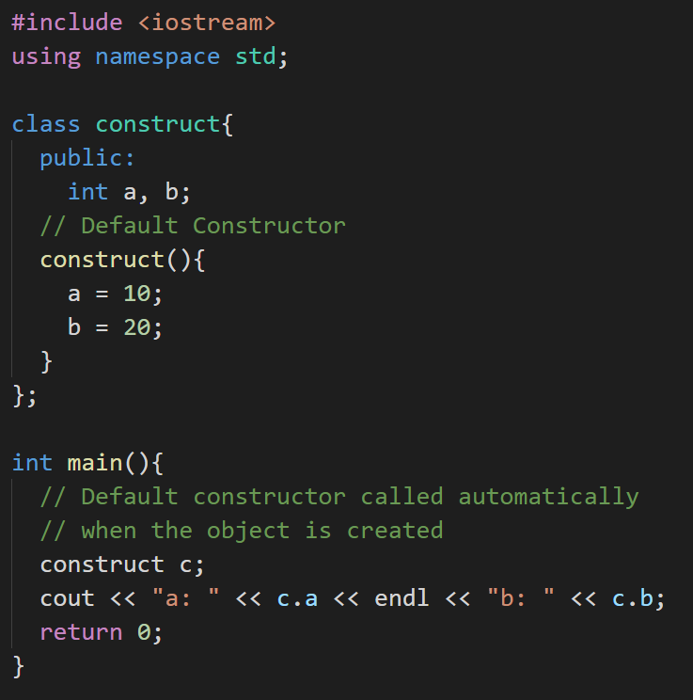
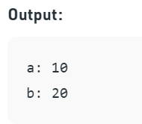
Default Constructor

Slide 11
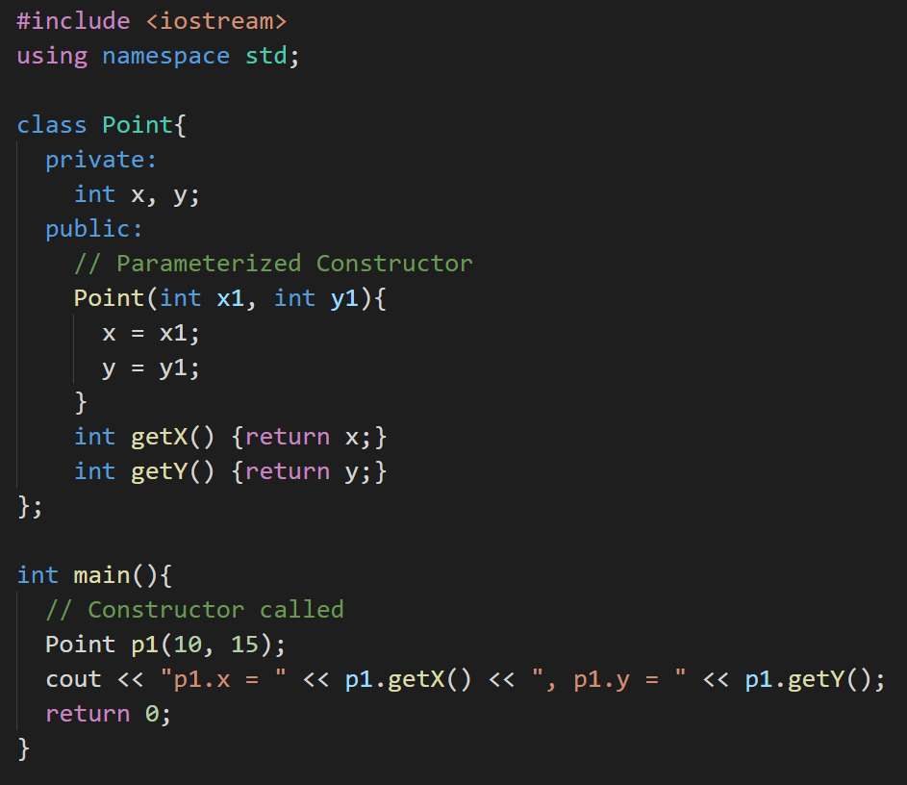
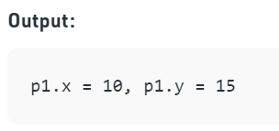
Parameterized Constructor

Slide 12
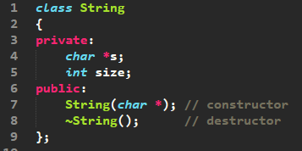

Destructor
When a class contains a pointer to memory allocated in class, we should write a destructor to release memory before the class instance is destroyed
Example:
Destructor is called when objects leave scope
Can not have the return type
Can not have any parameter
Performs termination housekeeping before the system reclaims the object’s memory

Slide 13
Passing Class as Argument
Use class as a new type
Example:
Complex add_two_complexes(Complex a, Complex b){
……
}
Return type: Complex
Parameter a’s type: Complex
Parameter b’s type: Complex

Slide 14
Lab Exercise (1/3)
Define and implement two new class “Rectangle” and “Triangle”
These are 2 private data members for Rectangle
width
height
These are 2 private data members for Triangle
base
height
Note: width, height and base will be unsigned
integer

Slide 15
Lab Exercise (2/3)
Define and implement two new class “Rectangle” and “Triangle”
Implement a member function for each class to calculate the area of the polygon
At the end, show the polygon with the biggest area

Slide 16
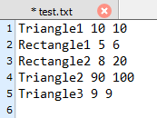
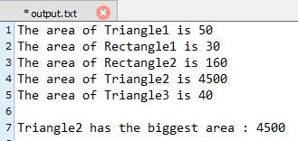
Lab Exercise (3/3)
Please output the area of the Rectangle and Triangle separately, and output the polygon with the biggest area at the end
Example:
Input :
Output :

Slide 17
Submission
Ask TAs for demo
Try your best to debug your code by yourself
Upload all your cpp to new E3
Naming rule : studentID_lab5.cpp

