Slide 1
LAB 7 GDB
Department of Electronics Engineering
National Chiao Tung University

Slide 2
Introduction to GDB
GDB (GNU Debugger) is a debugging tool for
UNIX system to debug C and C++ programs.
Especially useful for segmentation fault , it can directly tell you where segmentation fault happened.
Notes:
GDB是Unix系統上一個debug的工具
平常遇到segmentation fault只能自己去找可能錯在哪行
而GDB可以直接顯示 發生在哪一行 可以讓debug更有效率

Slide 3

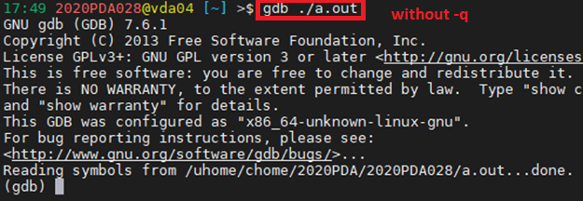
How to execute
To use GDB, we need to add the -g argument while compiling .
Use -q argument can hide copyright related messages
Notes:
要使用GDB debug的程式 在編譯時必須加上 –g
之後輸入gdb -q ./執行檔檔名 (如果沒有加上-q 每次開啟時 會顯示一大串的版權訊息)
進入 gdb console 才能開始使用GDB相關功能 (也可以使用GUI介面來執行GDB 後面會介紹)

Slide 4
Common instructions
You can use the full name or abbreviation to execute an instruction.
list | l
run | r
breakpoint | break | b / continue | c
next | n / step | s
display | dis / print | p / watch
info | I
delete | d / quit | q
Notes:
以下是較常見的指令 後面會依序介紹
可以輸入全名 或是只輸入縮寫 來執行該指令

Slide 5
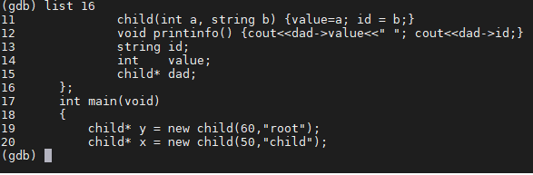
List | l
Command l can show the last 10 lines of code
Notes:
list 可以顯示出當前/特定行數 往上5行 往下4行 共10行的code

Slide 6
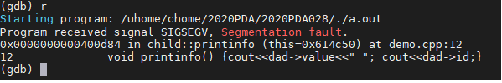
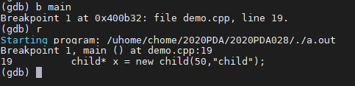
Run | r
Use command r to start executing GDB
Once a breakpoint is encountered or an error occurs, it will pause.
Notes:
使用r指令開始執行GDB 一旦遇到中斷點 或是bug 就會停下 (若在執行中輸入r指令 則會重新開始)
如果整個程式都沒有設定中斷點 或是沒有bug 就會執行到尾
如果要追蹤特定變數 要在r之後才可以設定

Slide 7
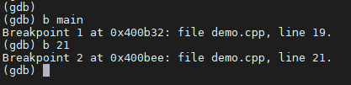

Breakpoint | b / Continue | c
The way to set a breakpoint is
b function name or b specific line
You can use command c to continue execution
from a pause caused by the breakpoint.
Notes:
設定中斷點 可以透過 b 函式名稱 或是直接 b 程式碼的某一行
可以透過c 從中斷點繼續執行gdb

Slide 8


Next | n / Step | s
If you only want to execute one line of code each time, you can do it through n / s, don't need to set the breakpoint one by one.
The difference between n / s is that once encounters the sub function, s will enter it while n will not.
Notes:
如果一次只想執行一行程式碼 可透過next / step來完成 不必一個一個設定中斷點
n和s的差別在於 如果下一行遇到副程式 n會直接執行完副程式
而s則會進到副程式裡面的第一行

Slide 9
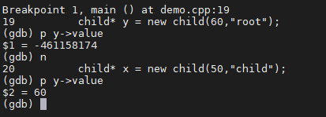
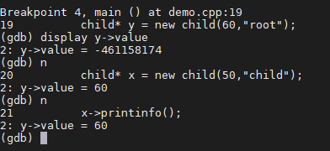

Display | d / print | p / watch
Command d/p can show the value of certain variable
The difference is that d will automatically show the value each step, while p needs to be entered manually
Watch can keep trace a certain variable, once its value change, GDB will pause.
Notes:
Print和display都可以顯示出指定的數值 差別在於
每次新的步驟 print都要手動輸入 而display會自動顯示設定的變數
Watch可以追蹤一個變數 一旦他的值發生改變 就會暫停
(如果要print的是一個array 可以使用print array_name@要顯示幾個元素)

Slide 10
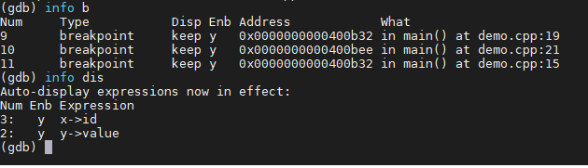
Info | i
Command info can display the current status of some settings
More information : help info
Notes:
Info 可以顯示出某些設定當前的狀態 如breakpoint / display目前設置了幾個
輸入help info會顯示所有info 可以觀察的設定

Slide 11
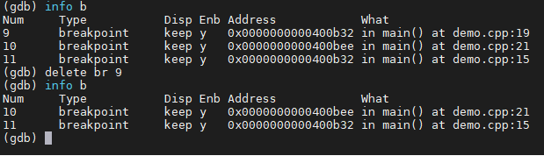
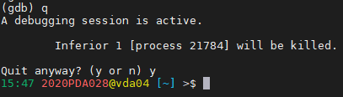
Delete | d / Quit | q
Command d can remove some previous settings
Command q is used to terminate GDB
Notes:
如果想把一些中斷點或display等設定刪掉 可以透過delete指令
若要終止執行GDB 則是透過quit指令

Slide 12
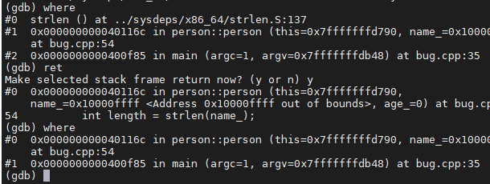
Other commands
where can tell which layers and lines you are now
finish can execute rest part of the function and return to the upper layer.
return will directly return function of upper layer.
Notes:
其他可能會用到的指令 where可以顯示現在在哪一層sub-function 是從主程式哪一行呼叫到現在這個sub-function的
Return則可以直接結束目前這層sub-function 返回上一層
有時候遇到bug 輸入where時可能會停在系統內建的function 這樣GUI不會顯示任何東西
這時候就可以用ret返回上一層sub-function 直到返回到自己寫的cpp GUI就會正常顯示
Finish & return 都可以用來返回上一層function 但return不會執行當層剩餘的部分
更多指令可以參考 : http://www.study-area.org/cyril/opentools/opentools/x1253.html

Slide 13
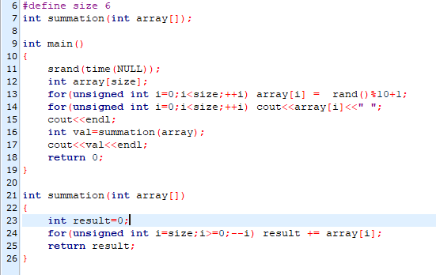

Example (1/8)
Running the following program will cause segmentation fault, so use GDB to debug.
Notes:
這個cpp的目的是 產生亂數並加總
但執行時會遇到segmentation fault 所以使用GDB來debug

Slide 14
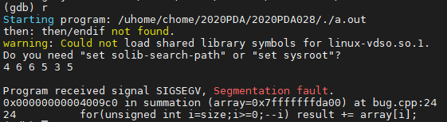
Example (2/8)
First, use r to find out which line cause segmentation fault.
Notes:
先使用r找出segmentation發生在哪一行, 看起來最有可能是 index i 錯誤

Slide 15
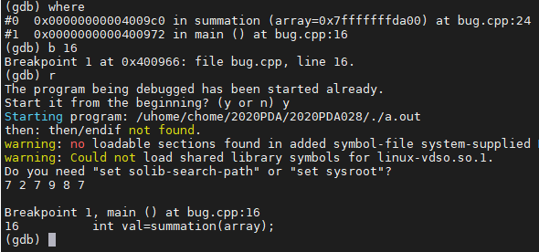
Example (3/8)
Then, use where to find where we call the function,
set a breakpoint and restart.
Notes:
使用where找出哪裡呼叫這個副函式 並設定中斷點 重新執行一次

Slide 16
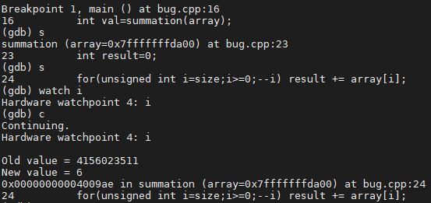
Example (4/8)
Use s enter sub-function, and use watch i to check value of i whenever it changes.
Notes:
使用s進到sub-function後 用watch觀察i的值
一開始是一個奇怪的數字 是因為還沒初始化 遇到迴圈之後 i的值變成6

Slide 17
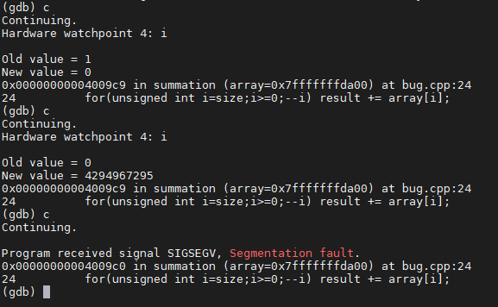
Example (5/8)
Find that -1 & unsigned cause this error.
Notes:
一步一步追蹤i的值 發現最後是一個奇怪的數字
因為i前面設定是unsigned 範圍是0~2^32-1 (4294967295) 所以i認不得-1 才會導致錯誤
因此將unsigned拿掉 重新編譯 執行GDB

Slide 18
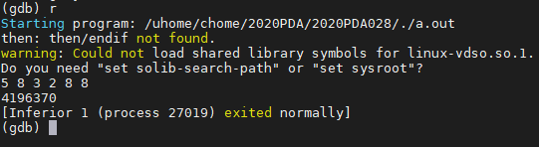
Example (6/8)
Remove unsigned part and compile again, find program can execute successfully, but final answer seems wrong.
Therefore use watch to trace variable of sub-function.
Notes:
重新編譯 成功解決segmentation fault 但最終答案還是錯的
所以使用watch去追蹤副程式的變數值

Slide 19
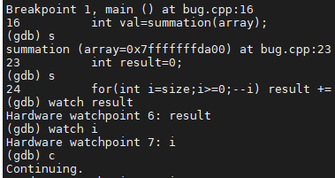
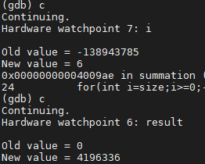
Example (7/8)
Find that due to the wrong index i, cause array read undefined space.
So modify it to the correct index.
Notes:
發現是i錯誤 導致array讀到未定義的空間

Slide 20
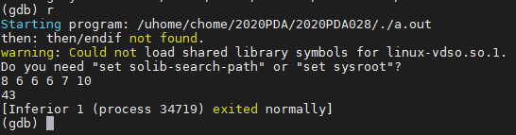
Example (8/8)
Compile again, and find final answer is correct.
=> finish.

Slide 21
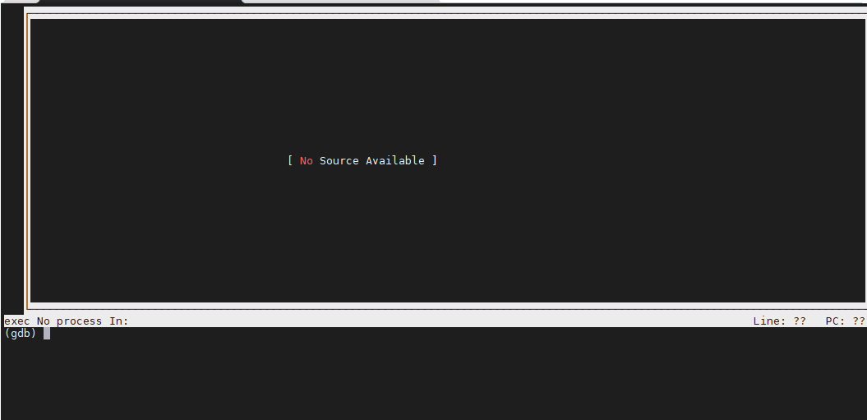
GUI (1/5)
You can also use GUI interface to get more intuitive information, all instructions are same as previous one.
After gdb ./executable file, you can use ctrl+x+a to enter GUI interface.
Notes:
也可以用GUI來debug 使用起來會更直觀 所有的指令跟前面都一樣
如果是使用GUI介面 流程會如下

Slide 22
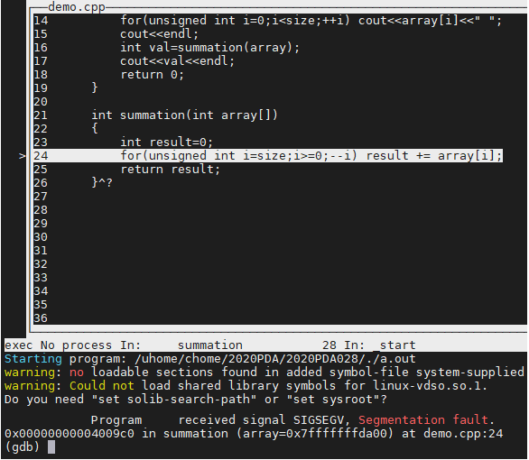
GUI (2/5)
Command r
Notes:
一樣先利用r找出segmentation錯在哪一行 , 反白的部分代表現在在哪一行

Slide 23
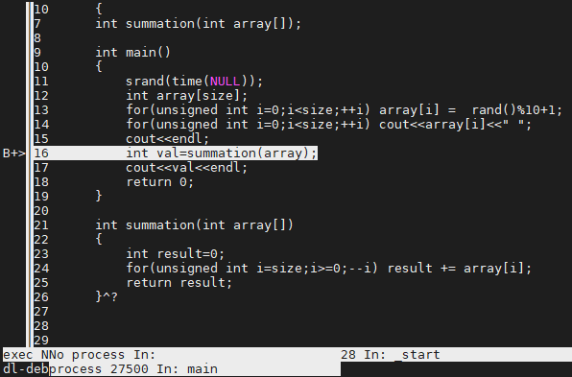
GUI (3/5)
Use where to find where sub-function was called.
Set breakpoint and restart.
Notes:
設定中斷點 重新執行一次 B代表中斷點

Slide 24
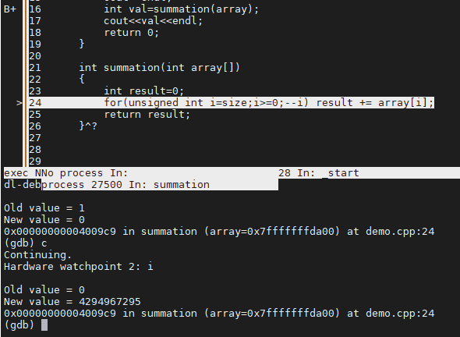
GUI (4/5)
Use watch to check the variable you want to trace.
Notes:
使用watch 來觀察想要追蹤的變數

Slide 25
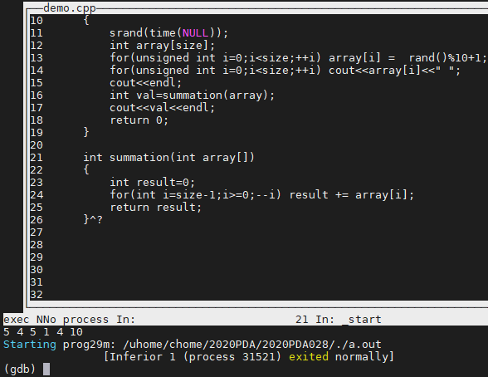
GUI (5/5)
Repeat above steps, until all bugs are removed.
Notes:
重複上面的步驟 直到所有bug都排除

Slide 26
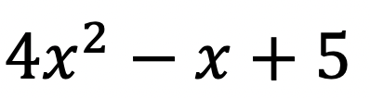
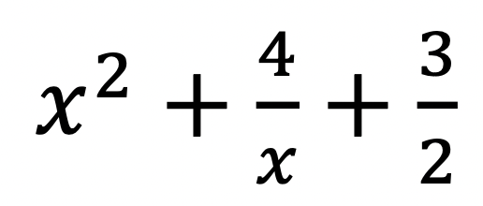
Exercise (1/4) - Description
In mathematics, a polynomial is an expression of finite length constructed from variables and constants, using only the operations of addition, subtraction, multiplication, and non-negative integer exponents.
For example, is a polynomial, but is not, because its second term involves division by the variable (4/𝑥) and because its third term contains an exponent that is not an integer.
In this problem, your job is to implement the following polynomial member functions and try to debug with GDB tool.

Slide 27
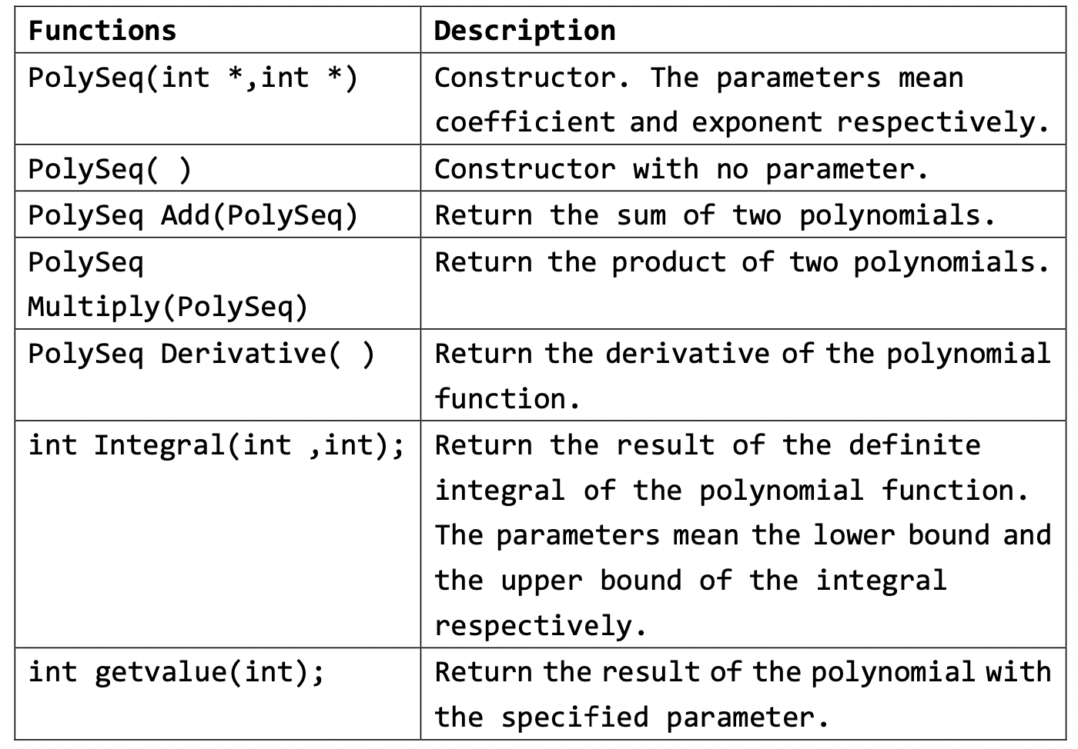
Exercise (2/4) - Specification
You must implement the PolySeq class with the following public member functions:

Slide 28
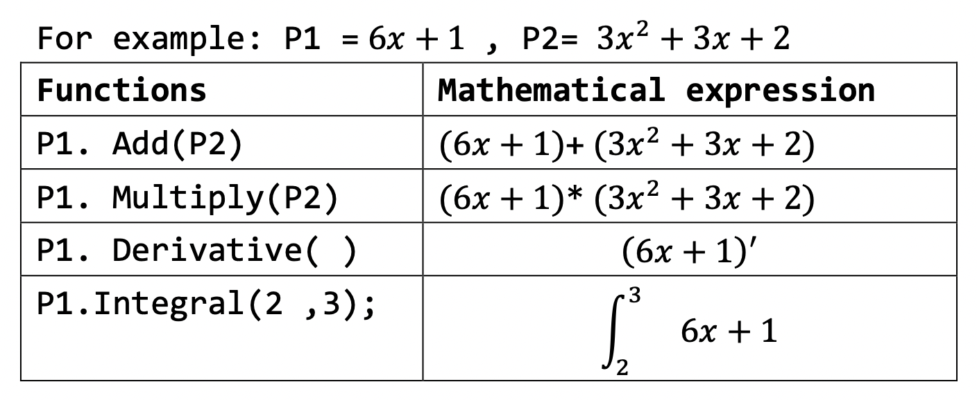
Exercise (3/4) - Specification
Follow the function calling rules as the following example.

Slide 29
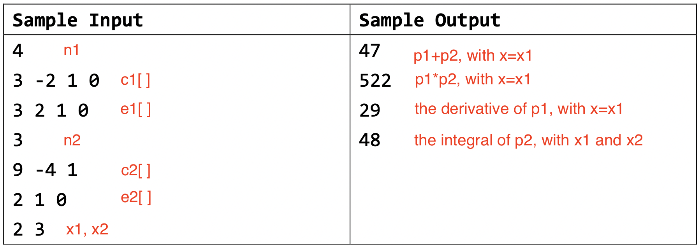
Exercise (4/4) - Output
The output should print the following integers in order. (1) The sum of the first and the second polynomials with parameter x1. (2) The product of the first and the second polynomials with parameter x1. (3) The derivative of the first polynomial with parameter x1. (4) The result of the definite integral of the second polynomial with parameter lower bound x1 and upper bound x2.

Slide 30
Submission
Ask TAs for demo
Try your best to debug your code by yourself
Upload all your cpp to new E3
Naming rule : studentID_lab7.cpp

