Slide 1
LAB 10 VECTOR
2022/5/16

Slide 2
STL: Standard Template Library
Containers: hold objects, all of a specified type
Iterators: a generic pointer to access objects in containers
Algorithms: act on objects in containers
Save you a lot of efforts to use those common data structures or algorithms
Notes:
Vector 是 C++ 標準程式庫(STL)中的一個 class，是C++標準程式庫中的眾多容器（container）之一
STL由以下三大部分所組成
Container(容器): 可以存放特定型別的物件
Iterator (抽象指標)指向容器內物件的一種pointer
Algorithm: 像是常用的 sort find 需要#include

Slide 3
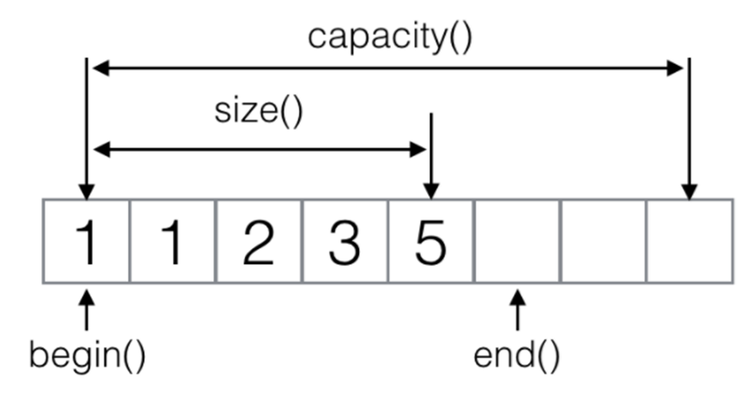
Introduction to vector (1/4)
“vector” in STL can be seen as an enhanced array which can extend its capacity automatically, and it also supports some operations that array can’t easily accomplish.
#include<vector>
Return an iterator which points to the next address of last element.
Notes:
可視為會自動擴展容量的陣列，也可以看做是一種強化版的array，支援一些array不能輕鬆完成的operations
容器均有提供 begin( ) , end( ) 成員函數，讓使用 者取得容器的第一個元素的位址與最後一個元素後 一個的位址

Slide 4
Introduction to vector(2/4)
Simple comparison between Vector & Array
 | Vector | Array
Capacity | Can be modified | Fixed
Get size | By vector.size() | Need additional variable to record
Insert element | By vector.insert() | Need design additional function by yourself
Delete element | By vector.earse() | Need design additional function by yourself
C++ Standard class template vector represents a more robust type of array with additional capabilities

Slide 5
Introduction to vector(3/4)
Vectors elements are indexed starting with 0
[ ]'s are used to read or change the value of an item
v[i]=42; cout<<v[i];
Elements are added to a vector using the member function push_back()
Declaration
You can declare vector with any types
std::vector<int> v;
std::vector<char> v;
<type> identifies vector as a template class
Initialization
vector<int> v1(5,0); v1=[0,0,0,0,0]
vector<int> v2{5,0, 3,5,7}; v2=[5,0,3,5,7]
vector<int> v3 = v2; v3=[5,0,3,5,7]
Notes:
向量元素從 0 開始索引
operator[ ]

Slide 6
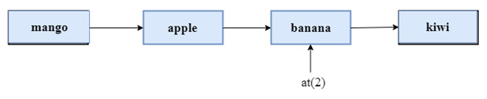
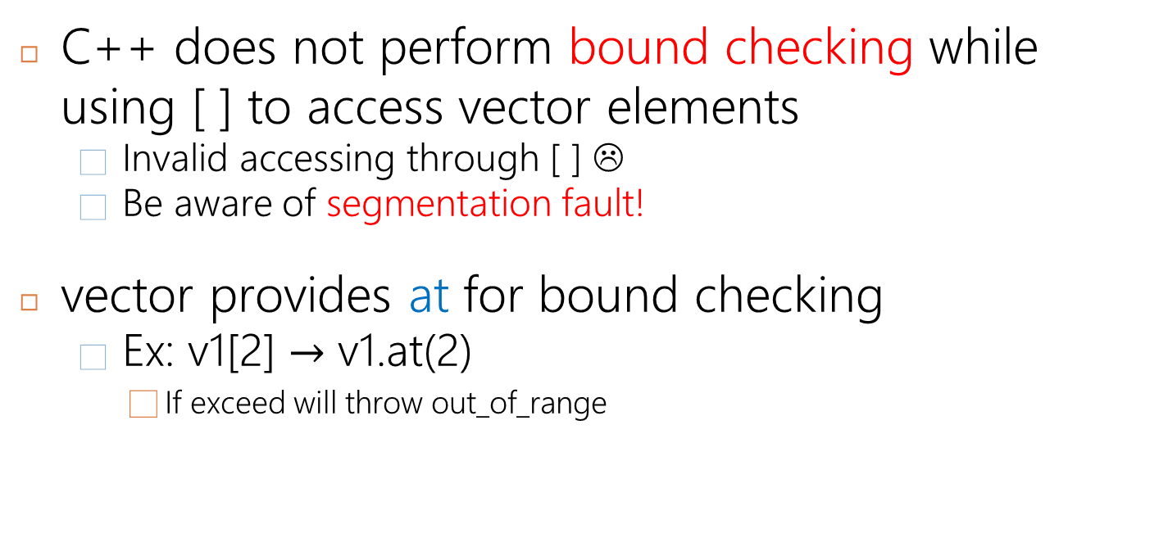
Introduction to vector(4/4)
C++ does not perform bound checking while using [ ] to access vector elements
Invalid accessing through [ ] ☹
Be aware of segmentation fault!
vector provides at for bound checking
Ex: v1[2] $→$ v1.at(2)
If exceed will throw out_of_range
Notes:
在C++鐘用 operator[]並不會進行邊界檢查， 可能會 Segmentation Fault。以 at() 存取會做陣列邊界檢查。撰寫較嚴謹的程式時可以用at

Slide 7
Size vs. Capacity in vector
Size is the number of elements that actually used
The range that [ ]’s can access the element
Function resize() can be used to shrink or expand a vector
A vector’s capacity is the number of elements allocated in memory
Accessible using the capacity( )
When a vector runs out of space, the capacity is automatically increased
Function reserve( ) increases the capacity manually
The two numbers are not the same. (capacity ≥ size)
Notes:
容量 (capacity) : 是這個 vector 目前可容納的最大元素個數。這個方法與記憶體的配置有關。可以用reserve()
長度 (size) : 是實際儲存了元素的空間大小。capacity 永遠不小於 size。

Slide 8
Useful functions of vector
Function | Effect
vector.empty() | Tell whether vector is empty
vector.clear() | Clear all elements of v
vector.size() | Return the size of vector
vector.begin() | Return the address of first element
vector.end() | Return next address of last element
vector.front() | Return the value of first element
vector.back() | Return the value of last element
vector.push_back() | Add element at the end of vector
vector.pop_back() | Delete last element
vector.resize() | Resize the capacity of vector
more functions :
http://www.cplusplus.com/reference/vector/vector/swap/

Slide 9
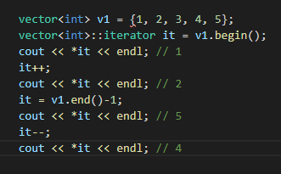
Iterator
A generic pointer to access objects in containers
Have similar behavior as pointer which it records address
Not a pointer but usually implemented using pointers
Treating iterators as pointers typically is OK ☺
Each container defines an appropriate iterator type
Same as above
Notes:
Iterator 的作用跟pointer很像，是可以用來當容器內的指標，以address儲存
這是他宣告的方式 跟vecto一樣的type並加上 :: iterator

Slide 10
Basic Iterator Operations
++ (pre- and postfix)
advance to the next data item
-- (pre- and postfix)
moves to previous data item
== and !=
test whether two iterators point to the same data item
* dereferencing operator
provides data item access
c.begin( )
returns an iterator pointing to the first element of container “c”
c.end( )
returns an iterator pointing past the last element of container “c”
Notes:
比較要注意的就是 Dereferencing * 字號

Slide 11

Basic Iterator Operations

Slide 12
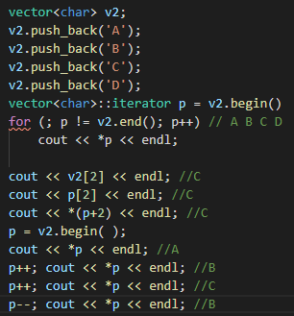
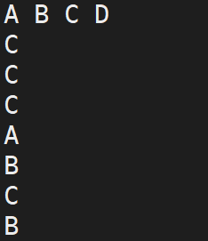
Example

Slide 13
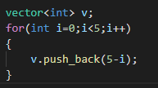
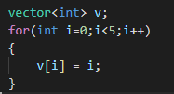
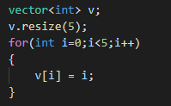
Add value to vector
push_back (automatically extend capacity if it’s not enough)
Directly assign (will not automatically extend capacity )
after for loop, v contains: 5 4 3 2 1
wrong! Initial size is 0,
need to resize capacity first.
after for loop, v contains: 0 1 2 3 4
Notes:
Push會自動增加capacity，直接用中括號卻不會，需要先resize，所以用pusshback比較方便

Slide 14
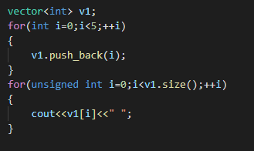
Go through whole vector(1/2)
0 1 2 3 4

Slide 15
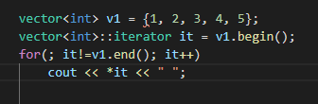
Go through whole vector(2/2)

Slide 16
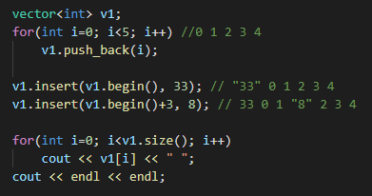
Insert value to vector at specific position
Position

Slide 17
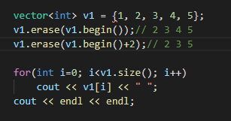
Delete value to vector at specific position
Position

Slide 18
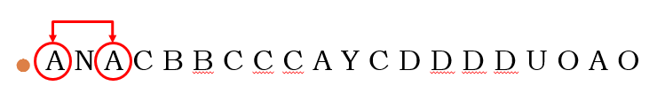
Lab Exercise
The game 消消樂 will be conducted
A set of letters will be given in Range: A ~ Z
The first letter will be deleted if there exist closest same letter
Both two letters will be deleted
Start from the Begining
If you cannot find the same letter, move to second letter
Keep doing until you canot find any same letter in set
Return the rest of letter (keep original order)
Then sorting the rest number in ascending order

Slide 19
Problem Formulation
Given: a file contains letters
Purpose: find the non-repeat set of letters and sort it
Output: print out the result in original order and in ascending order
Limitation
You need to use vector
You need to only use iterator to access element in vector
[ ] is NOT available in this Lab!

Slide 20

Lab Exercise – Input file
Given an list of letters
All the letters are in upper case

Slide 21

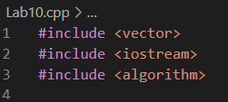
Execution result
You should exactly follow in the output format!
NO space here!
Hint : you can use

Slide 22
Hint
A N A C B B C C C A Y C D D D D U O A O

Slide 23
Hint
Go to next letter
N C B B C C C A Y C D D D D U O A O

Slide 24
Hint
N C B B C C C A Y C D D D D U O A O

Slide 25
Hint
N B B C C A Y C D D D D U O A O

Slide 26
Hint
N C C A Y C D D D D U O A O

Slide 27
Hint
N A Y C D D D D U O A O

Slide 28
Hint
Go to next letter
N Y C D D D D U O O

Slide 29
Hint
Go to next letter
N Y C D D D D U O O

Slide 30
Hint
N Y C D D D D U O O

Slide 31
Hint
N Y C D D U O O

Slide 32
Hint
Go to next letter
N Y C U O O

Slide 33
Hint
N Y C U O O

Slide 34
Hint
N Y C U

Slide 35
Hint
Sort ascending order
N Y C U -> C N U Y

Slide 36
Submission
You should exactly follow in the output format
Upload all your cpp to new E3
Naming rule : studentID_LAB10.cpp
Deadline is on E3
Make sure your code can run on server

