Slide 1
LAB 11 more about STL
2021/5/24

Slide 2
STL: Standard Template Library
Containers: hold objects, all of a specified type
Iterators: a generic pointer to access objects in containers
Generic algorithms: act on objects in containers
Save you a lot of efforts to use those common data structures or algorithms
Notes:
vector屬於STL的其中一種容器
Container: 可以存放特定型別的物件
Iterator: 指向容器內物件的一種pointer

Slide 3
Containers
Container classes in STL
Different kinds of data structure
Like vector, list, stack, queue
Container classes store objects and data.
Each is template class with parameter for particular data type to be stored
Ex: lists of int, double or myClass types
Each container has its own iterator.
Even though they are used similarly.
One might have bidirectional, another might just have forward iterators

Slide 4
Map(1/4)
Associative container.
Map provides sorting and friendly storing data structure, and it features one-on-one mapping system.
Mapping from one data item (a key) to another (a value).
Ex: student’s ID and student’s name

Slide 5
Map(2/4)
Key value : used to sort and uniquely identify the elements; in other words, there is no two same key values.
Mapped value : store the data associated with the key values.

Slide 6

Map(3/4)
#include <map>
Announce
map< (key) , (value) > (name)
EX:
m.insert(pair< type , type >( key , mapping ) );
Same as m[key] = value ;
EX:
If key is number/string, it will be auto. sorting by key.

Slide 7
Map(4/4)
iterator->first / (*iterator).first
Get key value
iterator->second / (*iterator).second
Get mapping value
m.find(key)
Return the iterator if found; otherwise, return m.end()
m.clear()
Remove all elements
m.erase(iterator), m.erase( key-value )
Remove the specified element
m.erase(iterator , iterator)
Remove the range of elements

Slide 8
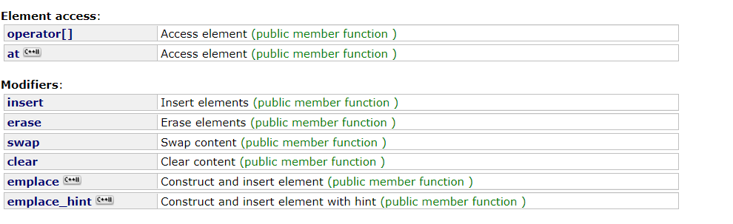
Map reference
http://www.cplusplus.com/reference/map/map/

Slide 9
Iterators
‘Abstraction’ of iterators
Designed to hide details of implementation
Provide uniform interface across different container classes
Using overloaded operators:
++, --, ==, !=, *
If p is iterator variable, *p gives access to data pointed to by p

Slide 10
Iterator Classifications
Forward iterators:
++ works on iterator
Bidirectional iterators:
Both ++ and -- work on iterator
Random-access iterators:
++, --, and random access all work with iterator
These are ‘kinds’ of iterators, not types!

Slide 11
Cycling with Iterators
Cycling ability using for loop: for (p = c.begin() ; p! = c.end() ; p++) process *p //*p is current data item
Keep in mind
Each container type in STL has own iterator types
Even though they’re all used similarly

Slide 12


Example of map Iterator
Declare:
Key
value
Mapped
value
traval:

Slide 13


std::sort() (1/3)
#include<algorithm>
sort(v.begin(), v.end())
v : 0 1 2 3 4 5
V : 5 4 3 2 1 0

Slide 14



std::sort() (2/3)
sort(v.begin(), v.end(), myfunc)
myfunc is a boolean function
v: 0 1 2 3 4
v: 4 3 2 1 0

Slide 15
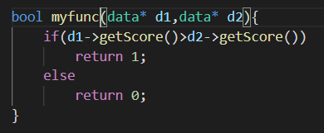

std::sort() (3/3)
Sorting object
You can also sort class, define your sort function by youself.
v: 0 1 2 3 4

Slide 16
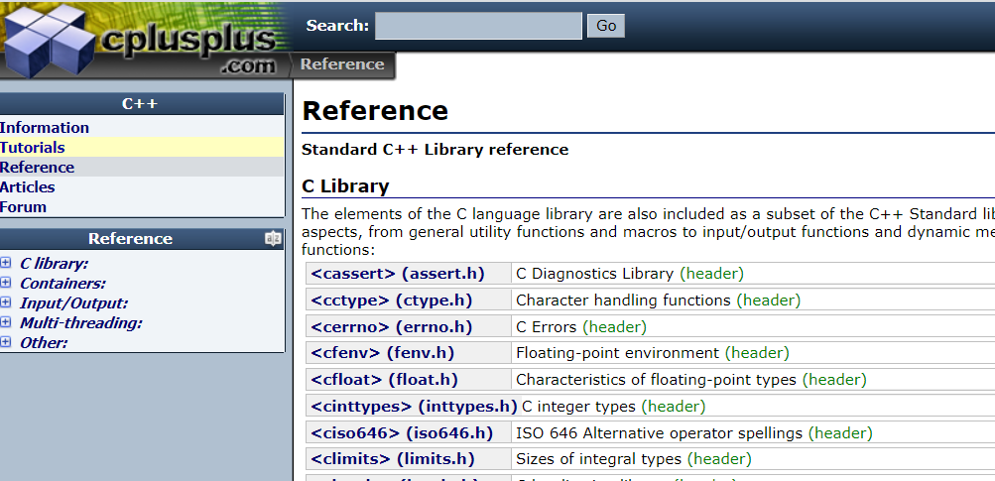
STL: Standard Template Library
http://www.cplusplus.com/reference/
Notes:
vector屬於STL的其中一種容器
Container: 可以存放特定型別的物件
Iterator: 指向容器內物件的一種pointer

Slide 17
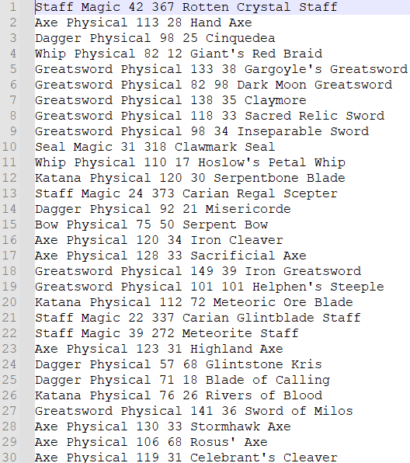
Lab Exercise (1/2)
Input file (weapons.txt)
Input file has a series of weapon information, including
(weapon type, weapon classification, physical attack, magic attack, weapon name)
e.g.
weapon type : Staff
weapon classification : Magic
physical attack : 42
magic attack : 367
Weapon name : Rotten Crystal Staff

Slide 18
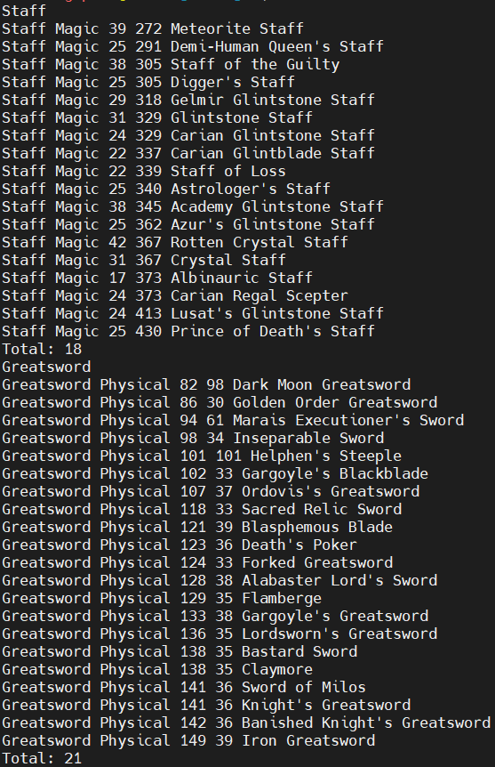

Lab Exercise (2/2)
Output (cout)
Output should be a series of information searched by the “weapon type”.
Note:
Infinite loop (until cin “EXIT”).
Output all of the information searched by the “weapon type”.
Output the total number of weapons at the bottom line.
The series of weapon information should be sorted by the physical attack or magic attack depending on weapon classification.
If the weapon type doesn’t exist, output “No data”.
If attacks are the same, the order is not matter.

Slide 19
Submission
You should exactly follow in the output format
Upload all your cpp to new E3
Naming rule : studentID_LAB11.cpp

