Slide 1
IoT Smart Home System
組 員 : 蔡定維 C108185144
許凱翔 C108185130
龔一舫 C108285106

Slide 2
Outline
Features
Environment / Materials
Hardware Architecture
Actual Work

Slide 3
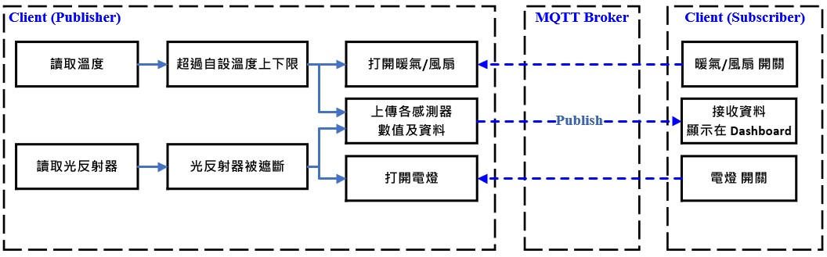
Features

Slide 4
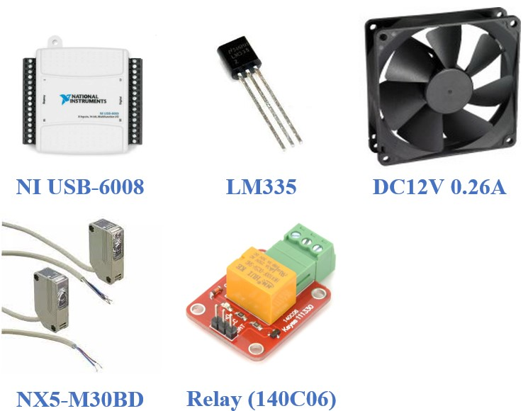
Environment / Materials

Slide 5
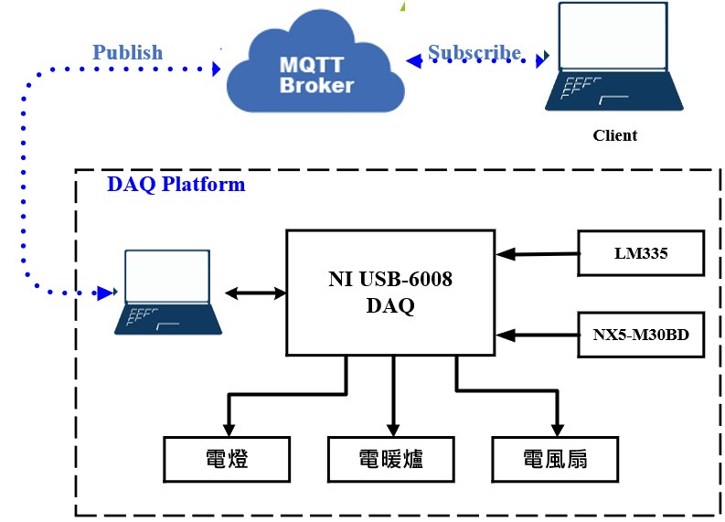
Hardware Architecture

Slide 6
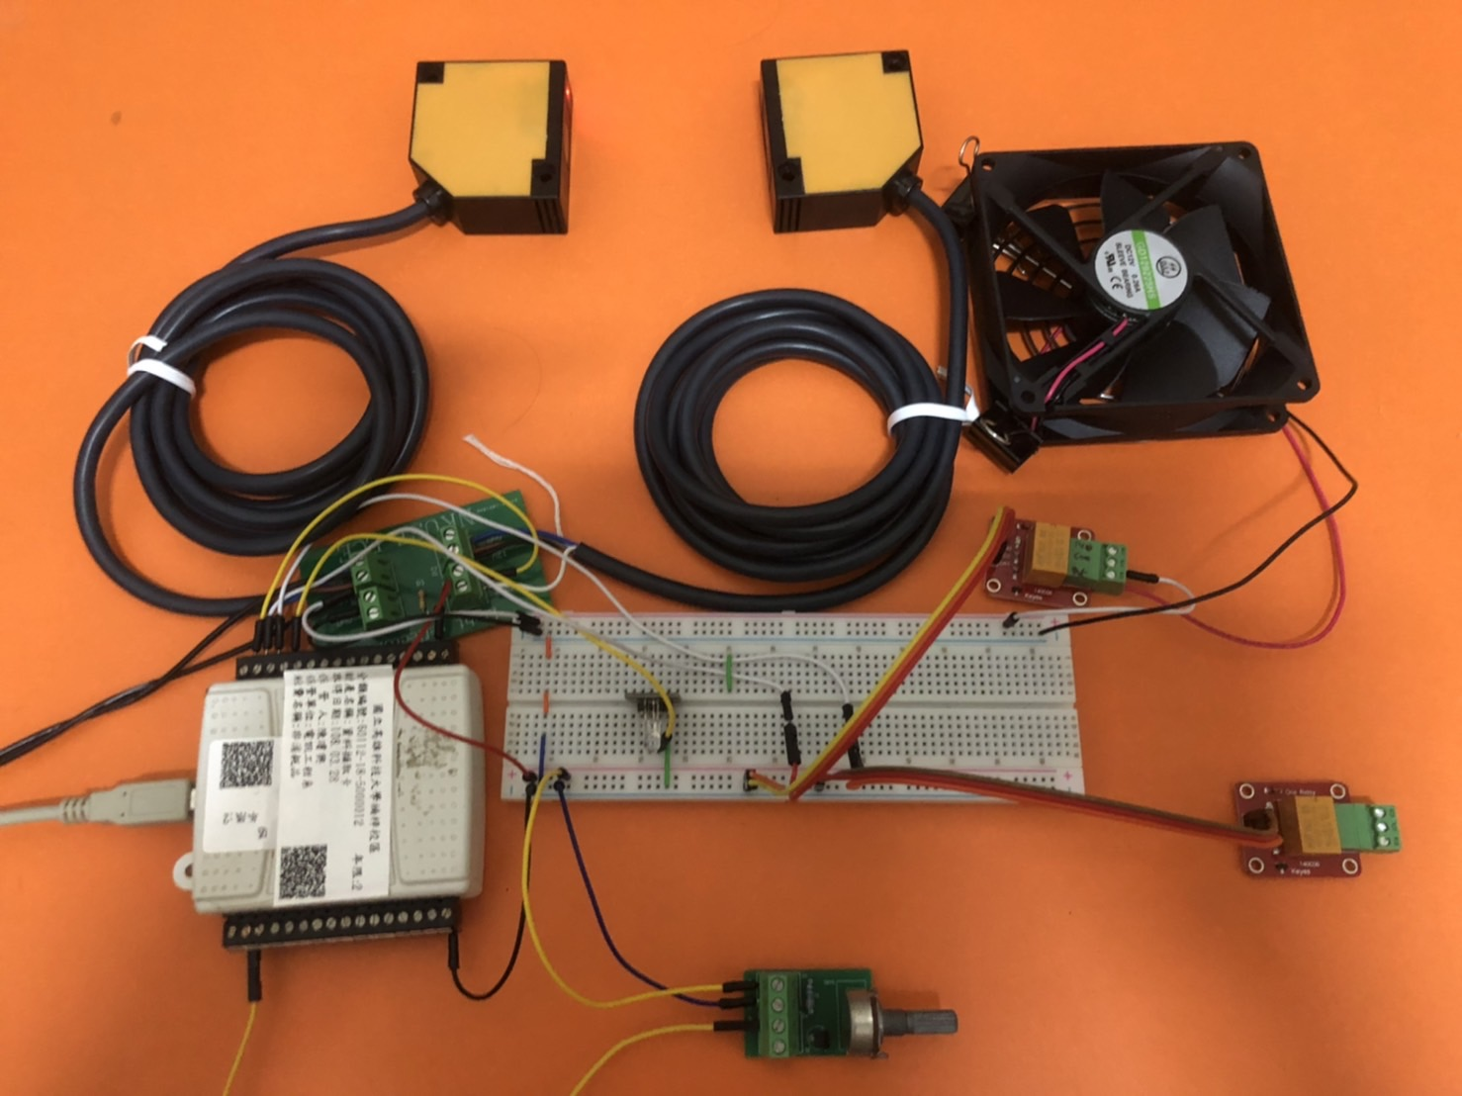
Actual Work

Slide 7
END

