Slide 1
END-TO-END DATA SCIENCE PROJECT
Predicting credit risk with explainable ML
32,581 loans • 3 model families • SHAP explanations
A decision-support proof of concept, not an automated credit approval system
01

Slide 2
CREDIT RISK | PORTFOLIO CASE STUDY
Executive summary
XGBoost achieved 0.903 ROC-AUC on the held-out test set.
At a 0.40 cutoff: 82% default recall, 53% precision.
Trade-off: 255 missed defaults versus 1,033 false alarms.
02

Slide 3
CREDIT RISK | PORTFOLIO CASE STUDY
The lending decision problem
False negative → borrower defaults without being flagged.
False positive → borrower is flagged despite not defaulting.
Goal: rank risk accurately, then choose a reviewed, cost-aware operating threshold.
03

Slide 4
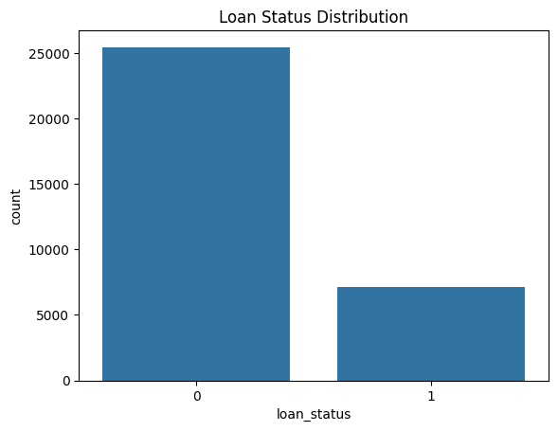
CREDIT RISK | PORTFOLIO CASE STUDY
Dataset & class imbalance
32,581 records
12 original columns
21.8% defaults
Stratified 80/20 split
04

Slide 5
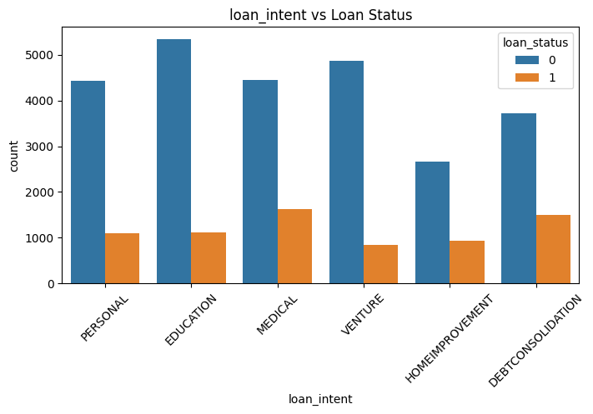
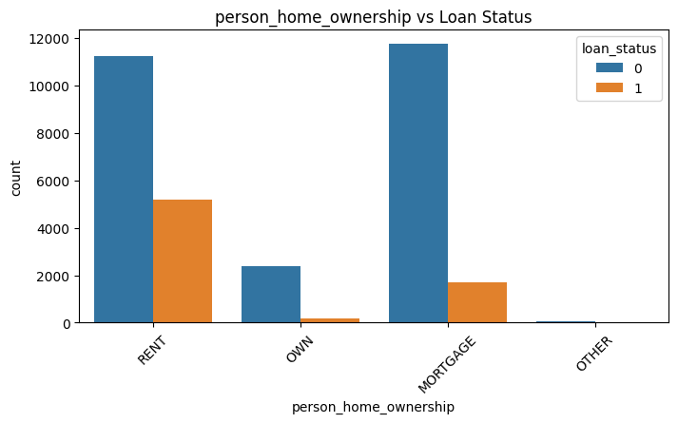
CREDIT RISK | PORTFOLIO CASE STUDY
EDA | housing and borrowing purpose
05

Slide 6
CREDIT RISK | PORTFOLIO CASE STUDY
EDA | observed default rates
RENT: 31.6% • OWN: 7.5% • MORTGAGE: 12.6%
Debt consolidation: 28.6% • Medical: 26.7%
Education: 17.2% • Venture: 14.8%
Associations in this dataset—not causal explanations.
06

Slide 7
CREDIT RISK | PORTFOLIO CASE STUDY
Feature engineering and preparation
Engineered: loan-to-income, income quartiles, employment bands, credit-experience ratio.
Excluded loan grade, interest rate, loan-percent-income and age.
Encoded categories; imputed missing model features; scaled Logistic Regression inputs.
Caveat: quantile bins were computed before splitting—fix in the next pipeline revision.
07

Slide 8
CREDIT RISK | PORTFOLIO CASE STUDY
Model comparison | ROC-AUC
08

Slide 9
CREDIT RISK | PORTFOLIO CASE STUDY
XGBoost | threshold trade-offs
THRESHOLD PRECISION RECALL FALSE NEG. FALSE POS.
0.50 0.67 0.75 356 537
0.40 0.53 0.82 255 1,033
0.30 0.43 0.90 144 1,669
0.40 is illustrative, not a validated business optimum.
09

Slide 10
CREDIT RISK | PORTFOLIO CASE STUDY
XGBoost | confusion matrix at 0.40
PREDICT NON-DEFAULT PREDICT DEFAULT
ACTUAL NON-DEFAULT 4,062 1,033
ACTUAL DEFAULT 255 1,167
Accuracy 0.80 • Recall 0.82 • Precision 0.53 • F1 0.64
10

Slide 11
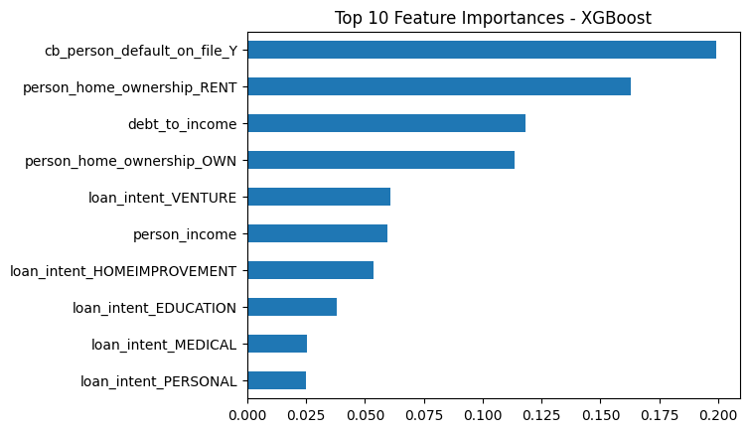
CREDIT RISK | PORTFOLIO CASE STUDY
Feature importance | model-native
11

Slide 12
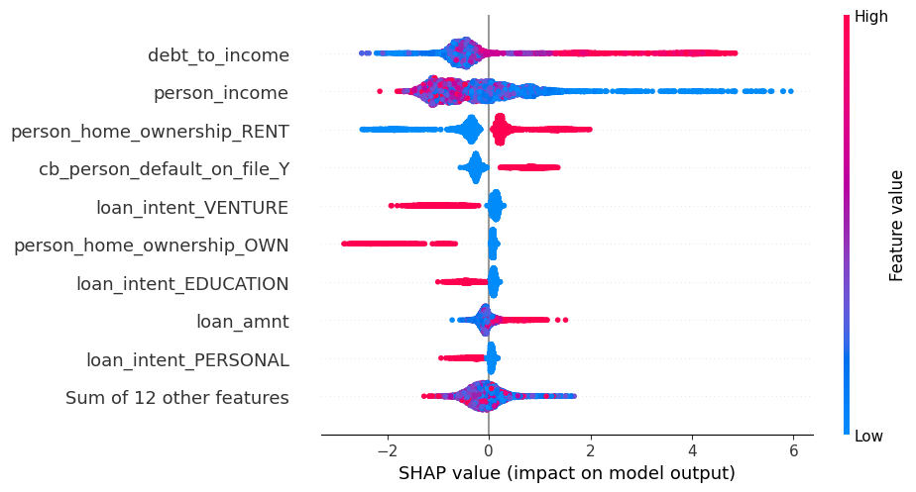
CREDIT RISK | PORTFOLIO CASE STUDY
SHAP | understanding predictions
12

Slide 13
CREDIT RISK | PORTFOLIO CASE STUDY
Recommendations for lenders
1. Use model output to prioritize manual credit reviews.
2. Add affordability verification for higher-risk applications.
3. Audit fairness and proxy variables such as housing status.
4. Evaluate realistic costs before fixing an approval threshold.
13

Slide 14
CREDIT RISK | PORTFOLIO CASE STUDY
Limitations & responsible deployment
Single random holdout; no out-of-time or external validation.
Pre-split income quantiles and test-set threshold exploration.
Uncalibrated probabilities; missing lending cost assumptions.
No fairness audit, monitoring, or production inference pipeline yet.
14

Slide 15
CREDIT RISK | PORTFOLIO CASE STUDY
Roadmap & conclusion
NEXT: Train-fitted preprocessing → validation-based threshold → calibration → fairness review → Streamlit demo.
TAKEAWAY: XGBoost ranked default risk best in this experiment, but robust deployment requires more than good test metrics.
15

