Slide 1
Customer Churn Prediction
Final Project Presentation - SyriaTel Telecom
Wadhare Isaac
JULY 2025

Slide 2
Business Understanding
Stakeholder: SyriaTel Telecom
Business Problem:
SyriaTel is experiencing customer churn, resulting in revenue loss.
Goal:
Build a classification model to predict churn and retain at-risk customers.
Target Variable: Churn (Yes/No)
Success Metric: Recall

Slide 3
Data Overview
The dataset contains customer usage data, service plans, and churn labels.
Key Features:
- Call minutes (day, evening, night, international)
- Customer service calls
- International plan
- Account length

Slide 4
Data Preprocessing
Steps performed:
- Handled class imbalance with SMOTE
- Feature scaling and encoding
- Train-test split (80-20)

Slide 5
Modeling Process
Models Built:
- Baseline Logistic Regression
- Balanced Logistic Regression
- SMOTE + Logistic Regression
- Decision Tree (Tuned)
- Random Forest
Evaluation Metric: F1 Score, Recall

Slide 6
Model Performance Comparison
Tuned Decision Tree:
Accuracy: 93%
Recall (Churn): 67%
F1-Score (Churn): 75%
Best balance between recall and precision.
Random Forest: Slightly lower recall, similar accuracy.

Slide 7
Top Features Influencing Churn
1. total_day_minutes
2. customer_service_calls
3. total_eve_minutes
4. total_day_calls
5. international_plan
6. total_intl_minutes
7. total_night_minutes
8. total_night_calls
9. total_day_charge
10. account_length

Slide 8
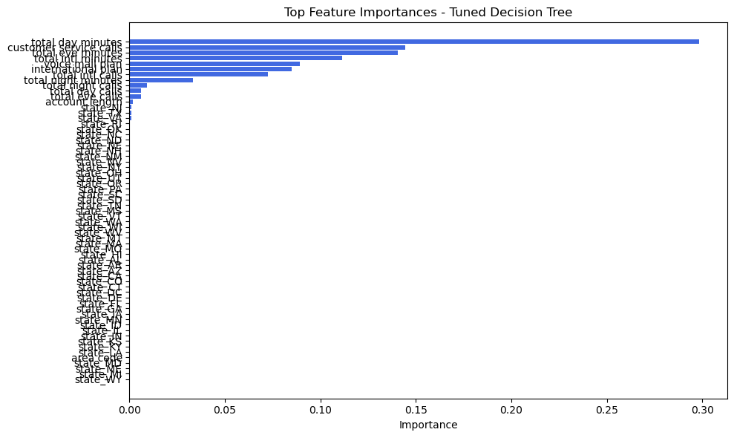

Slide 9
Model Comparison: ROC Curve & AUC
Why ROC? Measures how well models distinguish churn vs. non-churn customers.
AUC Scores:
Random Forest: 0.89 (Best Performer)
Tuned Decision Tree: 0.82
Logistic Regression: 0.81
SMOTE Logistic Regression: 0.79
Basic Decision Tree: 0.79
Insight: Random Forest shows the best balance of sensitivity and specificity.

Slide 10
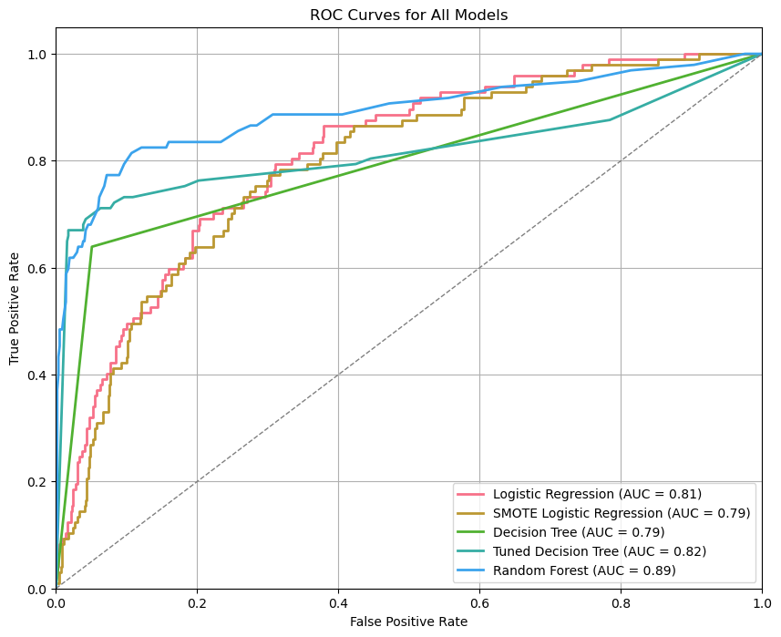

Slide 11
Business Recommendations
- Offer better value for high-usage customers.
- Monitor frequent service callers for dissatisfaction.
- Review pricing for international plans.
- Provide onboarding support to new users.

Slide 12
Limitations
- Only tabular data used; call/text content not analyzed.
- Assumes data is accurate and complete.
- Churn may be influenced by external factors not in dataset.

Slide 13
Next Steps
- Implement churn alerts system.
- Test personalized retention offers.
- Collect feedback from churned customers.

Slide 14
Thank You
Questions?

