Slide 1
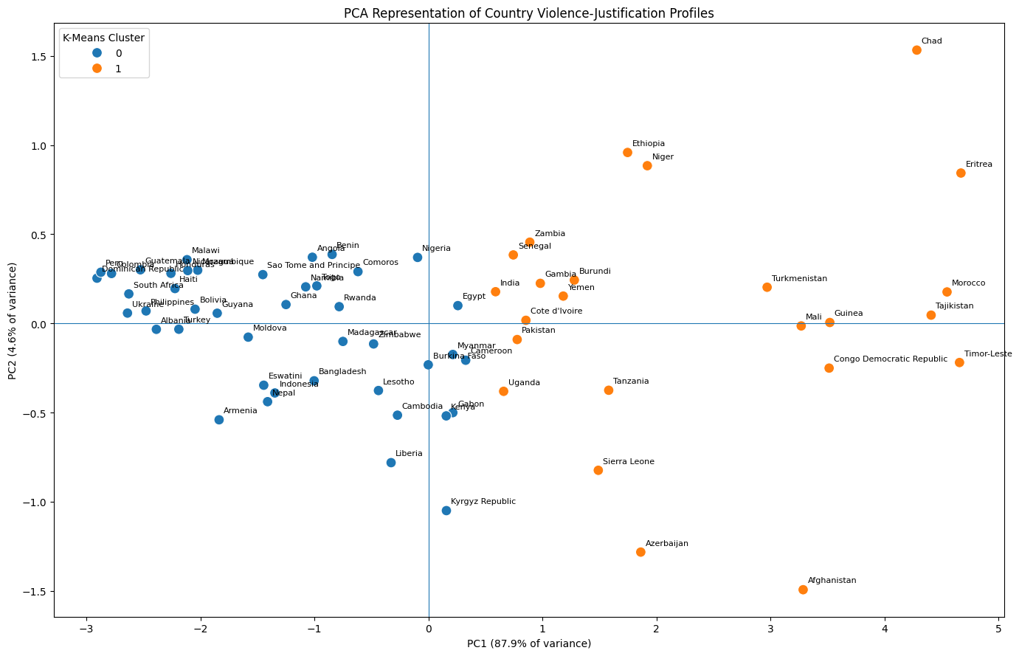
DATA SCIENCE PORTFOLIO PROJECT
Understanding Attitudes Toward Violence Against Women and Girls
A cross-country statistical and unsupervised-learning analysis of demographic and social patterns in aggregated survey estimates.
70
12.6k
5+1
87.9%
countries
rows
violence measures
variance explained by PC1
Statistical inference • Adjusted regression • PCA • K-Means

Slide 2
PROBLEM FRAMING
The real question is not “can we model it?”
It is: what can this data honestly support?
Dataset is not respondent-level
The project analyzes reported percentages of respondents who justify violence against women under specific scenarios. The challenge is methodological: the rows are aggregate subgroup estimates, not individual people.
Each row is a percentage for one country, gender, scenario and one demographic subgroup.
• Identify demographic and scenario-level patterns
• Avoid causal overclaiming from observational aggregates
• Use statistics and unsupervised learning where defensible
• Reject predictive modelling when the target and features are structurally weak
Correct framing
Explain associations and profiles; do not pretend to forecast individuals.
Aggregated survey estimates • 70 countries • subgroup-level analysis
02

Slide 3
DATA AUDIT
Data structure shaped every modelling choice
One analytical row
Why this matters
Country × Survey year × Scenario × Gender × One demographic subgroup
• Education rows do not also contain age, employment, residence and marital status.
• A “full feature” prediction model would manufacture fake combinations.
• Separate adjusted models preserve the real data-generating structure.
The demographic dimensions are alternative stratifications — not jointly observed features on the same respondent.
30
rows per RecordID = 2 genders × 15 demographic responses
Methodological discipline > algorithm decoration
Aggregated survey estimates • 70 countries • subgroup-level analysis
03

Slide 4
METHODOLOGY
Workflow: from audit to defensible insight
1
2
3
4
5
6
Data audit
EDA
Tests
Adjusted models
Profiles
Robustness
shape, missingness, row meaning
country, scenario & demographics
Friedman + Wilcoxon + effects
country-clustered inference
K-Means + PCA
diagnostics & sensitivity
No black-box prediction: the methods match the data structure.
Aggregated survey estimates • 70 countries • subgroup-level analysis
04

Slide 5
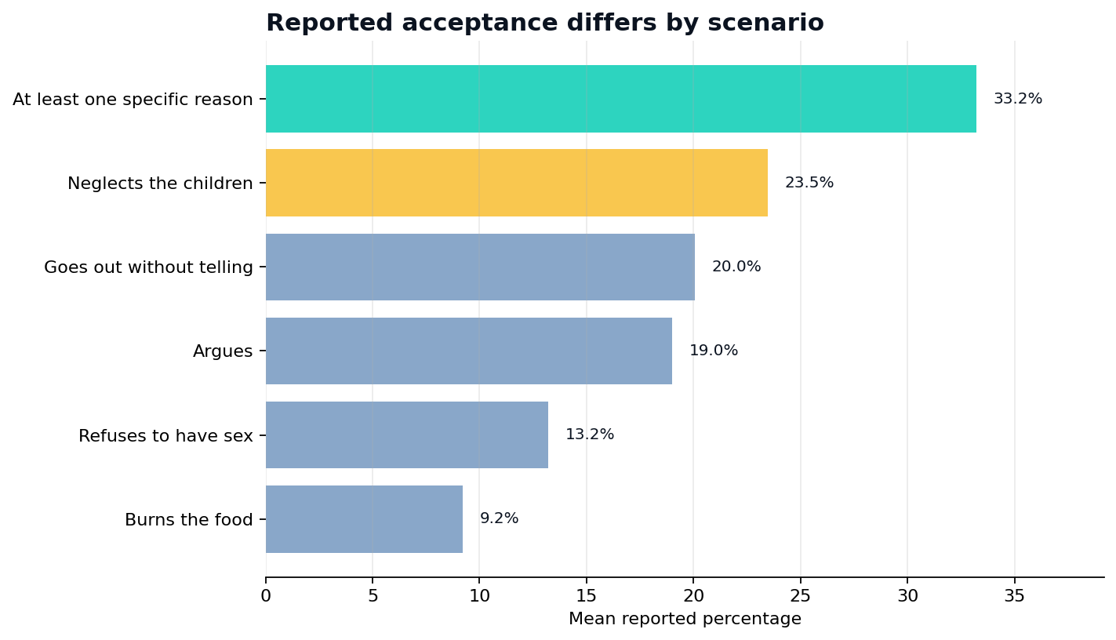
SCENARIO ANALYSIS
Violence-justification scenarios are not interchangeable
178.01
2.0e-37
Friedman statistic
p-value
0.664
9/10
Kendall's W
pairwise differences significant
Neglecting children was the highest-valued specific scenario in 48 of 70 countries. Burning food was never the highest-valued specific scenario.
Aggregated survey estimates • 70 countries • subgroup-level analysis
05

Slide 6
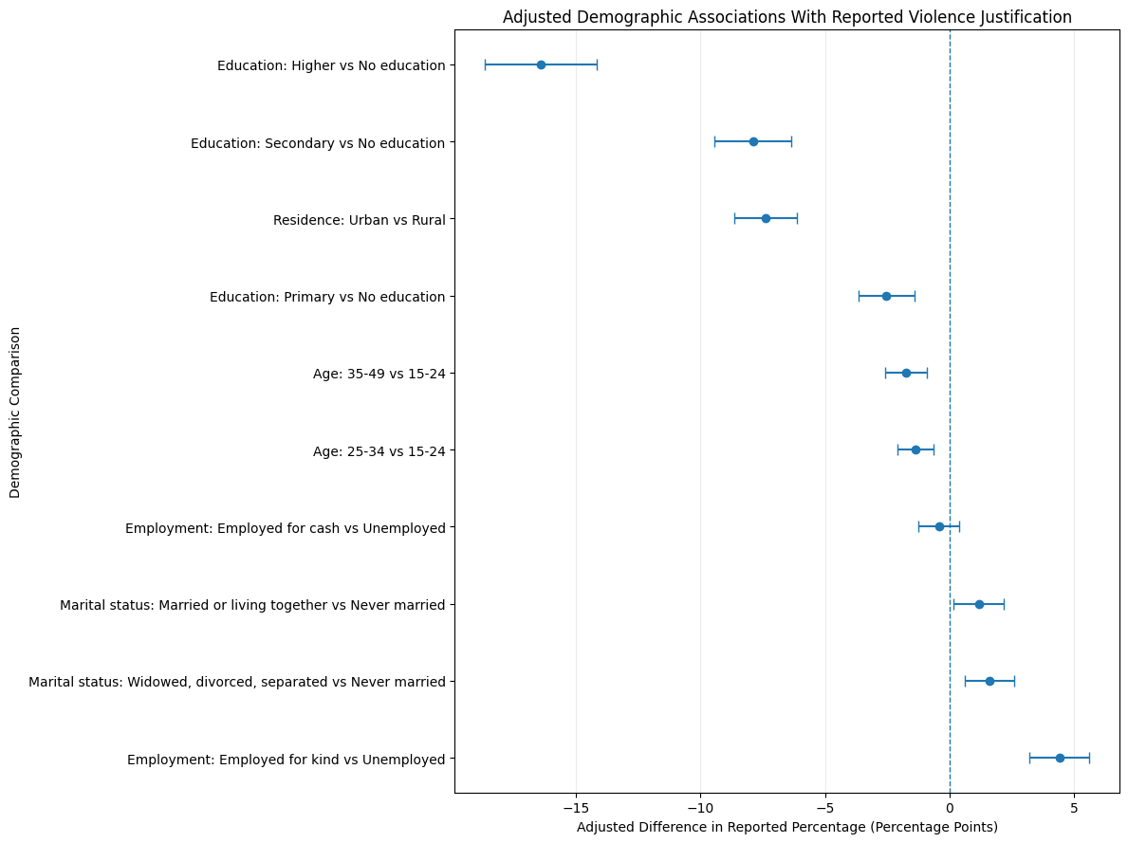
ADJUSTED REGRESSION
Education and residence dominate the adjusted demographic story
Largest adjusted effects
−16.42pp
higher vs no education
−7.40pp
urban vs rural
Final inference uses country-clustered standard errors with country, gender and scenario controls.
Aggregated survey estimates • 70 countries • subgroup-level analysis
06

Slide 7
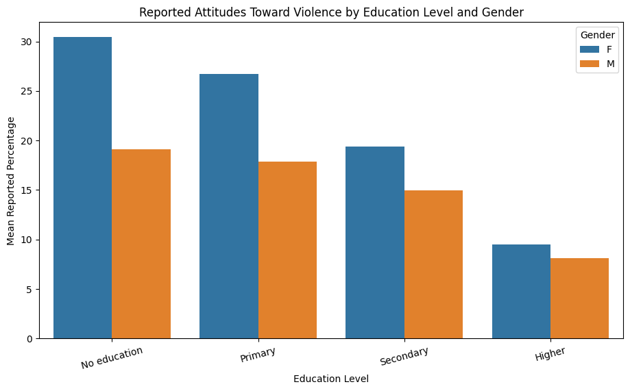
DEMOGRAPHIC INTERACTION
The education gradient is visible in both gender groups
What matters
• Reported values decline steadily as education rises.
• The female–male gap narrows at higher education levels.
• The pattern survives adjustment and sensitivity checks.
Do not overclaim causality.
This is an association among aggregate subgroup estimates.
Aggregated survey estimates • 70 countries • subgroup-level analysis
07

Slide 8
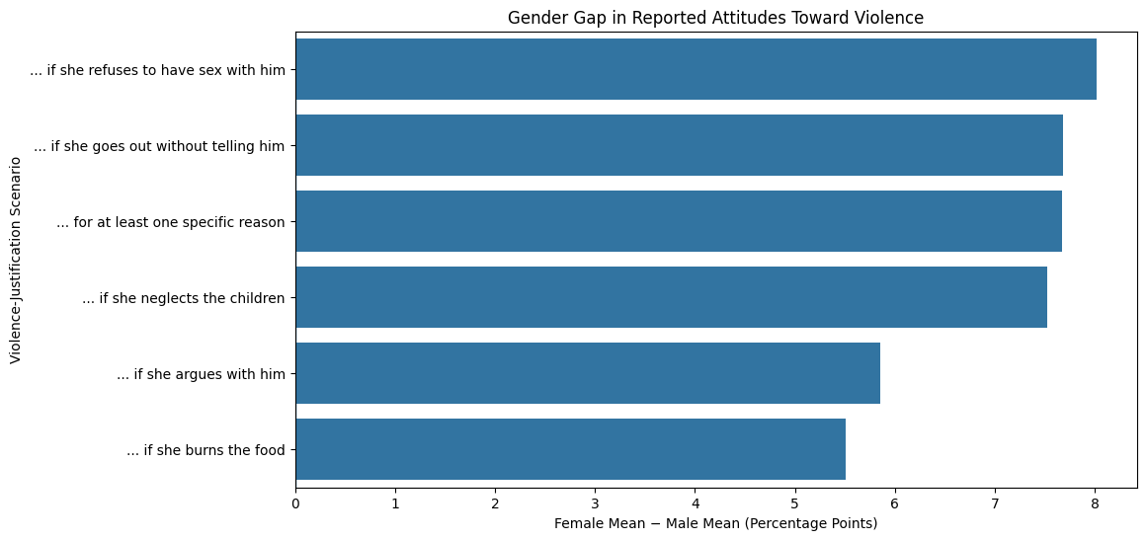
GENDER PATTERNS
Gender gaps appear across every scenario — with a caveat
+7.04pp
average female-minus-male gap
+8.02pp
largest gap: refusal of sex scenario
Caution
Male observations have substantially more missing values, so this is reported as a descriptive aggregate pattern, not a population-level claim about individuals.
Aggregated survey estimates • 70 countries • subgroup-level analysis
08

Slide 9
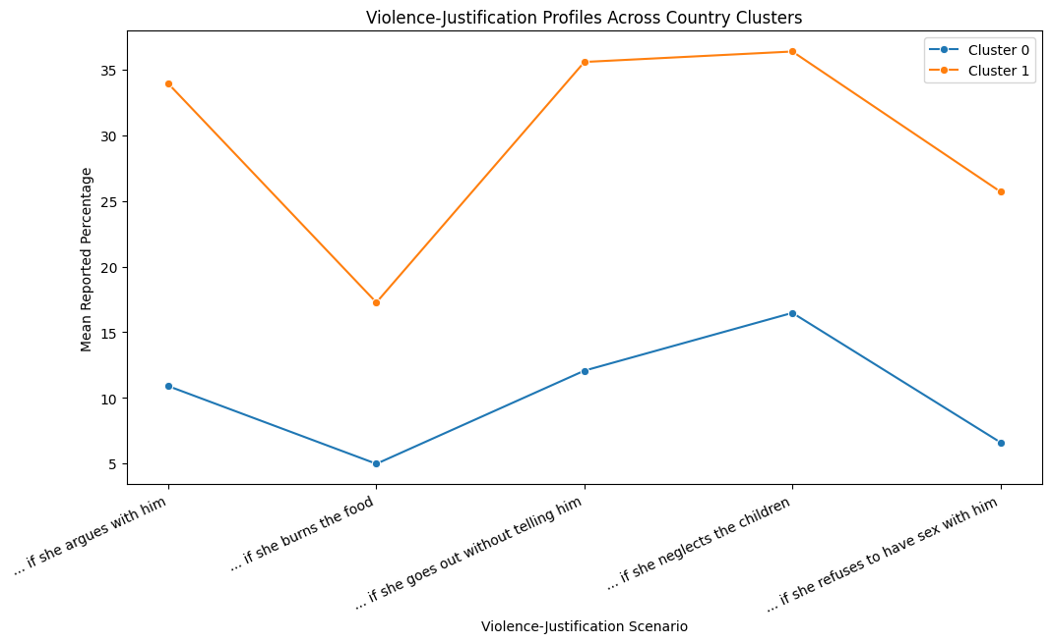
K-MEANS CLUSTERING
Country profiles form broad response patterns
k = 2
selected using silhouette + interpretability
43 / 24
country split among 67 complete profiles
Cluster 1 is higher across all five scenarios. A k=3 sensitivity check shows lower, intermediate and higher profiles — suggesting a continuum more than hard country “types.”
Aggregated survey estimates • 70 countries • subgroup-level analysis
09

Slide 10
DIMENSIONALITY REDUCTION
PCA reveals one dominant cross-country dimension
87.86%
variance explained by PC1
92.48%
variance explained by PC1 + PC2
All five scenarios load positively and almost equally on PC1. The cluster separation largely reflects position along this overall violence-justification continuum.
Aggregated survey estimates • 70 countries • subgroup-level analysis
10

Slide 11
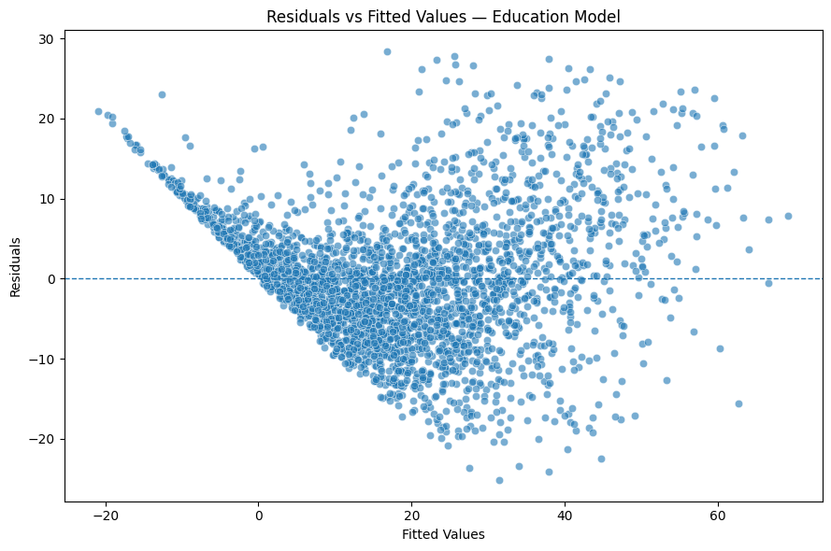
MODEL INTEGRITY
Robustness mattered more than flashy prediction
What was stress-tested
• Country-clustered standard errors are the primary inference method.
• HC3 robust inference preserved education conclusions.
• Cook's-distance sensitivity kept the education gradient intact.
• Supervised prediction was rejected because the rows are aggregate subgroup estimates.
The point: use the method the data deserve.
Aggregated survey estimates • 70 countries • subgroup-level analysis
11

Slide 12
CONCLUSION
Bottom line: strong patterns, careful interpretation
What the project earns
Portfolio signal
• Education is the strongest adjusted demographic gradient.
• Residence shows a large rural–urban difference.
• Scenarios differ systematically; neglecting children stands out.
• Country profiles mostly follow one common underlying dimension.
• Findings are associations in aggregate survey estimates — not causal effects.
This project demonstrates data judgement: it uses statistical models, PCA and clustering where appropriate — and explicitly avoids inappropriate supervised prediction.
Next deliverables
GitHub README, final notebook, and stakeholder presentation.
Thank you
Aggregated survey estimates • 70 countries • subgroup-level analysis
12

