Slide 1


Dividing Controllers into Providers
Full-Stack Web Development Bootcamp

Slide 2

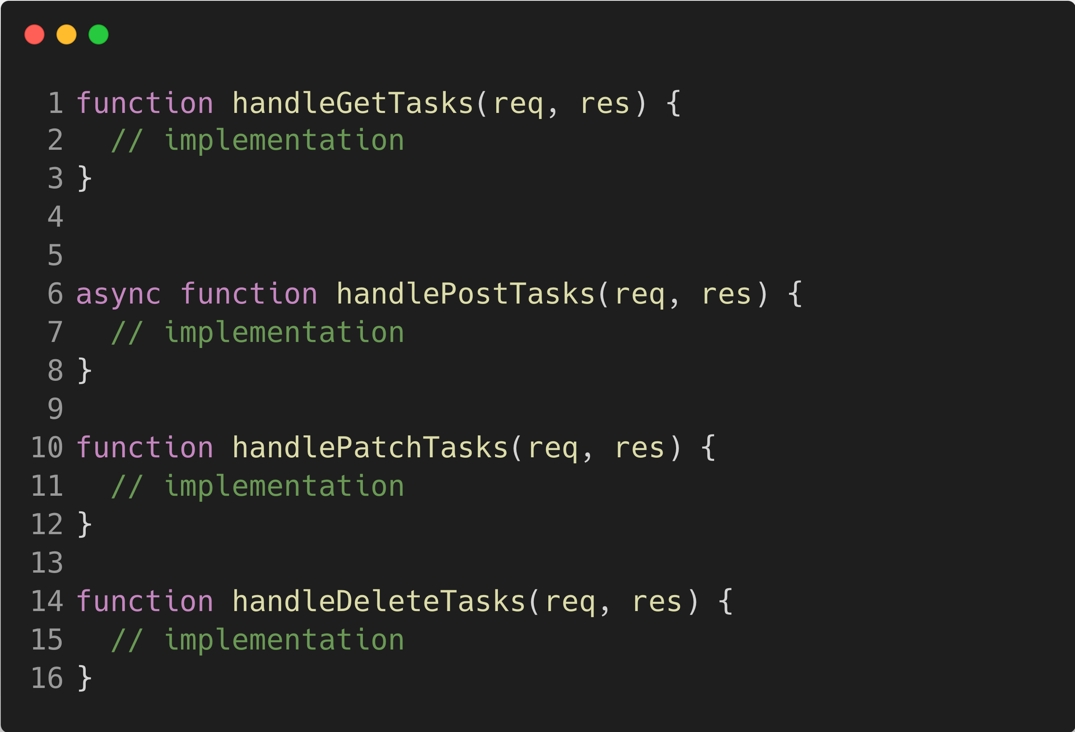
The Controller Files Become Lengthy
The Problem
When controller files grow lengthy due to many methods, encapsulating each controller method into a separate provider file simplifies management. This allows controllers to focus on routing, while providers handle specific business logic, enhancing modularity and maintainability of the code.

Slide 3






Create Helper Files Providers
tasksController
GET /users
usersRouter
User (model)
Database
(MongoDB)
Response
usersController
getUsersProvider
createUserProvider

