Slide 1


Difference Between Nodes and Elements
Full-Stack Web Development Bootcamp

Slide 2

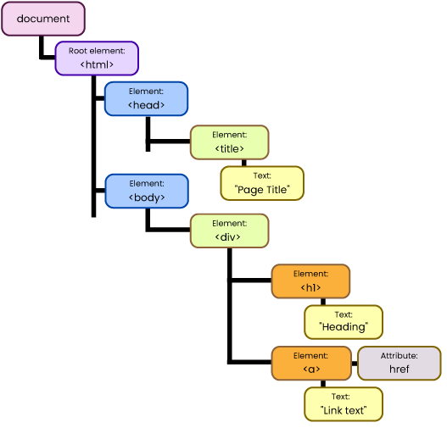
In The DOM Everything Is A Node
Everything Is A Node
The DOM (Document Object Model) is a programming interface that represents the structure of HTML or XML documents as a tree of objects, allowing scripts to manipulate and modify the document's structure, content, and style.
Notes:
https://github.com/john-smilga/javascript-basic-projects
https://zerotomastery.io/blog/javascript-practice-projects/##2.-Create-a-calculator

Slide 3
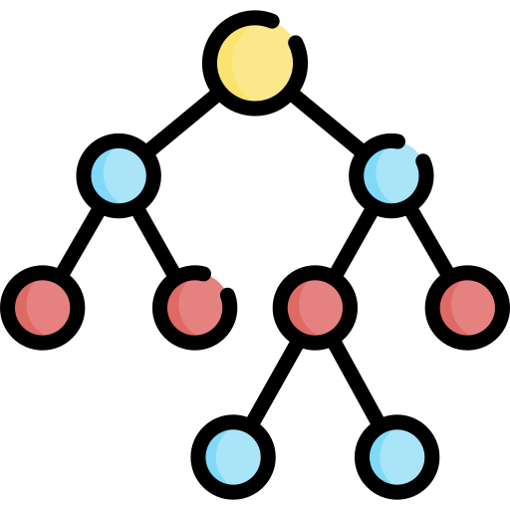
What is a DOM Node?
DOM Nodes are all types of objects within the DOM (elements, attributes, text, comments, etc.).
Element Nodes: These represent HTML elements, like <div>, <p>, or <h1>. They can contain attributes and other nodes, including text and child elements.
Text Nodes: These hold the actual text content inside an element. Text nodes cannot contain child elements but are part of the DOM structure within elements.
Attribute Nodes: These represent HTML attributes of an element (e.g., id, class). Unlike element and text nodes, they describe element properties rather than content.
Comment Nodes: These represent comments in the HTML document (e.g., <!-- comment -->). They are not rendered on the webpage but are part of the DOM for documentation purposes.

Slide 4
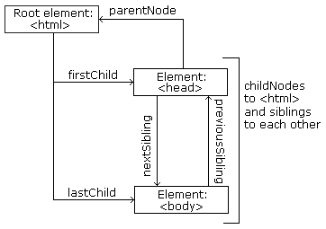
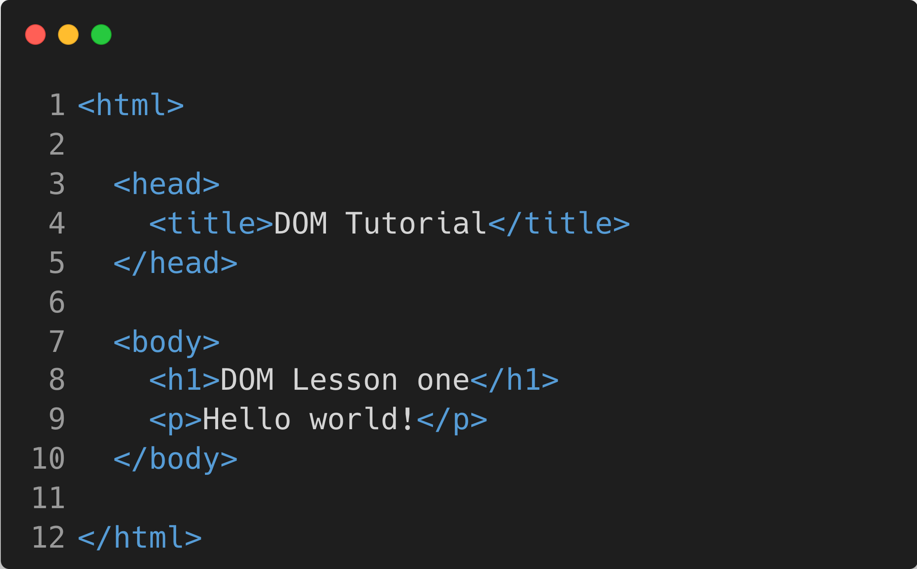
Example of Node Relationships
Diagram From: https://www.w3schools.com/js/js_htmldom_navigation.asp

Slide 5
Difference Between DOM Element and Node
Aspect | Node Objects | Element Objects
Definition | Base interface representing all types of nodes. | Subset of nodes that represent HTML/XML elements.
Types | Includes element, text, comment, and attribute nodes. | Represents elements like <div>, <span>, etc.
Properties | Generic properties like nodeType, nodeName. | Inherits from Node; has additional element-specific properties like getAttribute, classList.
Child Nodes | Can have child nodes depending on the type. | Always allows children (element or other nodes).
Access via JavaScript | Accessed with methods like childNodes. | Accessed with methods like getElementsByTagName, querySelector.

