Slide 1


Introduction To The Box Model
Full-Stack Web Development Bootcamp

Slide 2

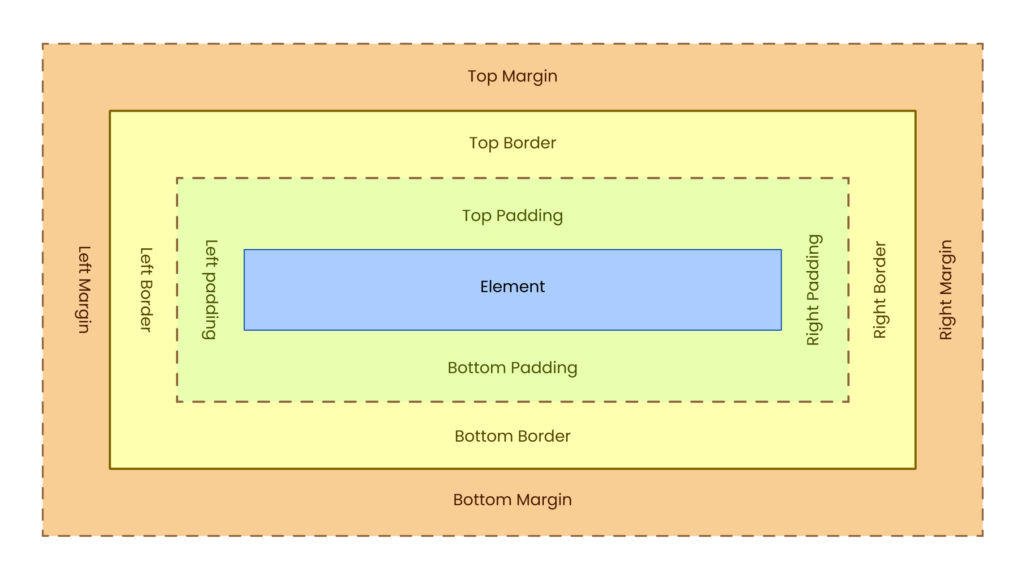
What is The Box Model?
width
height
The box model in CSS defines the layout of elements, consisting of four parts: content, padding, border, and margin. These layers determine how elements are sized and spaced, affecting the overall design and layout on the webpage.

Slide 3
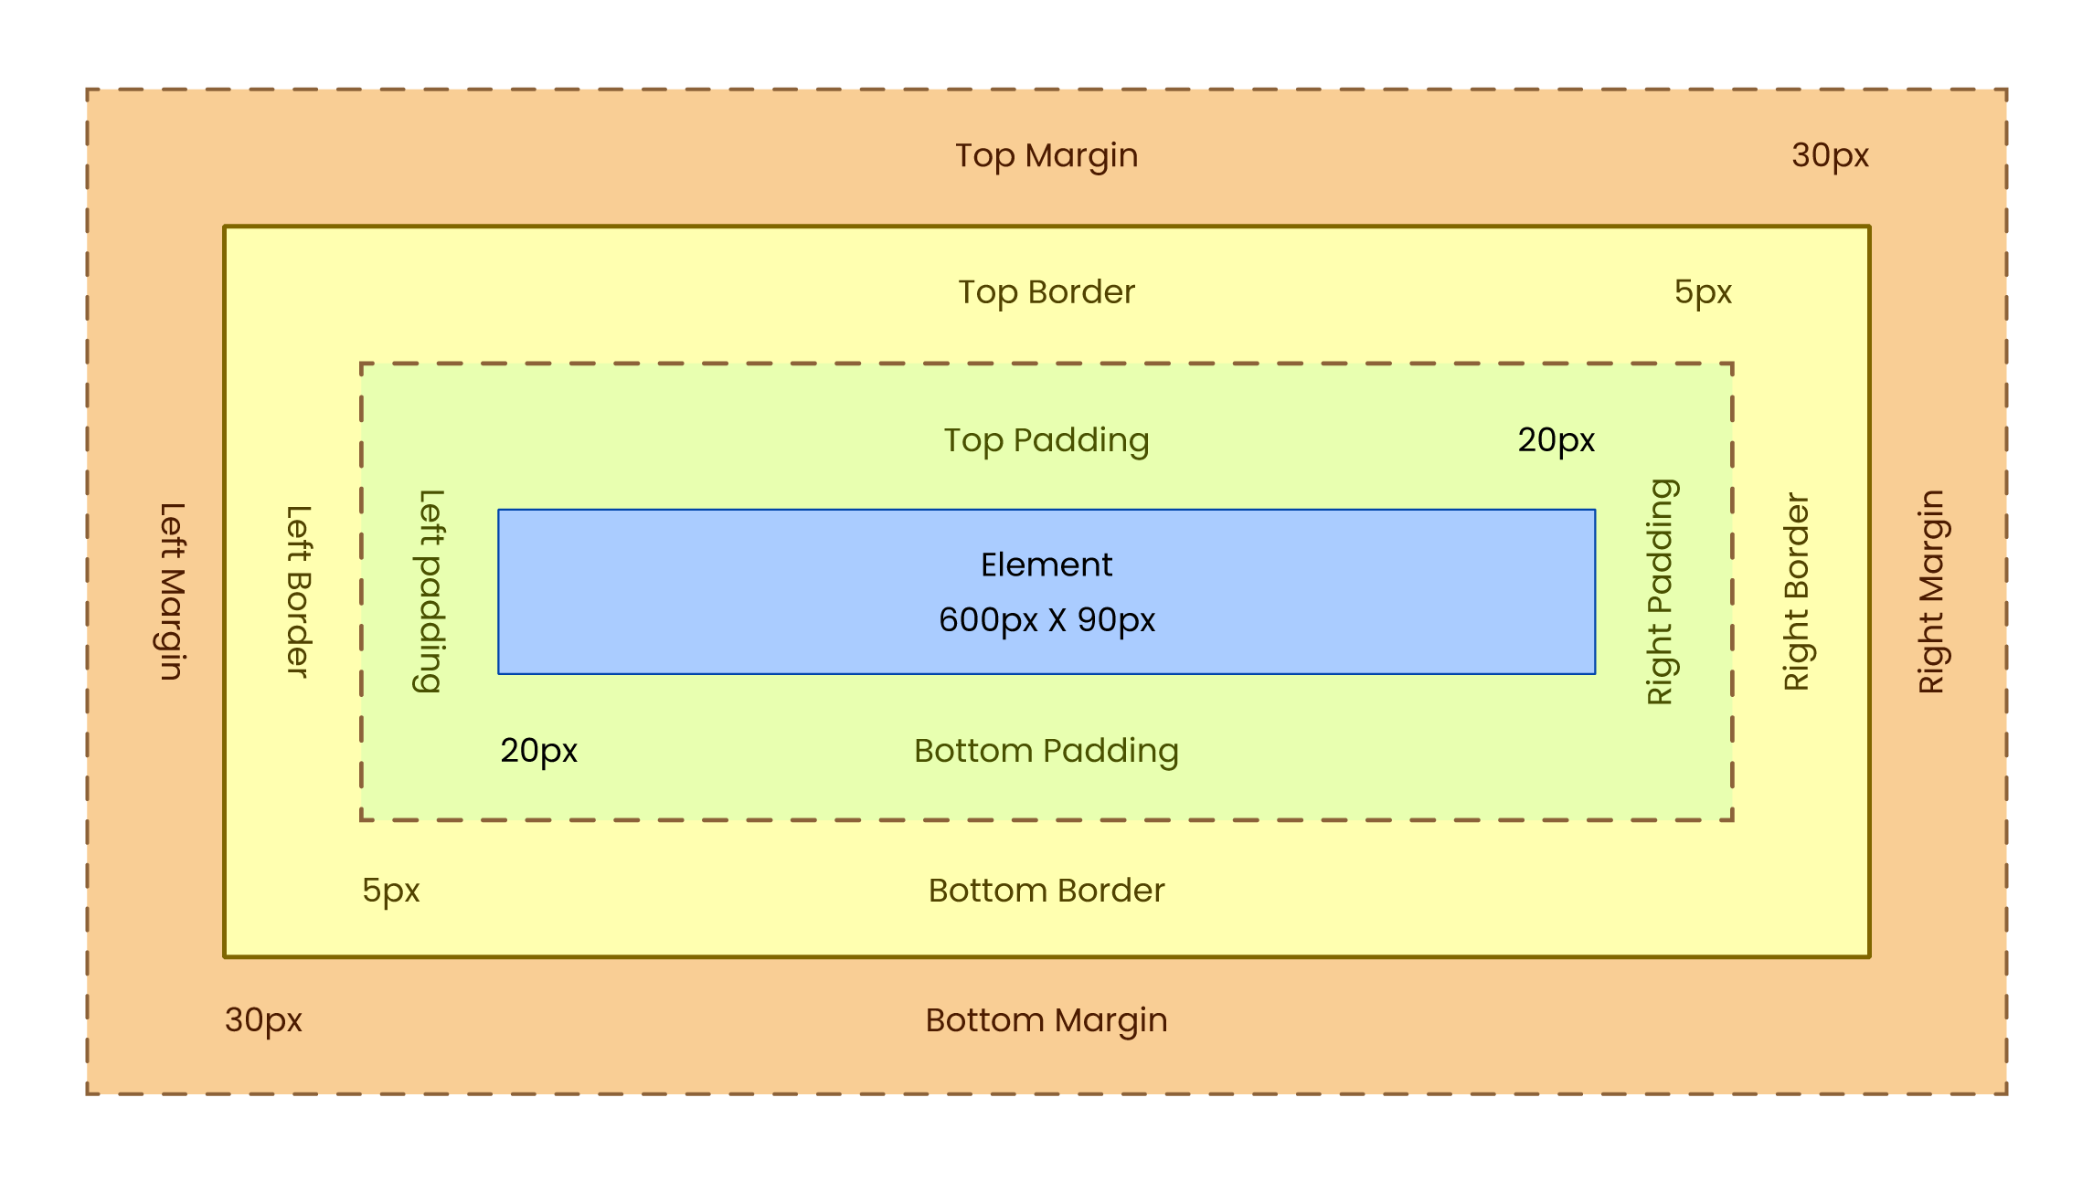
How Are Dimensions Calculated?
width
Total Width Calculation
600px (width of content area)
+ 40px (left padding + right padding)
+ 10px (left border + right border)
= 650px (total width)
Margin is outside of the element width and hence not added
height
Total height Calculation
90px (width of content area)
+ 40px (top padding + bottom padding)
+ 10px (top border + bottom border)
= 140px (total width)
Margin is outside of the element height and hence not added

Slide 4
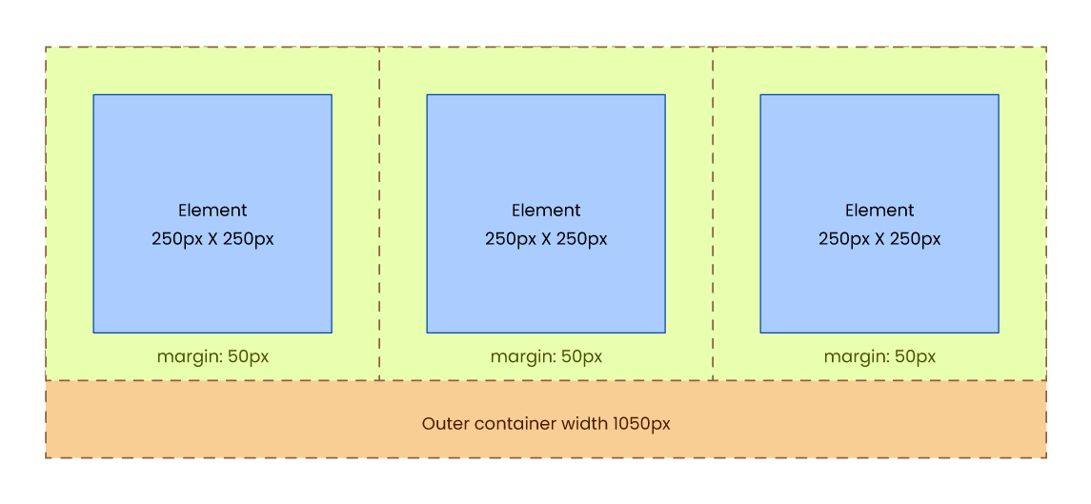
Margins Impact Outer Containers
Total Container Width = 1050px (-) 3 Elements Width 250px Each = 750px (-) 3 Elements Margin 100px each = 300px
Total =. 0px

Slide 5


Absolute Measurements Become Problematic
Absolute measurements, like pixels, can create issues when designing layouts for multiple devices with different screen sizes and resolutions. Since they are fixed values, elements won't adjust or scale according to the device. This can cause layouts to appear too large or too small on different screens, reducing flexibility and responsiveness.

Slide 6
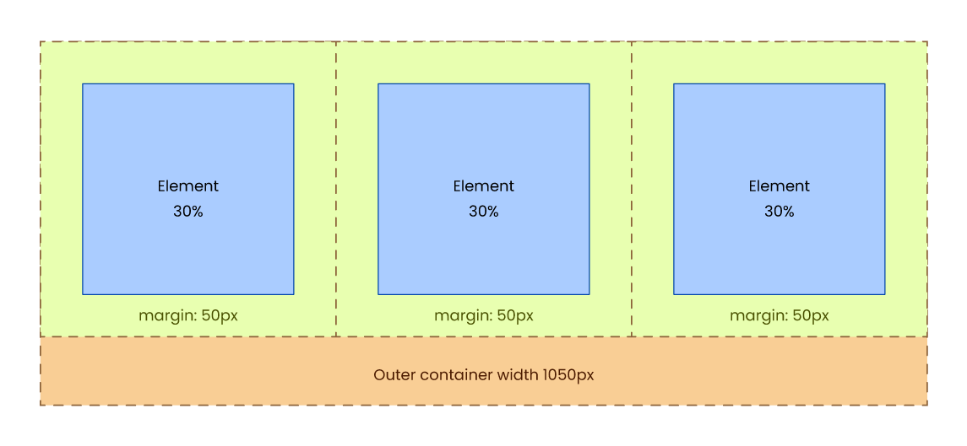
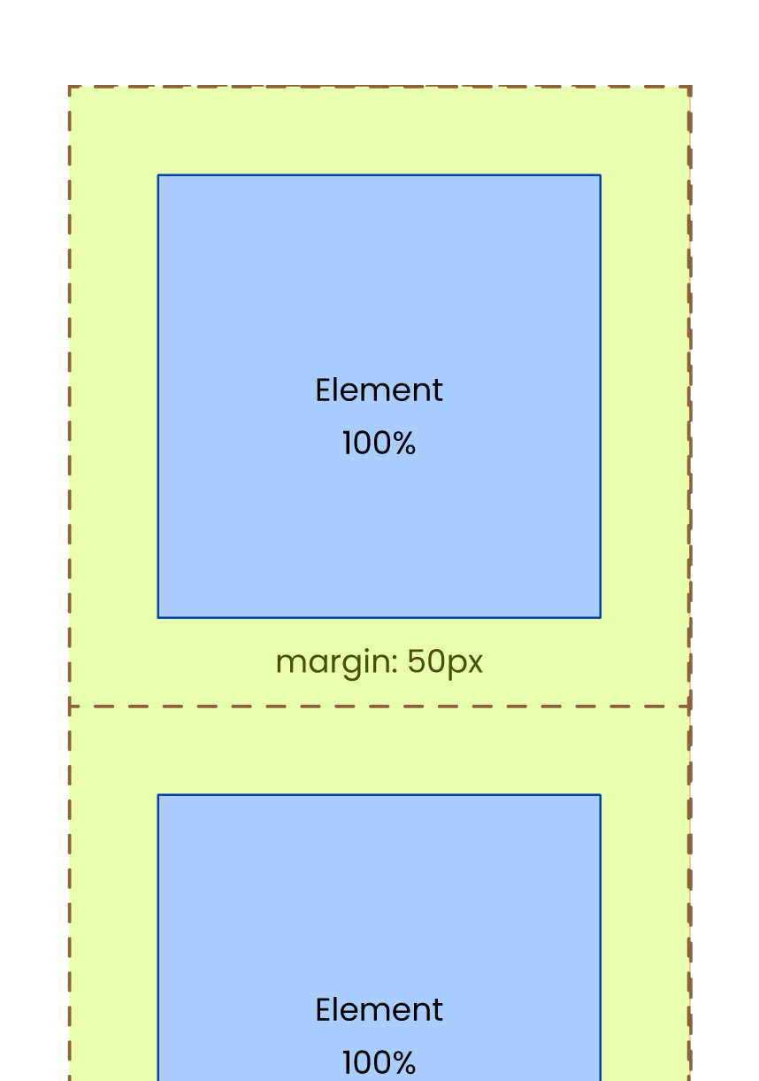
Relative Measurements Are Used
This is why relative units like percentages are preferred over absolute units like pixels, as they allow elements to adjust and scale dynamically across different screen sizes, ensuring better responsiveness and flexibility in layouts.

