Slide 1


Introduction To Tables
Full-Stack Web Development Bootcamp

Slide 2

Elements Of A Table
Column (auto)
Header (th)
Company | Contact | Country
Alfreds Futterkiste | Maria Anders | Germany
Centro comercial Moctezuma | Francisco Chang | Mexico
Ernst Handel | Roland Mendel | Austria
Island Trading | Helen Bennett | UK
Laughing Bacchus Winecellars | Yoshi Tannamuri | Canada
Magazzini Alimentari Riuniti | Giovanni Rovelli | Italy
Cell
(td - table data)
Row (tr)

Slide 3
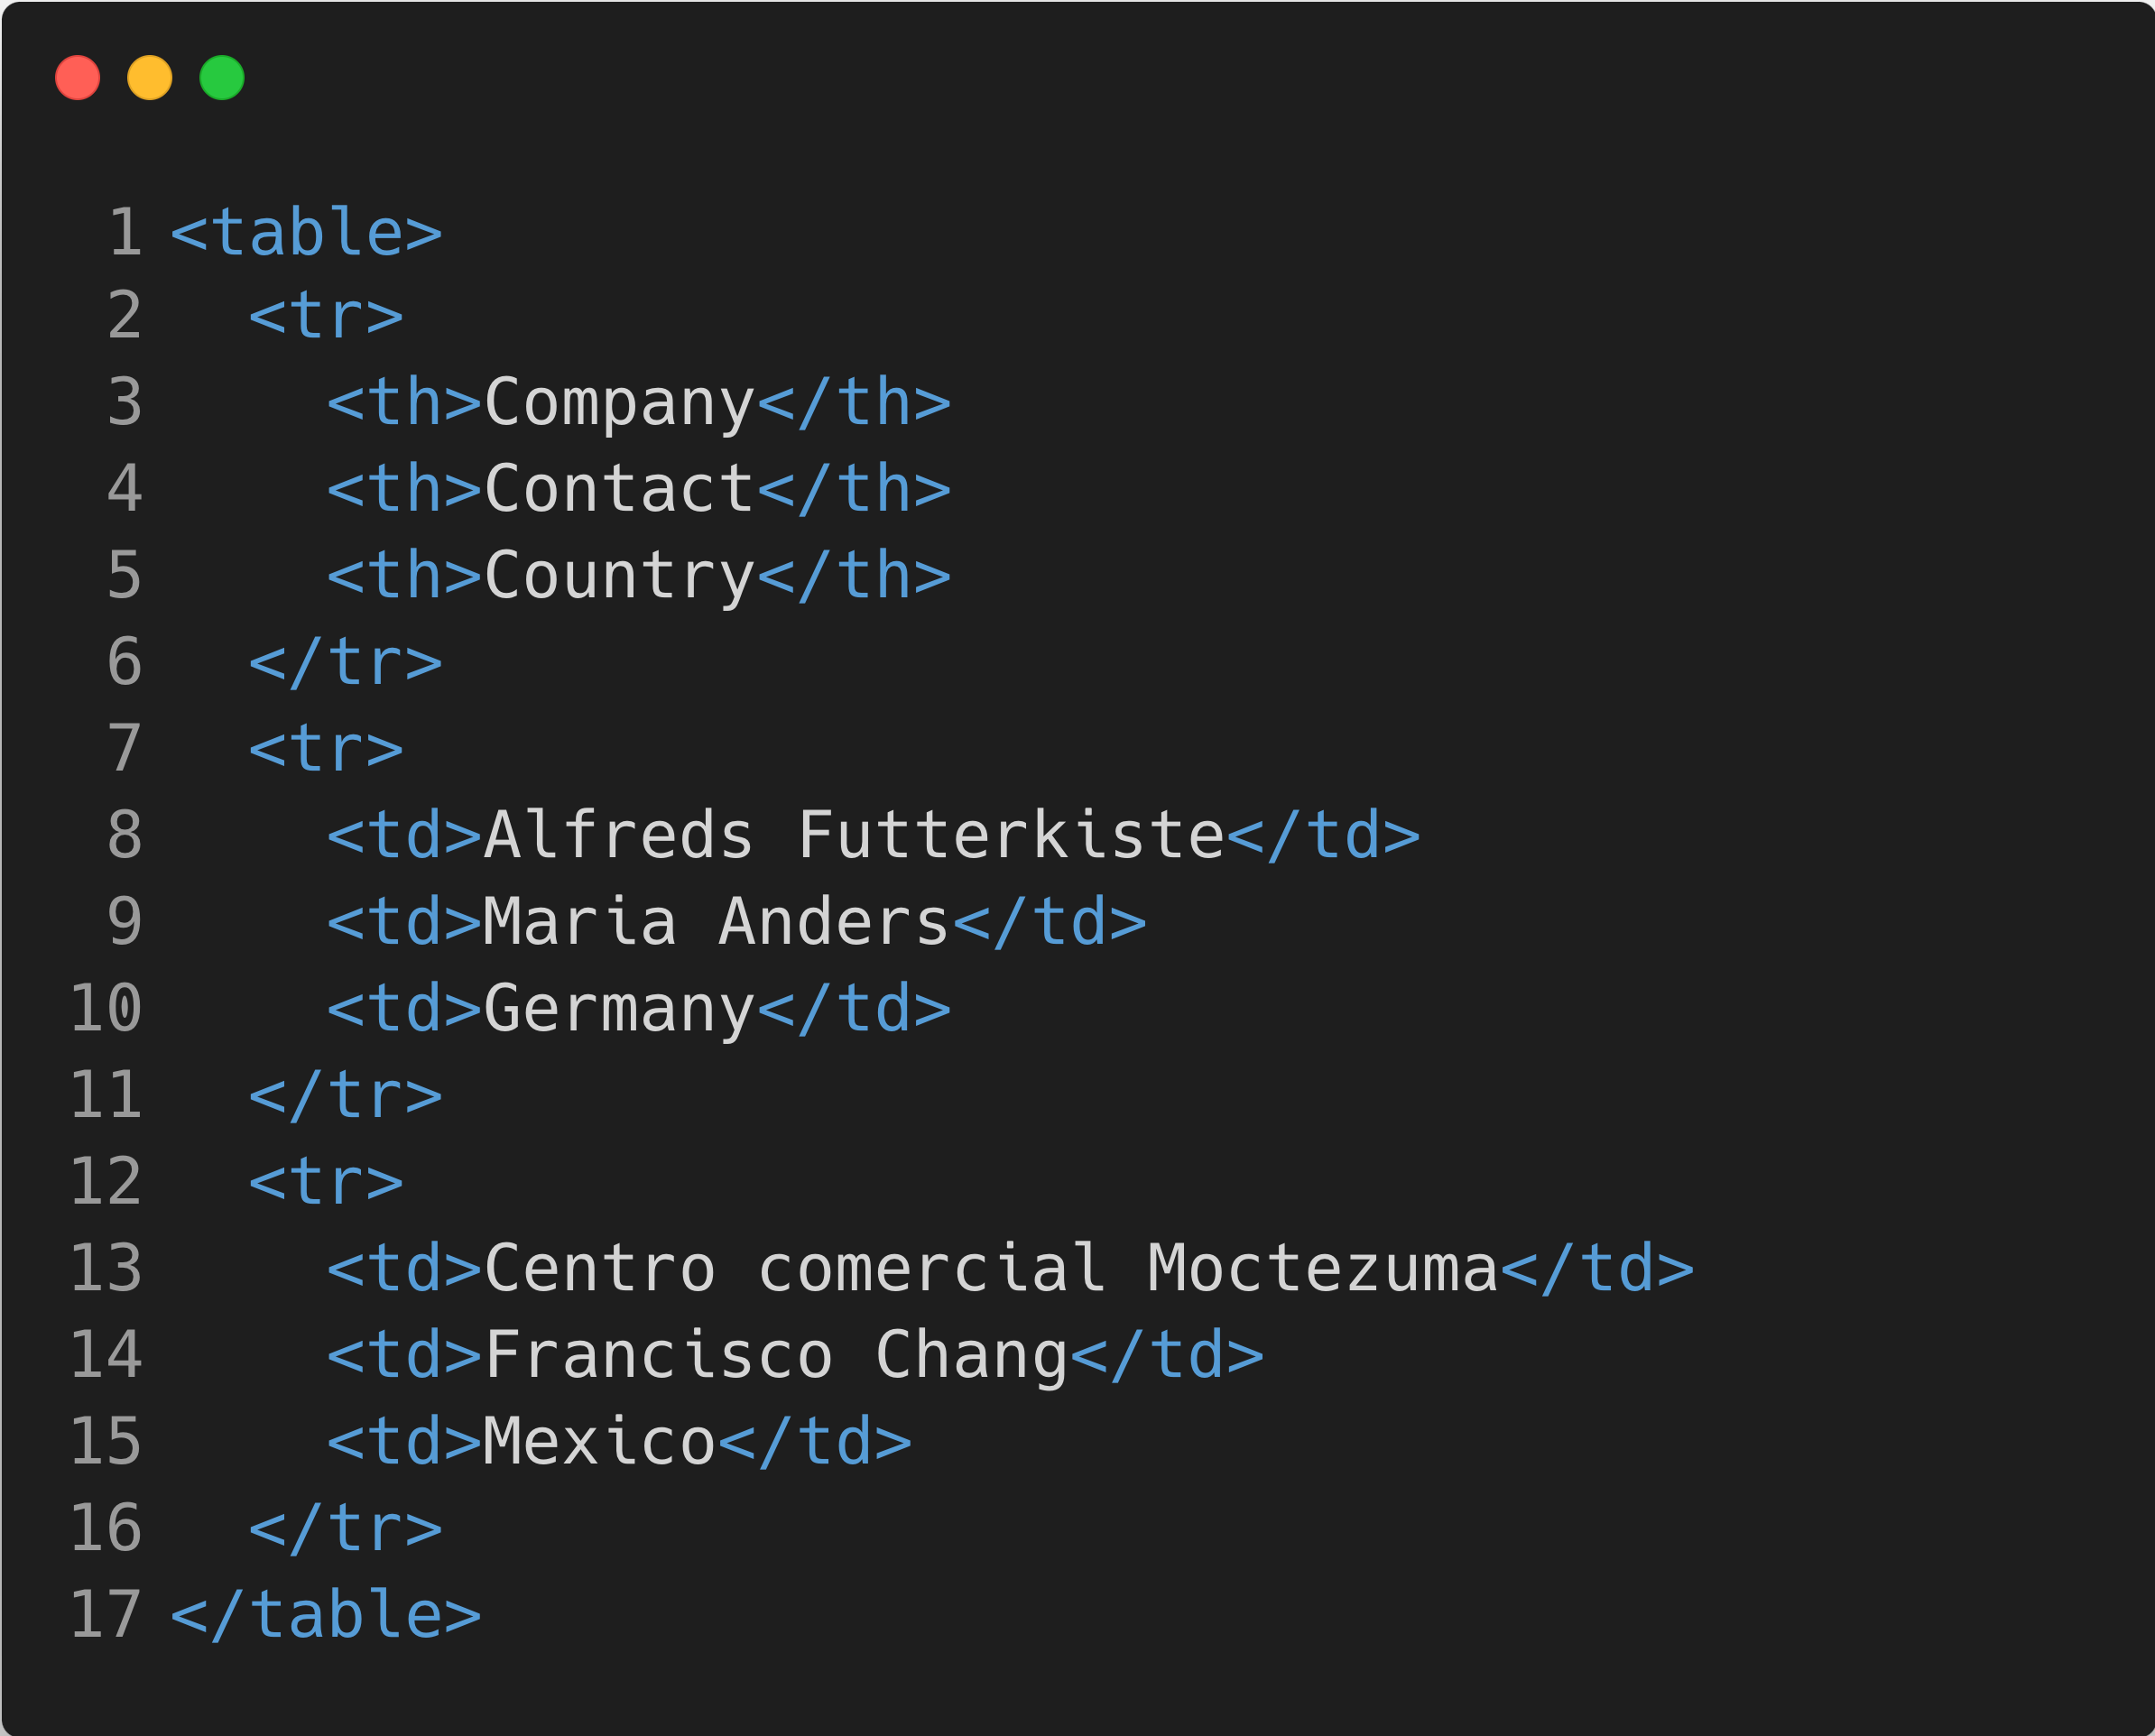
Code Behind A Table
Company | Contact | Country
Alfreds Futterkiste | Maria Anders | Germany
Centro comercial Moctezuma | Francisco Chang | Mexico
Ernst Handel | Roland Mendel | Austria
Island Trading | Helen Bennett | UK
Laughing Bacchus Winecellars | Yoshi Tannamuri | Canada
Magazzini Alimentari Riuniti | Giovanni Rovelli | Italy

