Slide 1


What is Responsive Web Design
Full-Stack Web Development Bootcamp

Slide 2


What is Responsive Web Design
Responsive Web Design
Responsive web design is an approach to building websites that adapt and adjust their layout, images, and content seamlessly across different screen sizes and devices, ensuring an optimal user experience on desktops, tablets, and mobile devices.

Slide 3

What is Device Orientation?
portrait
landscape
Device Orientation
Orientation in CSS refers to the screen's display mode, either portrait (taller than wide) or landscape (wider than tall). It helps apply styles based on how a device is rotated or positioned.

Slide 4
Introducing Media Queries
@media not|only mediatype and (media feature) and (media feature) { CSS-Code; }
Media Query Syntax
@media: Starts the media query, signaling the browser to apply conditional styles.
not|only:
only: Applies the styles exclusively to a specific media type.
not: Negates the query, applying styles if the media type or feature is not met.
mediatype: Specifies the type of device, such as screen, print, or speech.
and: Combines multiple conditions or features.
(media feature): Defines device characteristics, like min-width, max-width, orientation, etc.

Slide 5
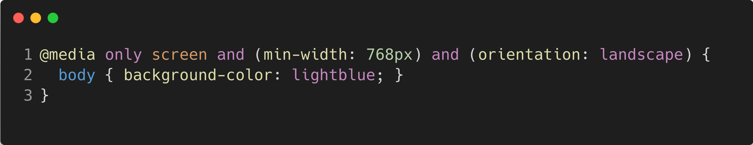
Example Of Media Query
Media Query Syntax
@media: Starts the media query, signaling the browser to apply conditional styles.
not|only:
only: Applies the styles exclusively to a specific media type.
not: Negates the query, applying styles if the media type or feature is not met.
mediatype: Specifies the type of device, such as screen, print, or speech.
and: Combines multiple conditions or features.
(media feature): Defines device characteristics, like min-width, max-width, orientation, etc.

Slide 6
Common Media Features
Media Feature | Description | Example | Use Case
min-width | The minimum width of the viewport or device. | @media (min-width: 768px) | Targets tablets and larger devices.
max-width | The maximum width of the viewport or device. | @media (max-width: 480px) | Targets mobile phones.
min-height | The minimum height of the viewport or device. | @media (min-height: 600px) | Targets taller screens, typically desktop.
max-height | The maximum height of the viewport or device. | @media (max-height: 700px) | Targets shorter screens.
orientation | Detects the orientation of the device, either portrait or landscape. | @media (orientation: landscape) | Targets landscape orientation (e.g., tablets turned sideways).

Slide 7

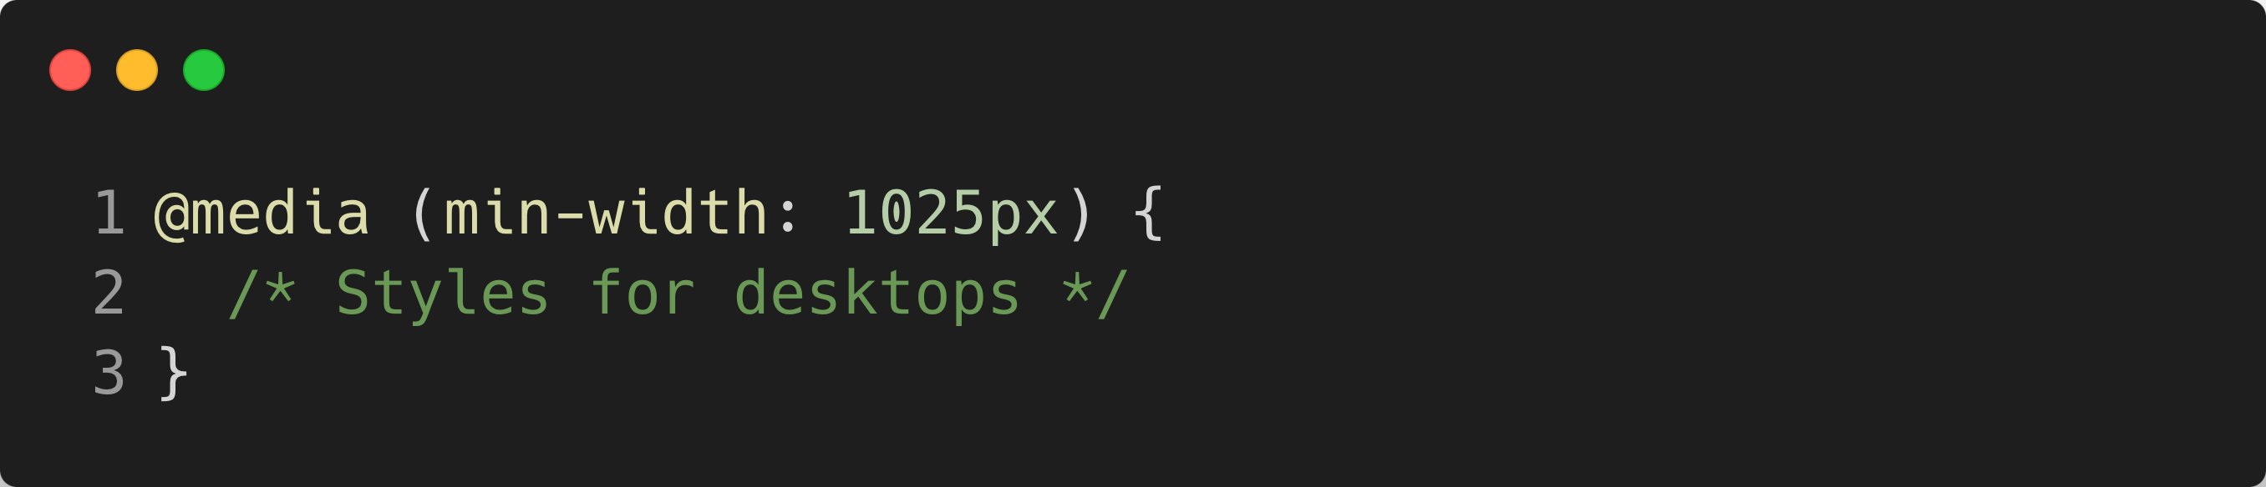
Media Query For Device Types
Desktop
Above 1024px

Slide 8
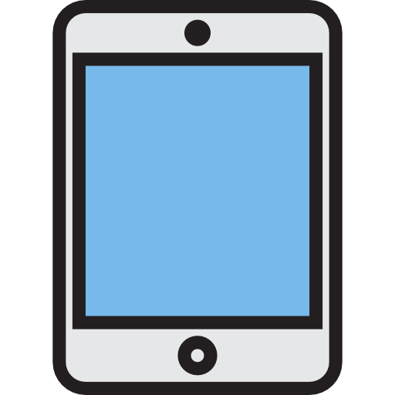
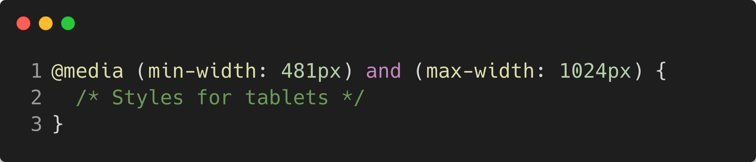
Media Query For Device Types
Tablets
Above 480px

Slide 9
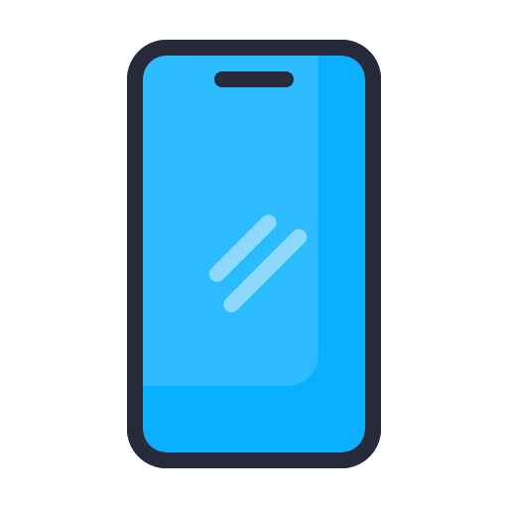
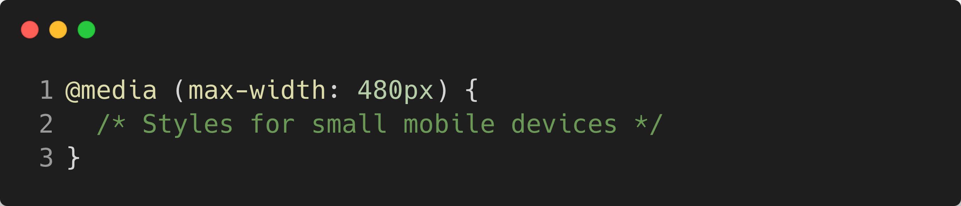
Media Query For Device Types
Mobiles
Below 480px

Slide 10
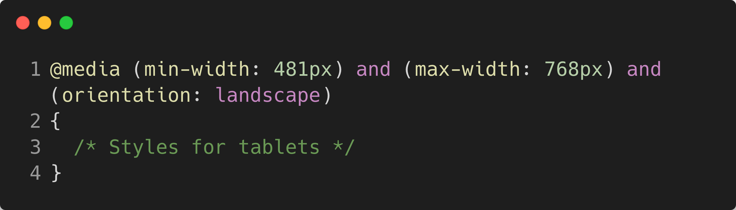
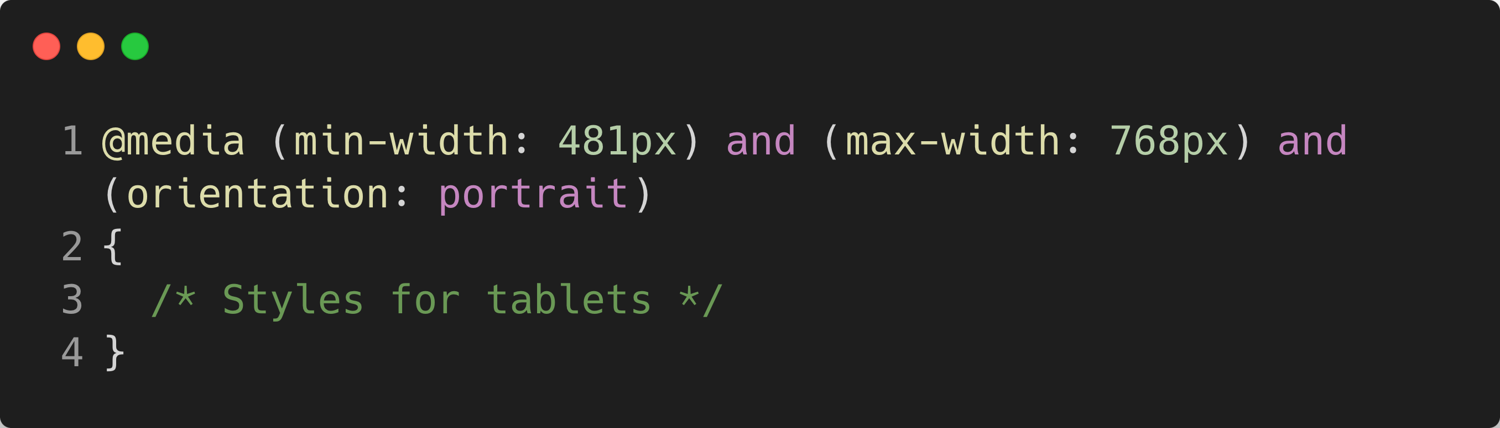
Media Query For Device Types
Tablets
Above 480px

