Slide 1

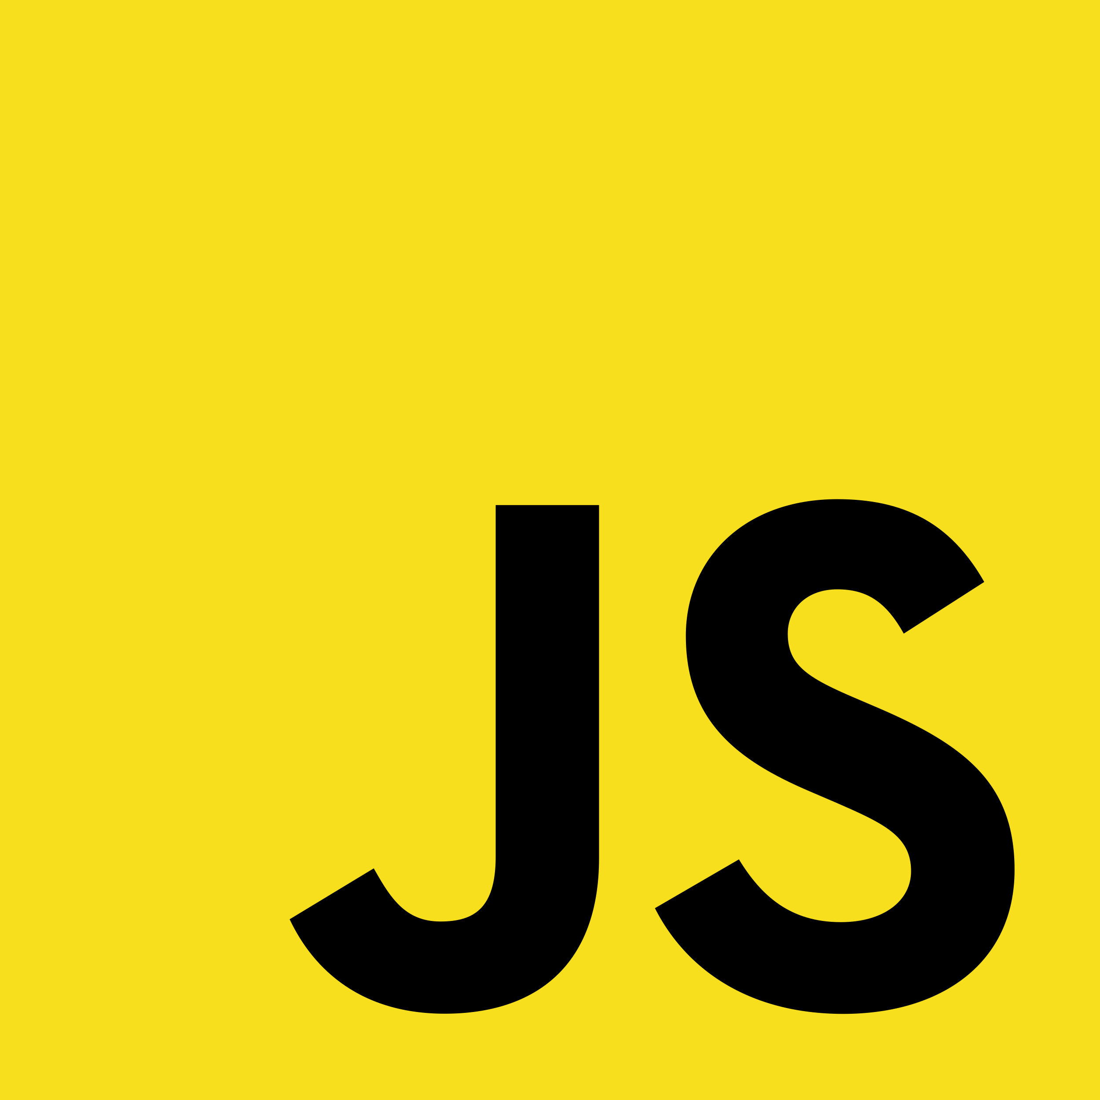
Getting Started With Variables
Full-Stack Web Development Bootcamp

Slide 2


What is a Variable
John
Doe
32
john@email.com
firstName
lastName
age
email
What is a Variable
A variable in programming is a named container that stores data values. It can hold different types of information, such as numbers or text, and allows the program to manipulate this data dynamically.

Slide 3
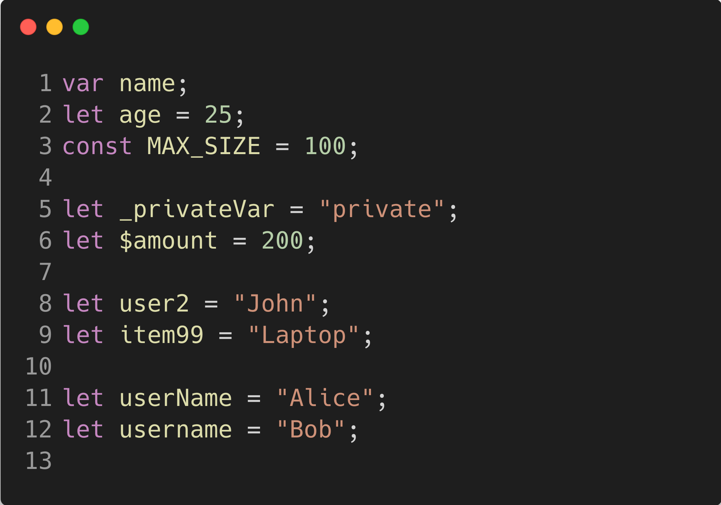
Rules for Naming a Variable
Rules For Naming a Variable
Start with a letter, underscore (_), or dollar sign ($): Variable names must not begin with a digit. Examples: myVar, _privateVar, $element.
Subsequent characters can be letters, digits, underscores, or dollar signs: After the first character, you can use letters, digits, underscores, and dollar signs. Example: var1, counter_1.
Case-sensitive: Variable names are case-sensitive, meaning myVar and myvar are different.
Avoid reserved keywords: You cannot use JavaScript keywords or reserved words as variable names (e.g., class, let, function).

Slide 4

Examples of Reserved Keywords
break, case, catch, class, const, continue
debugger, default, delete, do
else, enum, export, extends
false, finally, for, function if, implements, import, in, instanceof, interface
let
new, null
package, private, protected, public
return
static, super, switch
this, throw, true, try, typeof
var, void
while, with yield

