Slide 1


Getting Started With Primitive Types
Full-Stack Web Development Bootcamp

Slide 2


What are Data Types
John
Doe
32
john@email.com
firstName
lastName
age
email
Date Types
In programming, data types define the type of value a variable can hold. They specify how the data is stored and how operations on the data are performed.

Slide 3
Introducing Primitive Data Types
string
boolean
undefined
number
null
bigint
symbol
Primitive Types
Primitive data types in JavaScript are the most basic types of data that are immutable and hold only a single value. These include Number, String, Boolean, Null, Undefined, Symbol, and BigInt. They cannot be modified directly, and operations on them result in new values rather than altering the original.

Slide 4
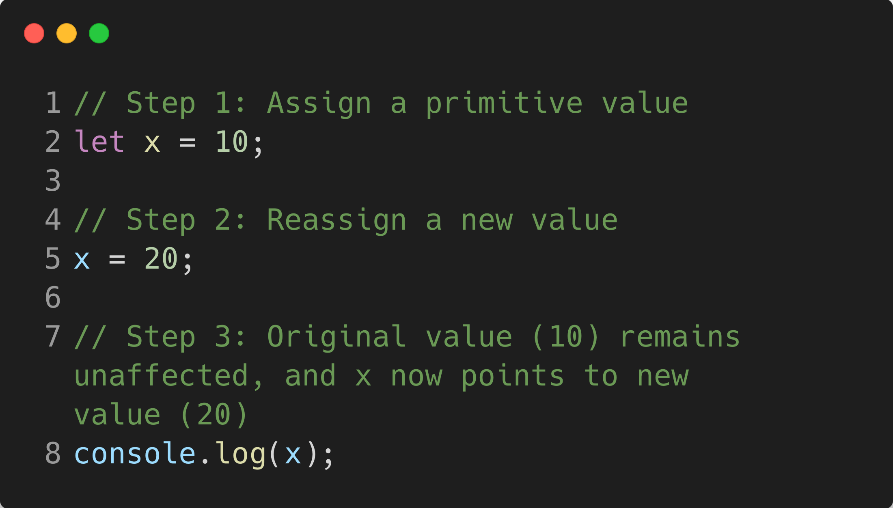
Why are Primitives Immutable
Memory
10
20
Primitive values in memory do not mutate or CHANGE, hence immutable
Primitive value assignment: A variable is assigned a primitive value (e.g., a number, string, or boolean).
Reassignment: When a new value is assigned, a new space in memory is allocated, and the variable now points to this new value.
Immutability: The original value remains unchanged in memory, and operations on it return new values rather than modifying the original one. This makes primitives immutable.

