Slide 1


Introduction to Conditional Statements
Full-Stack Web Development Bootcamp

Slide 2




How We Take Decisions
NO
Without Umbrella
YES
Raining?
With Umbrella

Slide 3
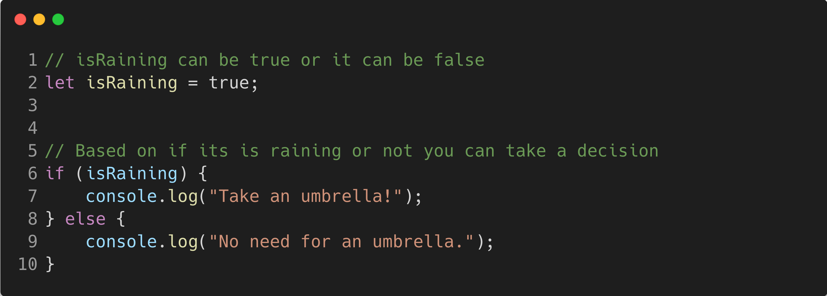
Syntax For Conditional Statements
Is it raining? If yes, I'll take an umbrella. Otherwise, I won't.
This code checks if the isRaining variable is true. If it is, it advises taking an umbrella. If not, it suggests you don't need one.

